Slide 1

Karaoke & Kod

Slide 2
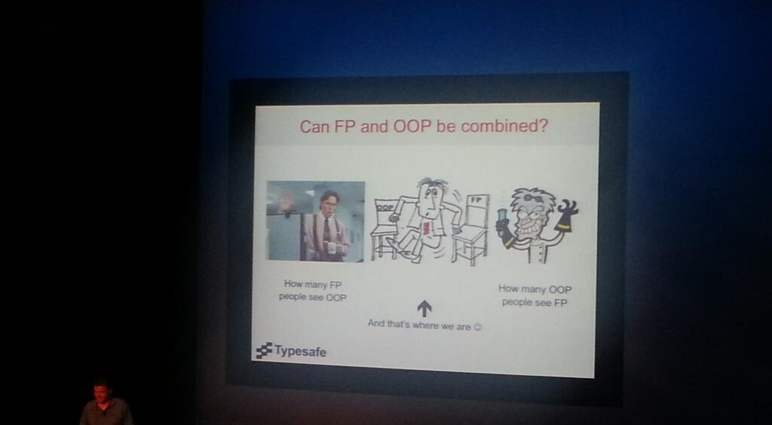
Keynote 1: ”I believe OOP has good answers for very hard and fundamental questions”- Odersky

Slide 3
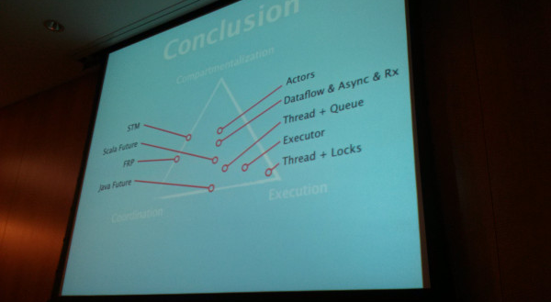
Hur kan man hantera samtidighet (Concurrency)?

Slide 4
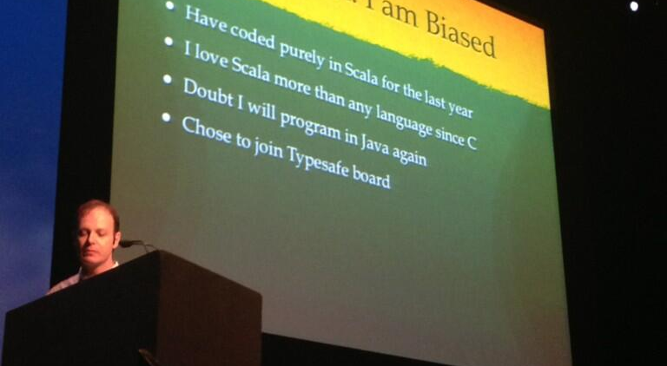
Keynote 2: ”I am biased” – Rod Johnson

Slide 5
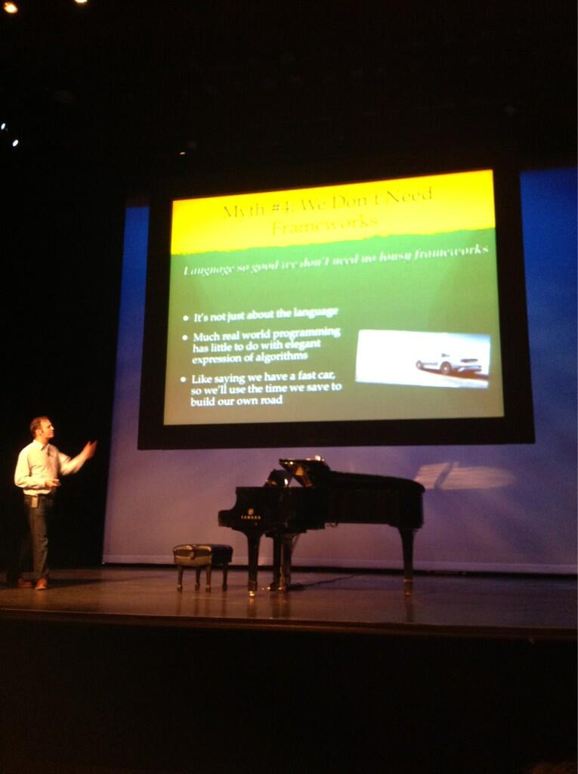
Keynote 2: ”We shouldn't view Java as the idiot country cousin” –Rod Johnson

Slide 6
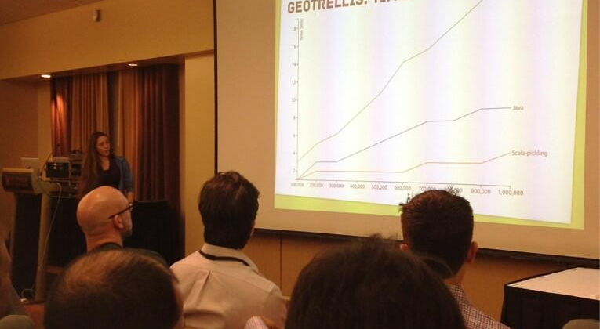
”zOMG Who knew that @heathercmiller built the best serializer out there?” #Pickler – Mr Oh K

Slide 7
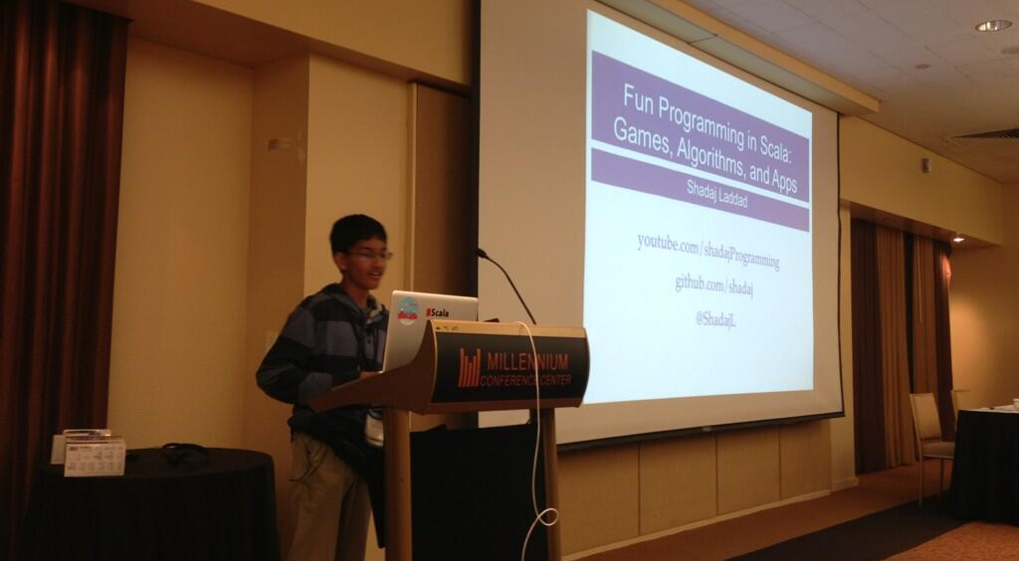
Shadaj fixar Scala till Minecraft

Slide 8
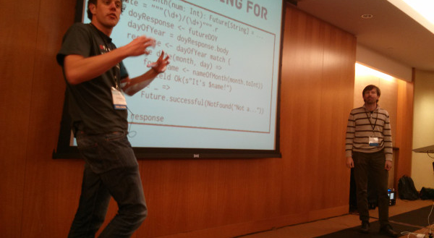
”It took us 15 min to write this code" - @retronym

Slide 9
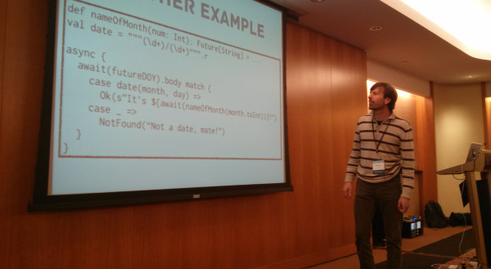
”I can’t believe it’s not blocking" - @retronym

Slide 10
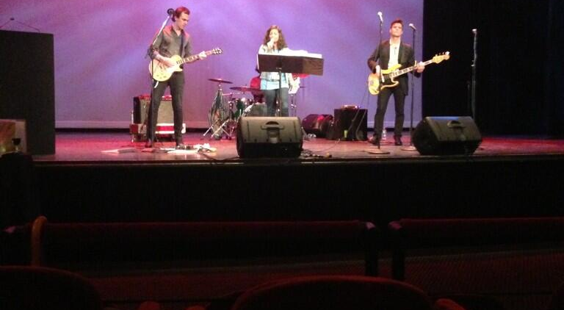
Karaoke

