Slide 1
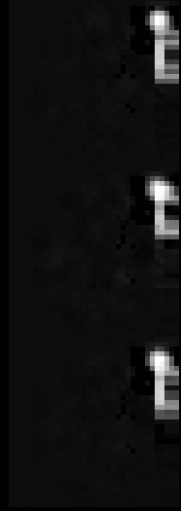
Future predict reinforcement learning
Frames 4 x 35x35 pixels
Post &
Pressent frames
f-3,f-2,f-1,f0
Next scene
prediction network
Next scene
f+1
Action- 0,1 or 2
Action 0
Action 1
Action 2
Action 0,1 or 2
Cycle though all 3 next predicted scene
Give 3 x 3 = 9 action policy values f
or future frame f+1
Next frames
f+1
Cycle all 3 actions 0,1 or 2
Policy network
Action 0
Action 0
Action 1
Action 0
Post,
Pressent frames
f-2,f-1,f-0
Action 1
Search for the
strongest of the
9 action values
Action 2
Action 1
Action 2
Action 2

Slide 2
Future predict scene network
Frame 35x35 pixels
f-3
f-2
f-1
f0
Next scene
f+1
Action- 0,1 or 2
Action 0
Action 1
Action 2
Action 0
1.0
Action 0
Action 1
0.0
Action 2
0.0

