Slide 1
KCLOUD Monthly Progress

Slide 2
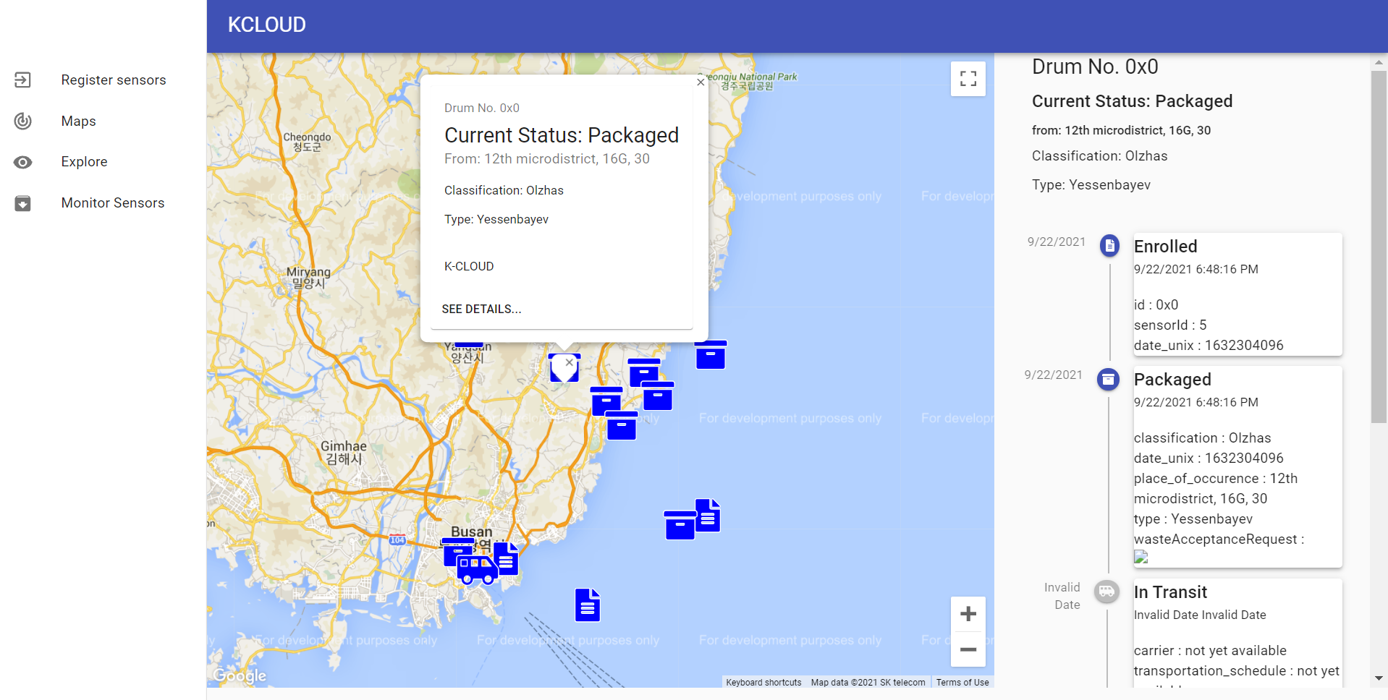
Redesigned maps
An interactive map which shows the locations for each individual drum, as well as the history of its transactions.

Slide 3
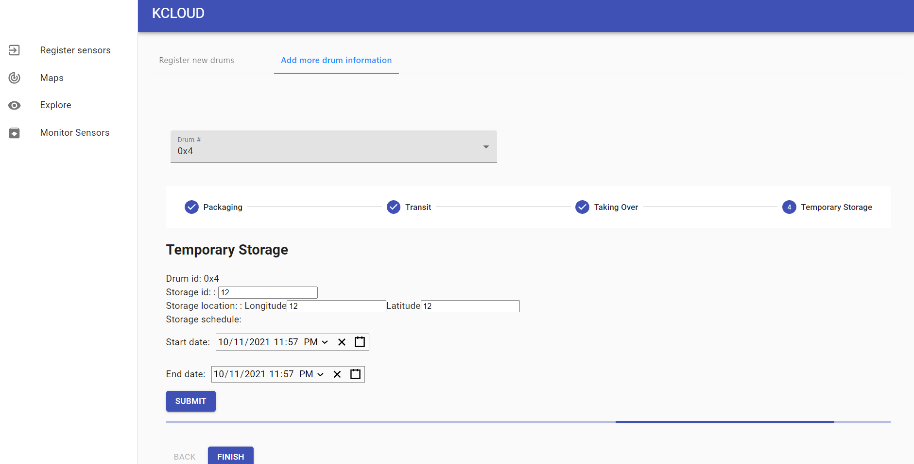
Updated registration interface
Now, the interface prompts the operator to the correct state of each drum, simplifying data input
The progress bar at the bottom shows the progress onEthereum transaction

Slide 4
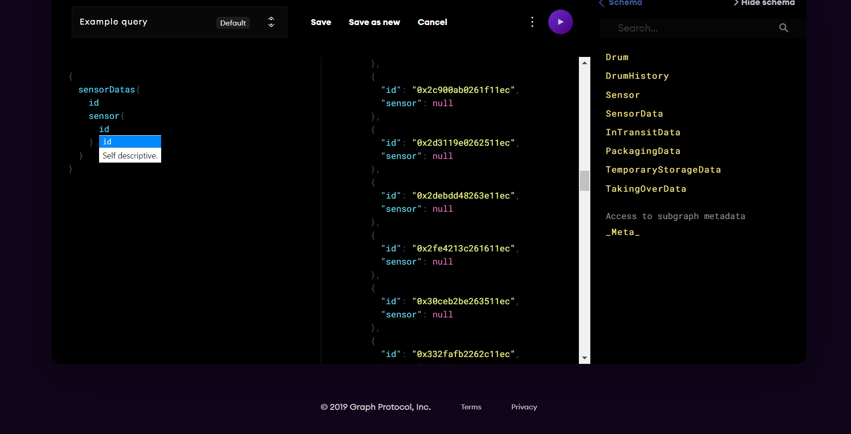
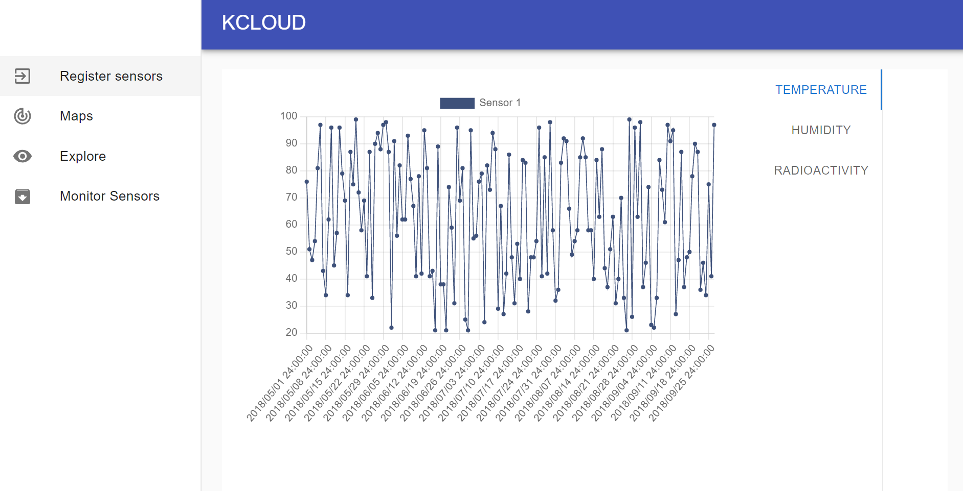
Starting to integrate the sensor information into the interface
Sensor Data on the GraphQL database and how it will eventually be displayed on the website

Slide 5
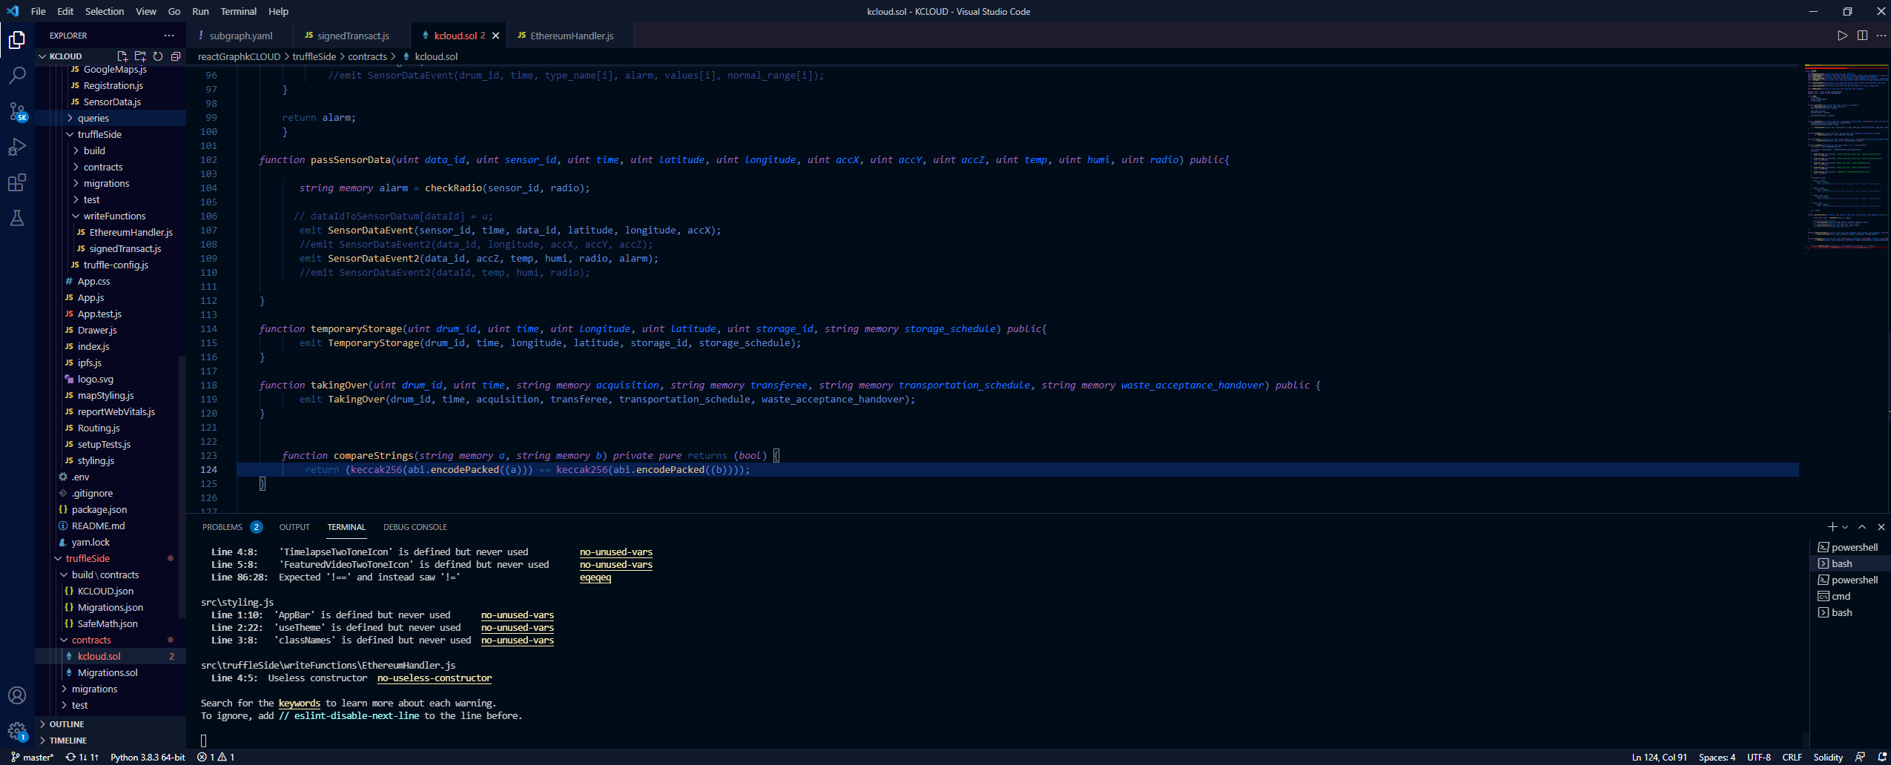
Deployed the smart contract into a local Ethereum network

