Slide 1
KCLOUD Monthly Progress

Slide 2
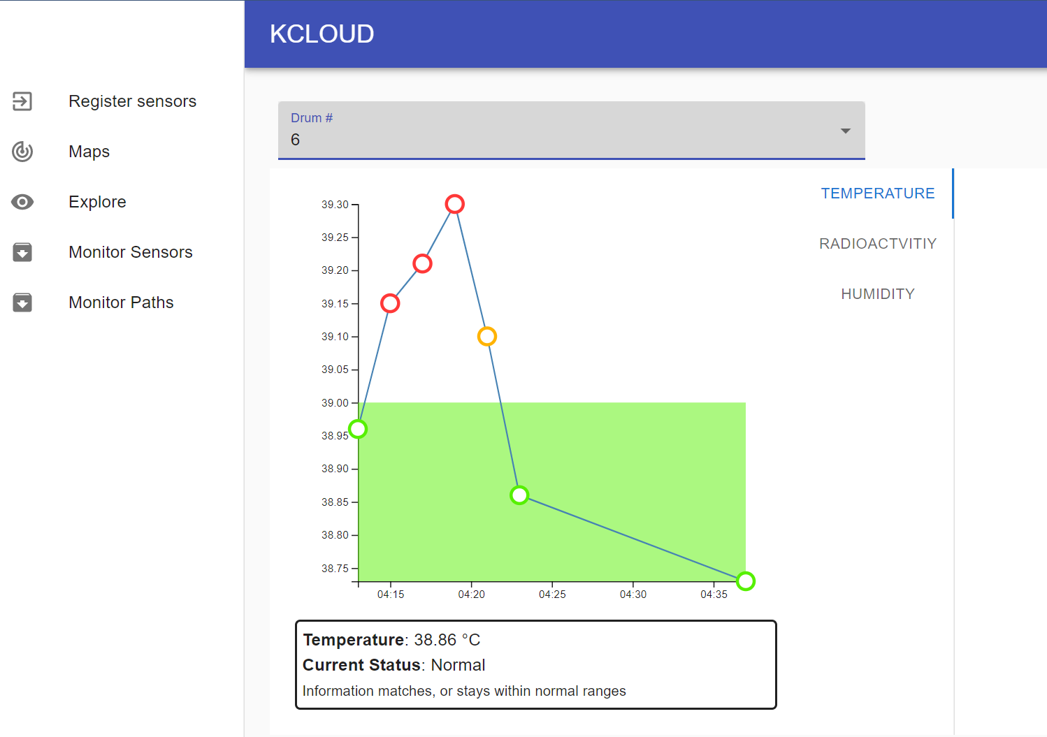
UI Progress
Updated interface for reading sensor data, with color-coding to show the state (normal range, danger, etc.)

Slide 3
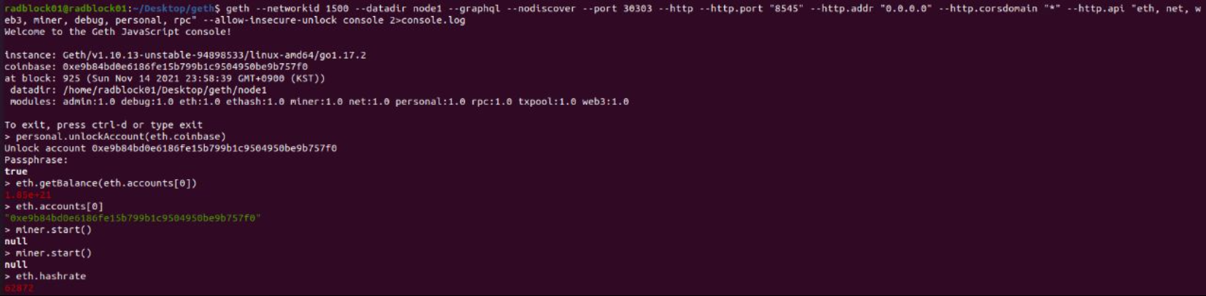
Back-end Progress
Started the private Ethereum network with Geth on the Mini-PCs

Slide 4
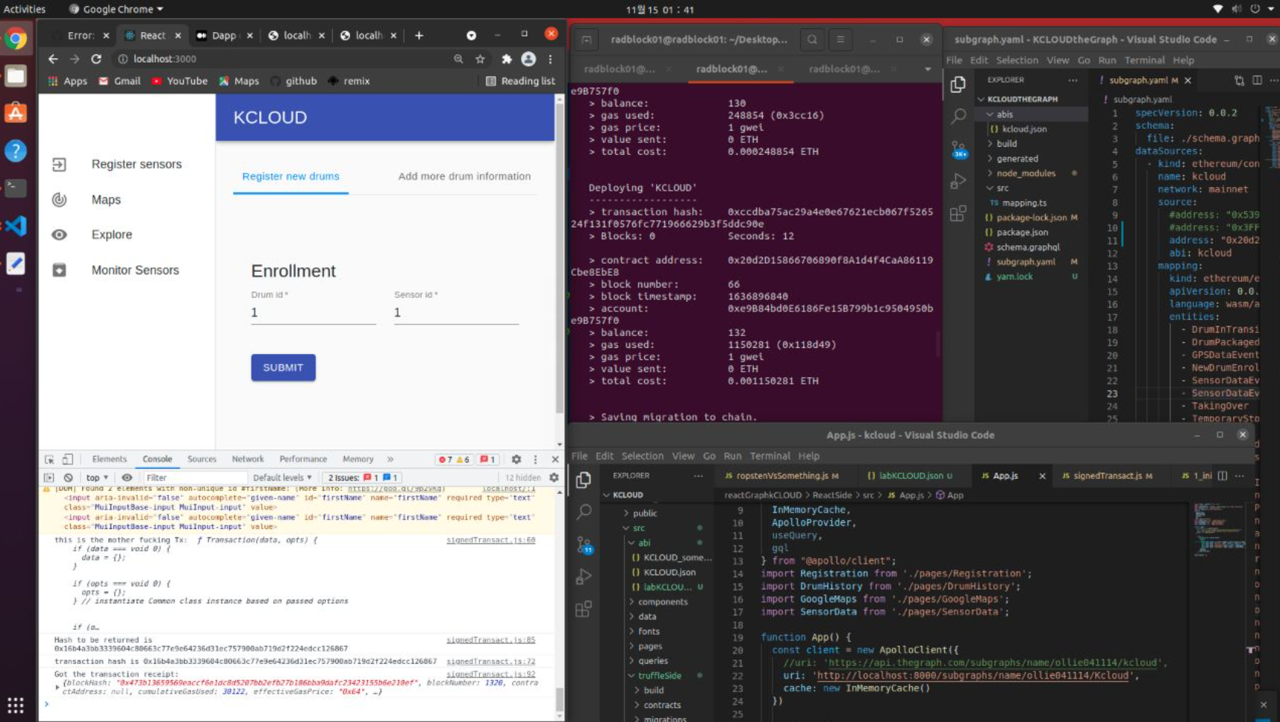
Integration Progress
Started a local GraphQL node which reads data from the local Ethereum network
Integrated writing to and reading from the private network, to the web-interface

