Slide 1
Security Discussion Forum
React Web Application Security

Slide 2
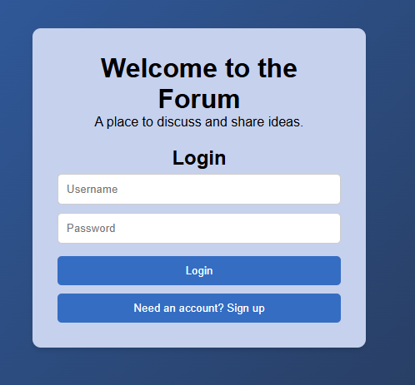
About the App
Uses MERN stack
MongoDB
Express.js
React
Node
Language: Javascript.

Slide 3
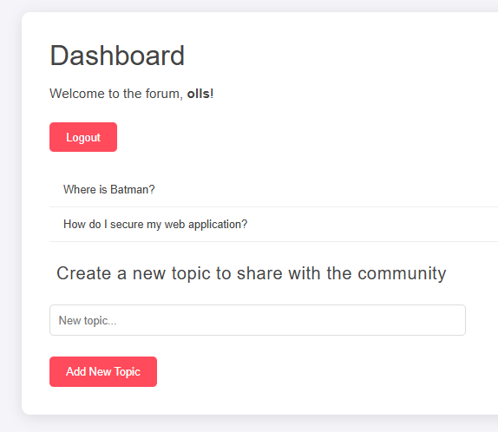
Functionality Briefly
Login/Signup
Post discussion topics
Post messages to selected topics
TODO edit, delete topic/msg
TODO Admin functionality

Slide 4
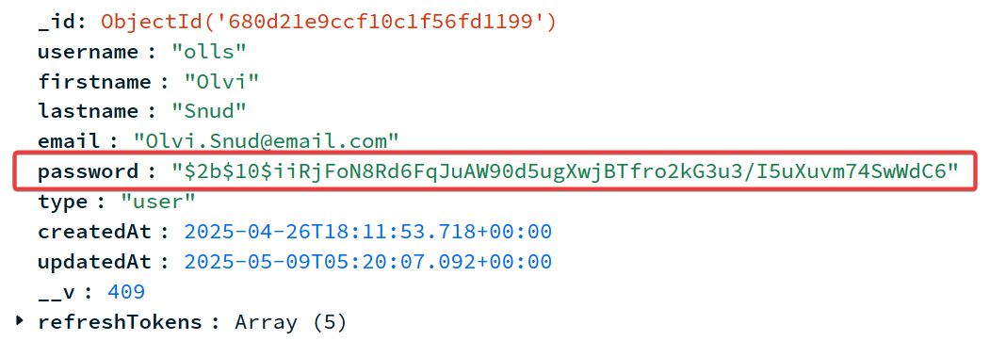
Password Security
Passwords hashed using bcrypt.
Salt and Pepper used in hashing.
"bcrypt is a password-hashing function designed by Niels Provos and David Mazières. It is based on the Blowfish cipher and presented at USENIX in 1999". (Wikipedia)
"The input to the bcrypt function is the password string (up to 72 bytes), a numeric cost, and a 16-byte (128-bit) salt value. The salt is typically a random value." (Wikipedia)

Slide 5
Token Authentication JSON Web Tokens (JWT)
Access Token:
Short-lived.
Sent with each request to validate access permissons to resources.
Roles: user, admin
Refresh Token:
Long-lived
Stored securely as HTTP-only cookie.
Used to obtain new access tokens.
Refresh Token Reuse Detection
Stored in DB: Refresh token id's are saved in the database hashed.
Checks if token is used more than once or after being invalidated.
After detected reuse all tokens for that user are revoked
Helps prevent token theft and session hijacking

Slide 6
Request Rate Limiting
Control the number of requests a client can make to the server in a given time window.
Helps prevent abuse, brute-force attacks, and server overload.
Library Used: express-rate-limit
Basic rate-limiting middleware for Express. Use to limit repeated requests to public APIs and/or endpoints such as password reset.

Slide 7
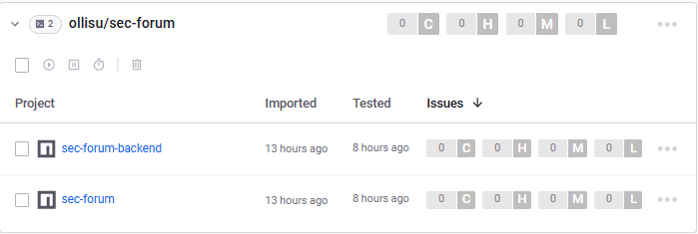
Snyk Security Scanning
GitHub workflow
What is Snyk?
Tool for finding and fixing vulnerabilities.
Dependency scannnig
Static code analysis

Slide 8
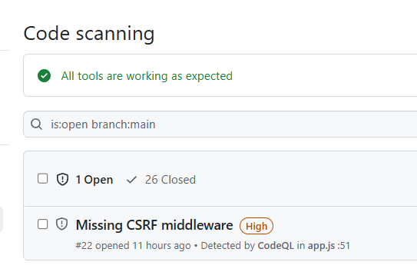
CodeQL Analysis
GitHub workflow
What is CodeQL?
A semantic code analysis engine developed by GitHub
Detects security vulnerabilities and coding errors using queries

Slide 9
TODO's
Prevent CSRF, CSRF tokens?
Add a few more role based actions (admin vs. user) to the app.
More robust error handling.
Tests if I have time.

Slide 10
AI-use
ChatGPT was used mostly to help with debugging coding issues and explain some concepts consisely.
VS Code has copilot.

