Slide 1
Porting BETA to .NET
Microsoft Academic Days,
April 21 2004, Oslo
  Peter Andersen

Slide 2
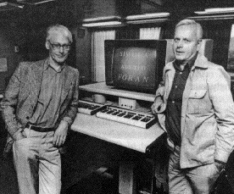
The BETA programming language
Object-oriented programming language
Since we are in Oslo, a little OO history…
  Scandinavian school of OO, starting with the Simula languages
    Simula developed at
    Norwegian Computing Center,
    Oslo by late Johan Dahl and
    Kristen Nygaard
    ACM Turing award
    & IEEE van Neumann medal 2002
  Kristen co-designer of BETA
    with Bent Bruun Kristensen,
    Birger Møller-Pedersen and
    Ole Lehrmann Madsen
Notes:
Birger Møller-Pedersen is now professor at University of Oslo
Bent Bruun Kristensen is now professor at Syddansk Universitet, Odense, Denmark
Ole Lehmann Madsen is now professor at University of Aarhus, Denmark.
Ole Lehmann Madsen and Peter Andersen are the two main researchers for BETA.Net.

Slide 3
Goals
Investigate OO language interoperability
Traditional language interoperability for procedural languages:
  Procedure libraries in different languages
  Common calling sequence for procedures
Language interoperability for OO languages:
  Uses of classes from different languages
  Inheritance from classes in different languages
  An explicit goal for .NET (no expectations for Java)

Slide 4
Challenges
Mapping must be complete and semantically correct
BETA should be able to uses classes from other languages
Other languages should be able to use classes generated from BETA source code
BETA should be able to inherit classes from other languages
Other languages should be able to inherit from BETA
The BETA mapping should be ’nice’ when seen from other languages
In .NET terminology:
  BETA compliant with Common Language Specification (CLS)
  BETA should be a CLS Extender

Slide 5
BETA vs. CLR/CLS
Class and method unified in pattern
General nesting of patterns, i.e. also of methods
  Uplevel access to fields of outer patterns
INNER instead of super
Enter-Do-Exit semantics
Genericity in the form of virtual patterns
Multiple return values
Active objects in the form of Coroutines
No constructors, no overloading
No dynamic exceptions

Slide 6
The mapping
Generating bytecode for CLR mostly corresponds to making a BETA source mapping into C# source code
C# used here for presentation purpose
But we do generate IL (intermediate language bytecodes) directly into IL files
IL files assembled with ilasm

Slide 7
Naive mapping into C# (1)
Calculator:
(# R: @integer;
set:
(# V: @integer enter V do V → R #);
add:
(# V: @integer enter V do R+V → R exit R #);
#);
public class Calculator: System.Object
{ public int R;
public void set(int V) { R = V; }
public int add(int V) { R = R + V; return R;}
}

Slide 8
Naive mapping into C# (2)
C: @Calculator;
X: @integer;
12 → C.set;
5 → C.add → X
Calculator C = new Calculator();
int X;
C.set(12);
x = C.add(5);
Notes:
Here’s a full program corresponding to the previous slides:
public class Calculator: System.Object
{
int R;
void set(int V) { R = V; }
int add(int V) { R = R + V; return R; }
public static void Main(System.String[] args){
Calculator C = new Calculator();
int x;
C.set(12);
x = C.add(5);
System.Console.WriteLine(x);
}
}

Slide 9
Instances of add
More complex mapping needed
Possible to create instances of pattern add
Calculator:
(# R: @integer;
…
add:
(# V: @integer enter V do R+V → R exit R #);
#);
C: @Calculator; X: @integer;
A: ^C.add;
&C.add[] → A[];
6 → A → X
Creation of an instance of C.add
Execution of the C.add instance
Notes:
Here’s a full BETA program using add both as a method and a class:
ORIGIN '~beta/basiclib/betaenv';
--PROGRAM: descriptor--
(#
Calculator:
(# R: @integer;
set:
(# V: @integer enter V do V -> R #);
add:
(# V: @integer enter V do R+V -> R exit R #);
display:
(# do 'Value: '->putText; R -> putInt; newline; #);
#);
C: @Calculator;
X: @integer;
A: ^C.add;
do 'Using add as a method' -> putLine;
12 -> C.set;
C.display;
5 -> C.add -> X;
C.display;
'Using add as a class' -> putLine;
&C.add[] -> A[];
17 -> C.set;
C.display;
13 -> A -> X;
C.display;
10 -> A.V;
A -> X;
C.display;
#)

Slide 10
Nested class add
public class Calculator: System.Object {
public int R;
public class add: System.Object {
public int V;
…
}
…
}
public class Calculator: System.Object {
public int R;
public class add: System.Object {
public int V;
public void Enter(int a) { V = a; }
public void Do() { R = R + V; }
public int Exit() { return R; }
}
…
}
public class Calculator: System.Object {
public int R;
public class add: System.Object {
public int V;
Calculator origin;
public add(Calculator outer) { origin = outer; }
public void Enter(int a) { V = a; }
public void Do() { origin.R = origin.R + V; }
public int Exit() { return origin.R; }
}
…
}
public class Calculator: System.Object {
public int R;
public class add: System.Object {
public int V;
Calculator origin;
public add(Calculator outer) { origin = outer; }
public void Enter(int a) { V = a; }
public void Do() { origin.R = origin.R + V; }
public int Exit() { return origin.R; }
}
public int call_add(int V){
add A = new add(this);
A.Enter(V);
A.Do();
return A.Exit();
}
…
}
Error: Outer R cannot be
accessed from
nested class!
Calculator:
(# R: @integer;
…
add:
(# V: @integer
enter V
do R+V → R
exit R
#);
#);
CLS does not allow for this
to be called just add()
Notes:
Notice: The CLS does not allow for a method to be identically named as a nested class in the same scope – this means that the method call_add() above cannot be called just add(), since there is also the nested class named add. This rule is enforced by C#. This is in contrast to Java, where an inner class is distinguished from an identically named method. Java also allows inner classes to access fields in the outer classes.
ECMA 335, clause 7.5.2:
CLS Rule 5: All names introduced in a CLS-compliant scope shall be distinct independent of kind, except where the names are identical and resolved via overloading. That is, while the CTS allows a single type to use the same name for a method and a field, the CLS does not.
We do not actually generate the above mentioned nested classes yet, but linearize all the classes to one level. It is, however, our intension to generate proper nested classes to make BETA generated code more comprehensable when seen from other .NET languages.
The call_add() method could still be called just add() (when generating IL directly) but would have to be marked as NON-cls-compliant.
However, it is provided as a convenience and possibly also an optimization…

Slide 11
Use of add as a class:
C: @Calculator;
X: @integer;
A: ^C.add;
&C.add[] → A[];
5 → A → X
Calculator C
= new Calculator()
int X;
Calculator.add A;
A = new Calculator.add(C);
A.Enter(5);
A.Do()
X = A.Exit();

Slide 12
Use of add as a method
C: @Calculator;
X: @integer;
5 → C.add → X
Calculator C
= new Calculator()
int X;
X = C.call_add(5);
Notes:
Here’s a full C# program corresponding to the previous slides:
public class Calculator: System.Object {
int R;
public class add: System.Object {
Calculator origin;
public int V;
public add(Calculator outer) { origin = outer; }
public void Enter(int a) { V = a; }
public void Do() { origin.R = origin.R + V; }
public int Exit() { return origin.R; }
}
public void set(int V) { R = V; }
public int call_add(int V){
add A = new add(this);
A.Enter(V);
A.Do();
return A.Exit();
}
public static void Main(System.String[] args){
Calculator C = new Calculator();
int x;
System.Console.WriteLine("Using add as a method");
C.set(12);
x = C.call_add(5);
System.Console.WriteLine(x);
System.Console.WriteLine("Using add as a class");
Calculator.add A = new Calculator.add(C);
C.set(17);
A.Enter(13);
A.Do();
x = A.Exit();
System.Console.WriteLine(x);
A.V = 10;
A.Do();
x = A.Exit();
System.Console.WriteLine(x);
}
}

Slide 13
Method combination with inner
Calculator:
(# ...
add:
(# V: @integer
enter V
do R+V → R; inner
exit R
#);
...
#)
WeirdCalculator: Calculator
(#
xadd: add (# do R * V → R #)
#)
Notes:
Here’s a BETA program using this:
ORIGIN '~beta/basiclib/betaenv';
--PROGRAM: descriptor--
(#
Calculator:
(# R: @integer;
set:
(# V: @integer enter V do V -> R #);
add:
(# V: @integer enter V do R+V -> R; INNER; exit R #);
display:
(# do 'Value: '->putText; R -> putInt; newline; #);
#);
WeirdCalculator: Calculator
(#
xadd: add (# do R * V -> R #)
#);
C: @WeirdCalculator;
X: @integer;
A: ^C.add;
do 'Using xadd as a method' -> putLine;
12 -> C.set;
C.display;
5 -> C.xadd -> X;
C.display;
'Using xadd as a class' -> putLine;
&C.xadd[] -> A[];
17 -> C.set;
C.display;
13 -> A -> X;
C.display;
10 -> A.V;
A -> X;
C.display;
#)

Slide 14
Semantics of inner
D: @WeirdCalculator;
X: @integer
12 → D.set;
5 → D.xadd → X
add: (# V: @integer
enter V
do R+V → R;
inner;
exit R
#);
xadd: add (#
do R * V → R
#)
inner;
5 → D.xadd → X
5 → D.add.V
R + V → R
inner
D.R → X
R * V → R

Slide 15
Class add with inner
public class Calculator {
public class add: System.Object
{ public Calculator origin; ...
public void Do()
{ origin.R = origin.R + V;
Inner_1();
}
public virtual void Inner_1(){}
}
...
}
public class WeirdCalculator: Calculator {
public class xadd: Calculator.add
{ ...
public override void Inner_1()
{ origin.R = origin.R * V;
}
}
...
}
Notes:
Complete C# program corresponding to this:
public class Calculator: System.Object {
public int R;
public class add: System.Object {
Calculator origin;
public int V;
public add(Calculator outer) { origin = outer; }
public void Enter(int a) { V = a; }
public void Do() { origin.R = origin.R + V; Inner_1(); }
public virtual void Inner_1(){}
public int Exit() { return origin.R; }
}
public void set(int V) { R = V; }
public int call_add(int V){
add A = new add(this);
A.Enter(V);
A.Do();
return A.Exit();
}
}
public class WeirdCalculator: Calculator {
public class xadd: Calculator.add
{
WeirdCalculator origin;
public xadd(WeirdCalculator outer):base(outer) { origin = outer; }
public override void Inner_1(){
origin.R = origin.R * V;
}
}
public int call_xadd(int V){
xadd A = new xadd(this);
A.Enter(V);
A.Do();
return A.Exit();
}
public static void Main(System.String[] args){
WeirdCalculator C = new WeirdCalculator();
int x;
System.Console.WriteLine("Using xadd as a method");
C.set(12);
x = C.call_xadd(5);
System.Console.WriteLine(x);
System.Console.WriteLine("Using xadd as a class");
WeirdCalculator.xadd A = new WeirdCalculator.xadd(C);
C.set(17);
A.Enter(13);
A.Do();
x = A.Exit();
System.Console.WriteLine(x);
A.V = 10;
A.Do();
x = A.Exit();
System.Console.WriteLine(x);
}
}

Slide 16
Inner at several levels
A: (# do X1; inner; Y1 #);
AA: A (# do X2; inner; Y2 #);
AAA: AA(# do X3; inner; Y3 #)
public class A: Object
{ public void Do() { X1; Inner_1(); Y1; }
public virtual void Inner_1(){}
}
public class AA: A
{ public override void Inner_1() { X2; Inner_2(); Y2; }
public virtual void Inner_2(){}
}
public class AAA: AA
{ public override void Inner_2() { X3; Inner_3(); Y3 }
public virtual void Inner_3(){}
}

Slide 17
Language Restrictions
Calculator: class
(# R: @integer;
set: proc
(# V: @integer enter V do V → R #);
add: proc
(# V: @integer enter V do R+V → R exit R #);
#);
Naive mapping is then sufficient (in this case)
Reduces amount of code

Slide 18
Interface to external classes etc.
Pt. in a declarative manner
Ex:
Rudimentary support for overloading, constructors etc.
Offline batch tool dotnet2beta implemented using reflection (generates BETA source files); should be part of BETA compiler
System.String vs. BETA text: Automatic coercion
String: ExternalClass
(# _init_ArrayOfChar: cons (* constructor *)
(# result: ^String; arg1: [0]@char;
enter (arg1[]) exit result[]
#);
...
CompareTo_Object: proc (* overloaded CompareTo *)
(# result: @int32; arg1: ^Object;
enter (arg1[]) do 'CompareTo' -> procname; exit result
#);
...
do '[mscorlib]System.String' -> className;
#);

Slide 19
Not described here…
Virtual classes – corresponding to generics (.NET 2.0 – “Whidbey”) – implemented with virtual instantiation methods and a lot of (unnecessary) casting.
Coroutines and concurrency – implemented with threads
Pattern variables: Classes and methods as first-class values – implemented with reflection
Leave/restart out of nested method activations – implemented with exceptions
Multiple return values – implemented with extra fields
Numerous minor details!

Slide 20
Demo
Simple Calculator program
  Debugging BETA in Visual Studio.NET
  Rotor execution
External class inherited in BETA
  WinForms BETA program
Subclassing of BETA pattern in C#

Slide 21
Status
95% of BETA language implemented
  Leave/restart across component border missing
  Coroutines and leave/restart not ideally implemented
Some things need to be more ‘nice’
Not yet 100% CLS compliant
  E.g. custom attributes and consumption of value types
Optimizations needed
  Large number of classes generated due to the generality of BETA

Slide 22
Major missing parts
Value types consumption
Enumeration consumption
Throw and handling of CLR exceptions
Consumption of static fields
Support for custom attributes
    Maybe proc, class etc. as attributes?
Leave/restart over coroutine border
Support for multiple interfaces
64 bit arithmetic
Boot-strapped compiler (needs some of above)
Implementation of BETA class libraries
Direct compiler support for reading external classes
Visual Studio .NET language extension

Slide 23
Plans for ROTOR (1)
Has just received MS grant to continue work in ROTOR setting
Plans:
  Implement simple hello-world and complete compiler test suite
    In principle simple, since ECMA standardized. But e.g. problems due to SkipVerification in .NET
    Hello-world and parts of compiler test suite up-and-running; clix script generation added.
  Implement (some of) above mentioned missing parts
  Bootstrapping the BETA compiler to ROTOR and .NET

Slide 24
Plans for ROTOR (2)
  Develop a GUI framework on top of ROTOR and .NET.
    System.Windows.Forms and System.Drawing not available on ROTOR
    BETA traditional GUI library Lidskjalv and new OpenGL based GUI library Octopus considered
    Perhaps better support for Simula/BETA-style coroutines
      Modify ROTOR bytecodes/jitter/GC/class libraries?

Slide 25
Practical odds and ends
Compiler organization
Recommended readings
Code generation tips
.NET advantages
What we miss in CLR
Some pitfalls, that have plagued us

Slide 26
Compiler organization
Frontend
  Parser,
  abstract syntax trees,
  semantic checking,
  semantic analysis,
  abstract code generation: untyped, register based
  Platform independent
Backend
  Code generation for a specific target
  Platform dependent
    Sun Solaris
    Linux
    Windows
    Macintosh

Slide 27
Compiler reorganization
Frontend
  Generate typed, stack-based code
Backend
  Generation for specific targets
    .NET
      IL assembler files input to ilasm
    Java-VM
      Emits .class files directly

Slide 28
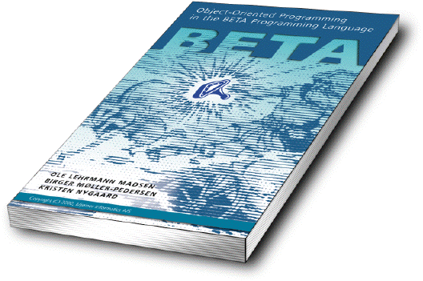
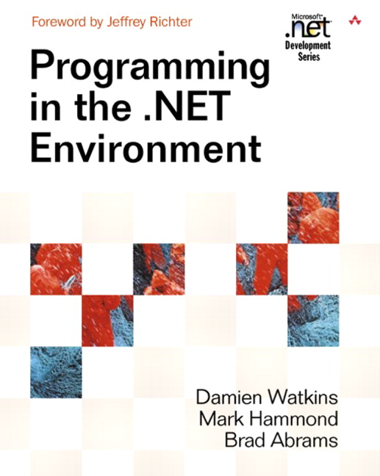
Recommended Readings
BETA:
Object-Oriented Programming in the BETA Programming Language
by Ole Lehrmann Madsen, Birger Møller-Pedersen, Kristen Nygaard, Addison-Wesley, June 1993, ISBN 0-201-62430-3
  ftp://ftp.mjolner.com/BETA/BOOK/betabook.pdf
.NET Overview:
Programming in the .NET Environment
by Damien Watkins, Mark Hammond, Brad Abrams, Addison Wesley Professional 2003, ISBN: 0-201-77018-0

Slide 29
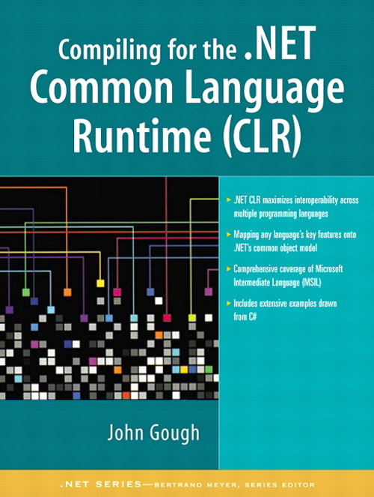
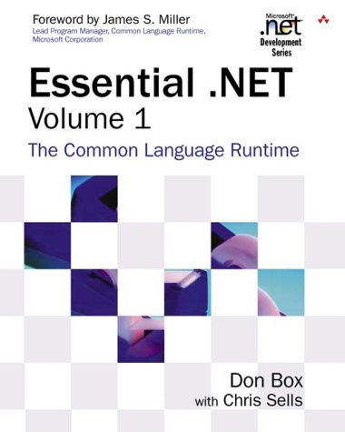
Recommended Readings (2)
Compiler construction [Gough]:
Compiling for the .NET Common Language Runtime (CLR)
by John Gough, Prentice Hall PTR 2001. ISBN: 0130622966;
  One of the first books on CLR compilation, but still one of the best
CLR in-depth:
Essential .NET, Volume I: The Common Language Runtime
by Don Box, Addison-Wesley, 2002, ISBN: 0201734117
ECMA-335: Common Language Infrastructure (CLI)
  PDF:
  http://www.ecma-international.org/publications/files/ecma-st/ECMA-335.pdf
  HTML with search:
  http://dotnet.di.unipi.it/EcmaSpecs.aspx

Slide 30
Code generation tips
Generate textual IL
  C# too much overhead
  IL files easy to debug, and fix code generation errors in
  Allows emitting your own debug info
  No speed up gained from generating code using System.Reflection.Emit [Gough, p. 338]
    Would require bootstrapped .NET compiler anyway (or COM)
Use ILDasm to check your generated code after assmbling, and to “reverse-engineer” generated, say, C# code
Use PEVerify for bytecode verification of your code
Generate assemblies, not netmodules
  allows for ILDasm, PEVerify
  Cannot link netmodules to one file (AL.EXE generates references)
  Runtime penalty?
Generate .line debug info
  Allows source level debug with VS.NET, DbgCLR and CorDBG
Notes:
There are COM libraries available for emitting IL too, but we do not have a stable COM support in BETA yet, and why the trouble, if no speed gain?
Search web for “Metadata Unmanaged API”.

Slide 31
.NET advantages
Well-defined run-time format
  More than just a calling convention for procedures
Memory management
  Storage allocation
  Object format & method activation format
  Garbage collection
One large class library that can be used from any language
Code from any CLS (extender) language can be reused
Powerful IDE: Visual Studio
Free command line tools and graphical debugger
ROTOR allows for
  in-depth experiments with jitter, GC etc.,
  experimenting with other platforms than Windows

Slide 32
What we miss in CLR…
No static link on stack frames
  Nested methods cannot access locals on outer methods
  Nested classes cannot access fields of outer classes
General exit out of nested method calls
  We currently have to use try-catch
No support for covariant method arguments or return types
CLR stack based, but no swap, dup2, etc. instructions (known from e.g. Java bytecodes). Only dup available.
  Can be simulated using local variables, but these are typed, so type of the top most stack items must be known.
  Probably better to fix your compiler front end to generate correct evaluation order!

Slide 33
Pitfall: verification or not?
.NET: Code Access Security permission SkipVerification on for code running from local machine
  Errors generated by your compiler may not be detected, even by running the code!
  Use batch program PEVerify to find them
ROTOR seems to perform full verification for code even from the local machine
  Our initial work with ROTOR revealed some errors we did not know of on .NET

Slide 34
Pitfall: verification…? Example 1
.try {
// leave.s L
br.s L
}
catch [mscorlib]System.Exception
{ ... }
L: …
ECMA 335, section 11.4: br cannot be used to exit a try block, leave must be used (unwinds stack)
Caught by PEVerify
Runs without errors in .NET v1.1
Fails on ROTOR

Slide 35
Pitfall: verification…? Example 2
.locals init (/*int32[]*/ int32)
ldc.i4.1
newarr [mscorlib]System.Int32
stloc.0
Obvious error: local variable type and actual object mismatch
Caught by PEVerify
Runs without errors in .NET v1.1
Fails on ROTOR
Notes:
Here is a full IL program showing these two errors.
/*
ilasm /exe clrproblems.il
.NET execution: clrproblems.exe - succeeds: prints out 1
ROTOR execution: clix clrproblems.exe - fails
Verification: PEVerify clrproblems.exe - fails
*/
.assembly extern mscorlib{}
.assembly clrproblems {}
.module clrproblems.exe
.class public auto ansi beforefieldinit clrproblems
extends [mscorlib]System.Object
{
.method public hidebysig static void Main() cil managed
{
.entrypoint
.maxstack 3
.try
{
// leave.s L
br.s L
}
catch [mscorlib]System.Exception
{
pop
leave.s L
}
L: ldc.i4.1
newarr [mscorlib]System.Int32
.locals init (/*int32[]*/ int32 V_0)
stloc.0
ldloc.0
ldc.i4.0
ldc.i4.1
stelem.i4
ldloc.0
ldc.i4.0
ldelem.i4
call void [mscorlib]System.Console::WriteLine(int32)
ret
}
.method public hidebysig specialname rtspecialname
instance void .ctor() cil managed
{
.maxstack 1
ldarg.0
call instance void [mscorlib]System.Object::.ctor()
ret
}
}

Slide 36
Separate compilation? (1)
Traditional compilation:
No need to know that bar() is in file foolib.o
Unresolved call to bar() in foo()
  Resolved by linker (ld/link)
foolib.c
gcc/cl
barlib.c
void foo(){
bar();
}
gcc/cl
void bar(){
...
}
foolib.o
barlib.o
ld/link

Slide 37
Separate compilation? (2)
CLR: References to other assemblies specified at compile time:
Complicates separate compilation
  Missing parts in partially implemented patterns forced to be in assemblies with predetermined names
  Two different implementations cannot reside in same directory (file name clash)
foolib.il
barlib.il
...
callvirt instance void
class [barlib]Bar::bar()
...
.assembly barlib{}
.class Bar {
.method public virtual
void bar() cil managed {}
}

Slide 38
Summary
Language interoperability is a benefit
  Increases code reuse
CLS a good basis for language interoperability with BETA
  Most BETA constructs fit nicely in CLS
  Some “bending” needed for a few constructs
ROTOR allows for in-depth experiments with the platform
  Looking forward to trying this
Immediate support for debugging in .NET debuggers is impressing

Slide 39

Contacts:
Questions?
Peter Andersen
  mailto:datpete@daimi.au.dk
Download:
  http://www.daimi.au.dk/~beta/ooli

