Slide 1
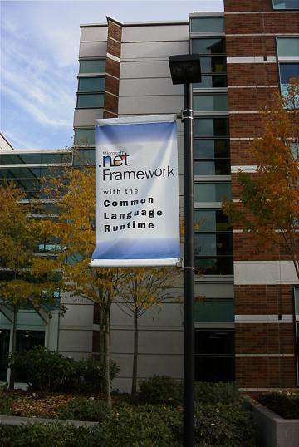
.NET CLR and
BETA.Net
Peter Andersen
29 november 2002

Slide 2
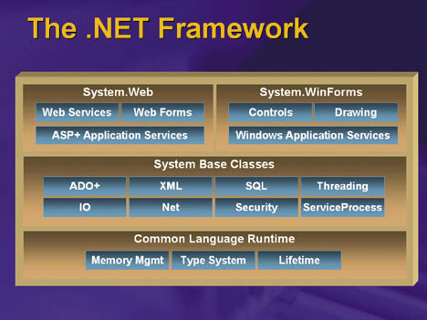
.NET Framework, details

Slide 3
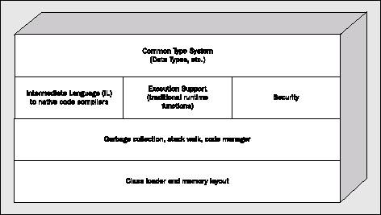
Common Language Runtime
Commom Type System
(Data Types, etc.)
IL to native code compilers
Execution
Support
Security
Garbage Collection, Stack walk, Code manager
Class Loader and memory layout

Slide 4
Common Language Runtime
CLR provides:
  Code management
  Software memory isolation
  Verification of the typesafety of IL
  Conversion of IL to native code
  Loading and execution of managed code (IL or native)
  Accessing metadata (enhanced type information)
  Managing memory for managed objects
  Insertion and execution of security checks
  Handling exceptions, including cross-language exceptions
  Interoperation between .NET objects and COM objects
  Automation of object layout for late binding
  Supporting developer services (profiling, debugging, etc.)

Slide 5
Java Byte Code and MSIL
Java byte code (or JVML) is the low-level language of the JVM.
MSIL (or CIL or IL) is the low-level language of the .NET Common Language Runtime (CLR).
Superficially, the two languages look very similar.
One difference is that MSIL is designed only for JIT compilation.
The generic add instruction would require an interpreter to track the data type of the top of stack element, which would be prohibitively expensive.
JVML:
iload 1
iload 2
iadd
istore 3
MSIL:
ldloc.1
ldloc.2
add
stloc.3

Slide 6
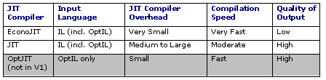
(MS)IL, OptIL and Jitters
Stack based byte code (like Java’s)
OptIL subset for optimization
No interpreter
Jitters:

Slide 7
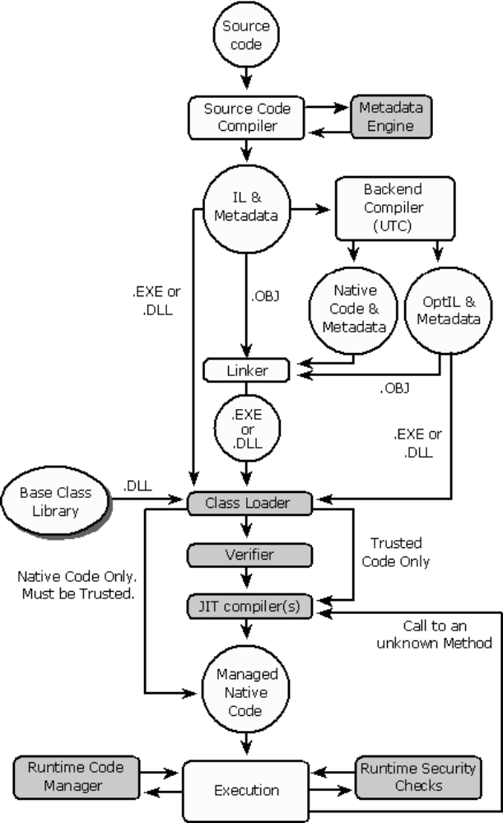
VES
Virtual Execution System:

Slide 8
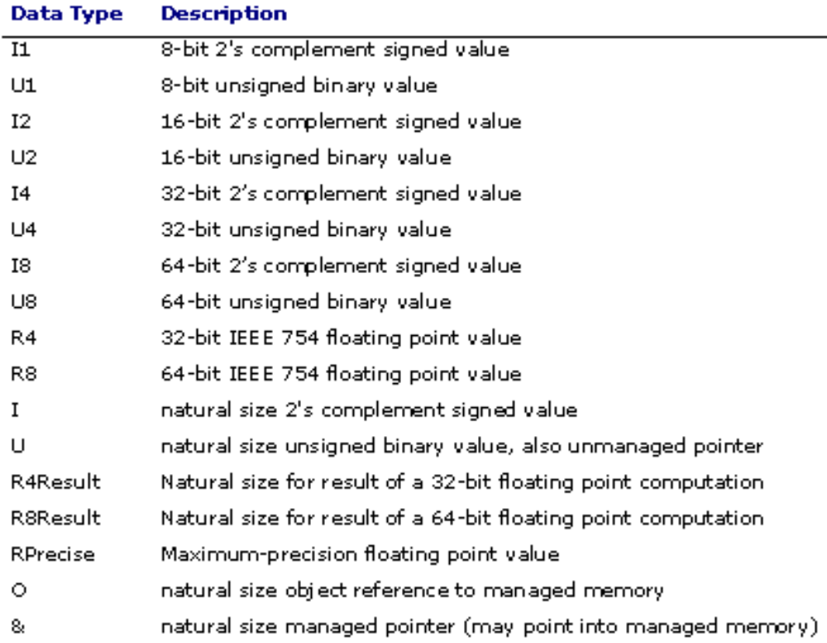
Common Type System (CTS)

Slide 9
Value vs. reference
CLR Supports
  Reference types (class)
  Value types (struct)
    Boxing/unboxing:
      int i; // value type
      Object o =((Object)i).ToString //copy!
    No int vs. Integer problem
    Boxed: Typed, heap allocated
    Unboxed: value type, not allocated directly in heap. Can be part of larger structure on heap.
    Not in Java

Slide 10
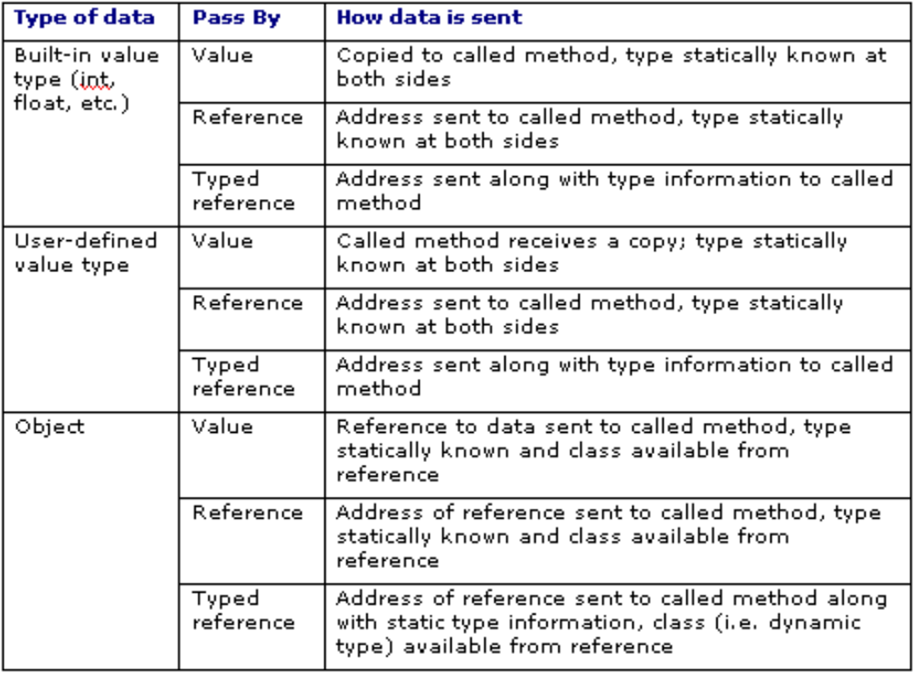
Parameter passing

Slide 11
Exception handling
MSIL support ((re)throw, leave, endfilter, endfinally)
Four kinds of handlers:
  Finally
      Executed when block exits
  Fault
      Executed if exception
  Type-filtered
      Handle exception of class or subclass
  User-filtered
      Executed based on result of user-supplied code

Slide 12
Metadata
Description of a deployment unit (called an assembly)
  Name, version, culture (which could determine, for example, the default user language)
  A public key identifying developer (for verification)
  Types exported by the assembly
  Dependencies – other assemblies which this assembly depends upon
  Security permissions needed to run
Base classes and interfaces referenced by the assembly
Custom attributes
  User defined (inserted by the developer)
  Compiler defined (inserted by the compiler to indicate something special about the language)

Slide 13
Garbage Collection
New to MS Developers!
Generation based (3 generations)
Finalization
  Finalization Queue
  Freachable Queue
  Resurrection!
Weak References
Write barrier (GetWriteWatch)
User API for GC
Concurrent GC possible
Special heap for large objects
Monitoring GC (PerfMon.exe)

Slide 14
Object-Oriented Language interoperability
Implement BETA for
  .NET
  Java-VM
Investigate the suitability of Java
and .NET as platforms for general language implementation

Slide 15
Java/C# language model
A program is a collection of classes
A class defines
  Data-items/attributes
    an attribute has a type
  Methods
    a method has arguments and a possible result value
Classes may be nested
  Java – real nesting
  C# - only a scope mechanism
No nesting of methods
Dynamic exceptions
Concurrency in the form of threads

Slide 16
BETA language specialties
Class and method unified into the
pattern mechanism
General nesting of patterns
INNER instead of super
Genericity in the form of virtual patterns
Multiple return values
Active objects
  Coroutines and concurrency
  Basis for writing schedulers
No constructors
No dynamic exceptions (yet)

Slide 17
Challenges with BETA mapping
Pattern mapping to class and methods
Nested patterns
Nested procedures
Enter-do –exit-semantics
Inner
Virtual patterns – class and procedure
Multiple return values
Leave/restart out of nested method activations
Coroutines and concurrency
Pattern variables
Basic values – signed/unsigned

Slide 18
BETA example
Calc:
(# R: @integer;
set:
(# V: @integer enter V do V → R #);
add:
(# V: @integer enter V do R+V → R exit R #);
#);
C: @Calc; X: @integer;
12 → C.set;
5 → C.add → X

Slide 19
Naive mapping into Java/C#
Class Calc extends Object
{ int R;
void set(int V)
{ R = V; };
int add(int V)
{ R = R + V; return R;}
}
Calc C = new Calc(); int X;
C.set(12);
X = C.add(5);

Slide 20
Instances of add
C: @Calc; X:@integer;
A: ^C.add;
&C.add[] → A[];
6 → A → X
Creation of an instance of C.add

Slide 21
Class add
class add extends Object
{ Calc origin ;
int V;
add(Calc org) {origin = org; }
void enter(int a) { V = a; }
void do() { origin.R = origin.R + V };
int exit() { return origin.R; }
}
C: @Calc;
X: @integer;
12 → C.set;
5 → C.add → X
add A; int X;
A = new add(C);
A.enter(5);
A.do()
X = A.exit();

Slide 22
Calc with call-add operation
Class Calc extends Object
{ int R;
void set(int V) { R = V; };
int add(int V)
{ add A;
A = new add(this);
A.enter(V);
A.do()
return A.exit();
}
}
We hope the
JIT compilers
inlines these calls!
Calc C = new Calc(); int X;
C.set(12);
X = C.add(5);

Slide 23
Calc with call-add & new-add
Class Calc extends Object
{ int R;
void set(int V) { R = V; };
int add(int V) { ...; return A.exit(); }
add add () { return new add(this); }
}
Call method for add
New method for add
Calc C = new Calc(); int X; add C.A;
C.set(12);
X = C.add(5);
A = C.add();

Slide 24
Language Restrictions
Calc: class
(# R: @integer;
set: proc
(# V: @integer enter V do V → R #);
add: proc
(# V: @integer enter V do R+V → R exit R #);
#);
Naive mapping is then sufficient (in this case)
Lots of corresponding considerations in work already done. Not time to go through them all here…

Slide 25
Remaining Issues
Active objects
  Coroutines and concurrency
Pattern variables
  Classes and methods as
  first-class values
Basic values – signed/unsigned
And lots of details

Slide 26
Demo
Various builds of BETA.Net/Beta.java can be downloaded from http://www.daimi.au.dk/~beta/ooli/download/
(probably only latest one interesting!)
Demo using latest:
  Subclassing of .NET class in BETA:
  WinForm graphics example
  Subclassing of BETA class in C#
    Using command line tools
    Using Visual Studio.NET

