Slide 1
Microsoft .NET Overview
Peter Andersen
29 november 2002

Slide 2
Articles
The .NET Vision
http://www.mastercsharp.com/printpage.aspx?ArticleID=20
  Explains some background for .NET emphasizing MS shortcomings to Java
Introduction to .NET
http://www.codeproject.com/dotnet/dotnet.asp?print=true
  Also starts out by comparing with Java, but then lists most major .NET parts.
  Language sometimes bad, sorry.
These slides will not be a walkthrough of the articles, but a supplement.

Slide 3
What is .NET?
MANY things
Microsoft long term strategy
Brand name
New (Windows) execution platform
Replacement of COM/DNA/ADO/ASP
”End of DLL Hell”

Slide 4
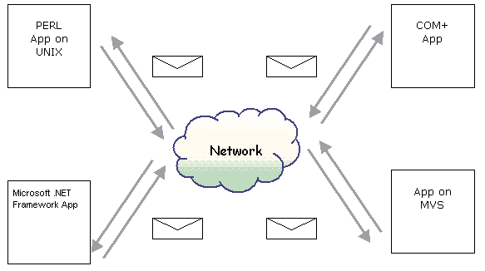
Vision: Internet as an OS

Slide 5
History
(D)COM and MTS -> (D)COM+
ASP -> ASP+
Universal runtime: COR/COM3? (funny DOS problem: COM3 is serial port)
NGWS (runtime)
DCOM -> SOAP, XML base
.NET unifies these new ideas

Slide 6
.NET Elements
.NET Framework, C#, VB.NET, JScript.NET, C++
ADO.NET
ASP.NET, SOAP, Web Forms
[.NET Enterprise Servers]
Visual Studio.NET
Passport.NET
[Office.NET]
Windows.NET

Slide 7
Framework Goals
Simplify Application Development
  Compared to previous windows development
Robust and secure execution environment
  Memory management and security automatically handled
Support multiple languages
  And class library identical from all languages
Simplify deployment and management
  Xcopy install, no more DLL hell

Slide 8
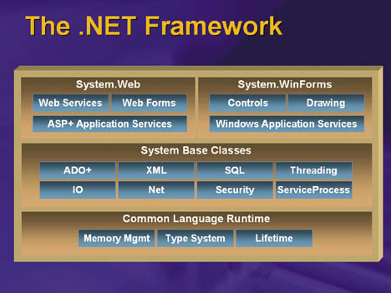
.NET Framework

Slide 9
.NET languages
Microsoft:
  C#, VB.NET, JScript.NET, C++.NET, J#
3rd party:
  ~20 other languages
  http://msdn.microsoft.com/vstudio/partners/language/default.asp
  Including:
  APL, CAML, C, COBOL, Eiffel, Haskell, Mercury, ML, Oberon, Objective Caml, Oz, Pascal, Perl, Python, Scheme, Smalltalk…
  BETA.Net!
  http://www.daimi.au.dk/~beta/ooli

Slide 10
Interoperability
Interoperation with Unmanaged Code
Two-way transitions between managed and unmanaged code.
Interoperation with existing COM clients and services (“COM interop”) [ComVisible]
Interoperation with compiled native DLLs (“Pinvoke (Platform Invoke)”) [DllImport]
Automatic marshaling that copy and/or reformat information across the boundary.

Slide 11
Simplify appl. development
Automatic memory management
Multiple languages
  Preserve investment
Type safety
Exception handling instead of HRESULT
Integrated tools
  Visual Studio open for 3rd party

Slide 12
Simplified Deployment
Assemblies
XCOPY install
  E.g. run from CD!
Zero-inpact install: DEL uninstall
No more DLL Hell
Eliminates COM plumbing
No more:
  Registry, IDL, GUID, CoCreateInstance, HRESULTs, IUnknown, AddRef/Release

Slide 13
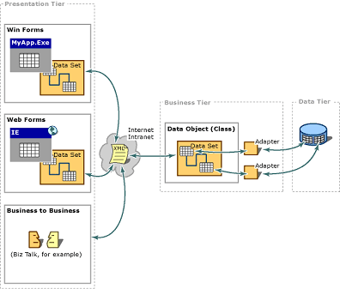
ADO.NET
Active Data Object using XML(SOAP) as transporation.
Gives integration with .NET WebForms and WinForms.

Slide 14
ASP
Active Server Pages (before .NET)
  Server side web scripting
  HTML and scripts intermixed
  Supported by Microsoft Internet Information Server (IIS) for all files with extension .asp
  Languages: VBScript, JavaScript, Jscript
  Microsoft version of CGI
  Simpler to use than CGI
  Later inspired SUNs JSP

Slide 15
ASP, cont.
ASP example:
    <%@ Language=VBScript %>
    <html>
    <head>
    <title>Example 4</title>
    </head>
    <body>
    <%IF Hour(time)>18 OR Hour(time)<4 THEN%>
    Good Night Everyone.
    <%ELSE%>
    Good Morning Everyone.
    <%END IF%>
    </body>
    </html>
Typical use: Database query -> HTML

Slide 16
ASP, cont.
ASP Disadvantages:
  Interpreted on server, less performance
  HTML (structure) and behavior intermixed.
  Web designers vs. VB programmers
  Limited Object model
  Dependent on IIS - cannot run on e.g. CD
  (IIS = Microsoft Internet Information server = MS webserver)

Slide 17
ASP.NET
ASP.NET (ASP+) offers:
  Server side programming in any .NET language; .aspx files
  Access whole .NET Framework
  All HTML elements accessible as objects
  CodeBehind decouple HTML/scripts
  Not interpreted, but JITted
  WebForms; server-side ”super-tags”, dynamically adapt to browser
  Web Services / SOAP; .asmx files
  IIS independent: .asmx files, other .NET-enabled web servers (Apache?)

Slide 18
ASP.NET, cont
Web Service
  Tracking.asmx:
    <%@ WebService language="c#" %>
    using System.Web.Services;
    public class Shipping {
    [WebMethod]
    public String OrderStatus(String OrderNumber) {
    // code here to retrieve order details
    // from data store
    return Status;
    }
    }
  Call HTTP-GET (IIS):
http://orders.ups.com/orders/Tracking.asmx/OrderStatus?OrderNumber=BRU123

Slide 19
SOAP
Old idea in new packing
CGI with XML formatted input/output
Envelope:
    <SOAP:Envelope>
    soap headers
    <SOAP:Body>
    data to be sent to program
    </SOAP:Body>
    </SOAP:Envelope>
Allows complex data compared to CGI data pairs

Slide 20
Visual Studio.NET
Next generation of Visual Studio
Integrates all MS languages: VC++, C#, Jscript.Net, J#.Net, VB.Net
Open to 3’rd party integration. Examples: COBOL, Eiffel, SML. And soon BETA (I hope (:-))

Slide 21
Other elements
Passport.NET
  http://www.passport.net
  Hotmail Passport next generation
  User-Verification for web-services
Office.NET
  Well?
Windows.NET
  Windows with build-in .NET support (.NET framework)
  http://www.microsoft.com/Windows.NetServer/ (Scheduled to be Available in April 2003)

Slide 22
.NET Mobile
http://www.microsoft.com/mobile
Software
  Pocket Outlook
  Pocket Internet Explorer
  MSN Messenger
  Windows Media Player
  Macromedia Flash Player
Microsoft Mobile Information Server (MIS)
  http://www.microsoft.com/miserver
  Exchange Server for Mobile devices

Slide 23
.NET Mobile, cont.
.NET Compact Framework
  For PDA Client application
.NET Mobile Internet Toolkit
  For Web application
  Previously: Device specific ASP pages
  http://www.msdn.microsoft.com/downloads/sample.asp?url=/msdn-files/027/001/817/msdncompositedoc.xml
  Extend the power of the Microsoft® .NET Framework and Microsoft Visual Studio® .NET to build mobile Web applications. The Microsoft Mobile Internet Toolkit contains server side technology that enables ASP.NET to deliver markup to a wide variety of mobile devices. These devices include WML and cHTML cell phones, HTML pagers, and PDAs like the Pocket PC

Slide 24
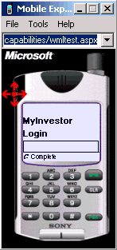
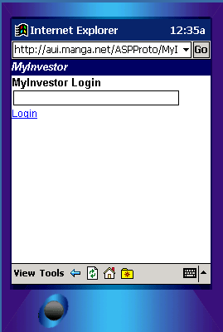
Emulators
Microsoft Mobile Explorer
Pocket PC

Slide 25
.NET implementations
C#,CLI are ECMA standards (and soon ISO)
  http://www.ecma.ch/ecma1/STAND/ecma-334.htm
  http://www.ecma.ch/ecma1/STAND/ecma-335.htm
Microsoft:
  .NET Framework for Windows 2000/XP (free)
  http://msdn.microsoft.com/netframework/downloads/howtoget.asp
  Shared Source CLI (Rotor) for Windows 2000/XP, FreeBSD, MacOSX (also free)
  http://msdn.microsoft.com/net/sscli
Project Mono:
  Open Source C# compiler, CLR and class library
  Linux/x86, Linux/PPC, S390, (StrongARM, SPARC)
  http://www.go-mono.com
Probably others (to come)…

Slide 26
Conclusion
Major cleanup and integration by Microsoft, partly dictated by Java success, partly by internal mess (DLL hell, registry etc.) Result looks promising.
Should benefit all Windows programmers
.NET: Multiple languages, (yet) one platform (or variants thereof). http://msdn.microsoft.com/vstudio/partners/language/default.asp
Perhaps other platforms later (all is in ECMA/W3C standardization)
Java: One language, multiple platforms. Other languages could be compiled to java bytecode though (BETA and others)
http://grunge.cs.tu-berlin.de/~tolk/vmlanguages.html

