Slide 1


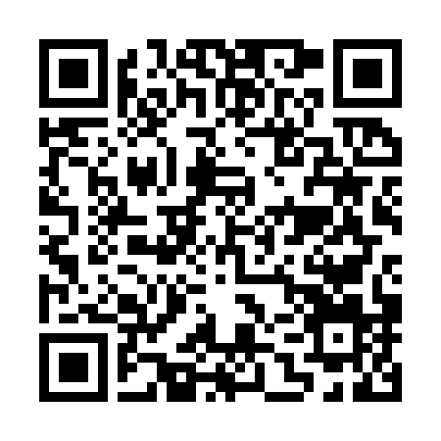
“Olmaliq KMK” AJ Muhandislik maktabi
S E R T I F I K A T
S № AGMK-2026-EN0148
Borliboyev Shahzod Baxodir o‘g‘li
F.I.O.
Muhandislik maktabida
O‘quv markazi nomi
da 2026-yil 2-fevraldan 24-aprelgacha 480 soatli
Elektromontyor
kasbi bo‘yicha qayta tayyorlash
kursini to‘liq tamomladi. -
Muhandislik maktabi direktori: B.A.Salimov
Berilgan sana: 29.04.2026

Slide 2
Engineering school of
“Almalyk MMC” JSC
C E R T I F I C A T E
S № AGMK-2026-EN0148
Borliboyev Shahzod Bakhodir ugli
Full name
Engineering school
Name of the training center
From 02.02.2026 to 24.04.2026 year 480 hours
completed full professional retraining course of
Electrician
In Engineering school
Name of vocational training center
-
Director of Engineering school B.A.Salimov
Date Issued: 29.04.2026

Slide 4
“Olmaliq KMK” AJ
Muhandislik maktabi
S E R T I F I K A T
“Almalyk MMC” JSC
Engineering school of

