Slide 1
EDA Case Study 1
Jonathon Roach and Jorge Olmos

Slide 2
Introduction
Goals:
Analyze market trends for 2,410 US craft beers brewed at 558 breweries
Communicate relationships between brewery location, beer alcoholic content (ABV), and Beer Bitterness (IBU)
Model and classify beer categories based on a variety of variables

Slide 3
Working Data Set
Brewery_id | beer_name | Beer_ID | ABV | IBU | Style | Ounces | brewery_name | City | State
1 | Get Together | 2692 | 0.045 | 50 | American IPA | 16 | NorthGate Brewing | Minneapolis | MN
1 | Maggie's Leap | 2691 | 0.049 | 26 | Milk / Sweet Stout | 16 | NorthGate Brewing | Minneapolis | MN
1 | Wall's End | 2690 | 0.048 | 19 | English Brown Ale | 16 | NorthGate Brewing | Minneapolis | MN
1 | Pumpion | 2689 | 0.06 | 38 | Pumpkin Ale | 16 | NorthGate Brewing | Minneapolis | MN
1 | Stronghold | 2688 | 0.06 | 25 | American Porter | 16 | NorthGate Brewing | Minneapolis | MN
1 | Parapet ESB | 2687 | 0.05 | 47 | Extra Special / Strong Bitter (ESB) | 16 | NorthGate Brewing | Minneapolis | MN
… | … | … | … | … | … | … | … | … | …

Slide 4
Number of Breweries by State
Breweries by State
State | # of Breweries
CO | 47
CA | 39
MI | 32
OR | 29
TX | 28
PA | 25
… | …
MS | 2
NV | 2
DC | 1
ND | 1
SD | 1
WV | 1
Top States
Bottom States

Slide 5
Missing Data
This is not concerning
Missing Data
Variable | Percent Missing Data
Alcohol by Volume (ABV) | 2.6%
International Bitterness Units (IBU) | 41.7%
All Other Variables | 0.0%
This is
Question for Future Consideration: How to we get these values back into our data?

Slide 6
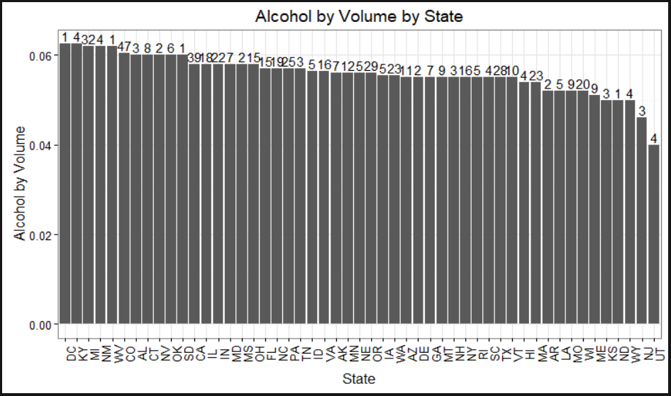
Alcohol by Volume for each state

Slide 7
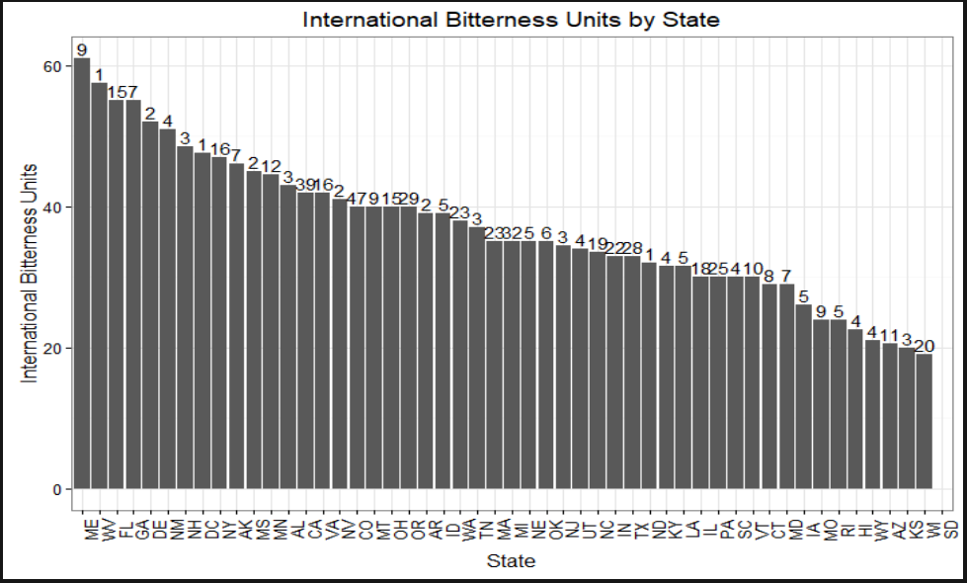
International Bitterness Unit for each state

Slide 8
States With Maximum ABV Beer and Most Bitter Beer
The state with the maximum ABV beer is Colorado. The “Lee Hill Series Vol. 5 - Belgian Style Quadrupel Ale” has an ABV of 0.128.
The state with the most bitter beer is Oregon. The “Bitter B*tch Imperial IPA” has an IBU of 138.

Slide 9

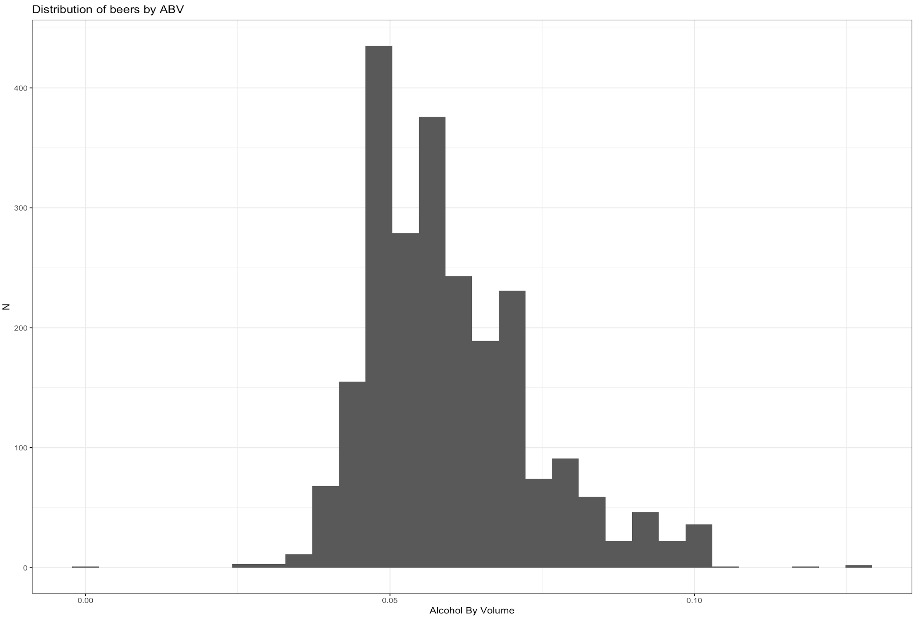
Summary Statistics

Slide 10
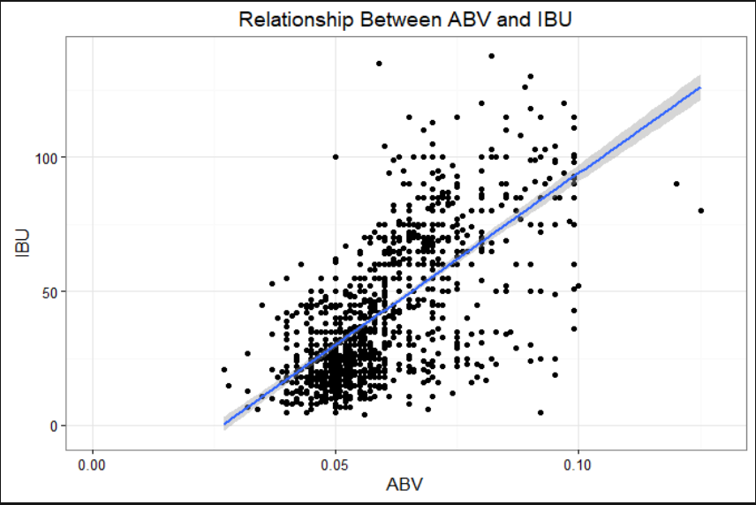
Relationship Between Bitterness and Alc. Content

Slide 11
Conclusion
Key Takeaways:
Colorado, California, Michigan, Oregon, and Texas are the largest markets with the widest variety of products
There is a strong relationship between Alcohol by Volume and International Bitterness Units, and beers can be accurately classified based on these metrics
International Bitterness Units are missing in the data more often than not. Models for imputing these data are accurate, but should be taken with a grain of salt

