Slide 1
Beer Industry Market Analysis
Jonathon Roach and Jorge Olmos

Slide 2
Introduction
Goals:
Analyze market trends for 2,410 US craft beers brewed at 558 breweries
Communicate relationships between brewery location, beer alcoholic content (ABV), and Beer Bitterness (IBU)
Model and classify beer categories based on a variety of variables

Slide 3
Working Data Set
Brewery_id | beer_name | Beer_ID | ABV | IBU | Style | Ounces | brewery_name | City | State
1 | Get Together | 2692 | 0.045 | 50 | American IPA | 16 | NorthGate Brewing | Minneapolis | MN
1 | Maggie's Leap | 2691 | 0.049 | 26 | Milk / Sweet Stout | 16 | NorthGate Brewing | Minneapolis | MN
1 | Wall's End | 2690 | 0.048 | 19 | English Brown Ale | 16 | NorthGate Brewing | Minneapolis | MN
1 | Pumpion | 2689 | 0.06 | 38 | Pumpkin Ale | 16 | NorthGate Brewing | Minneapolis | MN
1 | Stronghold | 2688 | 0.06 | 25 | American Porter | 16 | NorthGate Brewing | Minneapolis | MN
1 | Parapet ESB | 2687 | 0.05 | 47 | Extra Special / Strong Bitter (ESB) | 16 | NorthGate Brewing | Minneapolis | MN
… | … | … | … | … | … | … | … | … | …

Slide 4
Number of Breweries by State
Breweries by State
State | # of Breweries
CO | 47
CA | 39
MI | 32
OR | 29
TX | 28
PA | 25
… | …
MS | 2
NV | 2
DC | 1
ND | 1
SD | 1
WV | 1
Top States
Bottom States

Slide 5
Missing Data
This is not concerning
Missing Data
Variable | Percent Missing Data
Alcohol by Volume (ABV) | 2.6%
International Bitterness Units (IBU) | 41.7%
All Other Variables | 0.0%
This is
Question for Future Consideration: How to we get these values back into our data?

Slide 6
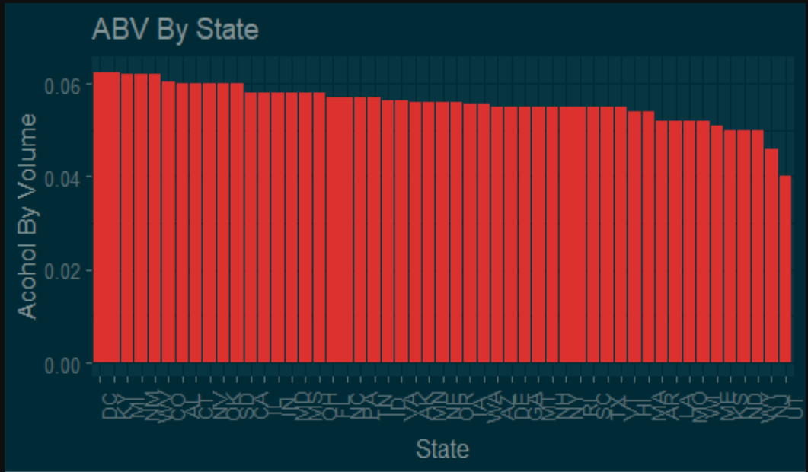
Alcohol by Volume For Each State

Slide 7
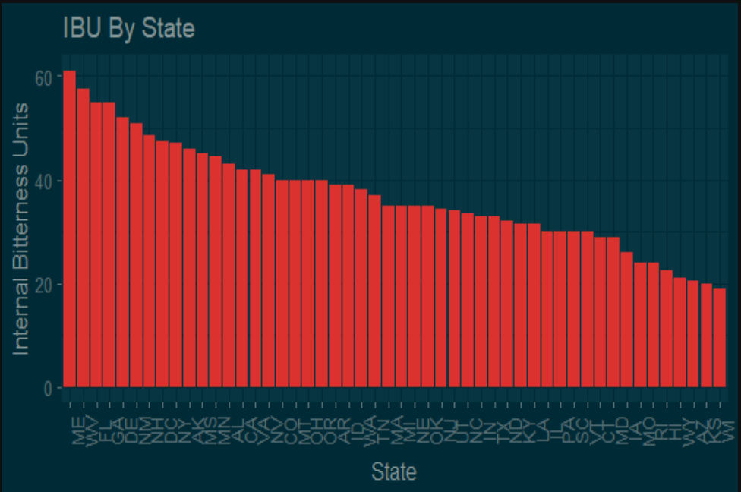
International Bitterness Unit For Each State

Slide 8
States With Maximum ABV Beer and Most Bitter Beer
The state with the maximum ABV beer is Colorado. The “Lee Hill Series Vol. 5 - Belgian Style Quadrupel Ale” has an ABV of 0.128.
The state with the most bitter beer is Oregon. The “Bitter B*tch Imperial IPA” has an IBU of 138.

Slide 9

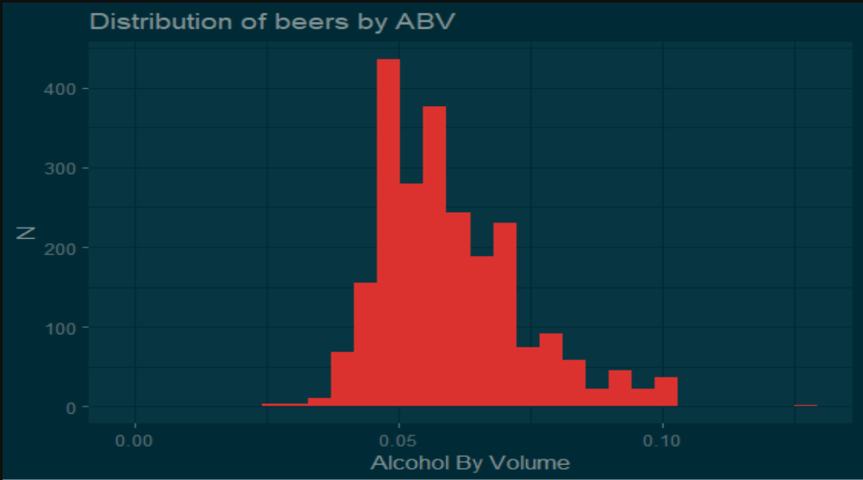
Summary Statistics

Slide 10
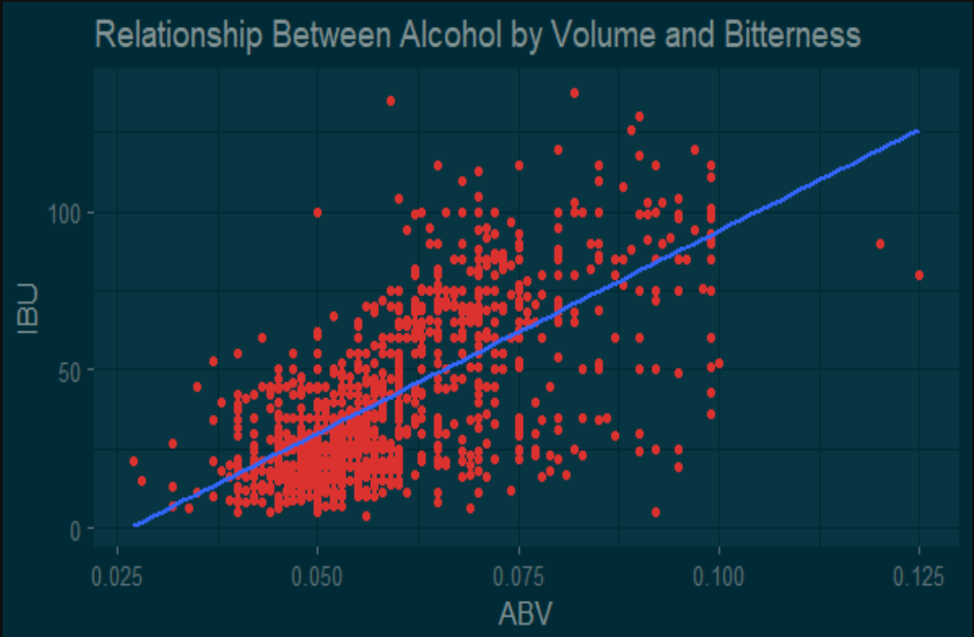
Relationship Between IBU and ABV

Slide 11
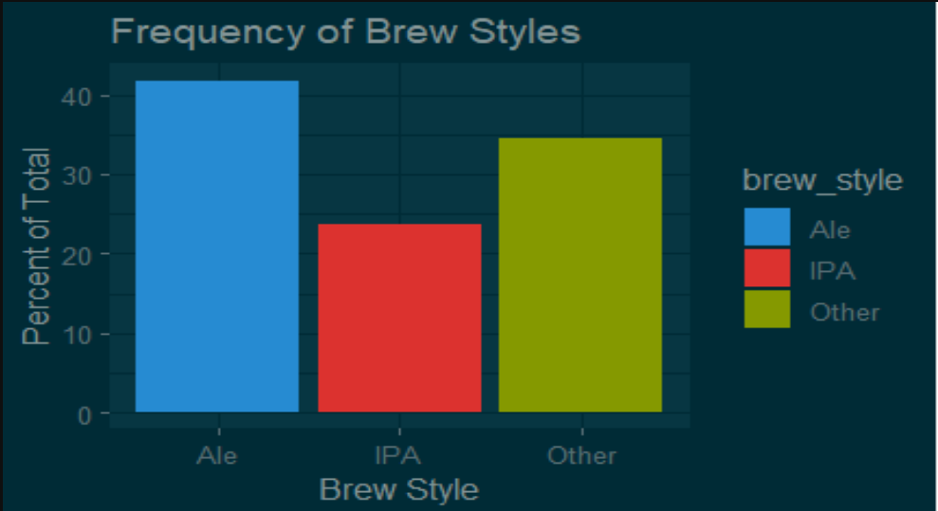
Frequency of Brew Styles

Slide 12
Predicting Brew Style by ABV and IBU
Model Used: k-NN
Wanted to investigate accuracy of predictions: IPA vs. Ale
Predictors: ABV and IBU
Model Accuracy: 85% - 90%

Slide 13
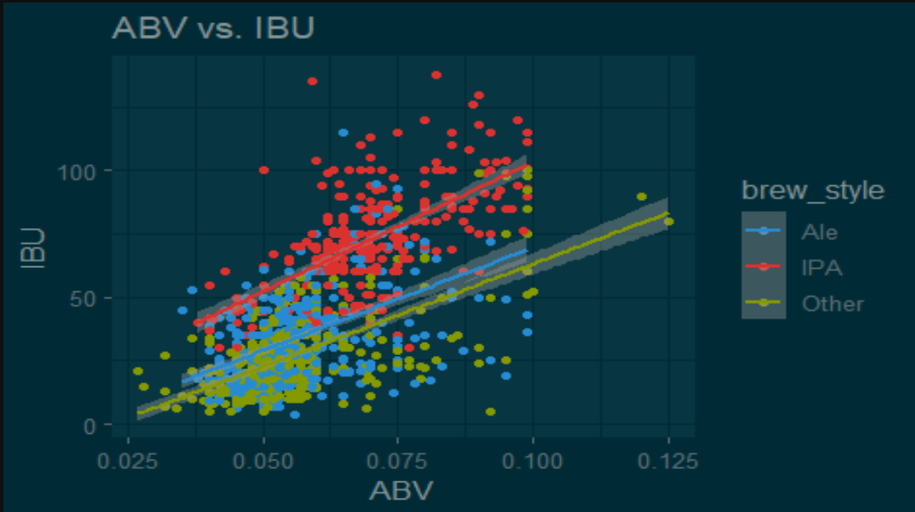
ABV vs. IBU by Brew Style

Slide 14
Imputing Missing Values
Linear regression used to impute missing values for IBU
On test data, average error was roughly 10-11 IBUs
Model accounts for trends across brew types and brewery states

Slide 15
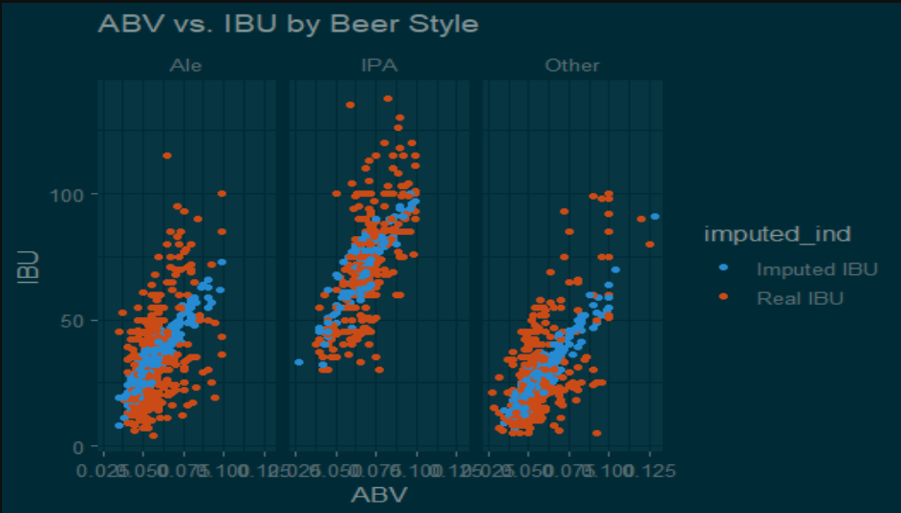
Imputed IBU Values From Model

Slide 16
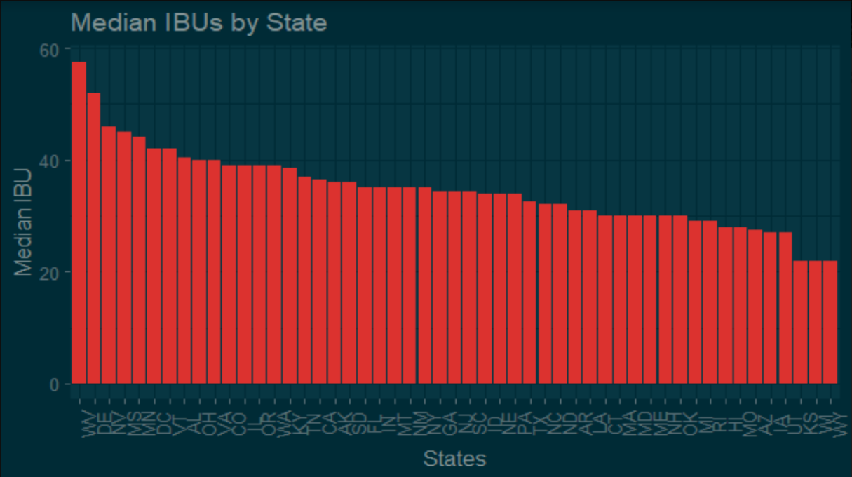
Model-Adjusted IBUs by State

Slide 17
Conclusion
Key Takeaways:
Colorado, California, Michigan, Oregon, and Texas are the largest markets with the widest variety of products
There is a strong relationship between Alcohol by Volume and International Bitterness Units, and beers can be accurately classified based on these metrics
International Bitterness Units are missing in the data more often than not. Models for imputing these data are accurate, but should be taken with a grain of salt

