Slide 1
EDA Case Study 1
Jonathon Roach and Jorge Olmos

Slide 2
Introduction
Goals:
Analyze market trends for 2,410 US craft beers brewed at 558 breweries
Communicate relationships between brewery location, beer alcoholic content (ABV), and Beer Bitterness (IBU)
Model and classify beer categories based on a variety of variables

Slide 3
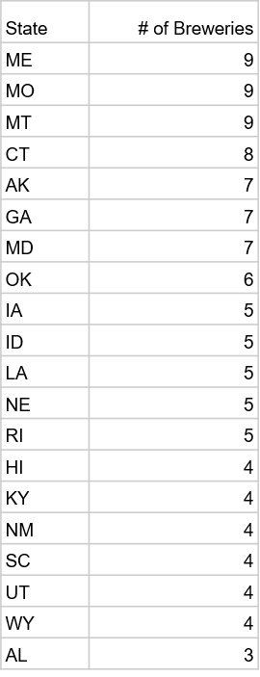
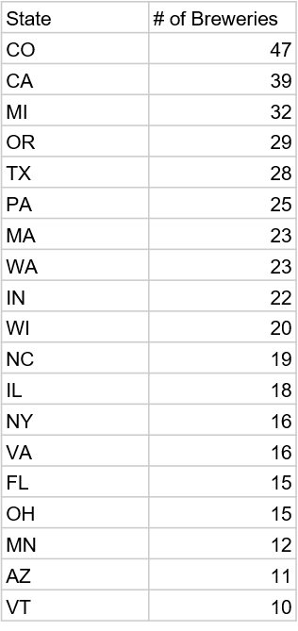
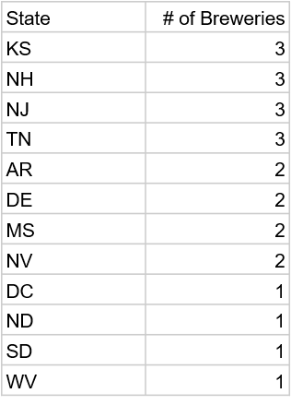
How many breweries are present in each state?

Slide 4
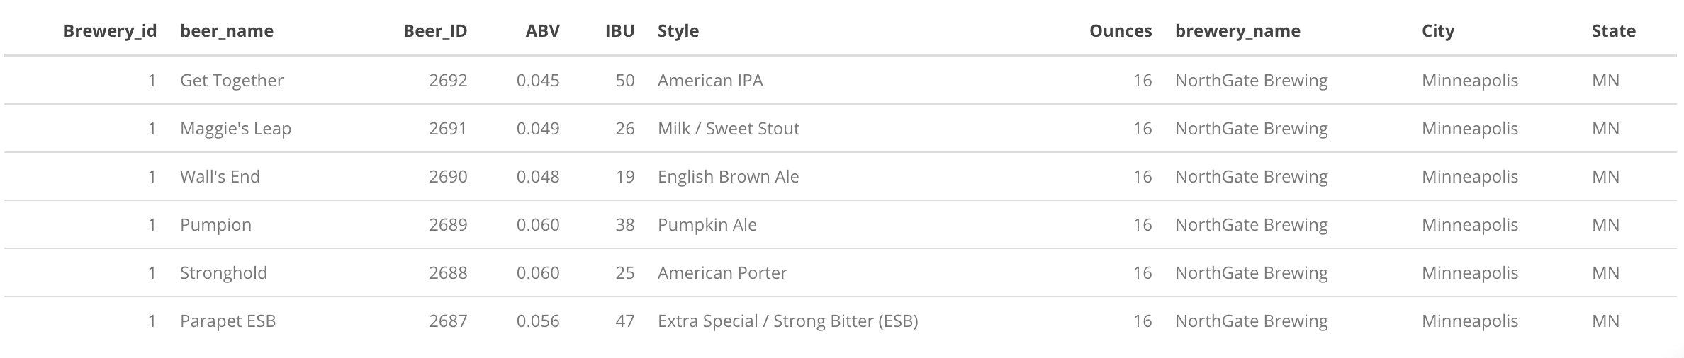
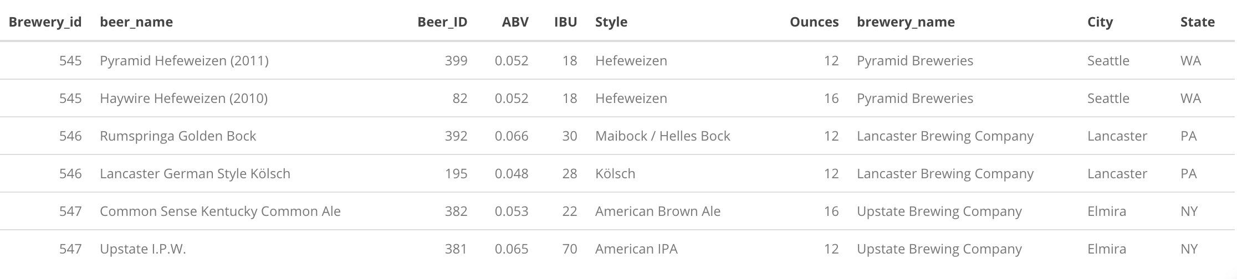
Merge Data

Slide 5
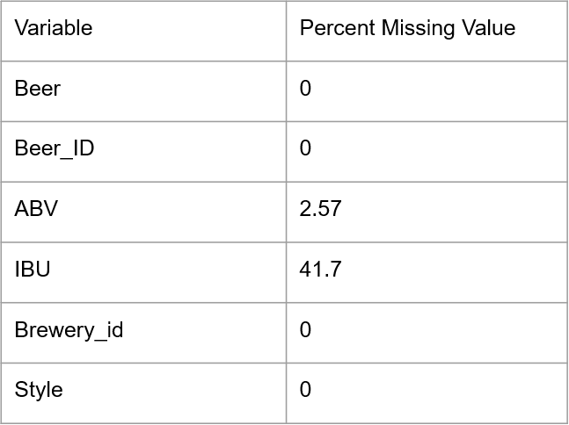
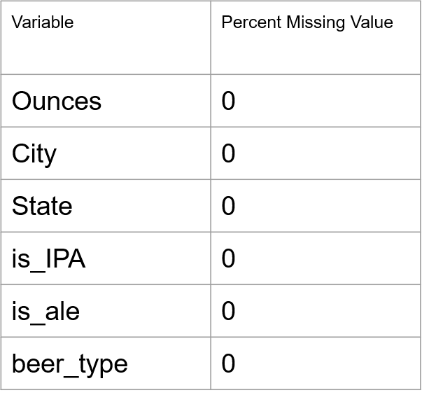
Address the Missing Values

Slide 6
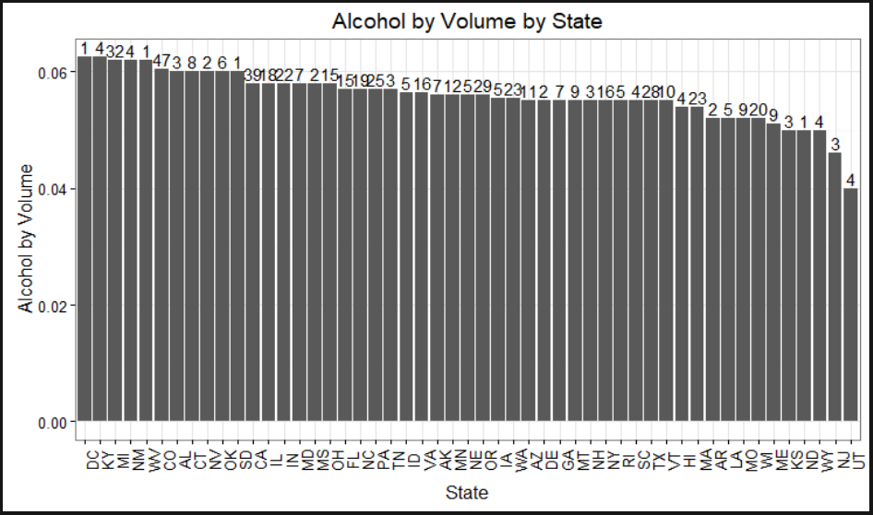
Alcohol by Volume for each state

Slide 7
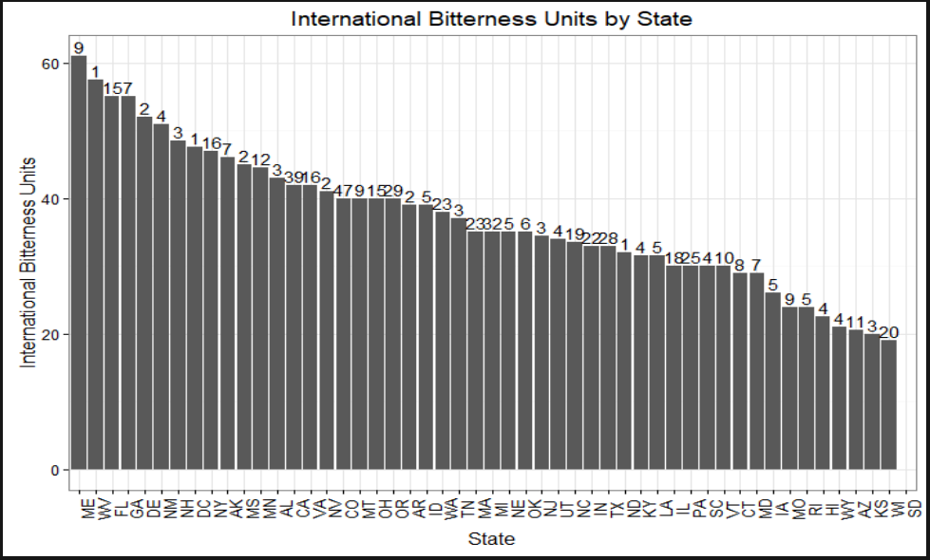
International Bitterness Unit for each state

Slide 8
States With Maximum ABV Beer and Most Bitter Beer
The state with the maximum ABV beer is Colorado. The “Lee Hill Series Vol. 5 - Belgian Style Quadrupel Ale” has an ABV of 0.128.
The state with the most bitter beer is Oregon. The “Bitter B*tch Imperial IPA” has an IBU of 138.

Slide 9

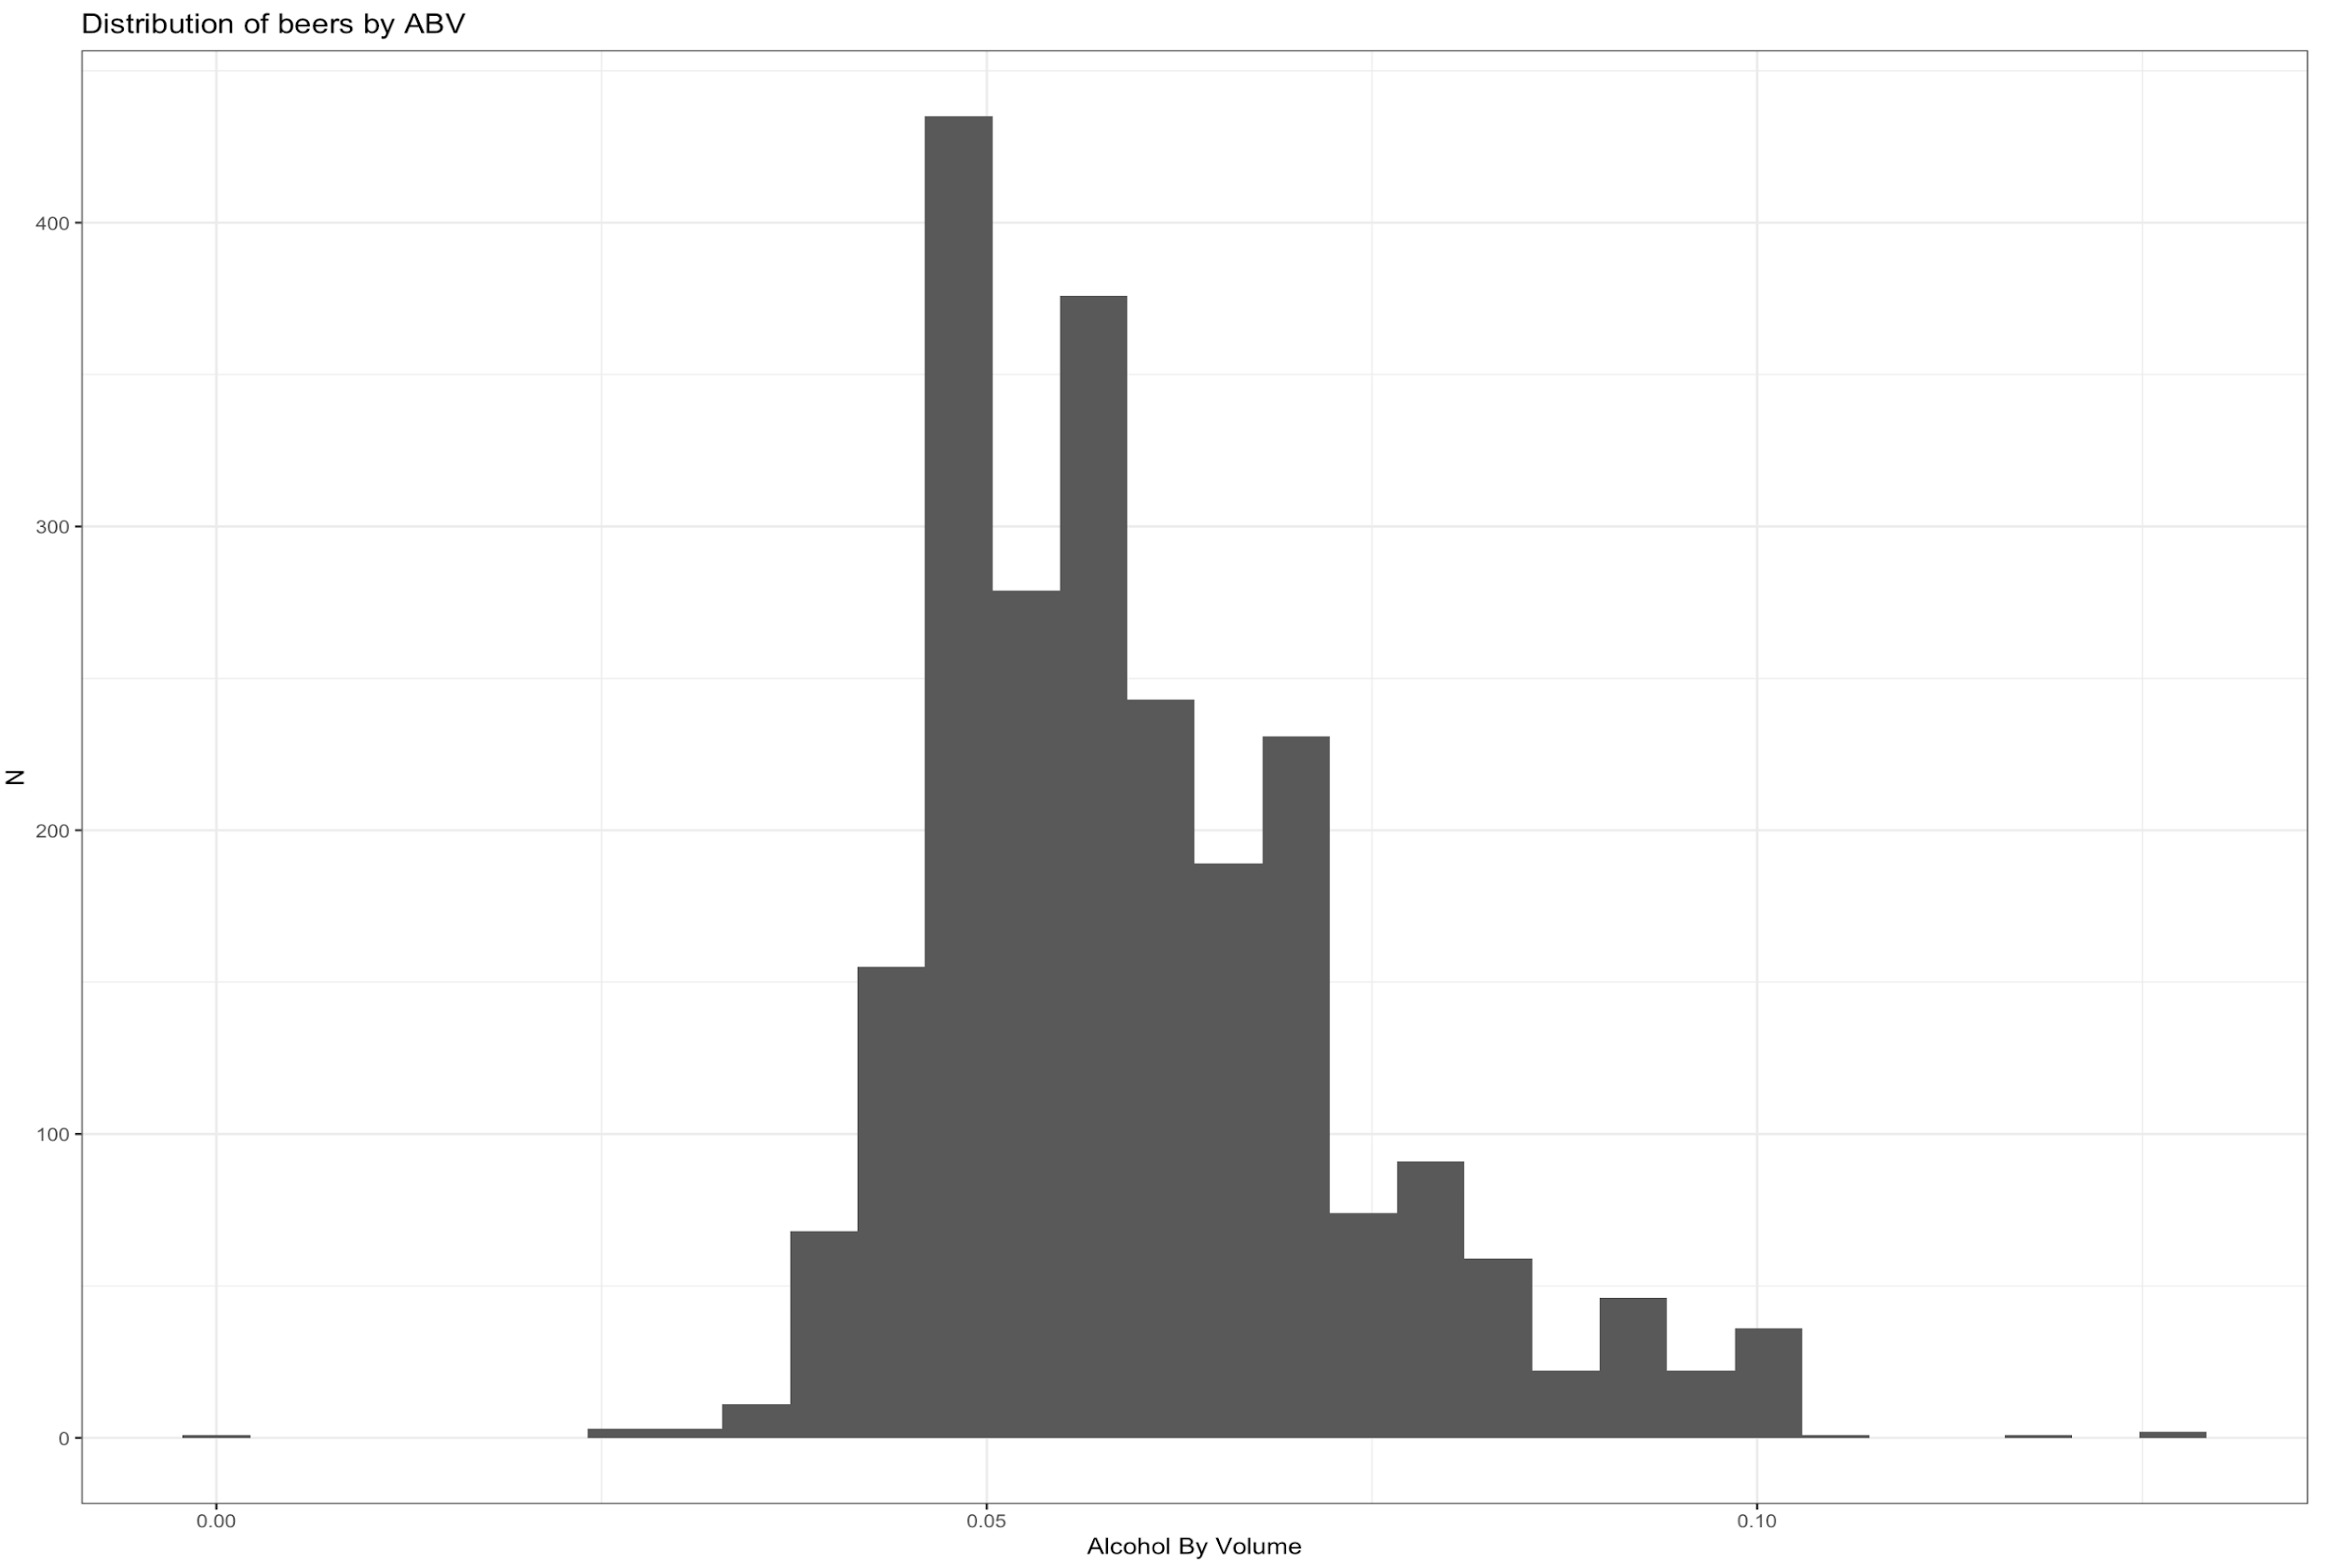
Summary Statistics

Slide 10
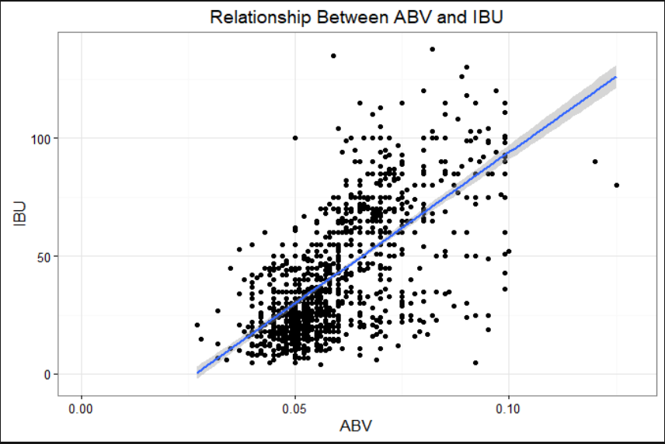
Relationship Between Bitterness and Alc. Content

