Slide 1

Gene List Analysis Report
Hint: Each slide has notes that explain the analysis!
http://metascape.org
Please cite Zhou et al. Nature Commun. 2019 10(1):1523
Jul 16, 2024
Notes:
This analysis report is automatically generated by Metascape (https://metascape.org).

Slide 2
Gene List Summary
You gene list contains 3 identifiers, 3 human Entrez Gene IDs.
Please check online Metascape User Manual for explanation of each annotation field.
Notes:
Metascape first automatically converts you input identifiers (Entrez Gene ID, RefSeq, Ensembl ID, UnProt ID or Symbol) into Human Entrez Gene ID. For example, input identifiers can be from human, mouse or rat orthologs, which can be mapped into human (or “analysis as” species) based on both EggNOG and Homologene databases.

Slide 3
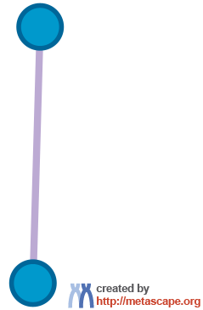
Protein-protein Interaction Network
Notes:
All protein-protein interactions among input genes were extracted from PPI data source and formed a PPI network.
GO enrichment analysis was applied to the network to extract “biological meanings”.

Slide 4


metascape.org
bioinformatics for biologists
Hint: If you have multiple related gene lists, upload them in one Excel file will trigger meta analyses.
Easy, Fresh & Free
Submit gene identifiers, one click on Expression Analysis. Done!
Interpretable results: visualizations, methods, pptx, xslx, zip
Best Practices for Gene List Analyses
Rich annotations for thousands of genes at once
Pathway & process enrichment analysis
Protein-protein interaction network analysis
Overlap analysis across multiple gene lists
Common and unique pathways across multiple studies
Support key model organisms
Scalable
Docker containers available for bioinformaticians
Notes:
Thank you for using Metascape, you are welcome to past question to our public forum: https://metascape.freeforums.net, or email us with your private questions at “metascape.team at gmail.com”.

