Slide 1
Object Detection from scratch
Vitaliy Bulygin
16.11.2024

Slide 2
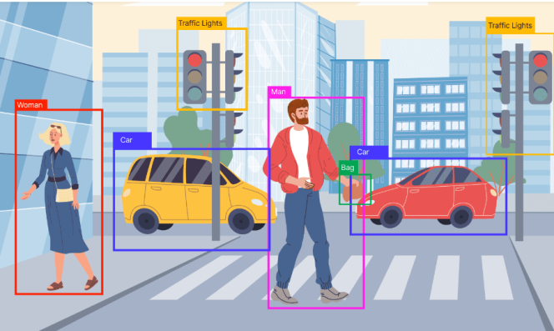
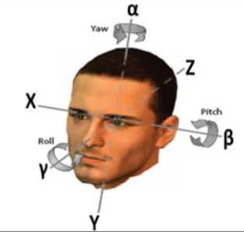
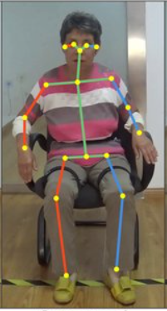
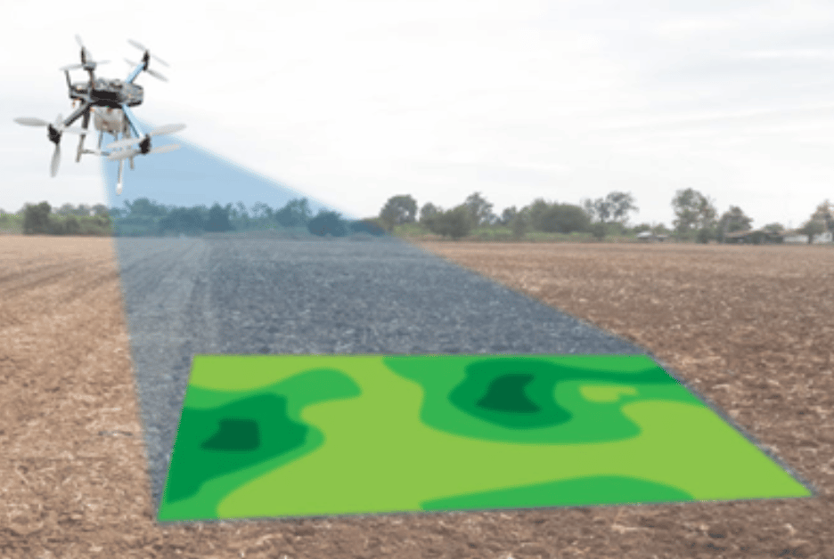
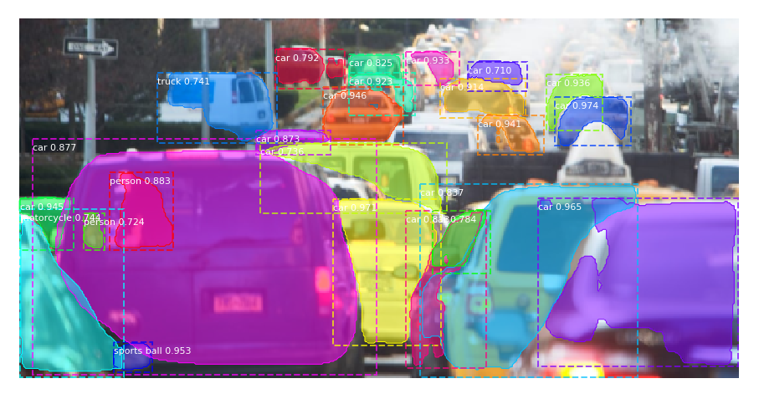
Motivation
Object detection
Head pose
estimation
95% of implementation
Add only 5%
Keypoint detection
ReID
Instance Segmentation

Slide 3
Motivation
I. Create very compact object detector to understand how it works clearly

Slide 4


Motivation
I. Create very compact object detector to understand how it works clearly
Modern Single stage detector
(https://github.com/tensorflow/models/tree/master/research/object_detection)
code line number: $100 000+$

Slide 5

Motivation
I. Create very compact object detector to understand how it works clearly
II. Have a possibility to find components in large object detectors for its modifications

Slide 6
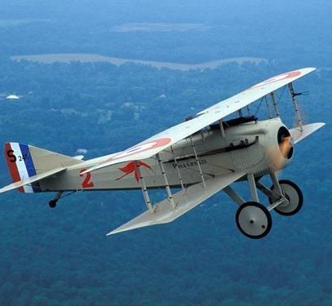
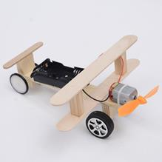
Motivation
I. Create very compact object detector to understand how it works clearly
II. Have a possibility to find components in large object detectors for its modifications
III. Use a small model for real complicated model

Slide 7
Motivation
I. Create very compact object detector to understand how it works clearly
II. Have a possibility to find components in large object detectors for its modifications
III. Use a small model for real complicated model

Slide 8
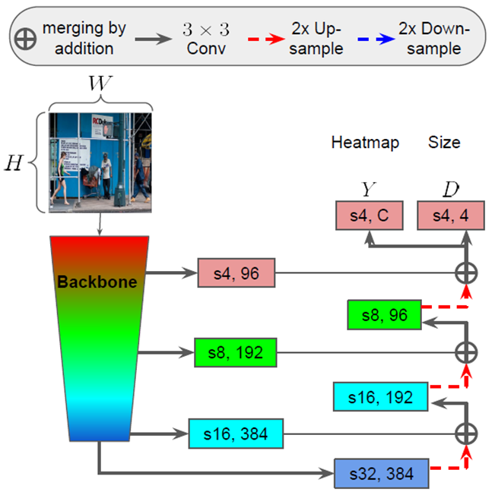
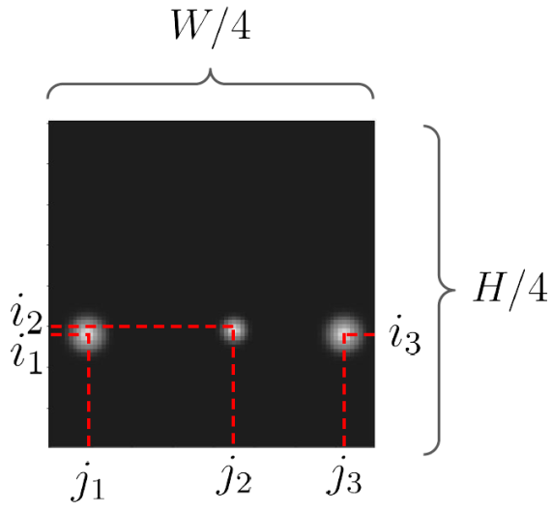




Model architecture
$$h^{t}$$
$$w^{l}$$
$$w^{r}$$
$$h^{b}$$

Slide 9
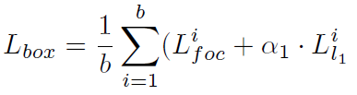
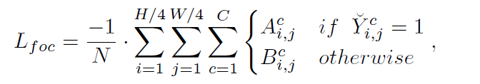
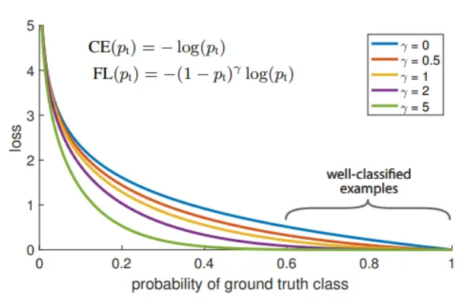







Loss functions
GT Heatmap
Heatmap
Size
$$h^{t}$$
$$w^{l}$$
$$w^{r}$$
$$A_{i,j}^{c} ={\left(1−Y_{i,j}^{c}\right)}^{2}⋅log\left(Y_{i,j}^{c}\right)$$
$$B_{i,j}^{c} ={\left(1−{\breve{Y}}_{i,j}^{c}\right)}^{4}⋅log\left({1−Y}_{i,j}^{c}\right)⋅{\left(Y_{i,j}^{c}\right)}^{2}$$
$$h^{b}$$
Predicted Heatmap
S$core{↔peaks of Y}_{i,j}^{c}$

Slide 10
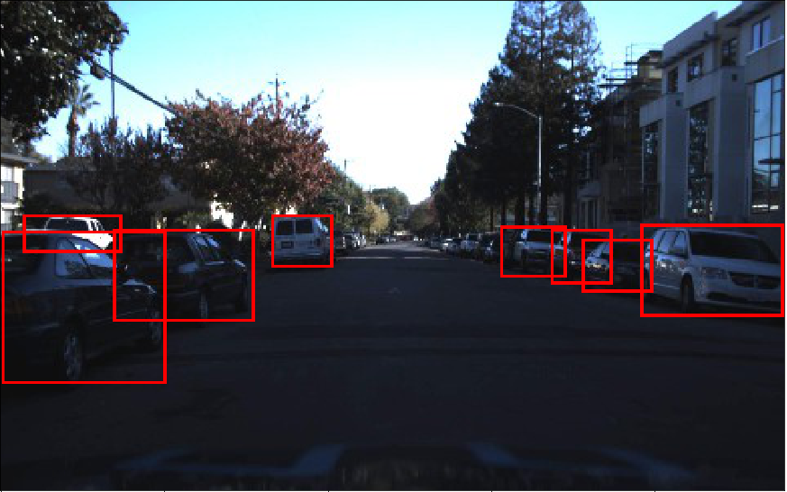









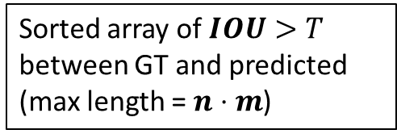





Accuracy evaluation
Sorted array of $IOU>T$
between GT and predicted
(max length = $n⋅m$)
$$1$$
$$1$$
$$↑$$
$$↓$$
$$2$$
$$(iou_{1}, iou_{2},iou_{3}, …)$$
GT
$$2$$
$$1$$
$$1$$
pred
$$3$$
$$1$$
$$2$$
$$2$$
$$3$$
evaluator.py -> sort_ious(gt_boxes, pred_boxes, iou_thr)
10

Slide 11




Accuracy evaluation
Sorted array of $IOU>T$
between GT and predicted
(max length = $n⋅m$)
$$1$$
$$1$$
$$↑$$
$$↓$$
$$2$$
$$(iou_{1}, iou_{2},iou_{3}, …)$$
GT
$$2$$
$$1$$
$$1$$
pred
$$3$$
$$1$$
$$2$$
$$2$$
$$3$$
if appear
firstly
matched GT
$$2$$
$$1$$
evaluator.py ->
matched pred
$$3$$
$$1$$
get_single_image_results(gt_boxes, pred_boxes, iou_thr)
11

Slide 12
Accuracy evaluation : true predicted
Sorted array of $IOU>T$
between GT and predicted
(max length = $n⋅m$)
$$1$$
$$1$$
$$2$$
True predicted
$$2$$
$$3$$
matched GT
$$2$$
$$1$$
evaluator.py ->
matched pred
$$3$$
$$1$$
get_single_image_results(gt_boxes, pred_boxes, iou_thr)
12

Slide 13
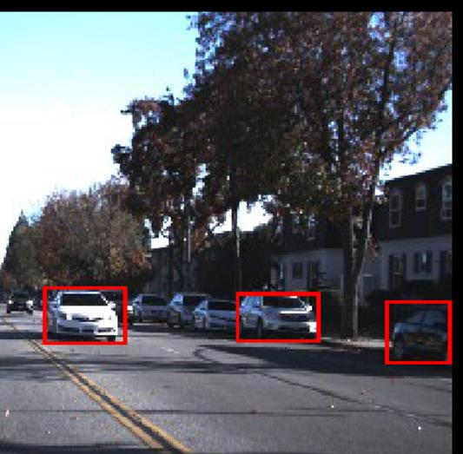
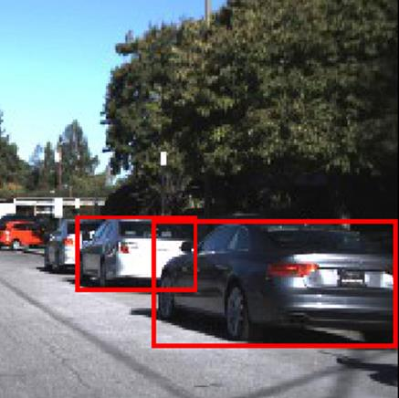

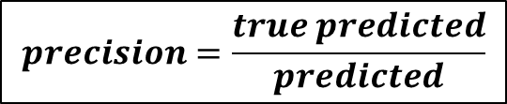

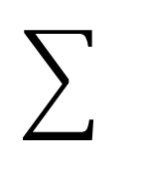
Accuracy evaluation : precision, recall
$$T=0.5$$
getTruePredicted
predicted = 4
ground truth = 3
true predicted = 1
predicted = 1
ground truth = 2
true predicted = 1
$$precision=\frac{true predicted}{predicted}$$
$$recall=\frac{true predicted}{ground truth}$$

Slide 14







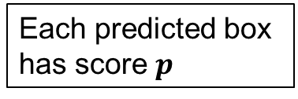

Accuracy evaluation : score$↔$precision, recall
$$↓$$
$$↑$$
sorted box
scores
$$(p_{1},p_{2},…p_{i},…,p_{N−1,} p_{N})$$
$$0.2$$
$$0.3$$
$$0.1$$
$$0.4$$
$$0.4$$
Each predicted box
has score $p$

Slide 15
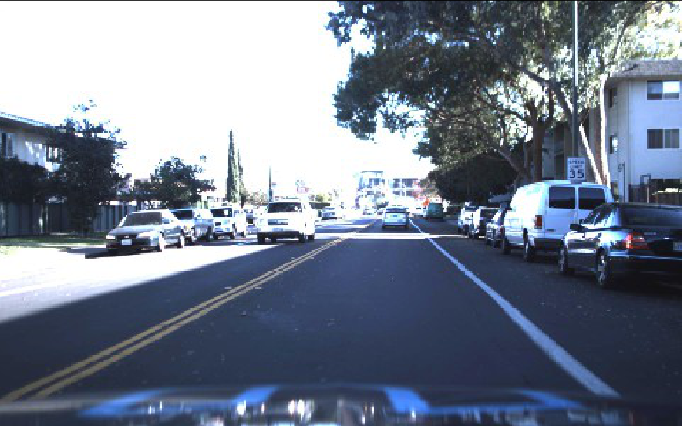

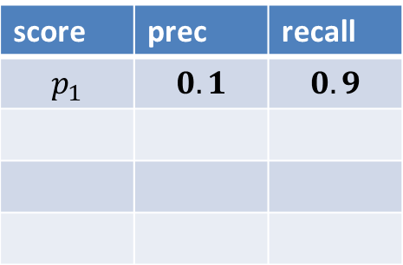



Accuracy evaluation : score$↔$precision, recall
$$↓$$
$$↑$$
sorted box scores
$$(p_{1},p_{2},…p_{i},…,p_{N−1,} p_{N})$$
$I.$Get boxes with $p≥p_{1}$, i.e. all boxes
calcPrecisionRecall
score | prec | recall
$$p_{1}$$ | $$0.1$$ | $$0.9$$
high recall
low precision
For all images together!

Slide 16
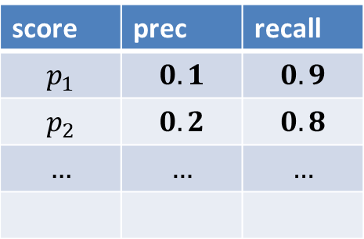
Accuracy evaluation : score$↔$precision, recall
$$↓$$
$$↑$$
sorted box scores
$$(p_{1},p_{2},…p_{i},…,p_{N−1,} p_{N})$$
$I.$Get boxes with $p≥p_{1}$, i.e. all boxes
calcPrecisionRecall
score | prec | recall
$$p_{1}$$ | $$0.1$$ | $$0.9$$
$$p_{2}$$ | $$0.2$$ | $$0.8$$
$$…$$ | $$…$$ | $$…$$
For all images together!

Slide 17
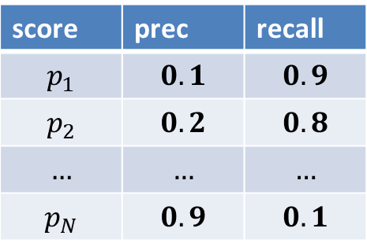
Accuracy evaluation : score$↔$precision, recall
$$↓$$
$$↑$$
sorted box scores
$$(p_{1},p_{2},…p_{i},…,p_{N−1,} p_{N})$$
$I.$Get boxes with $p≥p_{1}$, i.e. all boxes
calcPrecisionRecall
score | prec | recall
$$p_{1}$$ | $$0.1$$ | $$0.9$$
$$p_{2}$$ | $$0.2$$ | $$0.8$$
$$…$$ | $$…$$ | $$…$$
$$p_{N}$$ | $$0.9$$ | $$0.1$$
High precision
For all images together!
low recall

Slide 18
Accuracy evaluation : score$↔$precision, recall
$$↓$$
$$↑$$
sorted box scores
$$(p_{1},p_{2},…p_{i},…,p_{N−1,} p_{N})$$
$I.$Get boxes with $p≥p_{1}$, i.e. all boxes
calcPrecisionRecall
score | prec | recall
$$p_{1}$$ | $$0.1$$ | $$0.9$$
$$p_{2}$$ | $$0.2$$ | $$0.8$$
$$…$$ | $$…$$ | $$…$$
$$p_{N}$$ | $$0.9$$ | $$0.1$$
High precision
get_thr_prec_rec(…)
low recall

Slide 19






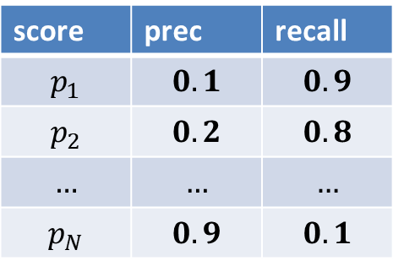

Accuracy evaluation : score$↔$precision, recall
$$T^{IOU}=0.5$$
hundreds of values for
real data sets
$$1$$
score | prec | recall
$$p_{1}$$ | $$0.1$$ | $$0.9$$
$$p_{2}$$ | $$0.2$$ | $$0.8$$
$$…$$ | $$…$$ | $$…$$
$$p_{N}$$ | $$0.9$$ | $$0.1$$
$$precision$$
$$0$$
$$0.3$$
$$1$$
$$recall$$

Slide 20
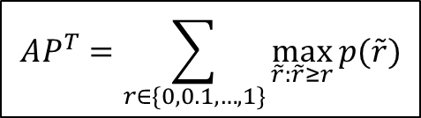
Accuracy evaluation : average precision
$$T^{IOU}=0.5$$
hundreds of values for
real data sets
$$1$$
score | prec | recall
$$p_{1}$$ | $$0.1$$ | $$0.9$$
$$p_{2}$$ | $$0.2$$ | $$0.8$$
$$…$$ | $$…$$ | $$…$$
$$p_{N}$$ | $$0.9$$ | $$0.1$$
$$precision$$
$$0$$
$$0.3$$
$$1$$
$$recall$$
$$AP^{T}=\sum_{r∈\{0,0.1,…,1\}}{\max_{\tilde{r}:\tilde{r}≥r}{p(\tilde{r})}}$$
11 recall thresholds

Slide 21
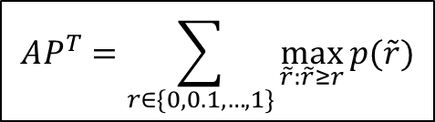

Accuracy evaluation : average precision
$$T^{IOU}=0.5$$
hundreds of values for
real data sets
$$1$$
score | prec | recall
$$p_{1}$$ | $$0.1$$ | $$0.9$$
$$p_{2}$$ | $$0.2$$ | $$0.8$$
$$…$$ | $$…$$ | $$…$$
$$p_{N}$$ | $$0.9$$ | $$0.1$$
$$precision$$
$$0$$
$$0.3$$
$$1$$
$$recall$$
$$\max_{\tilde{r}:\tilde{r}≥0.3}{p(\tilde{r})}$$
A lot of mAP tutorials has
misunderstanding : “area
under curve” (AUC) is not the same!
$$AP^{T}=\sum_{r∈\{0,0.1,…,1\}}{\max_{\tilde{r}:\tilde{r}≥r}{p(\tilde{r})}}$$
11 recall thresholds

Slide 22

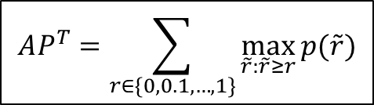
Accuracy evaluation : average precision
$$T^{IOU}=0.5$$
hundreds of values for
real data sets
$$1$$
score | prec | recall
$$p_{1}$$ | $$0.1$$ | $$0.9$$
$$p_{2}$$ | $$0.2$$ | $$0.8$$
$$…$$ | $$…$$ | $$…$$
$$p_{N}$$ | $$0.9$$ | $$0.1$$
$$precision$$
$$0$$
$$0.3$$
$$1$$
$$recall$$
$$AP^{T}=\sum_{r∈\{0,0.1,…,1\}}{\max_{\tilde{r}:\tilde{r}≥r}{p(\tilde{r})}}$$
$$Pascal VOC metric is AP^{0.5}$$

Slide 23
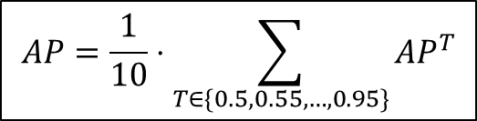
Accuracy evaluation : average precision
$$T^{IOU}=0.5$$
hundreds of values for
real data sets
$$1$$
score | prec | recall
$$p_{1}$$ | $$0.1$$ | $$0.9$$
$$p_{2}$$ | $$0.2$$ | $$0.8$$
$$…$$ | $$…$$ | $$…$$
$$p_{N}$$ | $$0.9$$ | $$0.1$$
$$precision$$
$$0$$
$$0.3$$
$$1$$
$$recall$$
$$AP=\frac{1}{10}⋅\sum_{T∈\{0.5,0.55,…,0.95\}}{AP^{T}}$$
$$MS COCO has metrics AP^{0.5}, AP^{0.75},AP$$

Slide 24


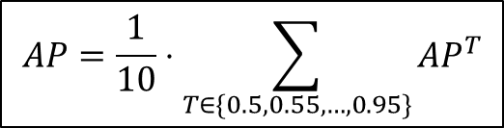







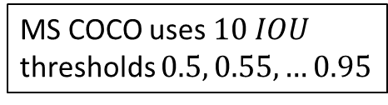


Accuracy evaluation : average precision
$$AP=\frac{1}{10}⋅\sum_{T∈\{0.5,0.55,…,0.95\}}{AP^{T}}$$
MS COCO uses $10 IOU$
thresholds $0.5, 0.55, …0.95$
$$1$$
$$T^{IOU}=0.5$$
$$T^{IOU}=0.6$$
$$T^{IOU}=0.7$$
$$precision$$
$$T^{IOU}=0.8$$
$$T^{IOU}=0.9$$
$$0$$
$$0.3$$
$$1$$
$$recall$$

