Slide 1
If you want to code along with tonight’s R presentation
Download and install R from https://cran.r-project.org/
Download and install RStudio from https://www.rstudio.com/
Open RStudio and run install.packages(”tidyverse”) to install the tidyverse packages
Download or clone files from: https://github.com/olofgarpinger/hands_on_data_science
Make sure the files are in the same folder
Note that the presentation slides are available there too
Navigate to the downloaded files and open the .Rproj file
In RStudio, open file ”getting_started_with_R.R”

Slide 2
Getting started with R Hands on Data Science
Olof Rännbäck-Garpinger
Notes:
Both R and Python have their advantages, knowing which helps a Data Scientist choosing the optimal tool for each task. Today I’ll go through parts of the tidyverse.

Slide 3

About R
Language and environment for statistical computing and graphics
Roughly 20 years old
Free
Download from: https://cran.r-project.org/
Most often used together with the RStudio IDE
Download from: https://www.rstudio.com/
Large number of packages
Statistics, Machine Learning, Visualization, Data Manipulation, etc.
Very popular among Data Scientists
Much thanks to…

Slide 4
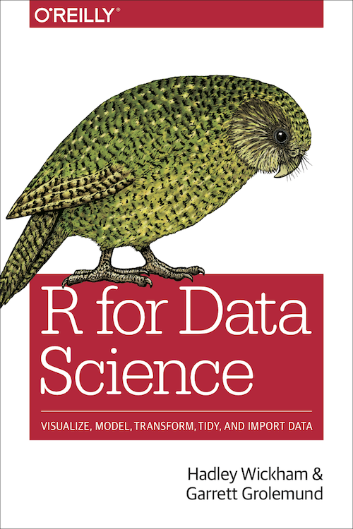
The Tidyverse
A collection of R packages for Data Science sharing the same philosophy
A modern take on many original R functions for:
Reading rectangular data (readr)
Data frames: (tibble)
Data manipulation: (dplyr)
Visualizations: (ggplot2)
Data tidying: (tidyr)
Iteration: (purrr)
Modeling: (modelr)
etc…
Pedagogically explained in ”R For Data Science”
Free e-book at http://r4ds.had.co.nz/
R for Data Science by H. Wickham and G. Grolemund
is licensed under CC BY-NC-ND 3.0 US.

Slide 5

Data
Airbnb data from Kaggle

