Slide 1
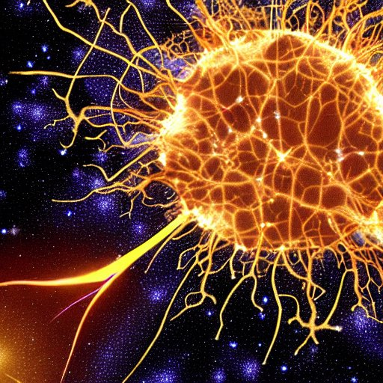
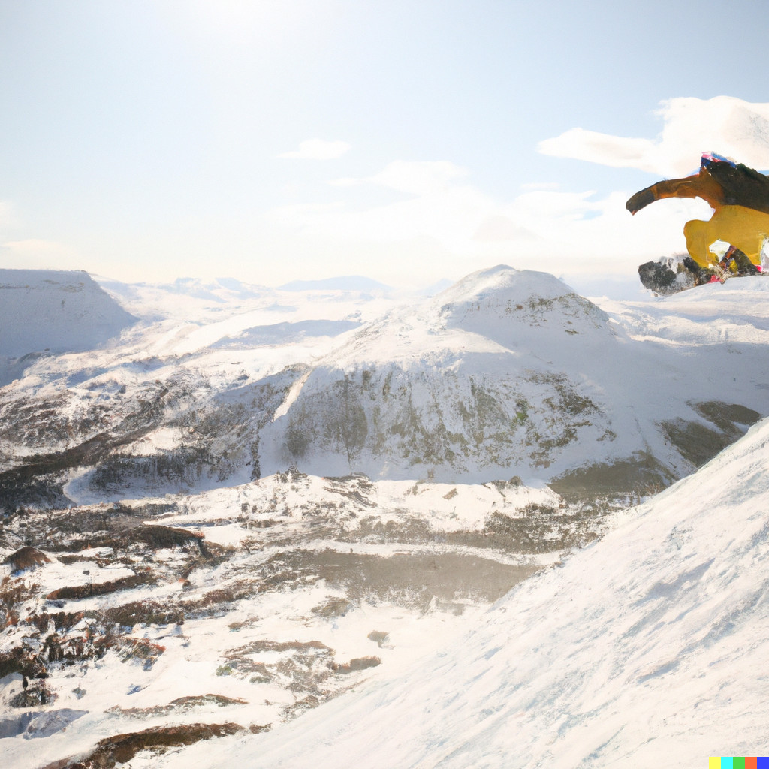
Test doc
* layout: center * Three images * And the final bullet

Slide 2
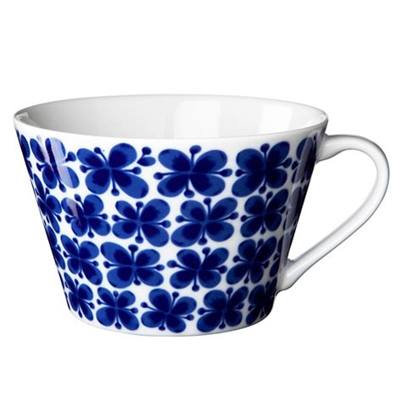
Image left
* layout: image_left_half * packed_images: true * And the final bullet

Slide 3
Image left small
* layout: image_left_small * Another bullet * And the final bullet

Slide 4
Image right
* One bullet * Another bullet * And the final bullet

Slide 5
Image right small
* One bullet * Another bullet * And the final bullet

Slide 6
Center again, not cropping
* One bullet * Another bullet * And the final bullet

Slide 7
Image center
* Default cropping * Another bullet * And the final bullet

Slide 8
Image fill
* The image_fill layout puts image as background, with or without text. * Another bullet: $a = \frac{b}{c}$ * And the final bullet

Slide 9
Black slide
* Only bullet

Slide 10
Latex and formatting
A bit __of italic__ $a = \frac{b}{c}$ And **a bold thing**, too. Testing [linking \(mogren.one\)](http://mogren.one/), too. A text, following with a $\frac{formula}{divisor}$

Slide 11
Some more strangeness
$a = \left(\frac{\frac{\sum_i^N X_i^2}{y}}{c}\right)$ * [Link to page 1](#Test doc)

Slide 12
Another formula
* A small one $a = b * c$ this time. -------------------------- * Another bullet

Slide 13
Two column layout
* First bullet * Second bullet
* Third bullet * Fourth bullet

Slide 14
Three column layout
* First bullet * Second bullet
* Third bullet * Fourth bullet
* Fifth bullet * Sixth bullet

Slide 15
Thank you

Slide 16
Writing a lot of cool things in a box. Maths: $\mathbf{x} = \sum_{i=0}^N x_i$
We can fill a page with boxes.
Level four headlines
create boxes
&nbsp;
**Really fill.**

Slide 17
And a page can overflow
* But * Then * The * OVerflow * Will * Not * Fit * On * The * Page * Overflow line 1 * Overflow line 2 * Overflow line 3 * Overflow line 4

Slide 18
Images side-by-side
&nbsp;

Slide 19
&nbsp; [Thank you!](#Latex and formatting)

