Slide 1
AN ENTERPRISE ARCHITECTURE FOR THE AGENTIC ERA
AIDEX
An Architecture for Human-Curated,
AI-Enabled Knowledge Work
James D. Longmire
Northrop Grumman Fellow · Chief Architect, Digital Ecosystems
Independent research · ORCID 0009-0009-1383-7698
2026

Slide 2
01 · THE STRATEGIC CLAIM
Three transitions are happening at once.
01
02
03
Workforce
Substrate
Accountability
Senior engineers retiring faster than they can be replaced. Mid-career talent recruited across boundaries. Early-career hires entering programs whose context took fifteen years to absorb.
The tools available to the individual knowledge worker in 2026 differ in kind, not in degree. Agentic execution, queryable synthesis, orchestrated workflow. The shape of work has changed.
Consumer-grade AI does not solve accountability. The defense enterprise that builds substrate without enforced human accountability has deployed a system the institution cannot govern.
The enterprise that deploys deliberately gets the strategic position.
AIDEX / AEON · J. Longmire
2 / 13

Slide 3
02 · THE COORDINATED PICTURE
Four terms that work together.
AEON
Enterprise control plane. Identity, authority, policy, evidence, integration, capability composition.
AI Enterprise Orchestration Nexus
AIDEX
Worker-facing subdomain within AEON. The substrate on which the knowledge worker operates.
AI Digital Experience
HCAE
The discipline AIDEX expresses. Practitioner curates AI-enabled output, remains the locus of judgment and accountability.
Human-Curated, AI-Enabled practice
The Practitioner
The human protagonist. HCAE practitioner operating on AIDEX under AEON orchestration.
Next-generation knowledge worker
AIDEX / AEON · J. Longmire
3 / 13

Slide 4
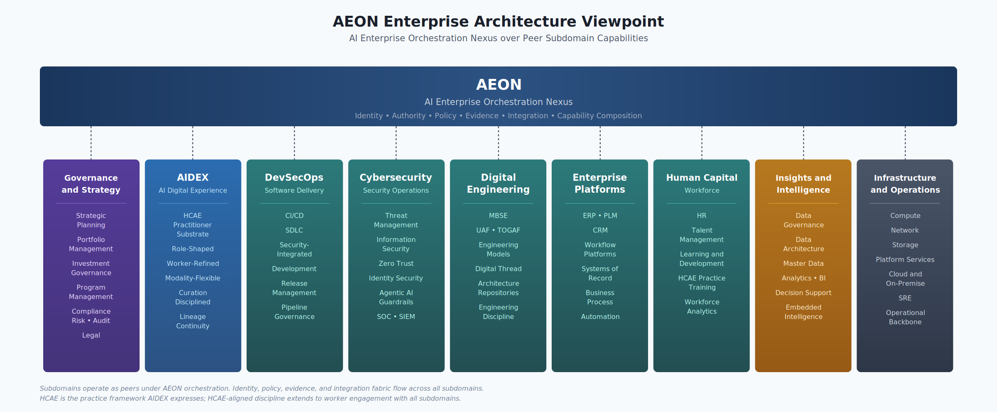
03 · THE AEON ARCHITECTURE
Nine peer subdomains under one control plane.
AIDEX is one peer subdomain among nine. AEON orchestrates capability composition across all of them.
AIDEX / AEON · J. Longmire
4 / 13

Slide 5
04 · THE FRAMEWORK
HCAE is the discipline. The order matters.
Risk-tiered curation
Human-curated first. Curation is the act that anchors accountability.
Curation discipline applied at the right level for the consequence of the action.
PER-ACTION
AI-enabled second. Enablement is the function of the substrate.
High-consequence actions. Explicit confirmation captured on each.
BATCH
Medium-consequence. Worker confirms grouped actions at end of unit of work.
The practitioner is the principal. The substrate is the instrument. Reversing the order produces a different framework.
SAMPLED AUDIT
Low-consequence routine. Audit sampling at the evidence plane.
AIDEX / AEON · J. Longmire
5 / 13

Slide 6
05 · THE SUBDOMAIN
What AIDEX does for the practitioner.
Role-shaped
Worker-refined
The substrate is configured for the specific role the practitioner occupies. Architect, engineer, program manager, analyst. Different roles see different capabilities, different defaults, different policies.
The practitioner shapes her own substrate over time. Memory layer is worker-owned. Personalization compounds with tenure.
Modality-flexible
Curation-disciplined
Text, voice, ambient, programmatic. The substrate participates across surfaces while preserving identity, authority, and lineage continuity.
Propose-and-confirm posture at every consequential action. Captured curation becomes part of the evidence chain AEON aggregates.
Eight axes (presentation, persona, role, authority, context, memory, modality, lineage) vary independently. Detail follows.
AIDEX / AEON · J. Longmire
6 / 13

Slide 7
06 · THE MODULARITY MODEL
Eight axes vary independently.
01
02
03
04
Presentation
Persona
Role
Authority
Named entity, voice, visual presence. Worker-selectable where appropriate.
Communication register and pattern. Configured by deployment.
Functional taxonomy that shapes available capabilities.
AEON-evaluated policy on identity-resolved attributes.
05
06
07
08
Context
Memory
Modality
Lineage
Program, project, and situational scope of the work.
Worker-owned personalization. Opt-in, attributed, revocable.
Text, voice, ambient, programmatic. Identity continuous across.
Attributed contribution to institutional practice over tenure.
AIDEX / AEON · J. Longmire
7 / 13

Slide 8
07 · THE CONTROL PLANE
AEON provides. AIDEX consumes.
AIDEX does not maintain its own user store, policy engine, audit infrastructure, or vendor governance. AEON provides these as enterprise services.
Identity
Authority
Policy
Authenticated principal across classification environments. Federation that AIDEX inherits.
Policy evaluation on identity-resolved attributes at moment of action.
Decomposition from enterprise scope into subdomain-specific enforcement.
Evidence
Integration
Composition
Aggregation of subdomain activity into enterprise audit picture.
Cross-subdomain workflow orchestration. AIDEX agents participate.
Capability lifecycle. What can be combined, by whom, for what purpose.
AIDEX / AEON · J. Longmire
8 / 13

Slide 9
08 · DEPLOYED REFERENCE ARCHITECTURE
Claude Cowork shows the productivity layer is real.
Released January 2026 (research preview), GA April 2026. The interaction substrate is configurable, not developable. The remaining work concentrates in AEON integration, role packaging, classification topology, and lineage.
WHAT COWORK DEMONSTRATES
WHERE IT FALLS SHORT ON HCAE
Agentic interaction at scale, deployable today
Plugin architecture for role-specific capability
Enterprise governance posture sufficient for many contexts
Multi-modality across desktop and ambient surfaces
Memory layer that personalizes over time
No deep AEON IDAM binding or delegation chain enforcement
Memory not yet a long-arc role-shaped accumulation
No lineage layer for attributed institutional contribution
Partial classification deployment story
Vendor-coupled; substrate portability requires architectural work
AIDEX / AEON · J. Longmire
9 / 13

Slide 10
09 · DEPLOYMENT TOPOLOGY
Multi-backend by design.
The conventional cloud-versus-on-prem framing is wrong. The real picture has four topologies mapped to different classification environments. AIDEX supports all four simultaneously.
Commercial Cloud
GovCloud
UNCLASSIFIED
CUI / FedRAMP HIGH
Frontier-class capability. Vendor-hosted. Suitable for non-sensitive enterprise work.
Frontier capability within accredited boundaries. The mainstream defense deployment target.
On-Premises Open-Weight
On-Premises Commercial
NOFORN / RESTRICTED
EMERGING
Llama-class models inside the boundary. Capability gap acknowledged. Air-gap compatible.
Vendor models behind enterprise control. Currently rare; trajectory worth tracking.
AIDEX / AEON · J. Longmire
10 / 13

Slide 11
10 · THE STRATEGIC POSITION
The accountability frontier.
Consumer-grade AI has not had to solve accountability. The consumer market does not require it. The defense enterprise that deploys substrate without enforced human accountability has deployed a system the institution cannot govern.
01
02
03
Consumer-grade alternatives are not building here.
The defense enterprise needs this regardless of AI vendor strategy.
Early HCAE-aligned deployment compounds the institutional advantage.
AIDEX / AEON · J. Longmire
11 / 13

Slide 12
11 · PARTNERSHIP REQUIREMENTS
This is not just an IT program.
Enterprise IT leads. Success depends on partnership across the institution.
HR
Worker-ownership and consent commitments. Employment, IP, and separation processes that operationalize HCAE practitioner rights.
Chief Learning Officer
HCAE practice training. Curation discipline development. Workforce capability building for the agentic substrate.
Program Leadership
Deployment selection and operational integration. The substrate has to fit how programs actually run.
Information Security
AEON control plane integration. Identity federation across classification environments. Cryptographic delegation chains.
Legal
Contractual and policy infrastructure for worker contributions, revocation rights, records retention, and accountability allocation.
AIDEX / AEON · J. Longmire
12 / 13

Slide 13
12 · THE DECISION
What we are asking.
Sanction a pilot.
TARGET ROLE
One well-defined role with clear curation expectations.
TARGET PROGRAM
One program with engaged leadership and tractable systems of record.
TARGET TOPOLOGY
Whichever classification environment matches the program.
PARTNERSHIPS
HR, CLO, Information Security, Legal aligned before deployment.
INSTRUMENTATION
Metrics defined that can falsify the strategic argument, not just confirm it.
The workforce transition is happening on its own timeline. The question is whether the enterprise faces it with the framework, the subdomain, and the control plane, or without them.
AIDEX / AEON · J. Longmire
13 / 13

