Slide 1
ARCHITECTURE · ENTERPRISE IT · AGENTIC ERA
AIDEX
An Architecture for Human-Curated,
AI-Enabled Knowledge Work
James D. Longmire
Northrop Grumman Fellow · Chief Architect, Digital Ecosystems
Independent research. Does not represent any employer or program.

Slide 2
01
The Strategic Claim
The defense industrial base is in a workforce transition,
and the substrate of knowledge work is changing at the same time.
01
02
03
Workforce transition is real
The substrate has changed
Accountability is the frontier
Senior engineers retire faster than they can be replaced. Mid-career talent moves. Early-career hires inherit institutional context that took fifteen years to absorb.
Agentic capabilities, synthesis, and collaboration substrates compress what was assembly, research, and coordination. The shape of knowledge work is different now.
Consumer-grade alternatives are not building for accountability. Enterprises that deploy HCAE-aligned substrate deliberately position at a frontier competitors have not reached.
The decision is whether to face this transition with a framework, a subdomain, and a control plane, or without them.
AIDEX · AI Digital Experience under AEON
2 / 13

Slide 3
02
Three Terms, One Architecture
FRAMEWORK
The practice discipline. The human practitioner curates AI-enabled output, remains the locus of judgment and accountability, and contributes to institutional practice as an attributed and consenting participant.
HCAE
Human-Curated, AI-Enabled
SUBDOMAIN
The worker-facing substrate. The architecture that expresses HCAE operationally at the digital experience layer. One of nine peer subdomains under AEON.
AIDEX
AI Digital Experience
CONTROL PLANE
The enterprise control plane for the agentic era. Identity, authority, policy, evidence, integration, and capability composition across all subdomains.
AEON
AI Enterprise Orchestration Nexus
The next-generation knowledge worker is the HCAE practitioner operating on the AIDEX substrate under AEON orchestration.
AIDEX · AI Digital Experience under AEON
3 / 13

Slide 4
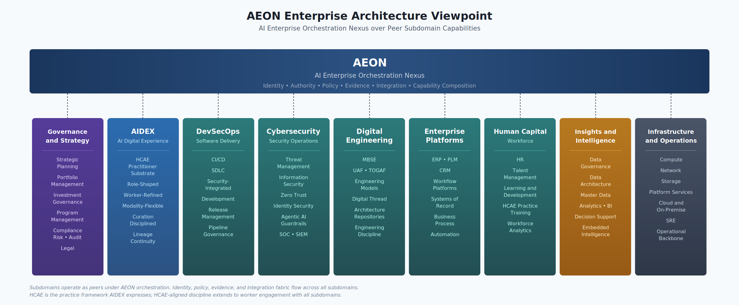
03
Where AIDEX Sits
AEON orchestrates nine peer subdomains. AIDEX is the worker-facing AI digital experience.
AIDEX · AI Digital Experience under AEON
4 / 13

Slide 5
04
HCAE: The Practice Framework
Curation, not approval
Human-
Curated,
AI-Enabled.
The practitioner engages continuously with substrate output throughout the work. She selects, attributes, revises, and signs. The signature certifies her curation.
Risk-tiered curation
Per-action confirmation for consequential work. Batch confirmation for routine work. Sampled audit for low-stakes work. The tier in effect is captured in the audit trail.
The order is not cosmetic.
Human-curated comes first because curation anchors accountability. AI-enabled comes second because enablement is the function of the substrate.
Accountability is architectural
Not a policy commitment. Every consequential action traces to a human principal through a cryptographically verifiable chain. The substrate enforces it; AEON provides the fabric.
AIDEX · AI Digital Experience under AEON
5 / 13

Slide 6
05
AIDEX: The Worker-Facing Substrate
What AIDEX does for the practitioner, expressed as the propose-and-confirm posture under HCAE discipline.
WHAT AIDEX PROVIDES
WHAT HCAE PRESERVES
Role-shaped substrate
Judgment
Configured to the worker's actual role, not a generic chat surface
The practitioner remains the locus of professional judgment, not the substrate
Modality-flexible interaction
Accountability
Chat, voice, document, agentic execution across the same session
Actions trace to a human principal who authorized them, not to a dissolving system
Propose-and-confirm posture
Professional standing
Consequential actions surface as proposals; curation is captured at the moment
The worker's signature certifies her curation, not the substrate's production
Worker-owned memory
Institutional discipline
Personalization to the practitioner over time, under her control and consent
Curation tier is recorded; the institution can verify what discipline applied
Lineage continuity
Attribution
Attributed contribution to her role's accumulated practice across tenure boundaries
Contributions to lineage carry the contributor's identity as an attestation
Cross-modality state
Consent
Context carries between surfaces without forcing the worker to reassemble it
Memory and lineage are opt-in, worker-controlled, and revocable within retention limits
AIDEX · AI Digital Experience under AEON
6 / 13

Slide 7
06
The Modularity Model
Eight independently varying axes. Reconfiguration along one axis does not disturb the others, a precondition for maintainability over defense program timescales.
1
2
3
4
Presentation
Persona
Role
Authority
Voice, self-reference, visual identity
Behavioral character, register, posture
Role-specific knowledge, tools, workflows
Policy that AEON evaluates per action
5
6
7
8
Context
Memory
Modality
Lineage
Working state across modality surfaces
Worker-owned, opt-in personalization
Chat, voice, document, agentic execution
Attributed contribution across tenure
AIDEX · AI Digital Experience under AEON
7 / 13

Slide 8
07
AEON: The Enterprise Control Plane
AIDEX consumes AEON services. AEON specifies them as enterprise-wide planes.
Identity
Authority
Policy
IDAM federation, CAC/PIV, cross-classification continuity
Per-action policy decisions on identity-resolved attributes
Decomposition from enterprise scope into subdomain enforcement
Evidence
Integration
Capability
Aggregated audit picture across all subdomains, cryptographically chained
Cross-subdomain workflow composition under principal delegation
Lifecycle, composition, and governance of agentic capabilities
AIDEX does not maintain its own user store, its own policy engine, its own audit infrastructure, or its own vendor governance. AEON provides these as services that AIDEX consumes.
AIDEX · AI Digital Experience under AEON
8 / 13

Slide 9
08
Cowork as Deployed Reference Architecture
Claude Cowork (Anthropic, GA April 2026) is the working reference for the productivity layer. AIDEX is not Cowork, but the concept can be developed against a deployed baseline rather than against speculation.
What Cowork Demonstrates
Where Cowork Falls Short on HCAE
The Migration Path
Sandboxed VM, MCP integration, plugin architecture
No deep IDAM binding to enterprise identity
Phase 1: deploy Cowork-class baseline
Enterprise governance posture and audit hooks
No long-arc worker-owned memory layer
Phase 2: AEON control plane integration
1M context, multi-modal interaction
No attributed lineage continuity
Phase 3: role packaging and SoR integration
Outcome-oriented agentic execution at scale
Partial classification deployment story
Phase 4-6: memory, lineage, multi-backend
Substrate portability is an architectural commitment. The next generation will be different; the architecture has to survive the transition.
AIDEX · AI Digital Experience under AEON
9 / 13

Slide 10
09
Multi-Backend Deployment Topology
AIDEX supports multiple model backends simultaneously, mapped to classification environments. Not a binary cloud-vs-on-premises choice.
UNCLASSIFIED
CUI / FEDRAMP HIGH
Commercial Cloud
GovCloud Commercial
Frontier commercial models. Highest capability. Strategic and administrative work outside controlled environments.
Same vendor models in compliant clouds. Capability-comparable to commercial. Controlled unclassified work under federal compliance.
NOFORN / AIR-GAPPED
ENCLAVED / CLASSIFIED
On-Prem Open-Weight
On-Prem Commercial
Llama-class open-weight in customer-controlled environments. Capability gap real but narrowing. Western defense default.
Vendor-licensed commercial models deployed in enclaves. Where available; vendor and program-specific arrangement.
Workers experience identity continuity across environments. AEON's identity plane federates; AIDEX presents a coherent substrate.
AIDEX · AI Digital Experience under AEON
10 / 13

Slide 11
10
The Accountability Frontier
Consumer-grade alternatives are not building for accountability.
The consumer market does not require it.
The defense enterprise that deploys substrate without HCAE-aligned accountability is deploying a system that may produce outputs the institution cannot govern.
Workforce continuity
Decision quality
Positional advantage
Lineage compounds across tenure; institutional knowledge stops evaporating at retirement
Curation discipline raises the floor on what reaches signed work
Built infrastructure competitors have not built and the consumer market is not building
AIDEX · AI Digital Experience under AEON
11 / 13

Slide 12
11
What This Asks of the Enterprise
Enterprise IT leadership is the natural owner. Success depends on partnership across the institution.
OWNER
WORKER OWNERSHIP
PRACTICE
DEPLOYMENT
Enterprise IT
Human Resources
Chief Learning Officer
Program Leadership
WHAT'S ASKED
WHAT'S ASKED
WHAT'S ASKED
WHAT'S ASKED
AEON control plane integration
Memory and lineage consent framework
HCAE practice training program
Pilot role and program selection
Multi-backend deployment topology
Contribution attribution policy
Curation discipline as professional skill
Systems of record integration scope
AIDEX substrate package and lifecycle
Worker contribution revocation rights
Role-based practitioner certification
Operational metrics and validation
AIDEX · AI Digital Experience under AEON
12 / 13

Slide 13
12
Decision Frame
The next step is a deployment design.
01
Select a target role and a target program
02
Configure the backend topology for that program's classification environment
03
Integrate AIDEX with AEON's control plane
04
Establish HCAE training and worker-ownership commitments in policy and contract
05
Instrument metrics that validate (or falsify) the strategic argument
06
Test the modularity model against actual practice
The workforce transition is happening on its own timeline.
The question is whether to face it with the framework, the subdomain, and the control plane, or without them.
AIDEX · AI Digital Experience under AEON
13 / 13

