Slide 1
THE ENTERPRISE AGENTIC
PLATFORM ARCHITECTURE
Control, Runtime, Experience, and Capability Planes for Governed AI Adoption
James D. Longmire
Northrop Grumman Fellow · Chief Architect, Digital Ecosystems
Independent research · May 2026
Notes:
Umbrella strategy paper condensed to a decision deck. The argument in three moves: the threat (ungoverned composition is happening now), the differentiation (enterprise ownership plus four-plane holism, with a capability asymmetry no vendor can match), and the decision (fund Level 1 plus a discovery, not a full transformation). Addressed first to defense and regulated enterprises.

Slide 2
THE QUESTION ON THE TABLE
The decision is not whether to adopt agentic AI.
That is already happening on its own momentum.
The decision is whether the enterprise governs how that capability composes, or accepts whatever composition emerges by default.
Individual agentic products work. What fails is the enterprise's ability to govern how they compose: identity does not flow from one agent to the next, authorization is enforced inconsistently, evidence scatters across logs that do not correlate.
The Enterprise Agentic Platform Architecture
2
Notes:
Reframe away from tools. Every CIO is being asked 'which agent platform' — wrong question. The accountability that used to live in the human at the keyboard dissolves into a system never designed to hold it. The real decision is architectural: deliberate governed composition, or accidental vendor-shaped composition.

Slide 3
THE THREAT
When the human leaves the keyboard, accountability leaves with it
UNGOVERNED
GOVERNED
A copilot adjusts a financial record under whatever credentials it inherited.
An auditor asks: who authorized this, and under what policy?
The answer is reconstructed by hand across disconnected logs. Often inconclusively.
Identity binds the action to the human principal who invoked it.
Authority evaluates whether that principal may act, and routes for confirmation if consequential.
Evidence records principal, decision, and result in one correlated chain.
The audit question is answered definitively. The mis-authorized action is caught before it happens.
The Enterprise Agentic Platform Architecture
3
Notes:
Same copilot, same usefulness. The only difference is whether the accountability primitives are present when it acts. This is the entire case for governing composition, made concrete on a single ordinary transaction. Hold this image; it's what Level 1 buys.

Slide 4
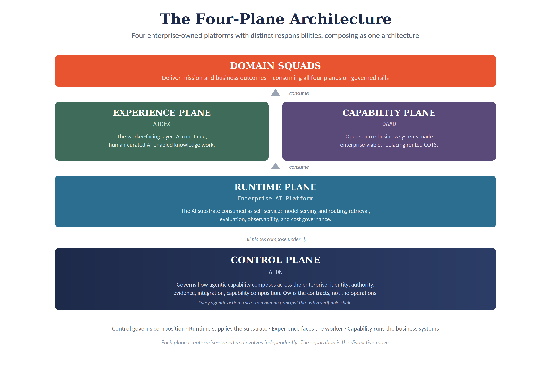
THE ARCHITECTURE
Four planes, enterprise-owned, each with a distinct responsibility
The Enterprise Agentic Platform Architecture
4
Notes:
Control governs how capability composes (AEON). Runtime supplies the AI substrate. Experience makes AI-enabled work accountable for the worker (AIDEX). Capability lets the enterprise own its business systems rather than rent them (OAAD). Domain squads consume all four. The distinctive move is the separation: most vendors collapse two or more into one rented platform, and that collapse is where lock-in lives.

Slide 5
COMPETITIVE REALITY · MAY 2026 SNAPSHOT
The market just proved us right about the what. It is dodging the who.
CONSENSUS NOW
Google Cloud Next and SAP Sapphire both repositioned around an agentic control plane — agent identity, registry, governance, observability as core capabilities. Tier-one analysts now frame the buyer's decision as an operating-model choice, not a tooling choice.
THE QUESTION THEY WON'T ANSWER
Every vendor control plane is one you rent. The center is the vendor's platform. None argues the control plane should be enterprise-owned, because none has the incentive to.
This convergence makes the control-plane problem consensus. It does not make enterprise ownership consensus. That gap is where this architecture lives.
Sources: Google Cloud Blog (Apr 2026); SAP News Center (May 2026); Bain & Company (Apr 2026). May 2026 snapshot.
The Enterprise Agentic Platform Architecture
5
Notes:
Concede the control plane openly — claiming we invented it gets us dismissed by anyone who reads Bain. Riding a validated wave is stronger than claiming a lonely insight. Sources: Google Cloud Blog and SAP News Center (primary vendor announcements), Bain (analyst). The differentiation is ownership and holism, not novelty.

Slide 6
WHAT SURVIVES THE CONSENSUS
Two differentiators the vendor convergence cannot erase
01
02
Ownership
Four-plane holism
A rented control plane is an exit you do not control.
For an enterprise whose sovereignty or regulatory posture makes vendor governance over its own operations unacceptable, ownership is the whole question — and the market left it unanswered.
The landscape has pieces. It has nothing that composes all four as one owned architecture.
And it has nothing resembling the capability plane — because no business-system vendor can sell the displacement of its own business.
The Enterprise Agentic Platform Architecture
6
Notes:
Ownership is contested but real. Holism is genuinely uncommon, and one piece of it — the capability plane — is structurally impossible for any incumbent to offer. That second point is the strongest single claim in the deck and gets its own slide next.

Slide 7
THE ASYMMETRY
No business-system vendor can sell you the path off itself.
SAP cannot sell an enterprise the path off SAP. Salesforce cannot sell the path off Salesforce. The incumbents are doing the opposite: using the agentic transition to tighten the cage.
SAP, 2026 API policy
SAP CEO, investor call
Forrester, May 2026
Third-party agents reach SAP data only through SAP-mediated agents, on a protocol SAP defines, governs, and meters.
Reserves the right to throttle high-volume agent traffic; calls SAP's domain knowledge “a great asset to protect.”
Characterized the move as an attempt to become “the gatekeeper of enterprise AI.”
Only the enterprise has the incentive to own the capability layer. That makes it the one differentiator that will not erode as the market matures.
Sources: C. Klein (SAP CEO) investor call via The Register (Apr 2026); SAP 2026 API policy; Forrester (May 2026). Salesforce and ServiceNow have not imposed equivalent hard restrictions.
The Enterprise Agentic Platform Architecture
7
Notes:
This is the un-copyable moat. Note the discipline: the hard-perimeter move is specifically SAP's; Salesforce and ServiceNow steer more quietly. Don't overclaim a uniform pattern. The boundary (next slide's model) keeps this from reading as reckless ERP replacement.

Slide 8
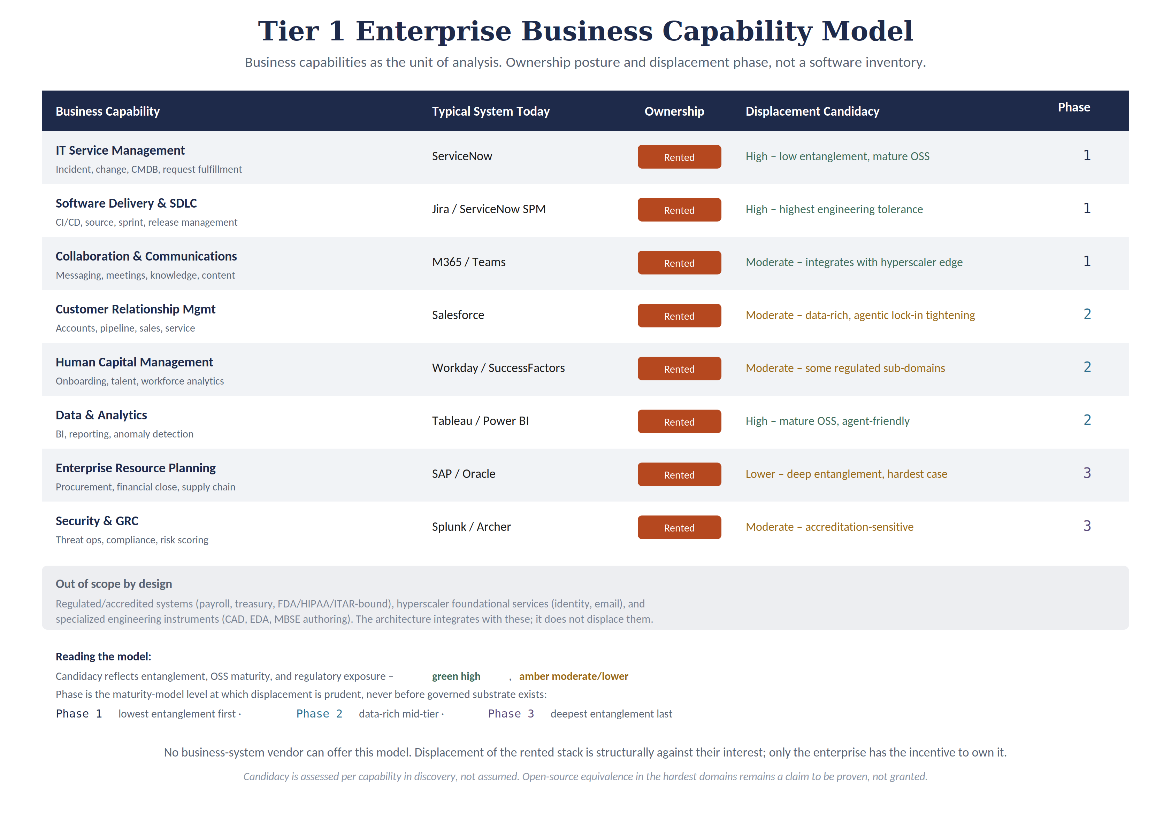
CAPABILITY MODEL
Capabilities as the unit of analysis, not a list of tools
The Enterprise Agentic Platform Architecture
8
Notes:
This is the EA-rigorous artifact that turns advocacy into architecture. Rows are business capabilities; columns are ownership and displacement phase. Sequenced by entanglement: software delivery and ITSM first, ERP and regulated security last. Boundary is explicit: regulated cores, hyperscaler foundational services, and specialized instruments are integrated, not displaced. Nothing here is early ERP replacement.

Slide 9
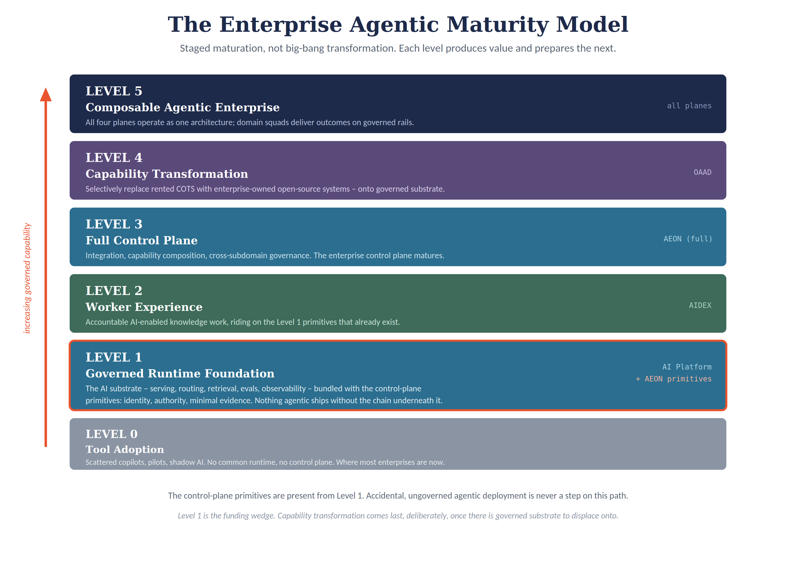
THE PATH
A staged path, not a four-platform megaproject
THE LEVEL 1 RULE
No production agentic capability without identity binding, authority decisioning, and evidence capture.
Ungoverned agentic deployment is never a step on the path. Each level produces value on its own and prepares the next.
The Enterprise Agentic Platform Architecture
9
Notes:
The funding wedge is Level 1: governed runtime plus control-plane primitives, bundled. The most important design decision in the whole model, promoted to a named rule. The enterprise can stop at any level and keep the value below it. Capability transformation (Level 4) comes last, deliberately.

Slide 10
WHAT CHANGES FOR ENTERPRISE IT
From integrating rented intelligence to owning it
YESTERDAY
THE AGENTIC ERA
COTS management & integration
Unit of work: the vendor seam
Core skill: procurement & integration
Intelligence accrues to: the vendor
AI-enabled platform lifecycle ownership
Unit of work: the owned platform
Core skill: platform engineering & governance
Intelligence accrues to: the enterprise
→
“Rented intelligence” is the operational learning, every refined workflow and handled edge case, that today accrues inside the vendor's platform rather than the enterprise's. A shift in the center of gravity, not a total replacement: vendor management persists as a supporting activity; platform lifecycle ownership becomes the defining one.
The Enterprise Agentic Platform Architecture
10
Notes:
Three things move at once — unit of work, core skill, where intelligence accrues — which is why this is an identity change, not a task change. The line that travels: Enterprise IT stops being the integrator of rented intelligence and becomes the lifecycle owner of its own.

Slide 11
HONEST BOUNDARIES
This is not a universal prescription
BUILD & OWN WHEN
RENT INSTEAD WHEN
Classified or mission systems
Regimes requiring first-party auditability of all agentic operations
Sovereignty exposure that makes vendor governance unacceptable
Low regulatory and sovereignty exposure
Time-to-first-capability matters more than ownership
Cannot sustain the multi-year horizon or senior-talent commitment
Either way: do not pass through a stage of ungoverned agentic capability. The primitives belong in place before agents act, whoever owns the platform underneath.
The Enterprise Agentic Platform Architecture
11
Notes:
Stating the boundary protects credibility. For a commercial enterprise without these pressures, a vendor control plane may be the rational choice — say so. The architecture's case is strongest exactly where defense and regulated pressures are highest. This honesty is what makes the rest believable.

Slide 12
EYES OPEN
The risks, named rather than buried
OSS-equivalence is the softest link
The cost of separation is real and recurring
Mature open-source alternatives exist for nearly every domain; enterprise-equivalence under real load in the hardest domains is a claim to prove in discovery, not grant.
Four-plane separation internalizes integration work a single vendor would absorb. It is the price of ownership and governability — paid knowingly.
The build-vs-rent bar has risen
The moat deserves the same scrutiny as the vendor critique
Six months ago an owned control plane competed against nothing comparable. Today it competes against polished vendor control planes shipping now.
Owned institutional intelligence is a strong argument against the rental model; whether it is a defensible moat warrants the same standard of evidence.
None of these is disqualifying. Each is a reason to proceed deliberately, to stage the commitment, and to keep the falsifiable claims under genuine test.
The Enterprise Agentic Platform Architecture
12
Notes:
A strategy that hides its weak points does the reader a disservice. The OSS-equivalence claim is the one to watch and is hedged everywhere in the paper. Naming the risks plainly is what earns trust for the rest of the argument.

Slide 13
THE DECISION
Fund Level 1 and a short discovery. Not the full transformation.
COMMIT NOW
PRE-COMMIT FOR LATER
Fund the governed runtime
AI substrate plus identity, authority, evidence. Target: governed deployments with a complete evidence chain in 6–12 months.
Authorize a focused discovery
Replace directional targets with the enterprise's own numbers, in weeks.
Architect governance first
Primitives and contracts before any agent acts in production.
Contingent on discovery and Level 1 results
The institutional function and the multi-year horizon
Central architecture authority, investment tolerance, senior talent.
Test the commitment honestly in discovery, not in full today. An enterprise that cannot meet the preconditions should stop at the value Level 1 delivers.
The first step is modest and self-justifying. The sequence after it is clear and conditional. The decision is whether to begin.
The Enterprise Agentic Platform Architecture
13
Notes:
The ask is small: Level 1 plus discovery. Everything above is a later decision made with better information. This separation is what lets a cautious executive say yes today without betting the enterprise on the destination. Close on 'the decision is whether to begin.'

Slide 14
LONGMIRE'S AI MAXIMS
01
Never trust the AI.
Treat it as an untrusted actor. Trust nothing it does that you cannot verify, authorize, and audit.
02
Overtake AI, or it will overtake you.
Own the agentic layer before vendors, pilots, and shadow automation own it for you.
James D. Longmire · The Enterprise Agentic Platform Architecture
Notes:
The two lines to carry out of the room, after the measured case has earned them. Maxim 1 is the Level 1 Rule in plain speech: verify, authorize, audit is identity, authority, evidence. Maxim 2 is the ownership thesis. Note the reframing of the first maxim: it is a governance stance, not a refusal to adopt AI. The point is not to avoid AI but to deny it unearned authority.

