Slide 1
Modus Primus
Engineering Specification for AI Architecture
(Portable Agent Harness Architecture Companion)
Executive Brief · Version 1.1
James (JD) Longmire
Northrop Grumman Fellow (unaffiliated research) · ORCID: 0009-0009-1383-7698
Modus Primus v1.1: doi:10.5281/zenodo.20113785 PAHA Rev 2.2: doi:10.5281/zenodo.20112631
Notes:
Modus Primus is the engineering specification companion to PAHA Rev 2.2. This deck is the executive entry point to a 42-page public DOI artifact. Both documents are CC BY 4.0 on Zenodo. The deck targets executive and enterprise-architect audiences; the underlying specification targets engineering, governance, and program audiences. When opening, name the companion relationship explicitly: PAHA says what the architecture must be; Modus Primus says how the enterprise's engineering practice produces and maintains it.

Slide 2
01 · THE CLAIM
PAHA is the architectural pattern.
Modus Primus is the engineering practice that produces it.
PAHA · Portable Agent Harness Architecture. An architectural pattern in which the durable layer is a meta-harness providing centralized governance, bounded execution, and substrate arbitration over fit-for-purpose consoles and composable agents.
Enterprise AI deployments fragment when each vendor's assistant becomes its own architectural anchor. PAHA establishes the architectural pattern for sovereignty-bounded AI: a durable meta-harness providing centralized governance, bounded execution, and substrate arbitration over fit-for-purpose consoles and composable agents.
Modus Primus is the engineering specification that establishes how an enterprise's engineering practice produces and maintains PAHA-conformant AI architectures. It addresses the engineering concerns general systems engineering does not fully cover: substrate volatility, behavioral non-determinism, federation across enclaves, and runtime assurance.
PAHA establishes what the architecture must achieve. Modus Primus establishes how the enterprise's engineering practice produces it.
2 / 14
Notes:
This is the single most important slide. The claim is bilateral: PAHA is the architectural pattern; Modus Primus is the engineering practice. Neither is sufficient alone. PAHA without engineering practice produces an aspirational pattern that organizations cannot operationalize. Engineering practice without an architectural pattern produces local optimizations that do not compose. Together they form a complete framework for sovereignty-bounded enterprise AI. The PAHA definition box at the top exists for first-time audiences. If the audience already knows PAHA, skim past it; the claim and pull quote carry the slide. If the audience remembers only one thing from this deck, it should be the relationship statement in the pull quote: architectural pattern + engineering practice.

Slide 3
02 · CONTEXT
Why this matters now
The pain Modus Primus addresses
Assistant-centric fragmentation
Governance bolted on after
Each vendor copilot (Microsoft 365 Copilot, AWS Bedrock, Cisco AI Canvas, ServiceNow Now Assist, program-specific assistants) carries its own identity, audit format, policy framework, and governance artifacts. The aggregate is fragmentation rather than capability.
Without a durable architectural layer, governance is retrofitted onto whichever assistant arrived first. Trust escalation, audit traceability, and policy enforcement become per-vendor configurations rather than architectural commitments.
Sovereignty constraints unaddressed
No shared engineering practice
Defense IT, regulated industries, and multi-enclave environments require federation patterns that vendor-integrated orchestration cannot provide. ITAR, FedRAMP, CMMC, and classified network segmentation force enclave-bound architectures that current AI deployments do not anticipate.
Programs reinvent agent contracts, V&V approaches, and runtime assurance for each AI capability. Without a specification, lessons learned do not transfer; without transfer, the enterprise pays the substrate-volatility cost repeatedly.
3 / 14
Notes:
These four pains motivate the framework. The deck does not need to prove that AI is important: the audience already believes this. The deck needs to show that current AI deployments have structural problems that current AI governance frameworks do not address. If you have a sovereignty-constrained audience (defense, regulated industries), emphasize the third block: that is the constraint vendor-integrated orchestration cannot meet. If the audience is commercial enterprise, emphasize the second and fourth blocks: those are the costs they are paying without realizing it.

Slide 4
03 · COMPANION RELATIONSHIP
PAHA and Modus Primus are a pair.
Two documents, one framework
PAHA · Architectural Pattern
MODUS PRIMUS · Engineering Practice
Portable Agent Harness Architecture
Engineering Specification for AI Architecture
What the architecture must achieve.
Three architectural planes (governance, cognitive, operational). Seven minimum viable harness services. Enclave constraint. Capability registry with purposive election. Trust escalation as a governance primitive. Substrate adapter abstraction.
How the engineering practice produces it.
Architectural principles. Work breakdown structure for a Modus Primus instance. Five-tier federation model. Four V&V instruments. Seven technical review gates. Per-enclave tech baseline pattern. Engineering specializations for substrate volatility and runtime assurance.
→
doi:10.5281/zenodo.20112631
doi:10.5281/zenodo.20113785
PAHA changes may require Modus revisions; Modus changes never require PAHA revisions. Where they appear in tension, PAHA's architectural commitments take precedence.
4 / 14
Notes:
This slide answers the first question every reviewer asks: why are there two documents? Because the architectural pattern and the engineering practice that produces it are distinct concerns. PAHA is short and stable; it states the architectural commitments. Modus Primus is longer and evolves with engineering practice; it states how those commitments are produced and maintained. The precedence rule (PAHA wins on tension) prevents the two documents from drifting into competing frameworks. Both documents are independently citable. Both are CC BY 4.0. Both are public.

Slide 5
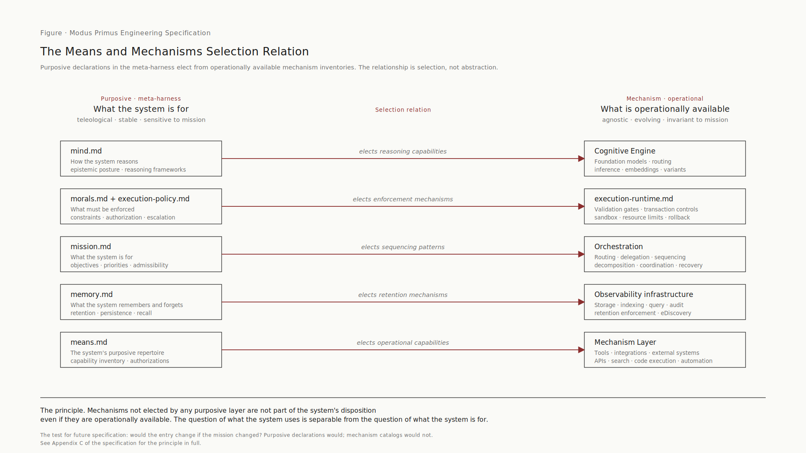
04 · ARCHITECTURAL PRINCIPLE
Means versus mechanisms
A tool is not part of the system's disposition until purposively elected.
A means is purposive.
What the system uses toward its mission within its morals. Means carry teleological weight: their existence is justified by what they advance.
A mechanism is operationally agnostic.
The machinery by which something works, independent of why. Mechanisms exist as available capacity. They become meaningful only when elected by some purposive layer; until then they are inventory.
The selection relation.
Purposive declarations elect from operationally available mechanisms. Mechanisms not elected by any purposive layer are not part of the system's disposition, even if operationally available.
Figure 1 · Five-row selection relation in canonical order
5 / 14
Notes:
This is the framework's sharpest intellectual move. The audience may not initially appreciate why this distinction matters. The right way to explain it: the assistant-centric pattern that PAHA critiques is precisely the conflation of means and mechanisms. A vendor copilot ships a bundled set of mechanisms (its tools, its memory, its retrieval) and presents them as the system's means by default, without requiring purposive election. The capability-centric pattern separates them: mechanisms are inventoried operationally; means are elected purposively. This is the antidote to silent capability creep. Every newly procured tool does not automatically become part of the architecture. It must be elected. Election is a governance act, not a procurement event.

Slide 6
05 · THE META-HARNESS
The five-M decomposition
Mind grounds morals. Morals grounds mission. Mission grounds memory. Memory grounds means.
MIND
How the system reasons. Epistemic posture, reasoning frameworks, inference quality. The cognitive disposition that grounds everything below.
mind.md
MORALS
What the system must not do. Constraints, prohibitions, safety boundaries. Ethical constraint grounded in reasoning posture.
morals.md
MISSION
What the system is for. Objectives, priorities, admissibility conditions. Purpose grounded in ethical constraint.
mission.md
MEMORY
What the system remembers and forgets. Retention, persistence, recall. What must be remembered, grounded in purpose.
memory.md
MEANS
The system's purposive repertoire. Capability inventory, authorizations. What the system uses to act, grounded in what is remembered.
means.md
Each file is a purposive declaration, not a mechanism catalog. If any file slips into operational description, it stops being one of the M's.
6 / 14
Notes:
The five-M decomposition is what makes the meta-harness coherent rather than a grab-bag. The hierarchy is more than a memorable name: it states the grounding relationship. Reasoning posture grounds ethical constraint; ethical constraint grounds purpose; purpose determines what must be remembered; what is remembered grounds what the system uses to act. Memory sits fourth, not fifth, because memory is determined by mission (what is worth remembering given what the system is for) and in turn grounds means (the system can only elect repertoire from what it has reason to remember). This is the canonical order. All five files are declarative, not procedural. They specify how the system reasons, what it must not do, what it is for, what it remembers, and what it uses: not how those declarations are mechanically realized. That separation is the load-bearing discipline.

Slide 7
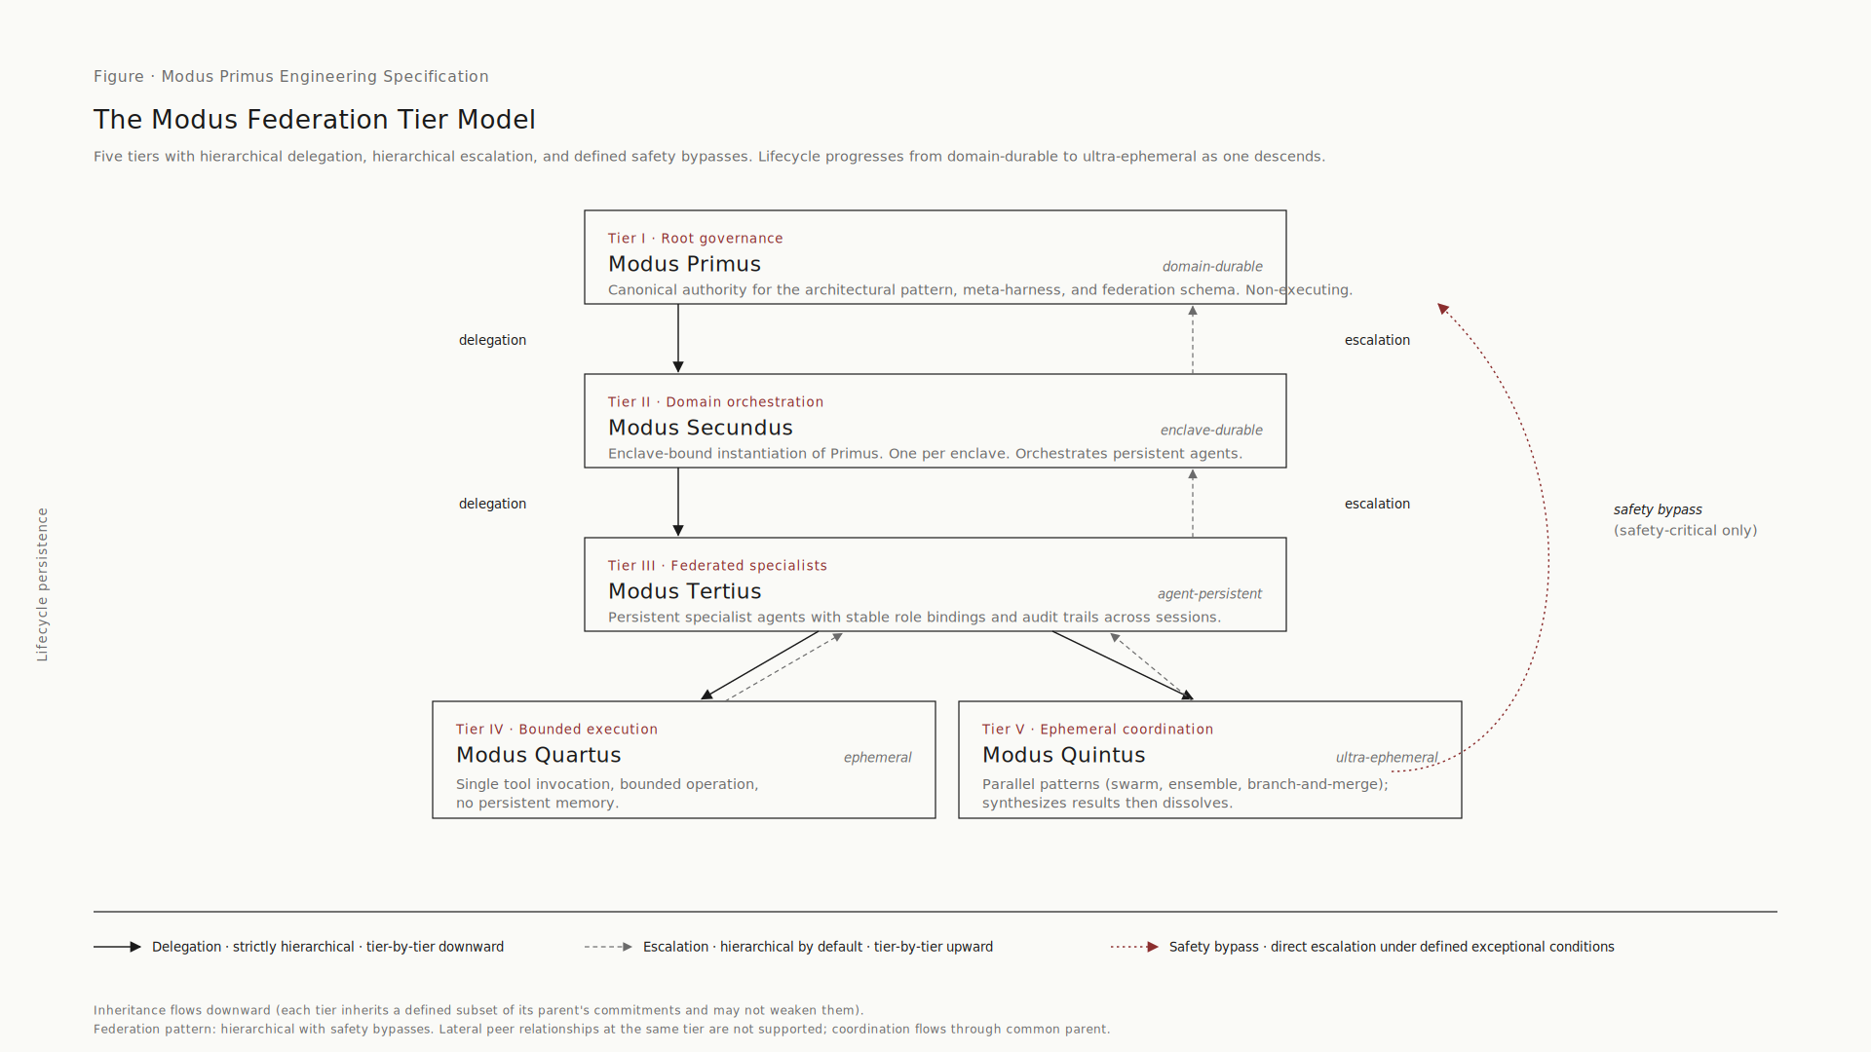
06 · FEDERATION
Five tiers of federated architecture
Modus Primus → Secundus → Tertius → Quartus → Quintus
DELEGATION strictly hierarchical, tier-by-tier downward ESCALATION hierarchical by default, tier-by-tier upward SAFETY BYPASS direct escalation under defined exceptional conditions
7 / 14
Notes:
The five-tier model gives program teams a concrete way to reason about who owns what across enclaves. Modus Primus is the canonical authority for the architectural pattern (one per architectural domain). Modus Secundus is the enclave-bound instantiation (one per enclave). Modus Tertius is the persistent specialist agents within a Secundus instance. Modus Quartus is bounded execution (discrete operational tasks). Modus Quintus is ephemeral coordination (short-lived parallel patterns). Lifecycle persistence decreases as you descend. Primus is domain-durable; Quartus and Quintus are non-persistent. The three principles at the bottom matter: delegation is strict, escalation is hierarchical by default, and safety bypass exists for defined critical conditions. The model is not a rigid hierarchy that breaks under operational pressure: it has a defined release valve.

Slide 8
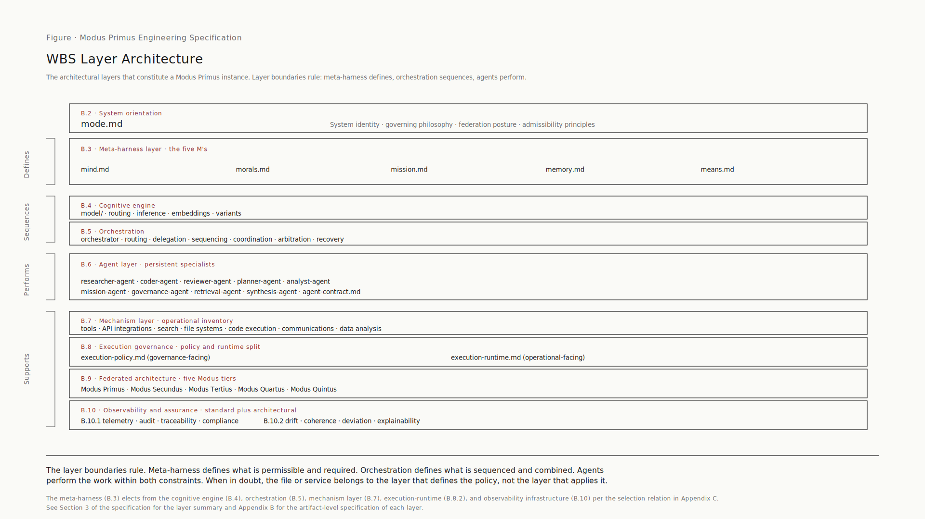
07 · STRUCTURAL VIEW
What a Modus Primus instance comprises
Work Breakdown Structure: meta-harness defines, orchestration sequences, agents perform.
Each layer has a defined function. The meta-harness elects from the cognitive engine, orchestration, mechanism layer, execution-runtime, and observability infrastructure per the selection relation in Appendix C of the spec.
8 / 14
Notes:
This is the concreteness slide. It proves the framework is implementable, not aspirational. The WBS specifies the architectural artifacts that constitute a Modus Primus instance. The full WBS is in Appendix B of the specification; this is the layer summary. Read top to bottom: B.2 is system orientation (mode.md). B.3 is the meta-harness with the five Ms in canonical order. B.4 through B.7 are the layers that define, sequence, perform, and operate. B.8 is execution governance with the policy/runtime split. B.9 is the federated architecture (the five tiers from the previous slide). B.10 is observability and assurance. The layer boundaries rule on the right side: defines, sequences, performs, supports: is the governing discipline. When in doubt, an artifact belongs to the layer that defines the policy, not the layer that applies it.

Slide 9
08 · DISTINCTIVE ENGINEERING MOVE
Runtime assurance as continuous validation
Not observability. Validation evidence between formal reviews.
DRIFT DETECTION
MISSION COHERENCE
POLICY DEVIATION
EXPLAINABILITY
Behavior drifting from declared mission scope. Triggers re-validation when bounds exceeded.
Outcomes aligned with mission objectives over time. Monitors fitness for declared purpose.
Actions deviating from execution-policy.md constraints. Generates audit evidence at the time of deviation.
Reasoning chains surfaceable for review. Required for trust escalation decisions.
The distinction that matters.
Generic V&V validates fitness at milestones. AI V&V monitors fitness continuously. Generic systems engineering treats runtime monitoring as observability: a post-hoc indicator. Modus Primus treats it as validation evidence: an active V&V instrument that produces continuous evidence the system is operating within its specification and toward its mission. This is the most distinctive engineering specialization in the framework.
9 / 14
Notes:
Runtime assurance is the framework's most distinctive contribution to V&V practice. Most AI governance frameworks treat runtime monitoring as observability: something to look at after the fact. Modus Primus treats it as a V&V instrument that produces continuous evidence between formal review milestones. Four detection categories: drift (the system departing from its mission scope), mission coherence (the system's outcomes still aligned with what it is for), policy deviation (actions deviating from execution policy), and explainability (the reasoning chain available for review). The framework requires that quantitative bounds for each category be calibrated per enclave in the tech baseline. The bounds are not in the canonical spec because they are properly enterprise- and enclave-specific.

Slide 10
09 · GOVERNANCE PRIMITIVE
Trust escalation model
Four levels. Each requires explicit governance approval to advance.
1
ADVISORY ONLY
System produces recommendations. Human authority makes all decisions. Default starting state for any new capability.
2
RECOMMEND AND APPROVE
System produces recommendations with implementation paths. Human authority approves before action. Audit trail captures both recommendation and approval.
3
AUTOMATED WITH AUDIT
System executes within bounded scope without prior human approval. Every action audited. Human authority reviews audit records periodically and on exception.
4
FULLY AUTONOMOUS
System operates without per-action human gating within declared mission scope. Reserved for narrow domains with strong runtime assurance. Requires the highest level of governance review.
Advancing from one level to the next is a governance act, not an engineering decision. Trust is earned through evidence, not asserted by capability.
10 / 14
Notes:
Trust escalation is the framework's primary control over how much autonomy the system has. Every new capability starts at level 1. Advancement to level 2, 3, or 4 requires explicit governance approval grounded in evidence. The evidence base comes from runtime assurance (the previous slide). A capability at level 1 accumulates runtime assurance evidence over time. When that evidence demonstrates the capability is operating within its specification and consistent with its mission, the governance review can approve advancement to level 2. The same pattern repeats for advancement to 3 and 4. Level 4 is reserved. Most enterprise AI capabilities will operate at levels 2 or 3 indefinitely. Level 4 should be exceptional, not aspirational. This model addresses the audience's primary concern: how do we control this? The answer is structurally: every advancement requires evidence and review.

Slide 11
10 · ADOPTION
What adoption looks like
Typical first actions, by audience
ENGINEERING
GOVERNANCE
PROGRAMS
Systems engineering, chief engineer's office
Architecture governance, compliance, security
Program managers, capability architects
Instantiate the WBS as a Modus Primus instance for the target domain
Populate the per-enclave tech baseline template (Appendix D) for the first enclave
Stand up the four V&V instruments at minimum viable fidelity
Initiate runtime assurance signals early: the longest-lead engineering effort
Approve ownership assignments for the five-M files
Define trust escalation thresholds and triggers in execution-policy.md
Set review cadences for the WBS and per-enclave tech baselines
Establish the means election review process as a working forum
Author initial agent contracts for the program's key Tertius agents
Identify candidate mechanisms that would benefit from purposive election
Integrate runtime assurance signals into program-level dashboards
Establish federation contract obligations with the parent Secundus instance
Descriptive of common adoption patterns, not prescriptive. Specific sequencing depends on enterprise context.
11 / 14
Notes:
This slide is what executives most want to see: what would my organization do? The three columns lift directly from Section 1.6 of v1.1, added in response to reviewer feedback. Engineering's longest-lead item is runtime assurance: start it early. Governance's prerequisite action is naming owners (WBS owner, means.md owner specifically). Without owners, every other governance action stalls. Programs should establish federation contract obligations early because federation requirements (schema, audit aggregation) constrain delivery if discovered late. Frame these as descriptive, not prescriptive. The audience's own context determines sequencing: this slide identifies first actions, not a mandatory roadmap.

Slide 12
11 · SCOPE
What Modus Primus is not
Explicit out-of-scope. Manage expectations early.
Detailed IAM implementation
Model selection and tuning recipes
The spec cites IAM constraints and trust escalation primitives. Identity provider choice, credential issuance, and session management remain enterprise IAM concerns.
The spec cites the Cognitive Engine layer and substrate substitution V&V. Specific model selection and fine-tuning live in per-enclave tech baselines, not the WBS.
Program management processes
Vendor-specific tooling guides
The spec cites delivery cadences and review gates. Schedule, cost, and staffing methodology are the enterprise's program management domain.
The spec is vendor-neutral. Implementations using specific clouds, models, orchestration platforms, or governance toolchains are addenda, not canonical.
Training curriculum
Operational runbooks
The spec identifies competency requirements implicitly through role definitions. Training content, certification pathways, and skills frameworks are workforce development.
The spec establishes the discipline that runbooks must align to the meta-harness. Runbook content itself is a property of specific deployments.
12 / 14
Notes:
This slide prevents the framework from being weaponized as 'Modus Primus has to solve everything.' Without explicit scope boundaries, every gap in the spec becomes an objection. With them, the objection collapses to 'that's not in scope, here's where it belongs.' Two patterns repeat: where Modus Primus stops, enterprise practice picks up (IAM, program management, training, runbooks); where Modus Primus stops, per-enclave tech baselines pick up (model selection, vendor tooling). Both patterns are intentional: the framework specifies what is shared, not what is local. If the audience pushes on any of these, the response is: it lives in the per-enclave tech baseline (Appendix D) or in the enterprise's existing engineering practice, depending on what's shared versus what's local.

Slide 13
12 · STANDARDS
Standards alignment
INCOSE · ISO/IEC/IEEE 42010 · TOGAF
MODUS PRIMUS CONCEPT
EXTERNAL STANDARD ANALOGUE
NOTES
WBS (Section 3, Appendix B)
INCOSE system breakdown; ISO/IEC/IEEE 42010 architecture description
WBS as architectural spec; tech baselines as realization
Five-M decomposition
ISO/IEC/IEEE 42010 architecture viewpoints
Each M is a viewpoint on the system's purposive disposition
Federation pattern
TOGAF federation; ISO/IEC/IEEE 42010 frameworks
Tier-bounded inheritance contracts with delegation
V&V instruments
INCOSE V&V; ISO/IEC/IEEE 15288
Specialized for substrate volatility and non-determinism
Runtime assurance
Runtime verification; continuous IV&V
AI-architecture-specific drift, coherence, deviation
Trust escalation model
Authority-to-Operate progression; risk-based access
Governance primitive tying execution-policy to execution-runtime
The framework is consistent with established systems engineering and architecture-description conventions. It does not claim to be a strict implementation of any single framework; where terminology differs, the specification's terminology is authoritative within its own scope.
13 / 14
Notes:
This slide reassures governance and compliance readers that the framework lives in their existing standards landscape. The mapping is deliberate but not overstated. The framing matters: Modus Primus is consistent with these standards, not a strict implementation of any of them. Overclaiming standards compliance is its own credibility risk: every external reviewer will check the claim against the standard's text and find places where the match is imperfect. Better to claim consistency and let the reader make the alignment judgment. If the audience presses on a specific standard, the right response is: the framework borrows from this standard where useful, but the framework's terminology is authoritative within its own scope. Where the standard and the framework differ, the framework wins for AI architecture specifically.

Slide 14
13 · CLOSING
Both documents are public.
Both documents are independently citable. Both are CC BY 4.0.
PAHA · ARCHITECTURAL PATTERN
MODUS PRIMUS · ENGINEERING PRACTICE
Longmire, J. (2026). Portable Agent Harness Architecture (Rev 2.2). Zenodo.
Longmire, J. (2026). Modus Primus: Engineering Specification for AI Architecture (PAHA Companion), Version 1.1. Zenodo.
doi:10.5281/zenodo.20112631
doi:10.5281/zenodo.20113785
James (JD) Longmire
Northrop Grumman Fellow (unaffiliated research) · ORCID: 0009-0009-1383-7698 · jdlongmire@outlook.com
14 / 14
Notes:
The closing slide is a doorway, not a conclusion. The audience should leave knowing exactly where to find both documents and how to cite them. Both DOIs are stable Zenodo identifiers. Both documents are CC BY 4.0: usable in any enterprise context with attribution. Both will appear under the ORCID profile, which gives the audience a way to track future revisions and related work. If the audience has questions that this deck did not answer, the next step is to read the specifications. The deck is the executive entry point; the specifications are the substance.

