Slide 1

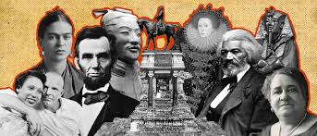

Why history?
What can you remember about Y7 & 8 History?

Slide 2


Why history?
Enquiry question: How does studying the past help us understand ourselves, our communities and our role in shaping the future?
Learning Objectives:
To recap the skills that we use in History.
To examine evidence to carry out a historical investigation.
History: The study of the past, telling the stories of people, places, and events.

Slide 3

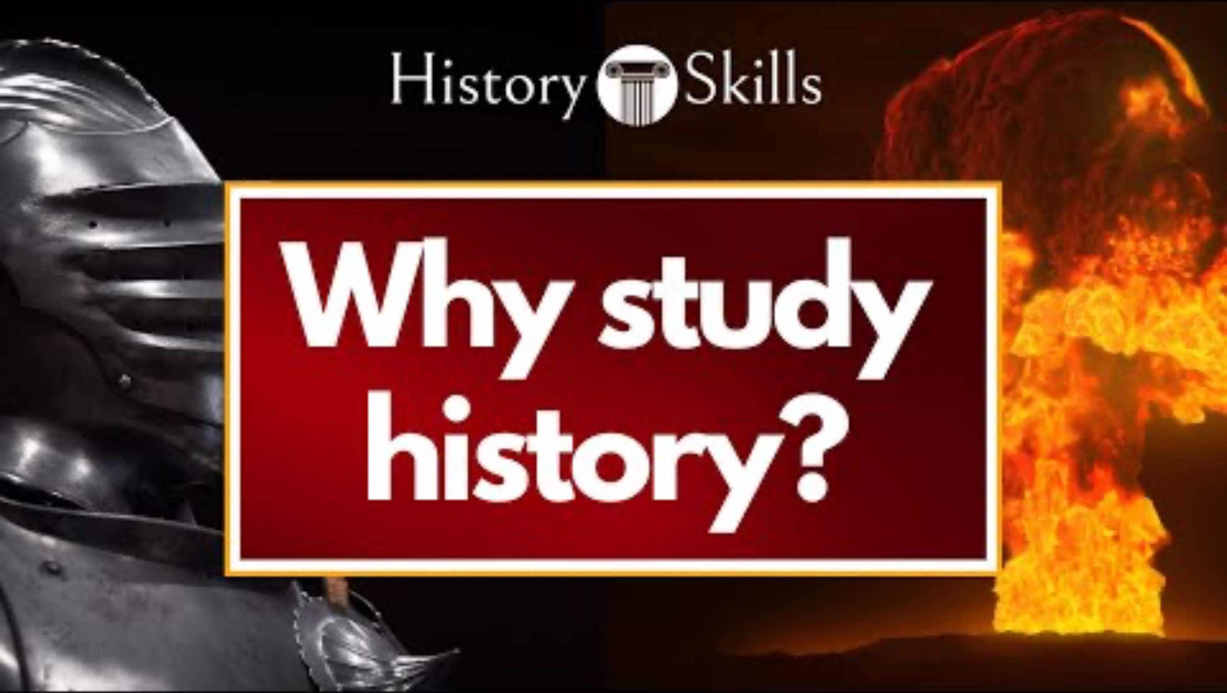
Why history?
Why should we study history?
How can studying past events help us make better decisions for the future?
Can ordinary people have a big impact on history? Why/why not?
In what ways might understanding history help you make sense of problems or issues in today’s world?
By showing us what worked and what didn’t in the past.
Everyone can! Through protests, inventions, or community action
It helps spot patterns and connections between past and present
Notes:
https://www.youtube.com/watch?v=MH-poqMomhk

Slide 4
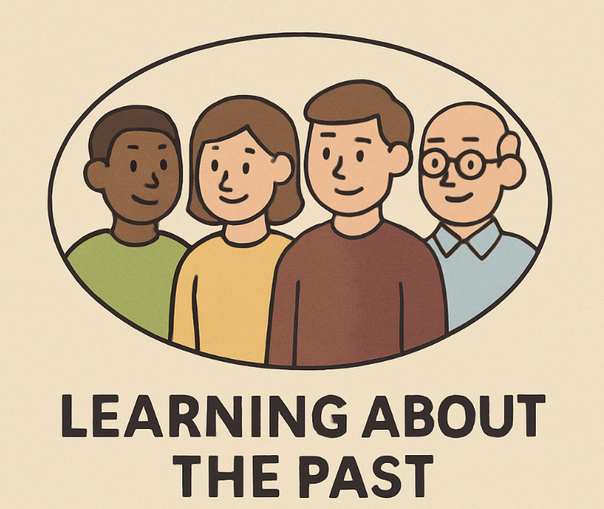
Why history?
Why should we study history?
The history we share brings people together and helps us feel part of the same community.
Helps us understand and fix the problems we face today.
Studying history improves our organisational skills and teaches us how to think carefully and critically.
It gives us greater respect and understanding for the people around us.

Slide 5
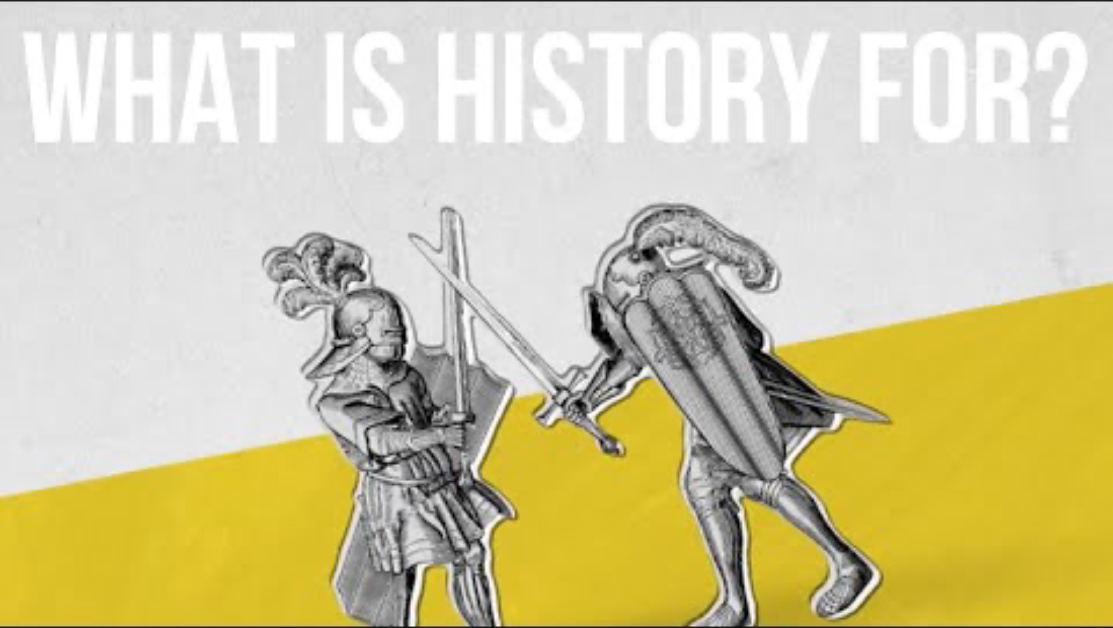
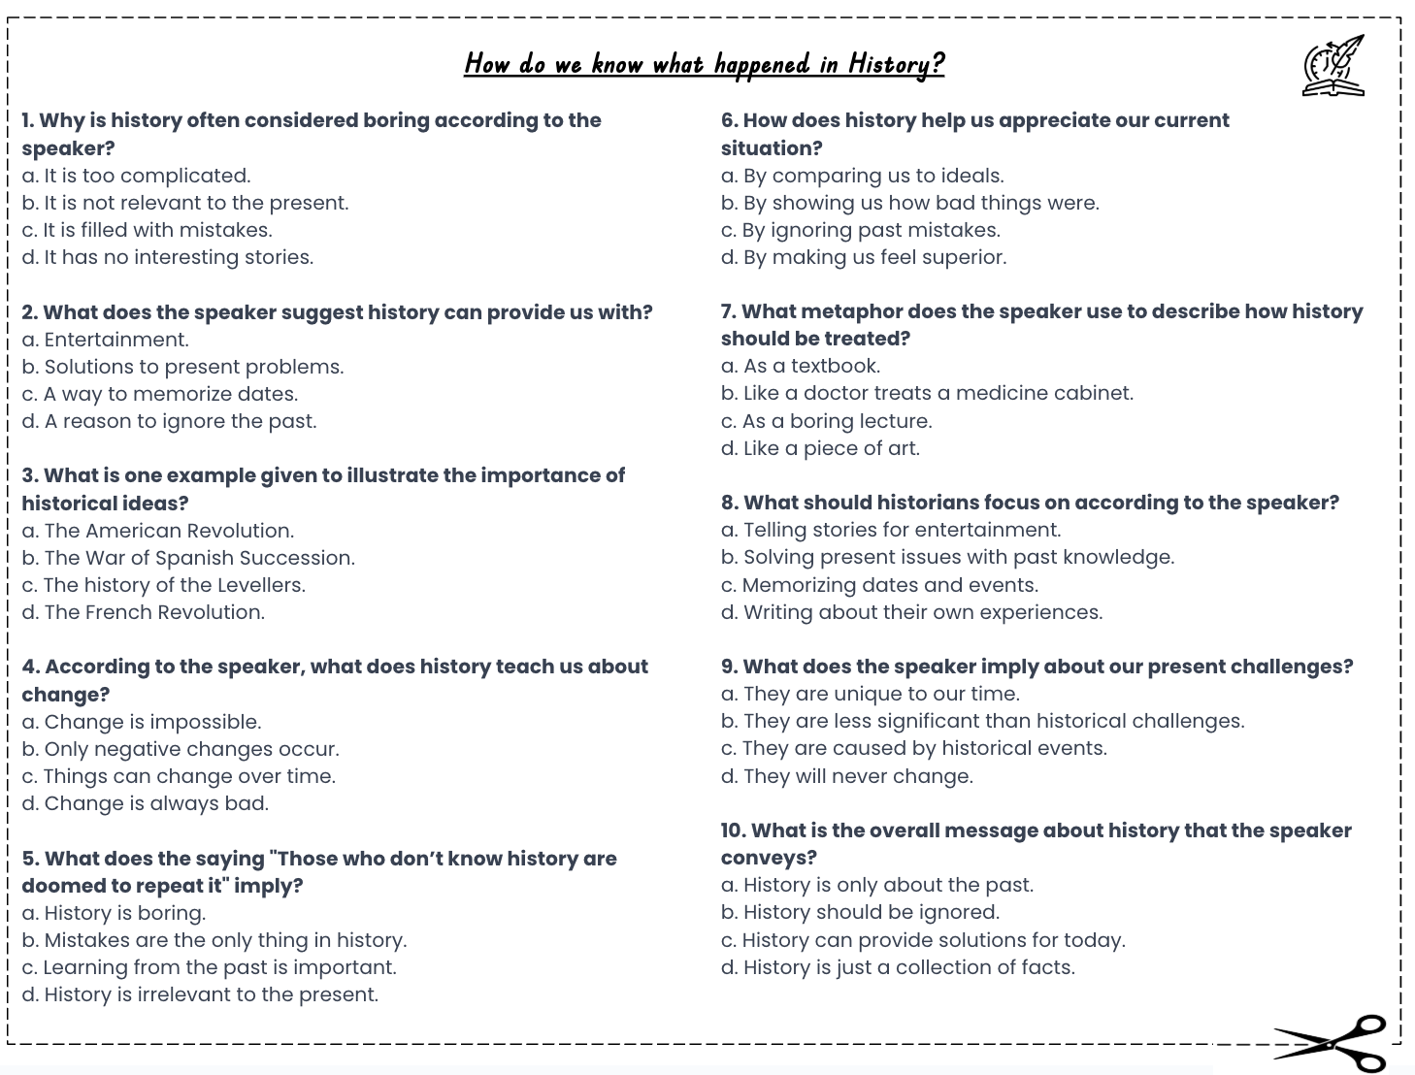
Why history?
How can Historians find out about the past?
Activity: Complete the multiple choice questions whilst watching the video:
‘How do we know what happened in History?’
Notes:
https://www.youtube.com/watch?v=hLE-5ElGlPM

Slide 6
Why history?
How can Historians find out about the past?
b. It is not relevant to the present.
b. Solutions to present problems.
c. The history of the Levellers.
c. Things can change over time.
d. Learning from the past is important.
a. By showing us how bad things were.
b. Like a doctor treats a medicine cabinet.
d. Solving present issues with past knowledge.
a. They are less significant than historical challenges.
c. History can provide solutions for today.
GREEN PEN YOUR ANSWERS

Slide 7
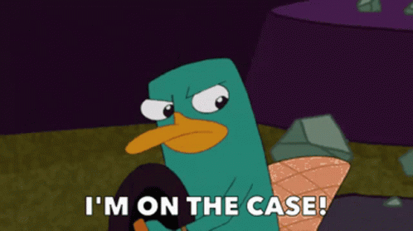
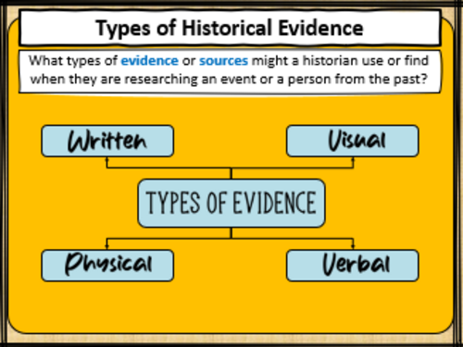
Historians are like detectives who gather information or evidence to put together the story of the past.
Why history?
How can Historians find out about the past?
They gather evidence from different sources e.g. archaeological digs, manuscripts or search the internet
他们从不同来源收集证据，例如考古发掘、手稿或在网上搜索

Slide 8
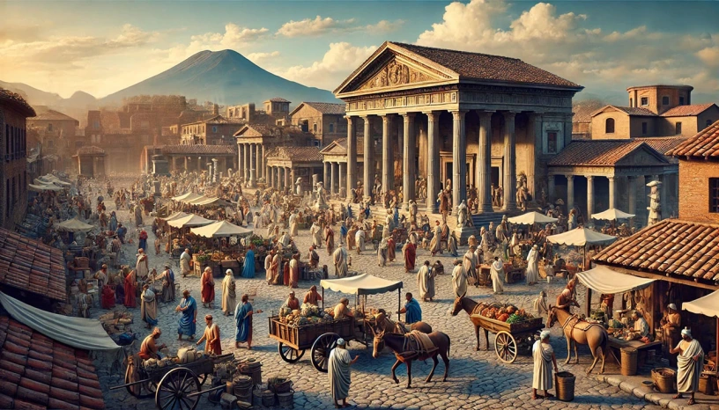
Why history?
A Historical Investigation - Pompeii – Life Before Disaster
In 79 CE, Mount Vesuvius erupted, burying Pompeii under metres of ash and pumice. The city was lost for almost 1,700 years before its rediscovery. Archaeologists have uncovered streets, buildings, food, art and even people frozen in their final moments.
Your challenge is to use the following evidence to investigate: What was life like in Pompeii in the hours before the eruption?

Slide 9
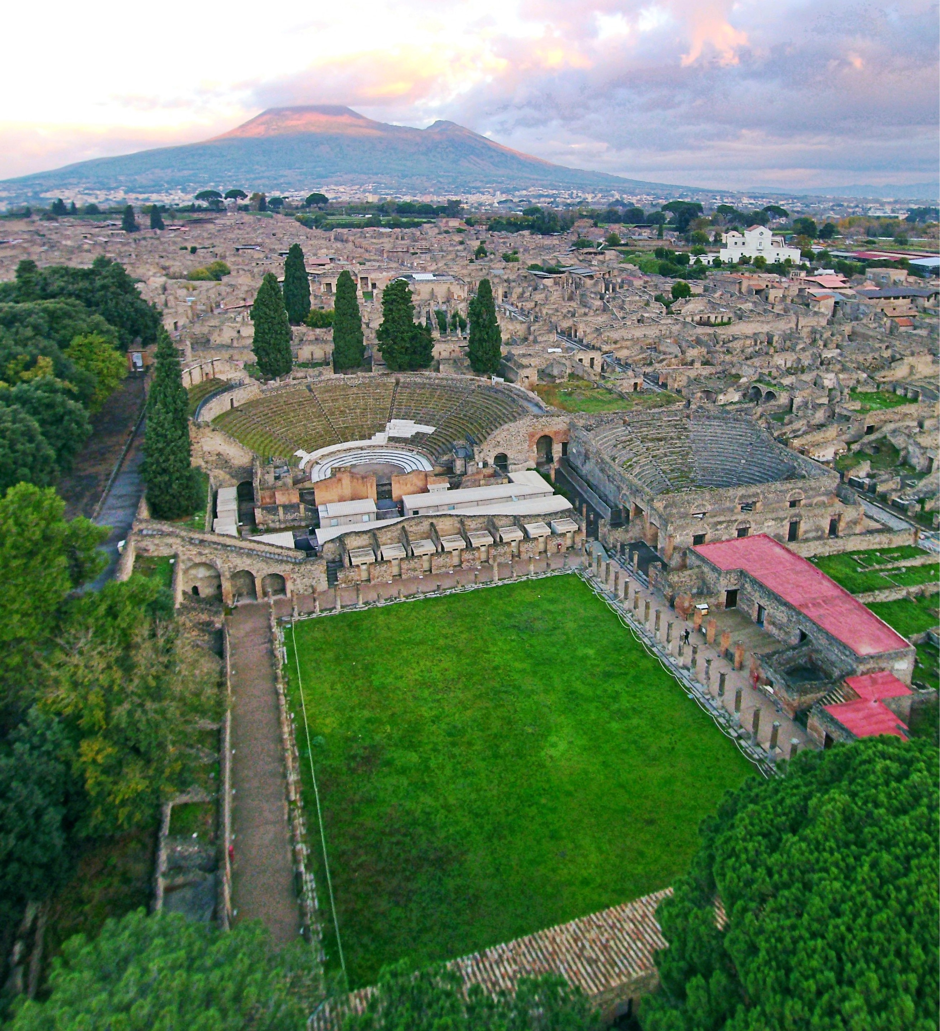
Why history?
A Historical Investigation - Pompeii – Life Before Disaster
Activities:
In pairs, you will use your evidence packs to answer the “Questions to think about” to review and summarise the evidence.
After reviewing the evidence, decide what you think life in Pompeii was like before the disaster.
In your books, complete the open ended questions to come up with your theory.

Slide 10
Pompeii – Life Before Disaster
Source A – Letter from Pliny the Younger (Eyewitness, AD 79)
Pliny describes the eruption with images of a pine-shaped cloud, ash falling like snow, shaking ground, and people fleeing. His position as a Roman official may have shaped how he wrote. The letter shows fear and reactions but reflects only his perspective.
Source B – Archaeological Field Notes (Excavation Report, 2020)
Archaeological evidence like bread left in ovens, coins on counters, and broken shelves shows life in Pompeii stopped suddenly. Dating objects helps reveal their age, but preservation varies. Archaeology is useful for daily life, though written sources give different perspectives.
Source C – Graffiti from a House Wall (Translated from Latin)
Graffiti in Pompeii shows people’s everyday interests, like love, gladiator games, and bread. These messages reflect values of relationships, entertainment, and food. Graffiti is useful for learning about ordinary lives, though it may not fully represent everyone’s experiences or opinions.
Source D – Modern Historian’s View (Dr. Lucia Romano, Roman History Specialist, 2019)
The casts of bodies in Pompeii show how people reacted; some curled up, some clutching belongings, others holding loved ones. They reveal the disaster’s speed but only capture one moment, so they have limits for understanding life before the eruption.
Notes:
A3 Print

Slide 11
Why history?
A Historical Investigation - Pompeii – Life Before Disaster
Open Ended Questions: In your books, answer the following questions in complete sentences:
Why do you think the people of Pompeii were unable to escape the eruption? Give two pieces of evidence to support your answer.
  I think the people of Pompeii could not escape because… One piece of evidence is… Another piece of evidence is…
How has the discovery of Pompeii helped historians understand life in a Roman city in AD 79?
  The discovery of Pompeii has helped historians because it shows… For example, we have learned that…
Which historical skills did you use to investigate the mystery of Pompeii, and how did they help you build your conclusions?
(Context, Corroboration, Inferences, Reliability, Sources & Usefulness)
  The historical skills I used were… These skills helped me because…

Slide 12
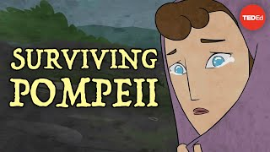
Why history?
A Historical Investigation - Pompeii – Life Before Disaster
Notes:
https://www.youtube.com/watch?v=9klE-iUxX0c

Slide 13


Why history?
How do character values (virtues) influence the work of a historian in studying and interpreting historical events?
How does the study of history contribute to the development of critical thinking and organisational skills?
Why is it important to recognise ordinary people’s contributions when studying history?

