Slide 1
8th October 2020
Interior and Exterior Angles
What is the definition of a polygon?
Name the following:
A six-sided polygon
A twelve-sided polygon
A seven-sided polygon
A nine-sided polygon
A five-sided polygon
A twenty-sided polygon
Let’s get started!

Slide 2
What are we going to learn today?
  By the end of this lesson I will be able to…
find interior and exterior angles of any polygon.
Notes:
LEARNING OBJECTIVE Phase 2
The learning objective should not be a checklist of tasks you’d like the students to complete by the end of the lesson i.e a list of outcomes.
What will students be able to do/demonstrate at the end of the lesson that they couldn’t do at the beginning? What are they going to learn in this lesson?
This learning objective needs to be copied onto the base of each subsequent slide, to remind the students (and the teacher!) of the lesson objective throughout the lesson.
The objective should be referred to continually during the lesson, not just at the beginning and the end.

Slide 3















Show us what you have learnt
?
An interior angle is just an angle between two sides within the shape.
The interior angles of a quadrilateral add up to 360°.
Parallelogram
1
2
?
?
?
3
4
Trapezium
Kite
?
?

Slide 4


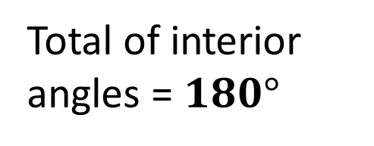
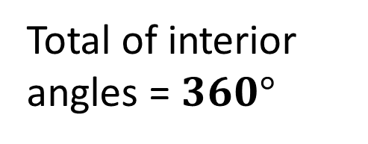
Input: Sum of interior angles
Can you guess what the angles add up to in a pentagon? How would you prove it?

Slide 5
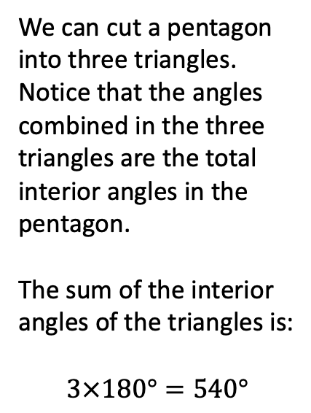

Input: Sum of interior angles
Click to animate
?

Slide 6






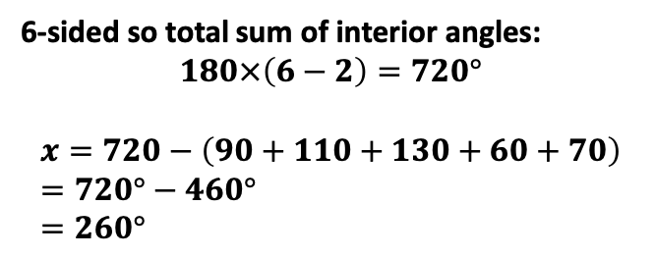
Learning Activity
1
What is the total interior, and therefore, each interior angle, of each of these regular polygons?
2
Regular Polygon | Total sum of Interior Angles | Each Interior Angle
Equilateral triangle (3)
Square (4)
Pentagon (5)
Hexagon (6)
Octagon (8)
Nonagon (9)
Decagon (10)
?
?
?
?
?
?
?
?
?
?
?

Slide 7






Learning Activity
A regular dodecagon (12 sides).
160°
130°
80°
120°
?
?
120°
40°
100°
?
40°

Slide 8
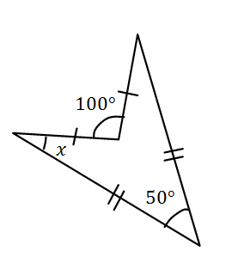
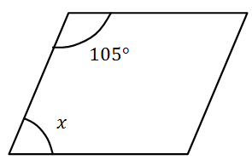
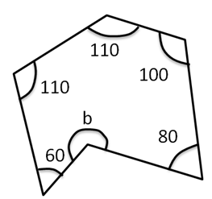
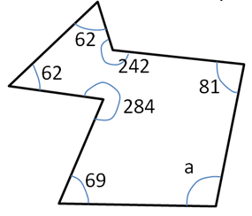
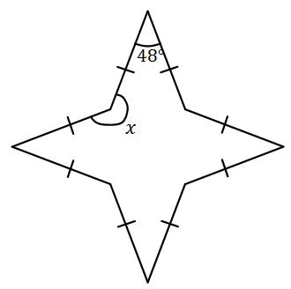
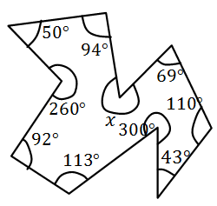
Learning Activity
(On supplied sheet)
1a
b
c
?
b = 260°
x = 75°
?
x = 25°
?
d
e
f
a = 100°
?
x = 222°
?
x = 309°
?

Slide 9
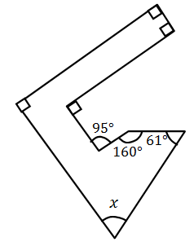
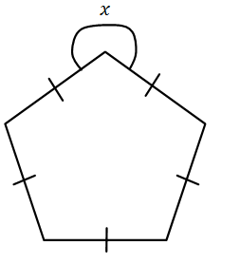
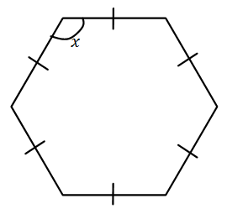
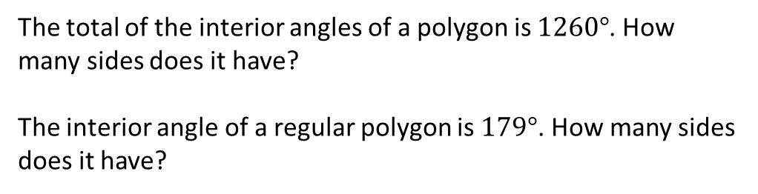

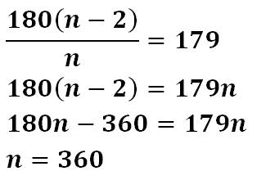
Learning Activity
g
h
i
x = 120°
?
x = 252°
?
x = 54°
?
2
?
☠₁
?

Slide 10
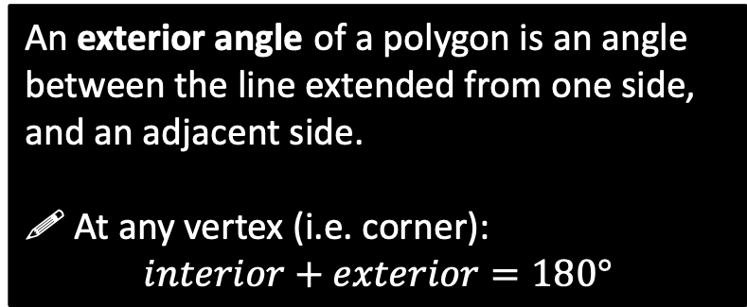
Input: Exterior Angles
exterior
interior
?
Which of these are exterior angles of the polygon?
?
?
NO
YES
?
NO

Slide 11
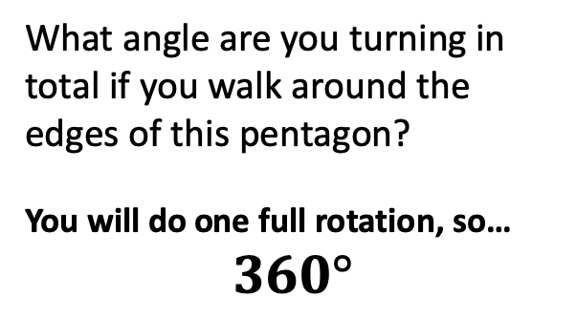
Input: Total Exterior Angle
?
🖉 The sum of the exterior angles of any polygon is 360°.
https://www.geogebra.org/m/KWb7RrTu

Slide 12
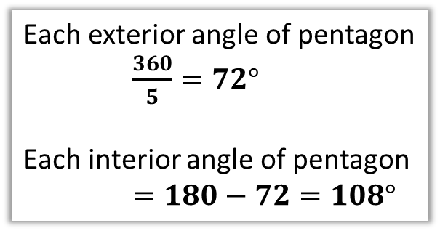


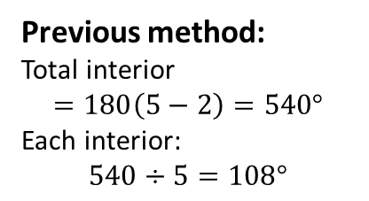
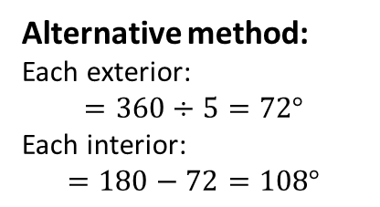
Input: Exterior/Interior Angle of Regular Polygon
If the pentagon is regular, then each exterior angle is the same. Therefore:
?
?
This therefore gives us an alternative way to work out the interior angle of a regular polygon:

Slide 13
Learning Activity
Sides |  | Exterior Angle | Interior Angle
3 | Equilateral Triangle
4 | Square
5 | Pentagon
6 | Hexagon
8 | Octagon
9 | Nonagon
10 | Decagon
?
?
?
?
?
?
?
?
?
?
?
?
?
?
Bonus Question: What is the largest number of sides a shape can have such that its interior angle is an integer?
360 sides. The interior angle will be 179°.
?

Slide 14

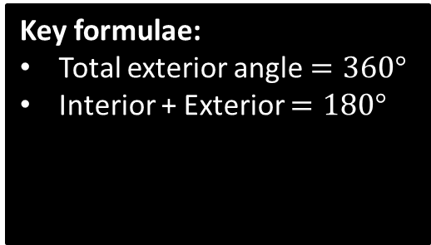


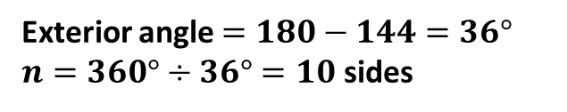
Input: Number of sides of a regular polygon
The advantage of this new method is that it works backwards: we can easily work out the number of sides of the polygon given an exterior or interior angle.
?
interior
exterior
?

Slide 15
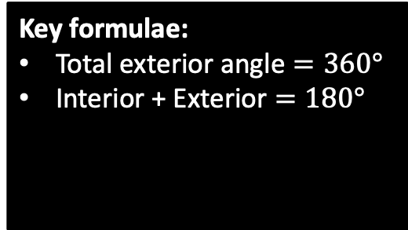
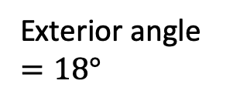
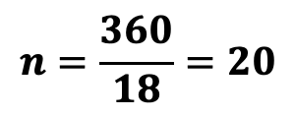

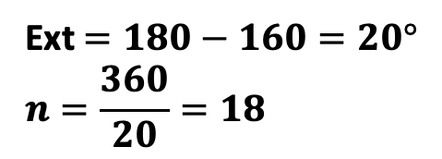

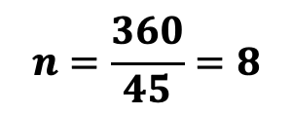

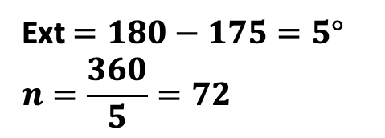

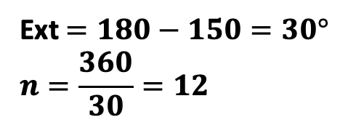
Learning Activity
How many sides do each of the following polygons have?
?
interior
?
exterior
?
?
?

Slide 16
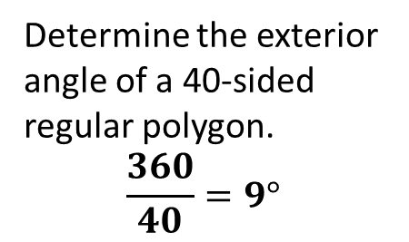






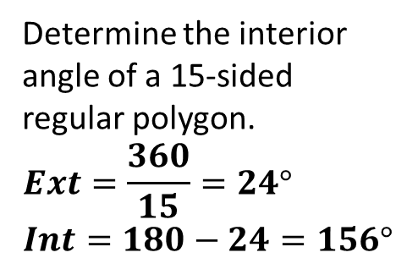

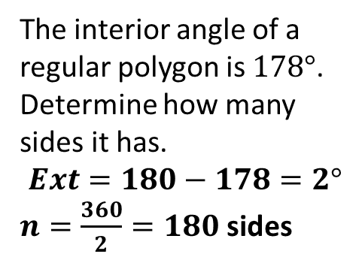
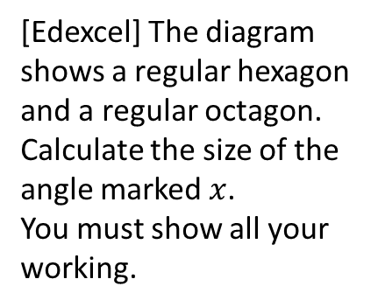
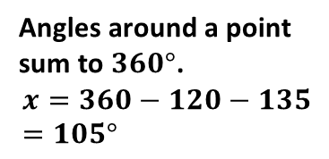
Learning Activity
1
4
?
?
2
5
?
3
?
?

Slide 17
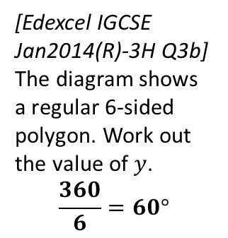
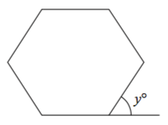
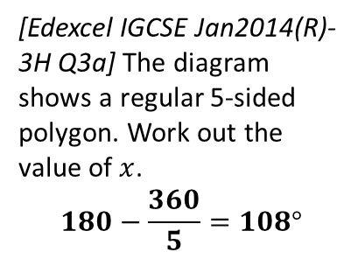
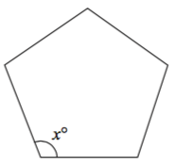

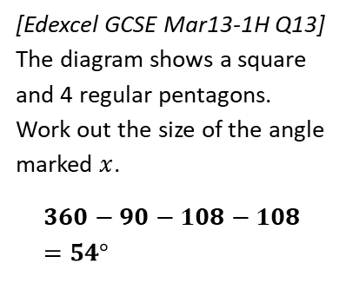




Learning Activity
4
Determine how many sides a regular polygon with the following exterior angle would have:
  30° 12 sides
  45° 8 sides
  12° 30 sides
  9° 40 sides
1
?
?
?
?
?
5
Determine how many sides a regular polygon with the following interior angle would have:
  156° 15 sides
  162° 20 sides
  144° 10 sides
  175° 72 sides
2
?
?
?
?
?
3
6
?
?

Slide 18
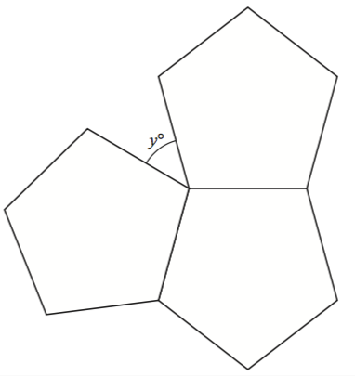
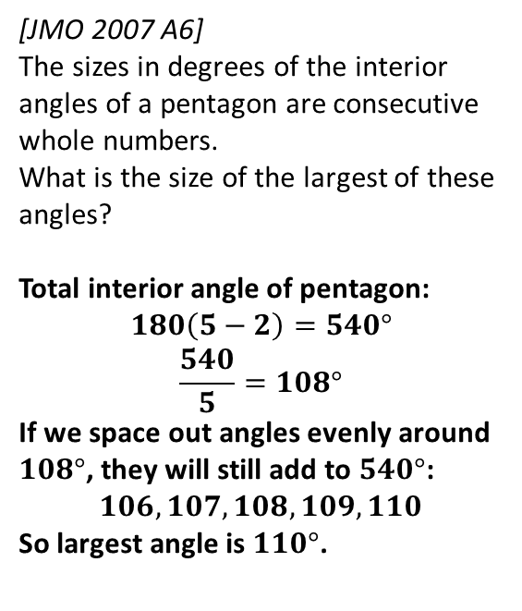
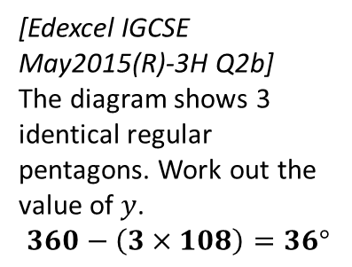
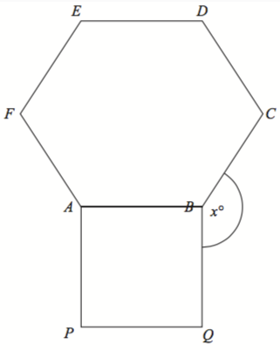
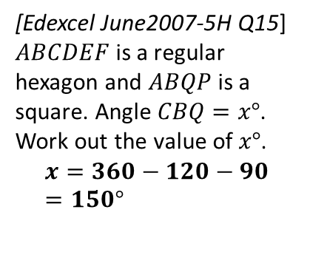
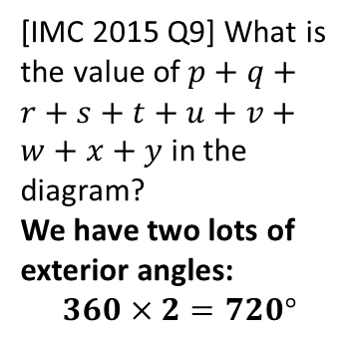
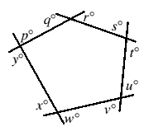
Learning Activity
9
7
?
?
8
10
?
?

Slide 19
Show us what you have learnt
Show me the correct letter
A
B
C
D

Slide 20
What is the total exterior angle of a polygon in terms of the number of sides n?
360
360
n
360n
180(n-2)

Slide 21
What is the total interior angle of a 20 sided polygon?
360
3600
3240
6480

Slide 22
The interior angle of a polygon is 178. How many sides does it have?
20
40
90
180

Slide 23
What is the interior angle of a 90 sided regular polygon?
172°
176°
178°
179°

Slide 24

Determine the angle .
61°
29°
105°
120°
215°
223°
225°
235°

Slide 25
Plenary and review
  This is what we planned to learn today:
To be able to find interior and exterior angles of any polygon.
  So, did you achieve this?
w.w.w................. e.b.i................
Notes:
PLENARY/REVIEW Phase 4
Opportunity to review the learning objective and to look ahead.
Must be a planned activity with adequate time allocated. Crucial element to the lesson.
Teacher needs to think of a means of assessing to what extent the learning objective has been met (show of hands, hold up 1, 2 or 3 fingers, Q&A, students asked to summarise what they have learnt, mini whiteboards etc.)
Once again handheld voting systems could be used here as well as tablet PCs or interactive whiteboard.
Possible to give a quick preview of the next lesson – what’s coming next, where are we heading? Leave students excited at the prospect.

Slide 26
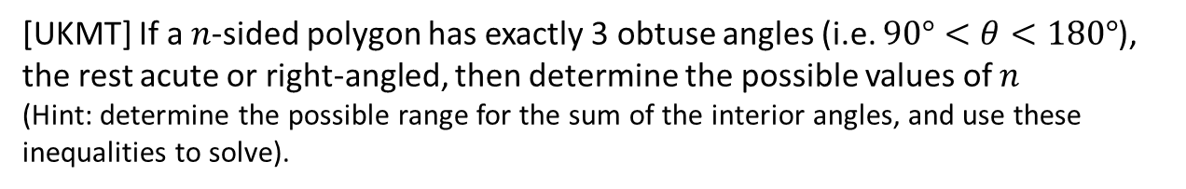
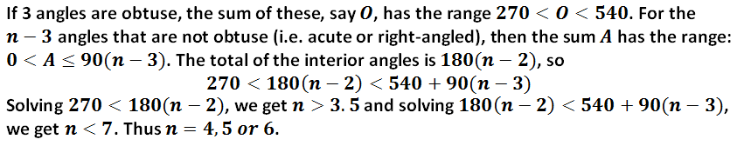
Extension
☠₂
?

