Slide 1


How do we know what happened in History?
1. Why is history often considered boring according to the speaker?
a. It is too complicated.
b. It is not relevant to the present.
c. It is filled with mistakes.
d. It has no interesting stories.
2. What does the speaker suggest history can provide us with?
a. Entertainment.
b. Solutions to present problems.
c. A way to memorize dates.
d. A reason to ignore the past.
3. What is one example given to illustrate the importance of historical ideas?
a. The American Revolution.
b. The War of Spanish Succession.
c. The history of the Levellers.
d. The French Revolution.
4. According to the speaker, what does history teach us about change?
a. Change is impossible.
b. Only negative changes occur.
c. Things can change over time.
d. Change is always bad.
5. What does the saying "Those who don’t know history are doomed to repeat it" imply?
a. History is boring.
b. Mistakes are the only thing in history.
c. History is irrelevant to the present.
d. Learning from the past is important.
6. How does history help us appreciate our current situation?
a. By showing us how bad things were.
b. By comparing us to ideals.
c. By ignoring past mistakes.
d. By making us feel superior.
7. What metaphor does the speaker use to describe how history should be treated?
a. As a textbook.
b. Like a doctor treats a medicine cabinet.
c. As a boring lecture.
d. Like a piece of art.
8. What should historians focus on according to the speaker?
a. Telling stories for entertainment.
b. Writing about their own experiences.
c. Memorizing dates and events.
d. Solving present issues with past knowledge.
9. What does the speaker imply about our present challenges?
a. They are less significant than historical challenges.
b. They are unique to our time.
c. They are caused by historical events.
d. They will never change.
10. What is the overall message about history that the speaker conveys?
a. History is only about the past.
b. History should be ignored.
c. History can provide solutions for today.
d. History is just a collection of facts.

Slide 2
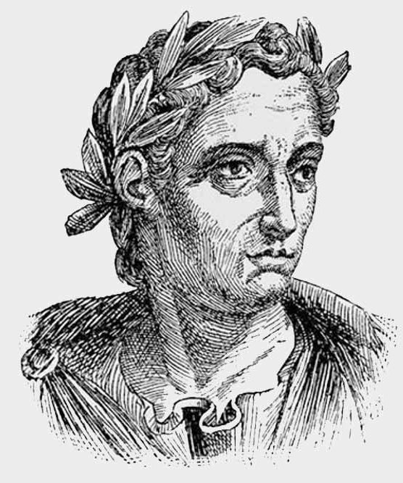
Pompeii – Life Before Disaster
Source A – Letter from Pliny the Younger (Eyewitness, AD 79)
"On the morning of the 24th of August, my uncle, the commander of the fleet, saw a strange cloud rising from Mount Vesuvius. It was shaped like a pine tree, with a long trunk of smoke and branches of ash spreading high into the sky. Soon, ash began to fall like snow, covering rooftops and streets. The ground shook violently, and people ran through the streets in panic, clutching their children and belongings. Some stayed indoors, hoping the danger would pass, while others prayed to the gods. I fled the city, terrified, and never saw many of my friends or neighbours again.”
Pliny the Younger (AD 61 – c. AD 113) was a Roman lawyer, writer, and government official. He is famous for writing letters that give us a detailed picture of life in Ancient Rome. When Mount Vesuvius erupted in AD 79, Pliny was staying across the Bay of Naples. His uncle, Pliny the Elder, was a famous naval commander and naturalist who sailed towards the eruption to help people. Pliny the Younger later described what he saw in two letters to the historian Tacitus.
Questions to think about:
What details in Pliny’s description help you picture the eruption?
How might Pliny’s social position influence what he wrote?
What parts of this account could be exaggerated or mistaken?
How useful is this letter for finding out how people reacted to the disaster?

Slide 3
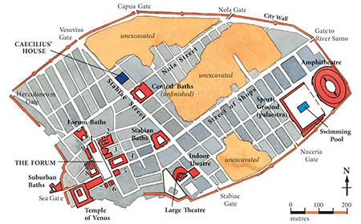
Pompeii – Life Before Disaster
Source B – Archaeological Field Notes (Excavation Report, 2020)
Location: Bakery near the Forum, Pompeii
Finds:
Several loaves of bread still in the stone ovens, carbonised by the intense heat. The bread retained its shape, suggesting it had been baking at the moment of the eruption.
Bronze weighing scales and small piles of coins left on the counter, as if a customer had just paid or was about to.
A wall painting covering almost an entire side of the shop, showing a banquet scene with guests reclining, servants bringing food, and musicians playing lyres and flutes.
Charred remains of wooden shelves and broken pottery scattered across the floor.
Questions to think about:
What evidence from the report suggests life stopped suddenly in Pompeii?
How can archaeologists tell how old objects are?
Why might some artefacts be better preserved than others?
How reliable is archaeology compared to written sources?
Observations:
The bread and coins suggest that business was being carried out as normal right up to the moment disaster struck, with no time to finish baking or complete transactions. The high-quality wall painting points to the importance of food, drink, and entertainment in Pompeian society, even in a working bakery. The sudden abandonment, with everyday tasks left incomplete, hints at the terrifying speed of the eruption. It also raises questions about how quickly ash and pumice filled the streets, trapping people before they could escape.

Slide 4
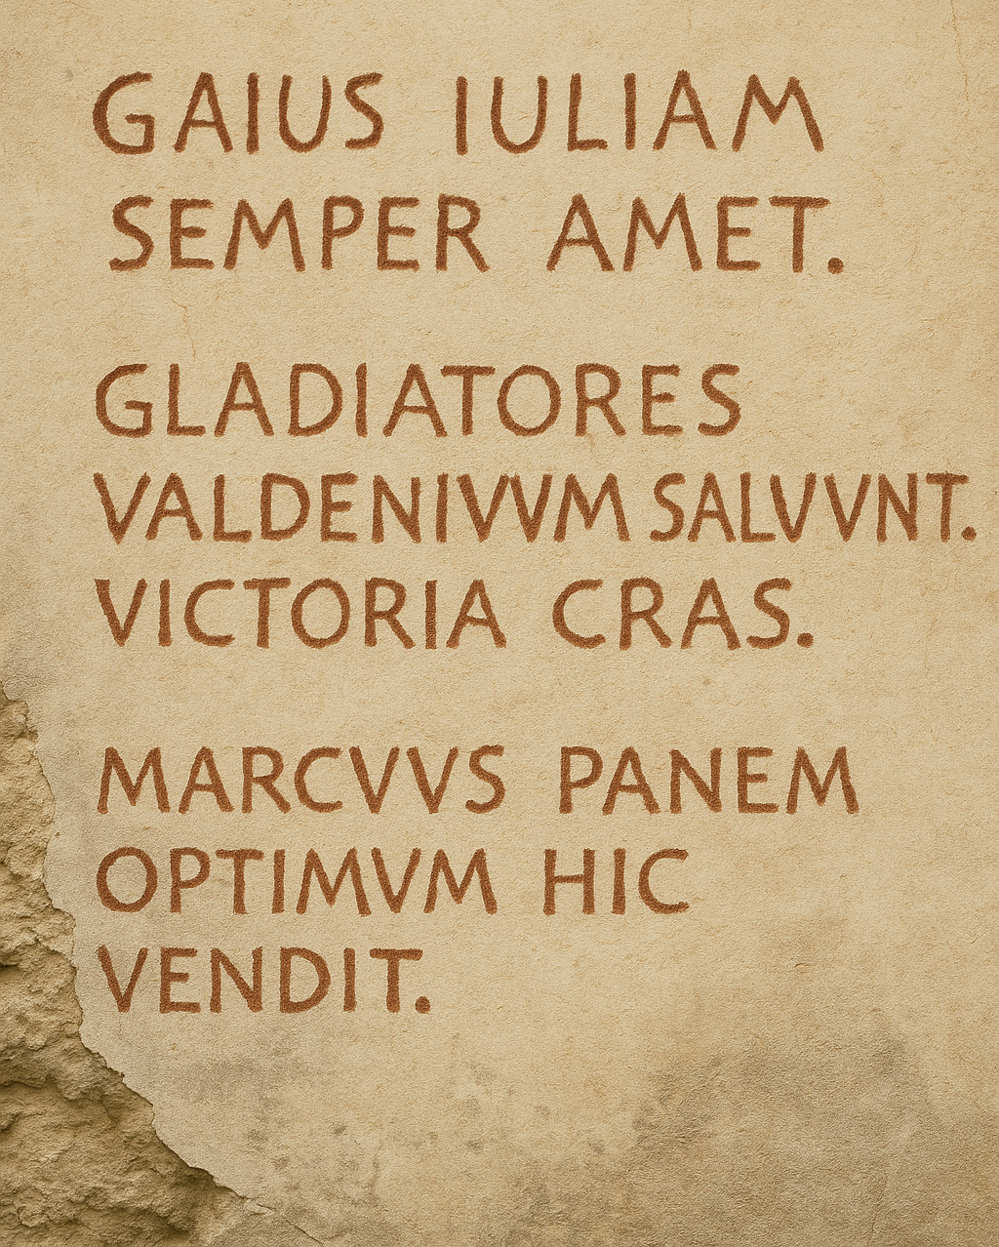
Pompeii – Life Before Disaster
Source C – Graffiti from a House Wall (Translated from Latin)
"Gaius loves Julia. May they always be together!"
"We gladiators salute our fans. Victory tomorrow!"
"The best bread in Pompeii is sold by Marcus."
In Pompeii, walls weren’t just for holding up buildings—they were a place where people left messages, jokes, advertisements, and personal notes. Archaeologists have found graffiti all over the city, from love notes to political slogans. This particular wall has three short messages: one about love, one about gladiators, and one advertising bread. They give us little snapshots of what people were talking about and what mattered to them in the days before the eruption of Mount Vesuvius.
Questions to think about:
What can these graffiti messages tell us about the everyday lives and interests of the people in Pompeii?
How might the messages about love, gladiators, and bread reflect the culture and values of the city?
Why might graffiti be a useful source for learning about the lives of ordinary people in the past?
What are some limitations of using graffiti as evidence about life in Pompeii?

Slide 5

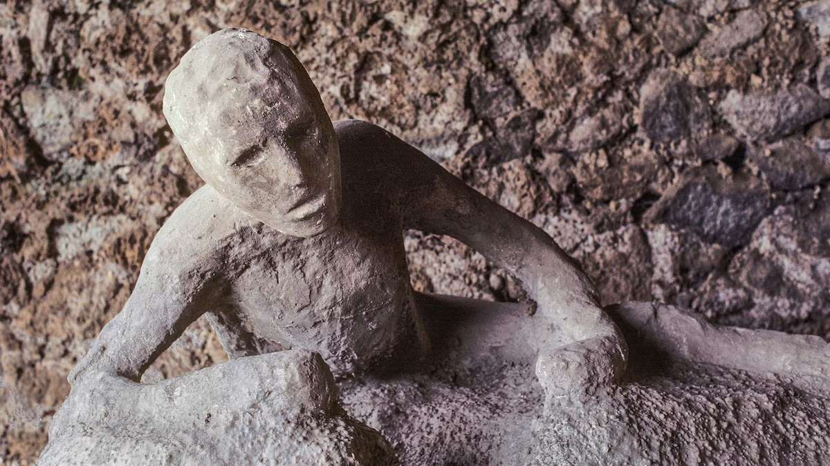
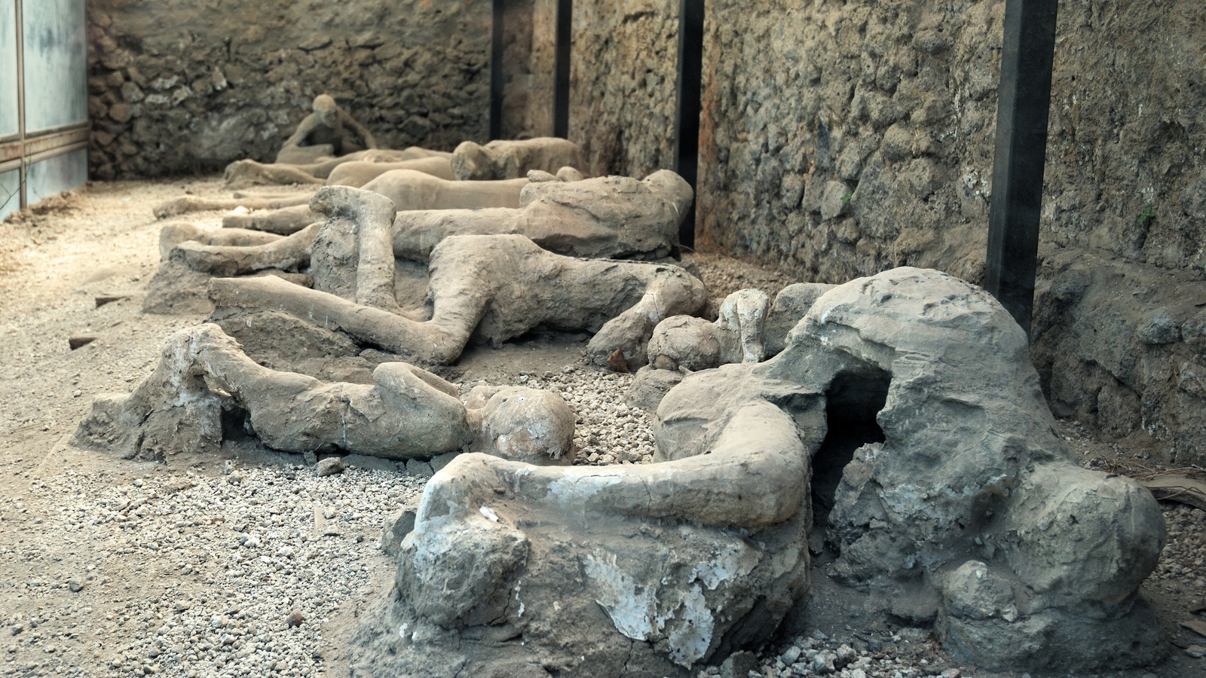
Pompeii – Life Before Disaster
Source D – Modern Historian’s View (Dr. Lucia Romano, Roman History Specialist, 2019)
Pompeii is like a giant time capsule from the day Mount Vesuvius erupted in AD 79. The ash didn’t just cover buildings and streets – it also kept the shapes of the people who were there when it happened. Some were found curled up, others holding loved ones, and some still holding their belongings. These casts give us clues about how fast the disaster happened and how people reacted. But we have to remember – what we see now is only a single moment in time, not the full story of what happened that day.
Questions to think about:
What can the positions of the bodies tell us about how people reacted when Mount Vesuvius erupted?
Why might some people have been holding objects or other people when they were found?
How reliable do you think these casts are for understanding the events of that day?
What are the limits of using this evidence to understand life in Pompeii before the eruption?

Slide 6
Based on the evidence explain what life was like in Pompeii – Life Before Disaster
Case File: Source A – Letter from Pliny the Younger
________________________________________________________________________________________________________________________________________________________________________________________________________________________________________________________________________________________
Case File: Source B – Archaeological Field Notes
________________________________________________________________________________________________________________________________________________________________________________________________________________________________________________________________________________________
Case File: Source C – Graffiti from a House Wall
________________________________________________________________________________________________________________________________________________________________________________________________________________________________________________________________________________________
Case File: Source D – Modern Historian’s View
________________________________________________________________________________________________________________________________________________________________________________________________________________________________________________________________________________________
What was life like in Pompeii in the hours before the eruption? (Use evidence to support your answer)
________________________________________________________________________________________________________________________________________________________________________________________________________________________________________________________________________________________________________________________

