Slide 1
TUESDAY • EVIDENCE 02
THE FOOTPRINT CIPHER
A muddy footprint was found near the Maths cabinet. A strip of paper contains six mysterious numbers.
THE ENCRYPTED MESSAGE
23 – 20 – 28 – 17 – 20 – 33
“The numbers have been shifted. Find the difference between the two clues below to discover how far.”
CLUE A
CLUE B
5² − 3
2³ − 1
06

Slide 2
TUESDAY • YOUR CHALLENGE
WHO DOES THE CODE NAME?
A = 1, B = 2, C = 3 ... Z = 26
1. Calculate the difference between Clue A and Clue B.
2. Reverse the shift on all six numbers.
3. Convert the results into letters.
Does the decoded name PROVE this person is guilty?
07

Slide 3
MATHS WEEK PROGRAMS
1. Maths Week Shape Estimation Challenge
Three posters, labelled Monday, Wednesday and Friday, will be displayed on the Mathematics bulletin board along the Maths corridor, beside Mr Hember's classroom.
Your challenge is to estimate the number of shapes on each poster and submit your answers using the Google Form below.
Submit your answers (only once for all three estimation) here: Shape Estimation Challenge (Link posted in your Maths GC)
Submission deadline: Friday, 6th November 2026, at 3:00 pm.
2. Mathematics Competition Questions as Lesson Starters
Throughout Maths Week, your teachers will introduce actual Mathematics competition questions as lesson starters.
3. The Great Maths Mystery (next slides)

Slide 4
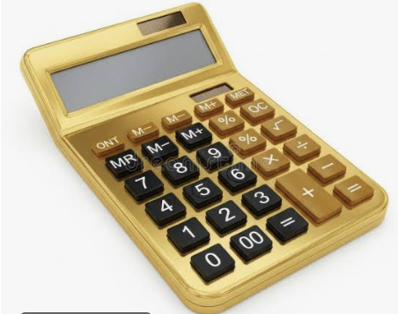
CASE FILE 001
THE GREAT MATHS MYSTERY
The case of the missing Golden Calculator
FOUR SUSPECTS. FIVE DAYS. ONE CULPRIT.
Crack the codes • Examine the evidence • Solve the mystery
01

Slide 5

THE INVESTIGATION
THE GOLDEN CALCULATOR HAS VANISHED
The Maths Department needs your help.
The display cabinet was opened, but nobody knows who took the Golden Calculator. Four teachers were nearby. Each has an alibi. Every day, new evidence will be released.
Do not accuse anyone without evidence!
02

Slide 6
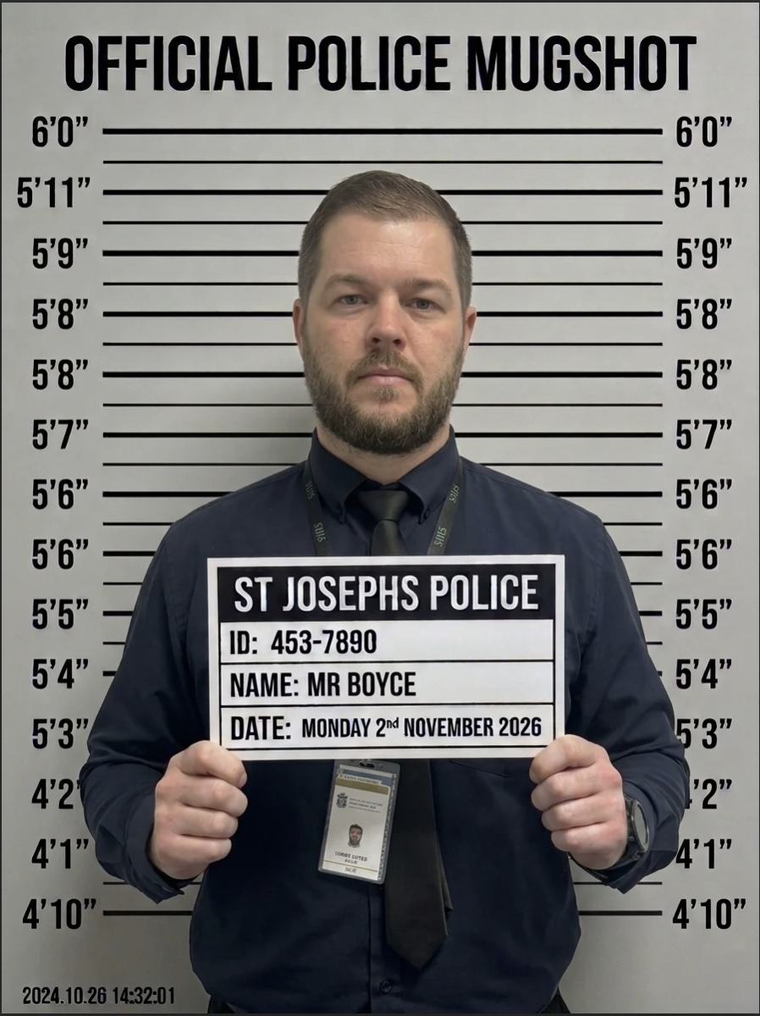
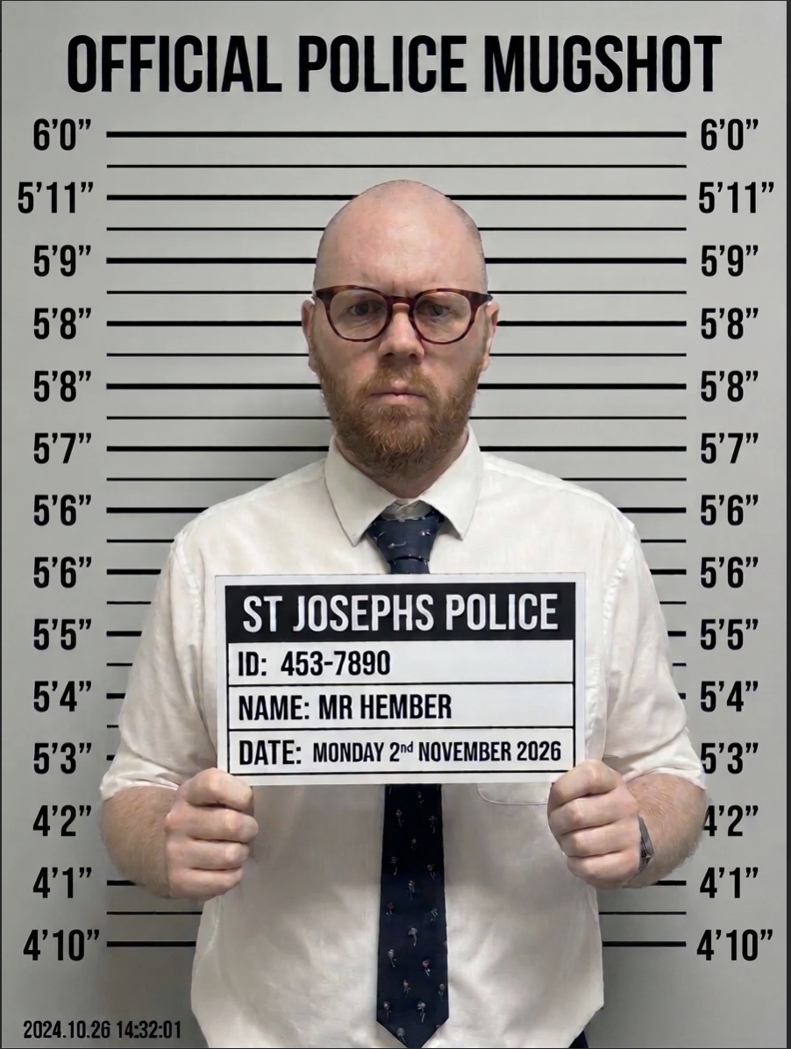
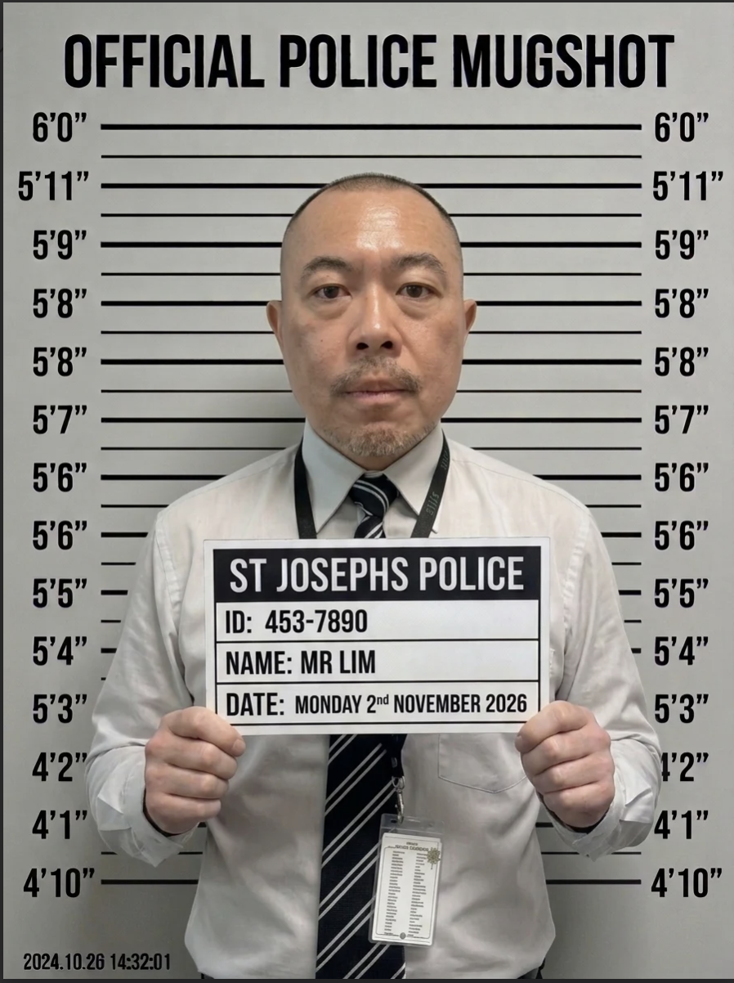
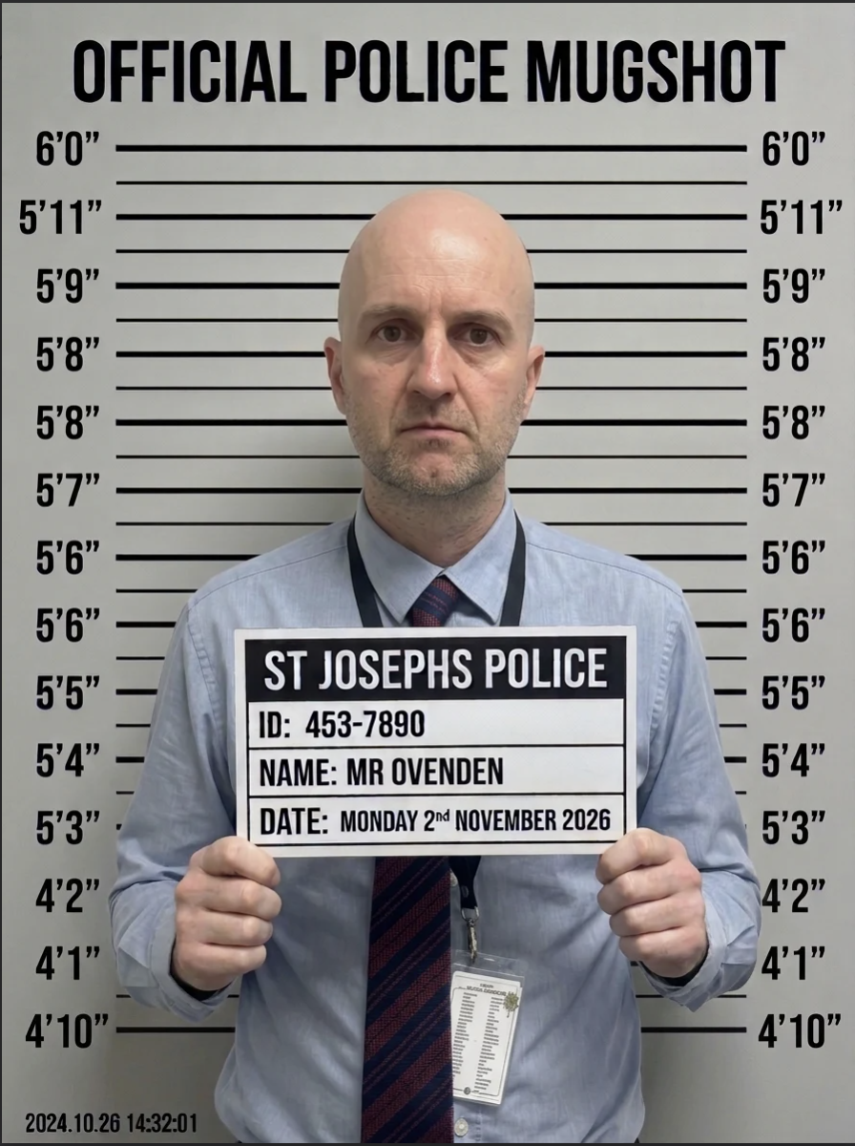
SUSPECT BOARD
MEET THE FOUR SUSPECTS
SUSPECT 01
SUSPECT 02
SUSPECT 03
SUSPECT 04
MR BOYCE
MR HEMBER
MR LIM
MR OVENDEN
03

Slide 7
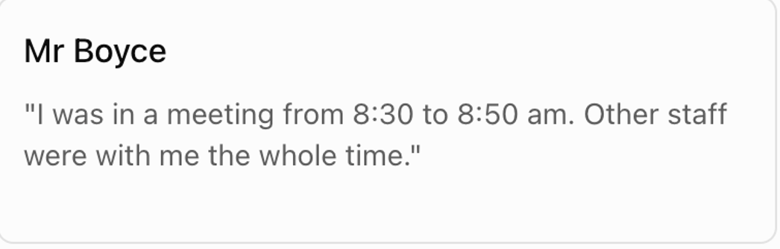
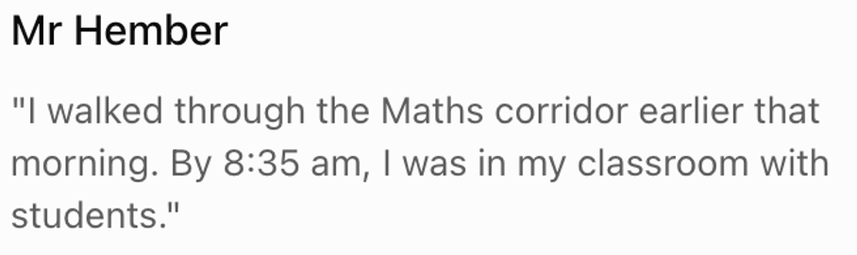
SUSPECT BOARD
SUSPECT 01
MEET THE FOUR SUSPECTS
SUSPECT 02
MR BOYCE
MR HEMBER
03

Slide 8
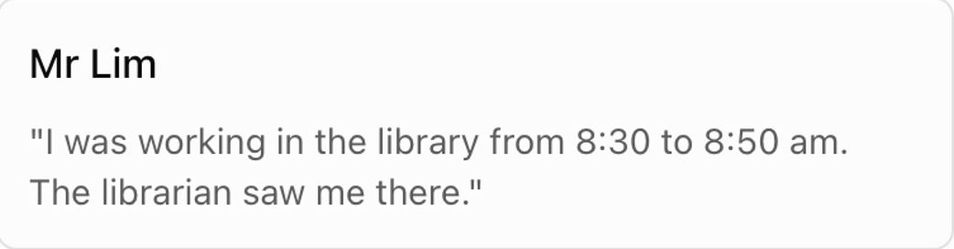
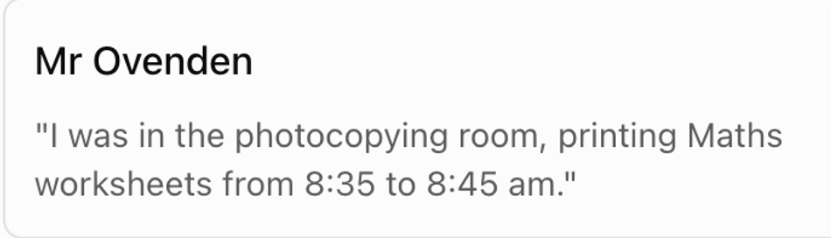
SUSPECT BOARD
MEET THE FOUR SUSPECTS
SUSPECT 03
SUSPECT 04
MR LIM
MR OVENDEN
03

Slide 9
MONDAY • EVIDENCE 01
THE SECURITY CODE
DIGIT 1
DIGIT 2
3² − 3 × (5 − 2)
2³ + 12 ÷ 3 − 4
DIGIT 3
DIGIT 4
(6² − 11) ÷ 5
5 × (3² − 7) − 8
The cabinet was opened at __ __ : __ __
What does the security code tell us — and what does it NOT tell us?
Submit your answer using the Maths Mystery QR code or through the form attached.
04

