Slide 1
FRIDAY LUNCHTIME • REVEAL
CASE CLOSED!
After five days of clues, the investigation is finally over.
THE CULPRIT IS...
MR OVENDEN!
Well done to all our Maths detectives!
THE GREAT MATHS MYSTERY • CASE FILE 001
07

Slide 2
FRIDAY • THE CONFESSION
A MESSAGE FROM THE CULPRIT
Optional: have Mr Ovenden read this aloud or record it.
“I thought I had planned the perfect crime!
I even made sure everyone suspected Mr Hember.
But I underestimated your detective skills.
I admit it — I took the Golden Calculator!”
THE GREAT MATHS MYSTERY • CASE FILE 001
08

Slide 3
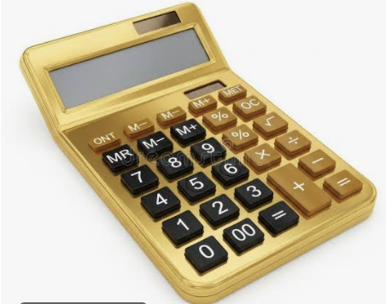
CASE FILE 001
THE GREAT MATHS MYSTERY
The case of the missing Golden Calculator
FOUR SUSPECTS. FIVE DAYS. ONE CULPRIT.
Crack the codes • Examine the evidence • Solve the mystery
01

Slide 4

THE INVESTIGATION
THE GOLDEN CALCULATOR HAS VANISHED
The Maths Department needs your help.
The display cabinet was opened, but nobody knows who took the Golden Calculator. Four teachers were nearby. Each has an alibi. Every day, new evidence will be released.
Do not accuse anyone without evidence!
02

Slide 5
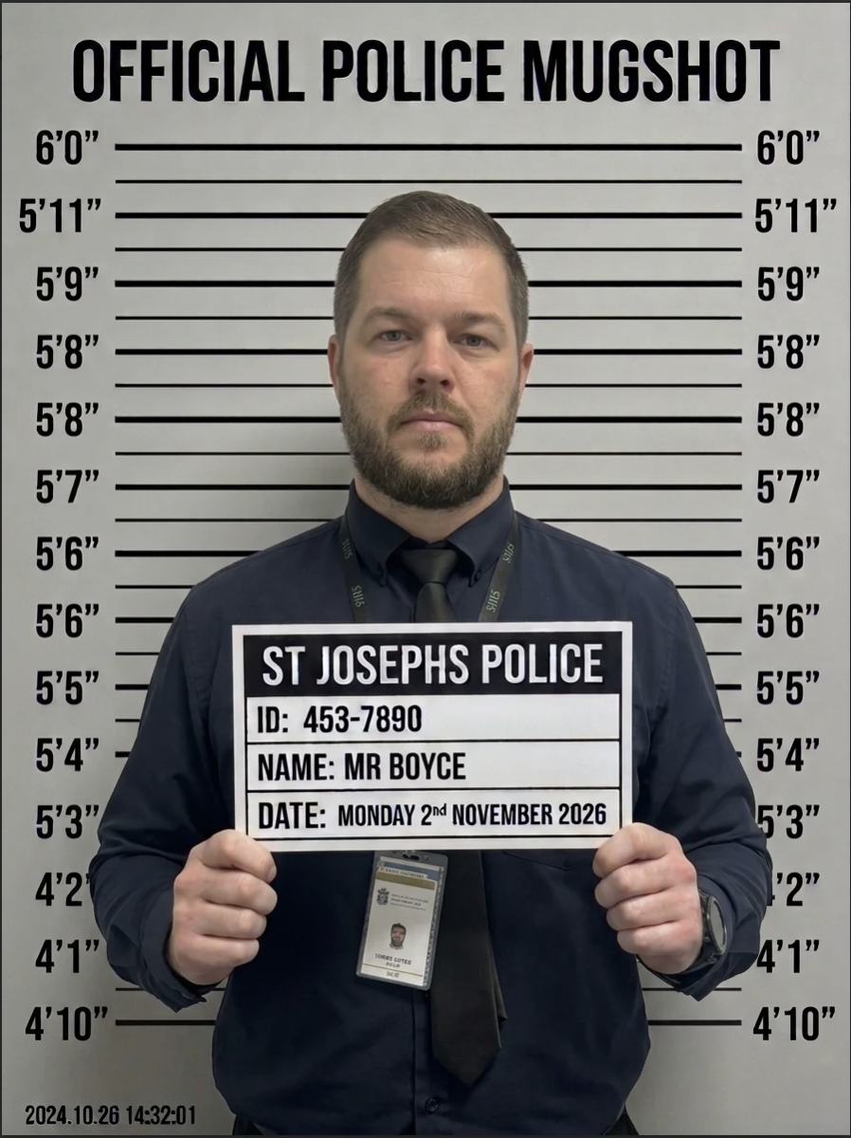
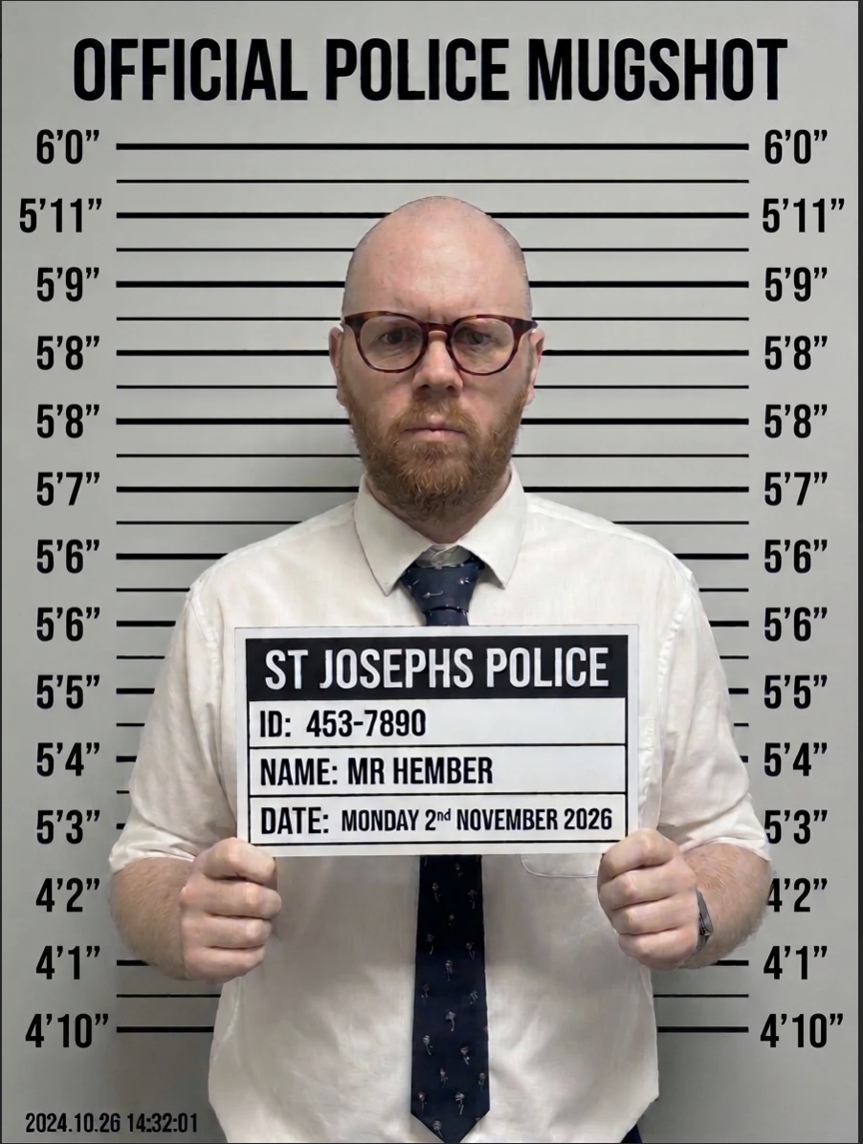
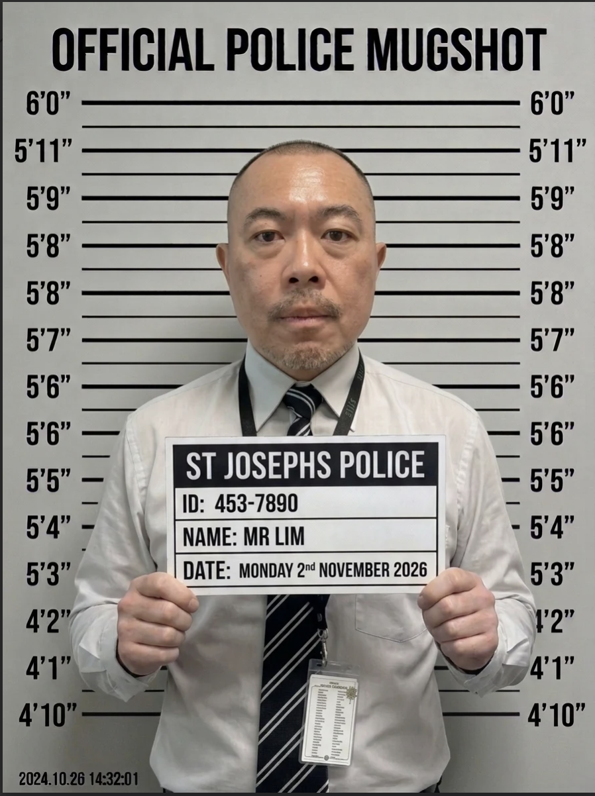
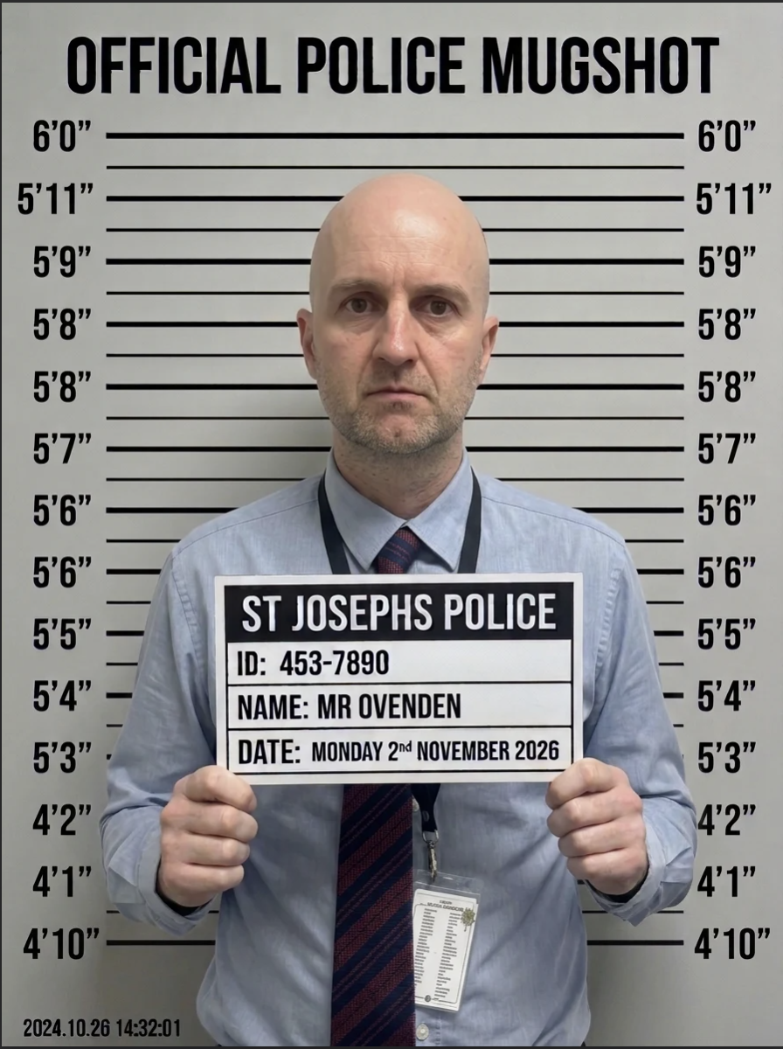
SUSPECT BOARD
MEET THE FOUR SUSPECTS
SUSPECT 01
SUSPECT 02
SUSPECT 03
SUSPECT 04
MR BOYCE
MR HEMBER
MR LIM
MR OVENDEN
03

Slide 6
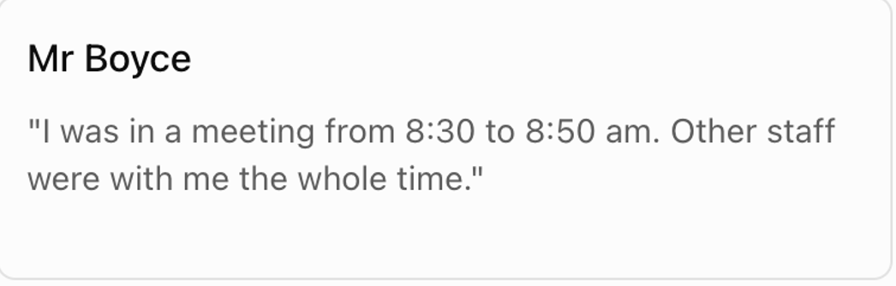
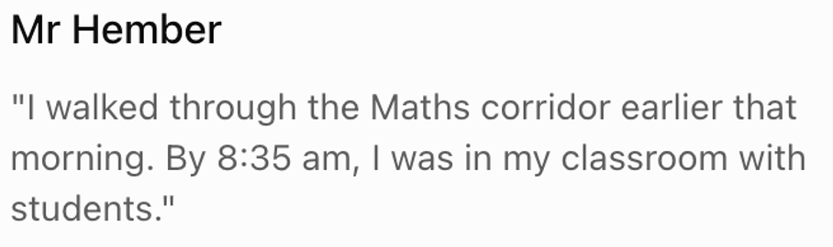
SUSPECT BOARD
SUSPECT 01
MEET THE FOUR SUSPECTS
SUSPECT 02
MR BOYCE
MR HEMBER
03

Slide 7
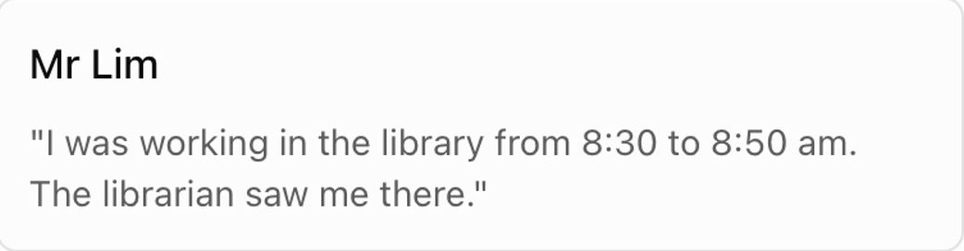
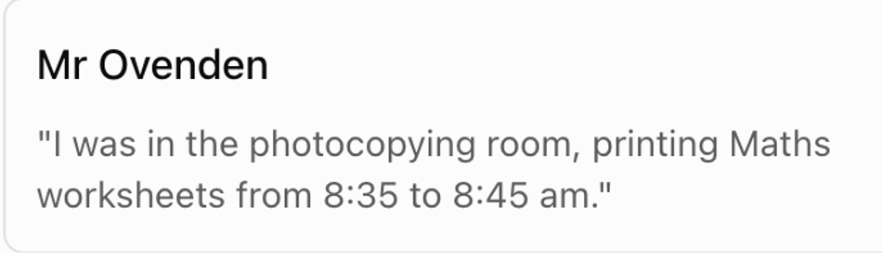
SUSPECT BOARD
MEET THE FOUR SUSPECTS
SUSPECT 03
SUSPECT 04
MR LIM
MR OVENDEN
03

Slide 8
MONDAY • EVIDENCE 01
THE SECURITY CODE
DIGIT 1
DIGIT 2
3² − 3 × (5 − 2)
2³ + 12 ÷ 3 − 4
DIGIT 3
DIGIT 4
(6² − 11) ÷ 5
5 × (3² − 7) − 8
The cabinet was opened at __ __ : __ __
What does the security code tell us — and what does it NOT tell us?
Submit your answer using the Maths Mystery QR code or through the form attached.
04

Slide 9
TUESDAY • EVIDENCE 02
THE FOOTPRINT CIPHER
A muddy footprint was found near the Maths cabinet. A strip of paper contains six mysterious numbers.
THE ENCRYPTED MESSAGE
23 – 20 – 28 – 17 – 20 – 33
“The numbers have been shifted. Find the difference between the two clues below to discover how far.”
CLUE A
CLUE B
5² − 3
2³ − 1
06

Slide 10
TUESDAY • YOUR CHALLENGE
WHO DOES THE CODE NAME?
A = 1, B = 2, C = 3 ... Z = 26
1. Calculate the difference between Clue A and Clue B.
2. Reverse the shift on all six numbers.
3. Convert the results into letters.
Does the decoded name PROVE this person is guilty?
07

Slide 11
WEDNESDAY • EVIDENCE 03
THE BROKEN CLOCK
The CCTV footage may not show what investigators first thought.
IT DISCOVERY: The CCTV clock was running 12 minutes FAST.
Remember Monday: the cabinet opened at 08:52.
THE GREAT MATHS MYSTERY • CASE FILE 001
01

Slide 12
THE GREAT MATHS MYSTERY • CASE FILE 001
01
THURSDAY • EVIDENCE 04
THE DAMAGED KEY REGISTER
The cabinet was locked and undamaged. Investigators believe the original key was used.
RECOVERED KEY REGISTER
CODE
COLLECTED
RETURNED
A
08:10
08:30
B
08:22
08:34
C
08:34
08:49
D
08:50
09:05

Slide 13
THE GREAT MATHS MYSTERY • CASE FILE 001
02
THURSDAY • WITNESS STATEMENTS
FOUR CLUES. FOUR TEACHERS.
The names were lost from the register. Use the recovered statements to match each teacher to a code.
1. Mr Boyce collected the key after Mr Hember, but before Mr Lim.
2. Mr Lim was the last person to collect the key.
3. Mr Ovenden collected the key 12 minutes after Mr Boyce.
4. Mr Hember was the first person to collect the key.

Slide 14
THE GREAT MATHS MYSTERY • CASE FILE 001
03
THURSDAY • YOUR CHALLENGE
CRACK THE KEY REGISTER
Solve the full puzzle before deciding who could have opened the cabinet.
1. Match Mr Boyce, Mr Hember, Mr Lim and Mr Ovenden to codes (A-D).
2. Write the letters in code order (for example B-C-A-D).
3. Which coded entry held the key at 08:40?
4. What does this suggest — and what still needs proving?

Slide 15
ORGANISER ONLY • DO NOT DISPLAY
MONDAY ANSWERS
Remove or hide these slides before sharing with students.
Digit 1: 9 − 9 = 0
Digit 2: 8 + 4 − 4 = 8
Digit 3: (36 − 12) ÷ 6 = 4
Digit 4: 5 × (9 − 7) − 10 = 0
SECURITY TIME: 08:40 am
09

Slide 16
ORGANISER ONLY • DO NOT DISPLAY
TUESDAY ANSWERS
This clue is a red herring, not proof of guilt.
Clue A = 25 − 3 = 22; Clue B = 8 − 1 = 7
Shift = 22 − 7 = 15
Subtract 15 from every number:
8 – 5 – 13 – 2 – 5 – 18
DECODED NAME: HEMBER
10

Slide 17
ORGANISER ONLY • DO NOT DISPLAY
WEDNESDAY + THURSDAY ANSWERS
Keep this slide out of student-facing exports.
WEDNESDAY
08:40 − 12 mins = 8:28am
Mr Hember is confirmed in class from 08:35 to 08:45.
THURSDAY
Hember: 20 minutes (08:10–08:30).
Ovenden: 15 minutes (08:34–08:49).
Only Mr Ovenden held the cabinet key at 08:40.
ORGANISER ONLY • DO NOT DISPLAY
10

Slide 18
THE GREAT MATHS MYSTERY • CASE FILE 001
04
ORGANISER ONLY • DO NOT DISPLAY
THURSDAY ANSWER KEY
Remove or hide this slide before showing the puzzle to students.
A → MR HEMBER 08:10–08:30
B → MR BOYCE 08:22–08:34
C → MR OVENDEN 08:34–08:49
D → MR LIM 08:50–09:05
ORDER: H–B–O–L • AT 08:40: CODE C (MR OVENDEN)

