Slide 1
WEDNESDAY • EVIDENCE 03
THE BROKEN CLOCK
The CCTV footage may not show what investigators first thought.
IT DISCOVERY: The CCTV clock was running 12 minutes FAST.
Remember Monday: the cabinet opened at 08:52.
THE GREAT MATHS MYSTERY • CASE FILE 001
01

Slide 2
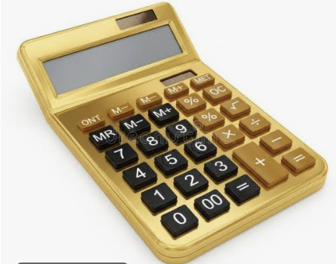
CASE FILE 001
THE GREAT MATHS MYSTERY
The case of the missing Golden Calculator
FOUR SUSPECTS. FIVE DAYS. ONE CULPRIT.
Crack the codes • Examine the evidence • Solve the mystery
01

Slide 3

THE INVESTIGATION
THE GOLDEN CALCULATOR HAS VANISHED
The Maths Department needs your help.
The display cabinet was opened, but nobody knows who took the Golden Calculator. Four teachers were nearby. Each has an alibi. Every day, new evidence will be released.
Do not accuse anyone without evidence!
02

Slide 4
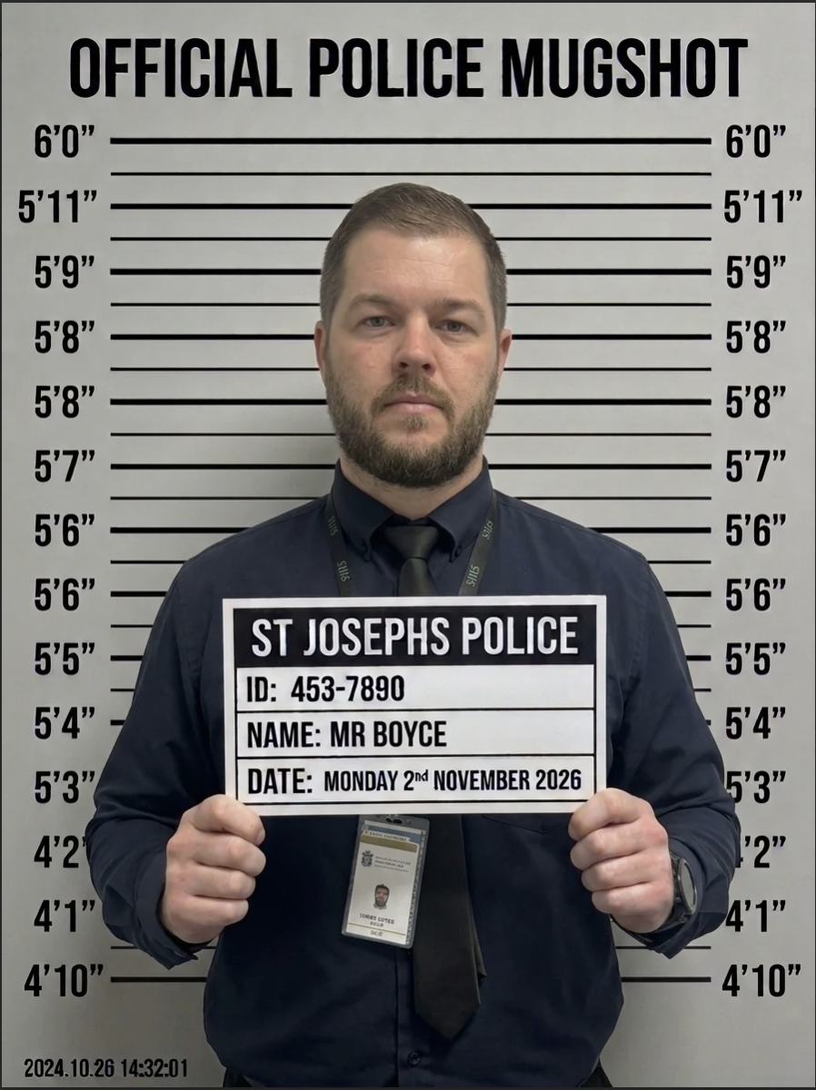
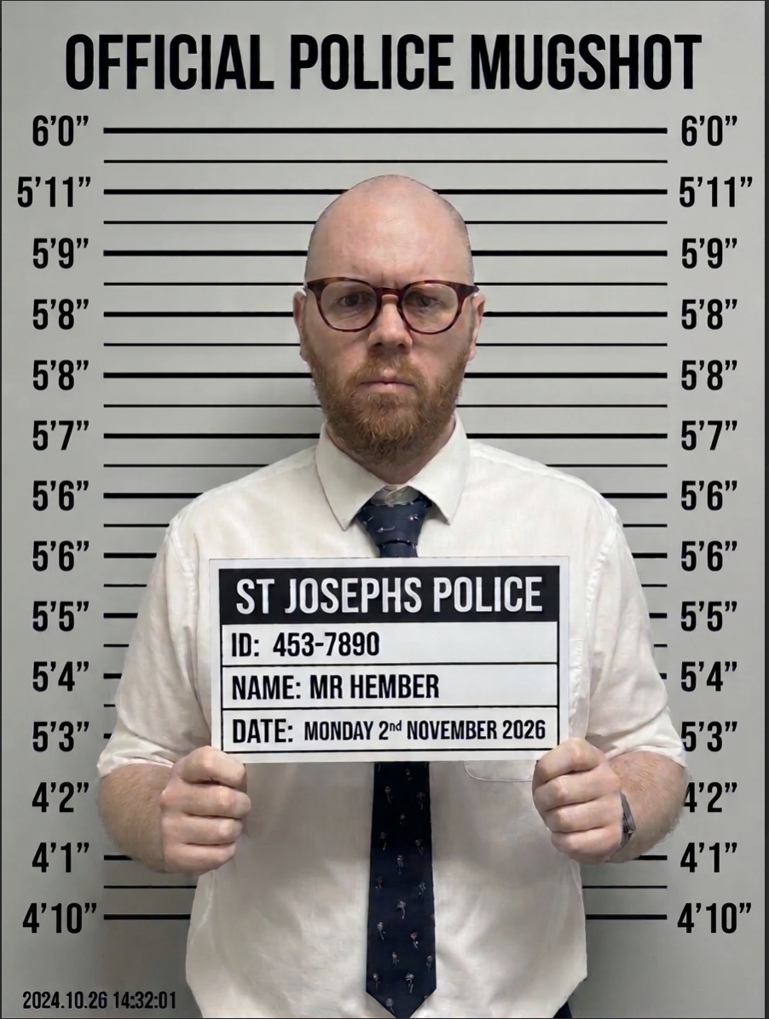
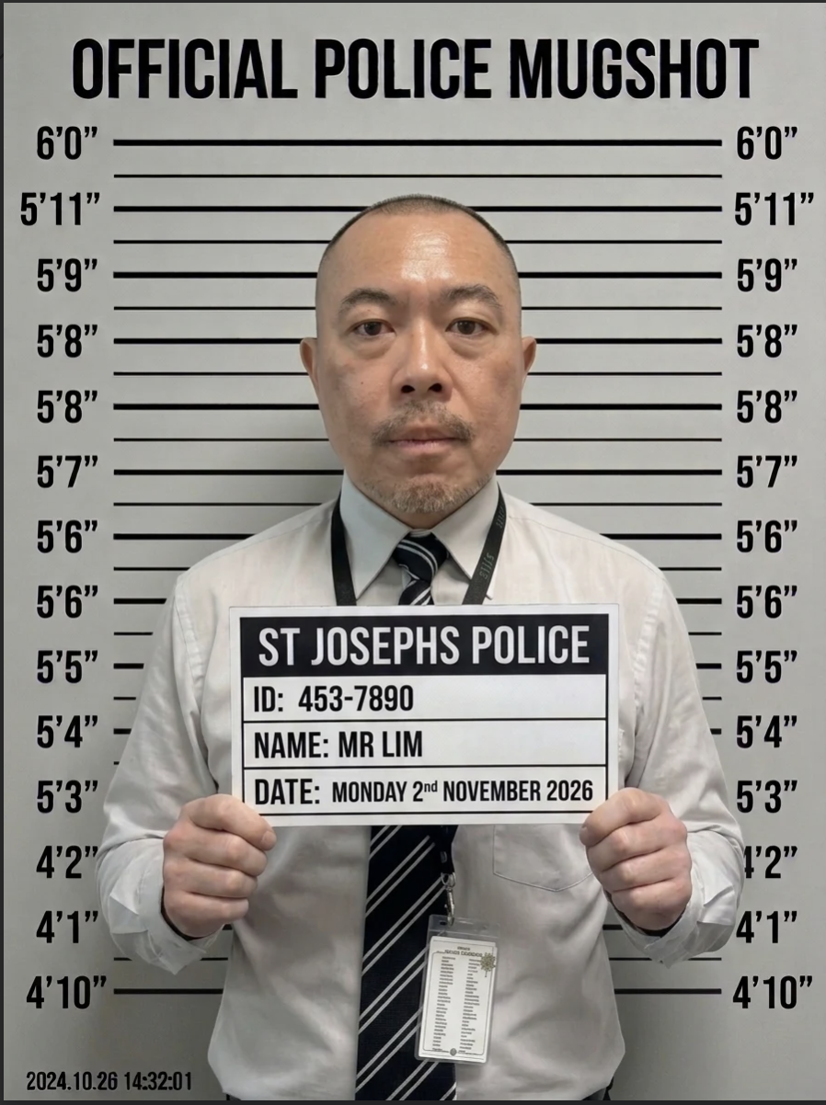
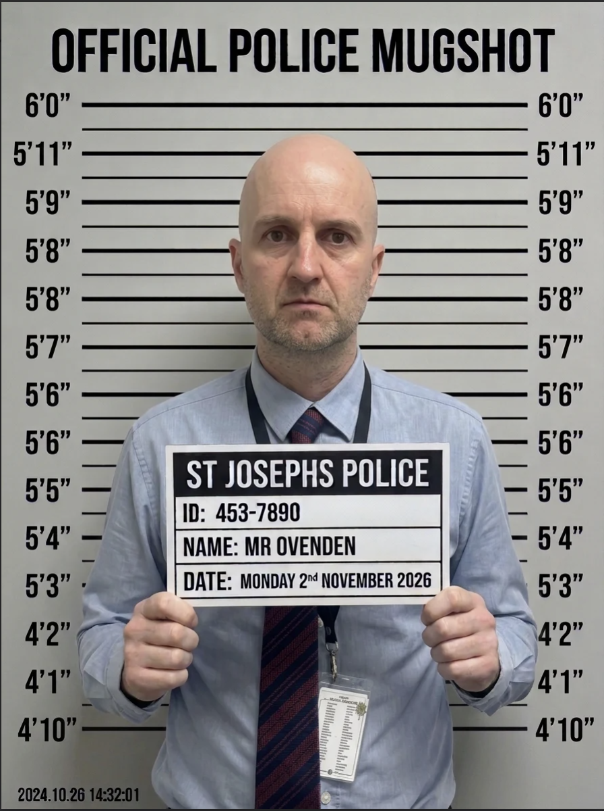
SUSPECT BOARD
MEET THE FOUR SUSPECTS
SUSPECT 01
SUSPECT 02
SUSPECT 03
SUSPECT 04
MR BOYCE
MR HEMBER
MR LIM
MR OVENDEN
03

Slide 5
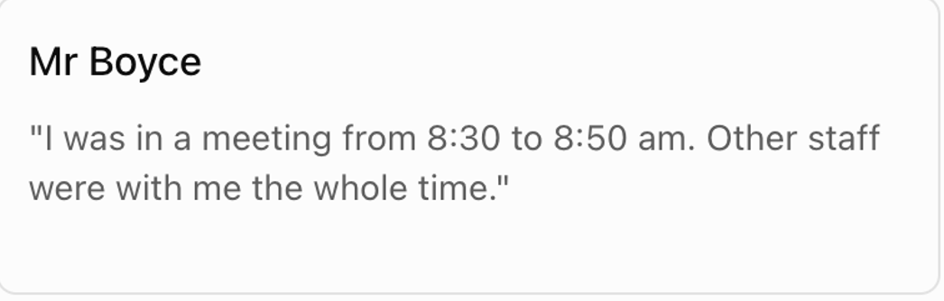
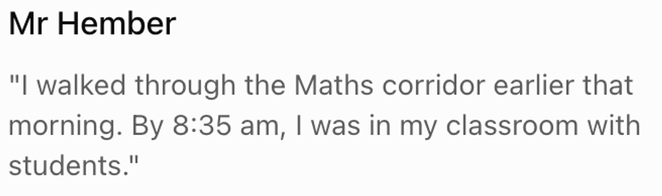
SUSPECT BOARD
SUSPECT 01
MEET THE FOUR SUSPECTS
SUSPECT 02
MR BOYCE
MR HEMBER
03

Slide 6
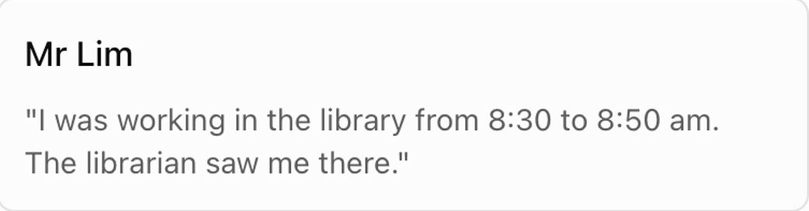
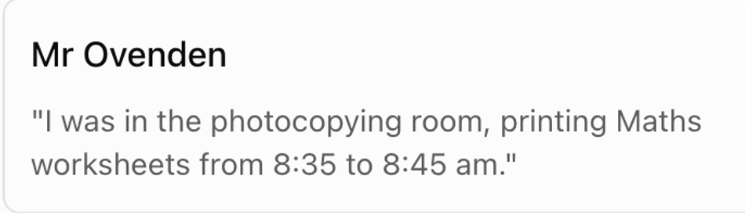
SUSPECT BOARD
MEET THE FOUR SUSPECTS
SUSPECT 03
SUSPECT 04
MR LIM
MR OVENDEN
03

