Slide 1

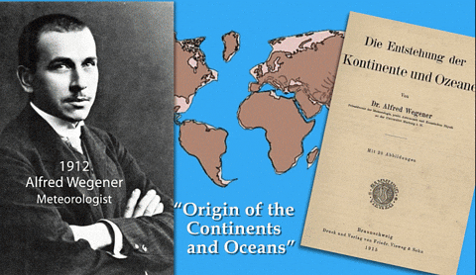
Title: How do we know the plates are moving?
LO: Analyse evidence to support the theory of continental drift; Discuss different theories of plate movement,
Date: Tuesday 9th September 2025
Title: How do we know the plates are moving?
Last Lesson: Name the 4 types of plate boundaries
Last Week: Why do earthquakes often happen near plate boundaries?
Last Week: Why don’t all volcanoes form at plate boundaries?

Slide 2
Title: How do we know the plates are moving?
LO: Analyse evidence to support the theory of continental drift; Discuss different theories of plate movement,
Date: Thursday 18th September 2025
Title: How do we know the plates are moving?
Last Lesson:
Use latitude and longitude to mark the major volcanic eruptions and earthquakes on your map.
Name the 4 types of plate boundaries

Slide 3
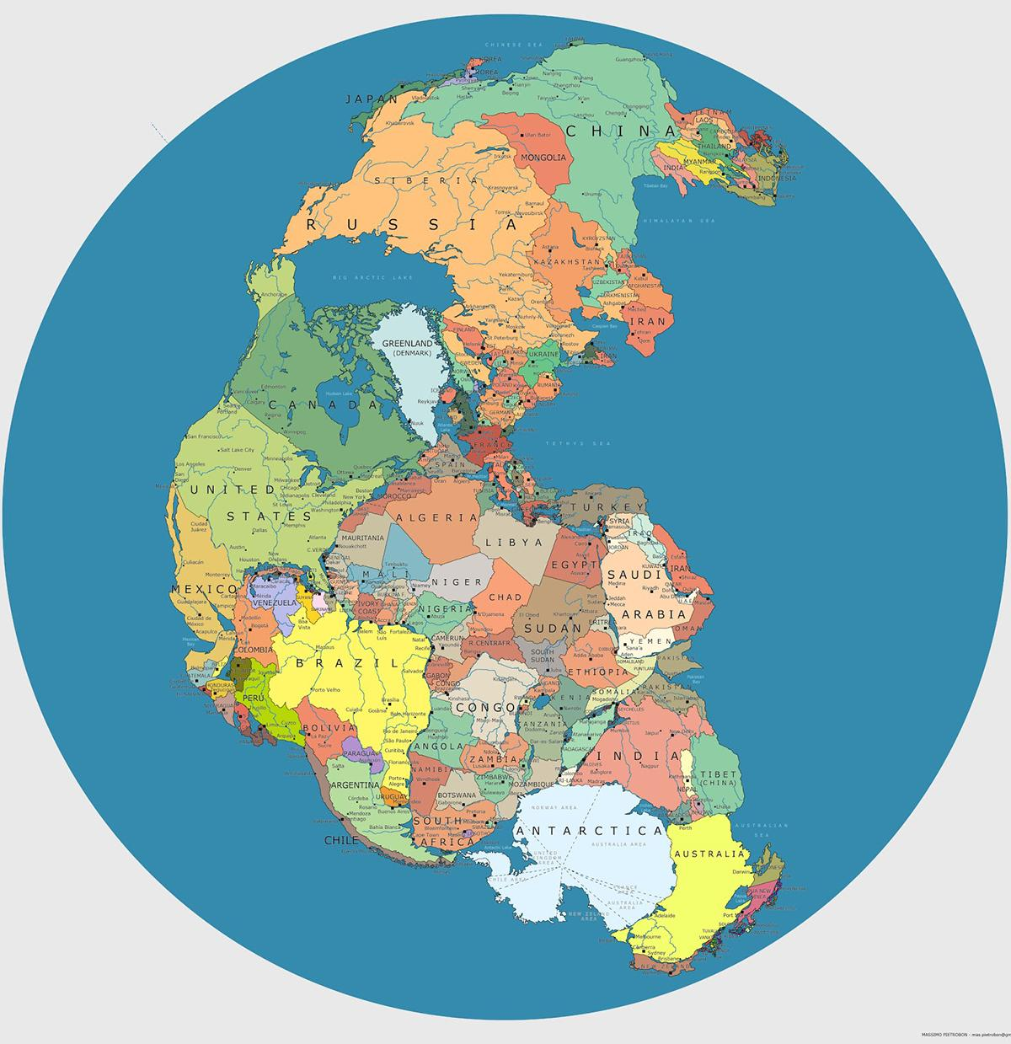
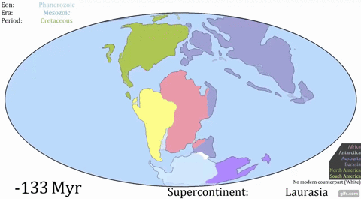
Title: How do we know the plates are moving?
LO: Analyse evidence to support the theory of continental drift; Discuss different theories of plate movement,
Pangaea Supercontinent
Around 300 million years ago, all the land on Earth was joined together in one supercontinent called Pangaea. But what happened next?

Slide 4
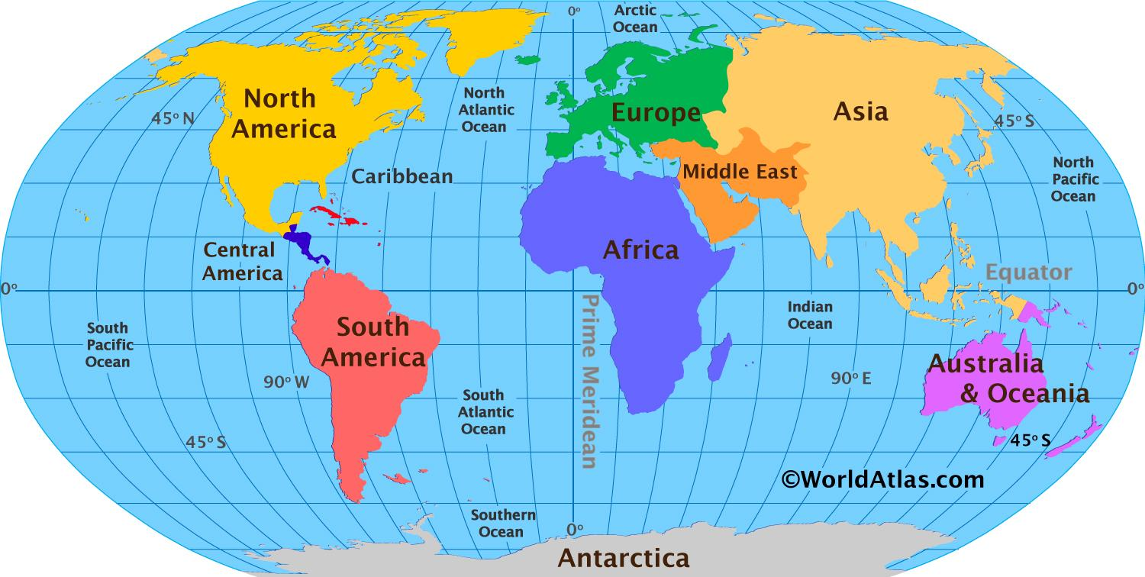
Title: How do we know the plates are moving?
LO: Analyse evidence to support the theory of continental drift; Discuss different theories of plate movement,
Which continents do you think look like they could fit together like jigsaw pieces

Slide 5
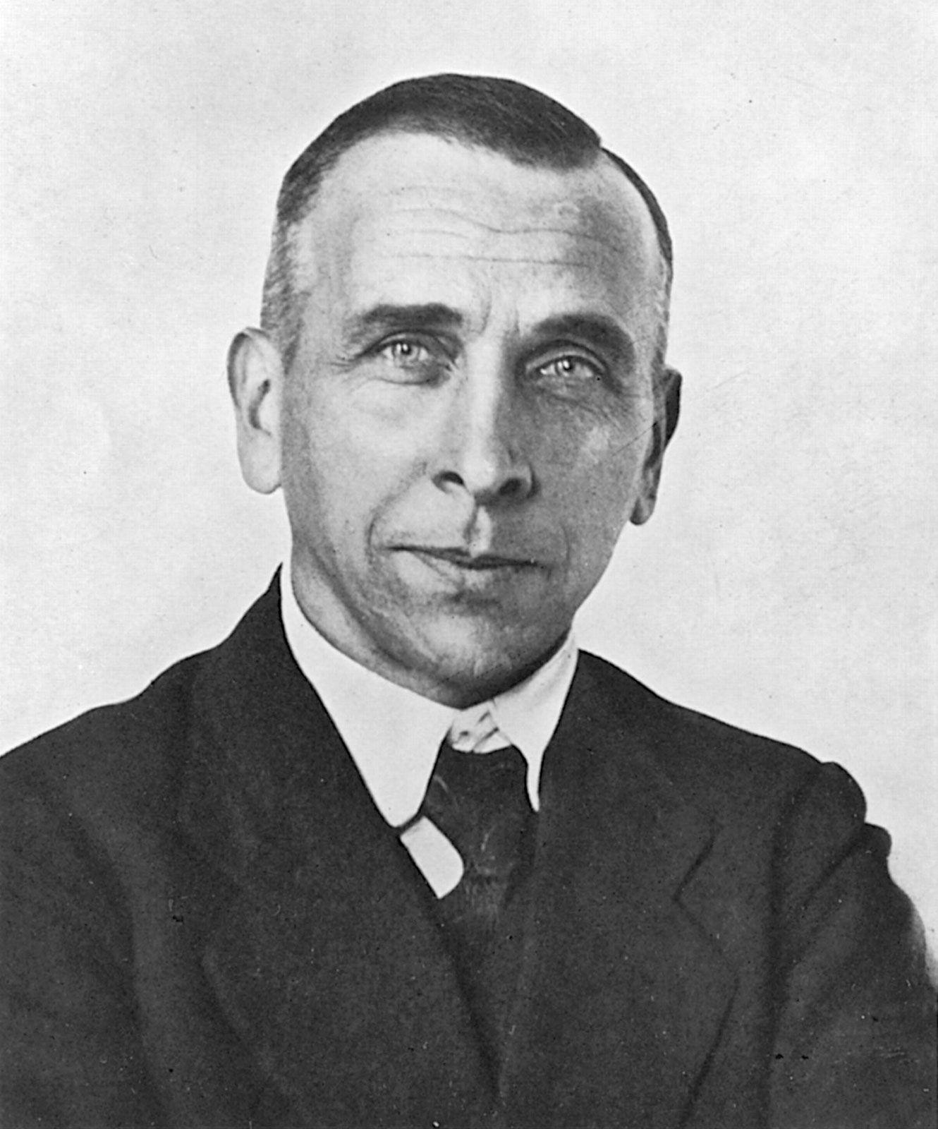
Title: How do we know the plates are moving?
LO: Analyse evidence to support the theory of continental drift; Discuss different theories of plate movement,
How do we know the continents have moved?
Alfred Wegener was a German scientist in the early 1900s. He first suggested the idea of continental drift — the process where tectonic plates move, causing the continents to spread apart.
Wegener noticed that the continents looked like they could fit together, like pieces of a puzzle.
At first, many scientists did not believe him, but later evidence showed he was right.
Alfred Wegener

Slide 6
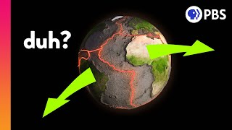
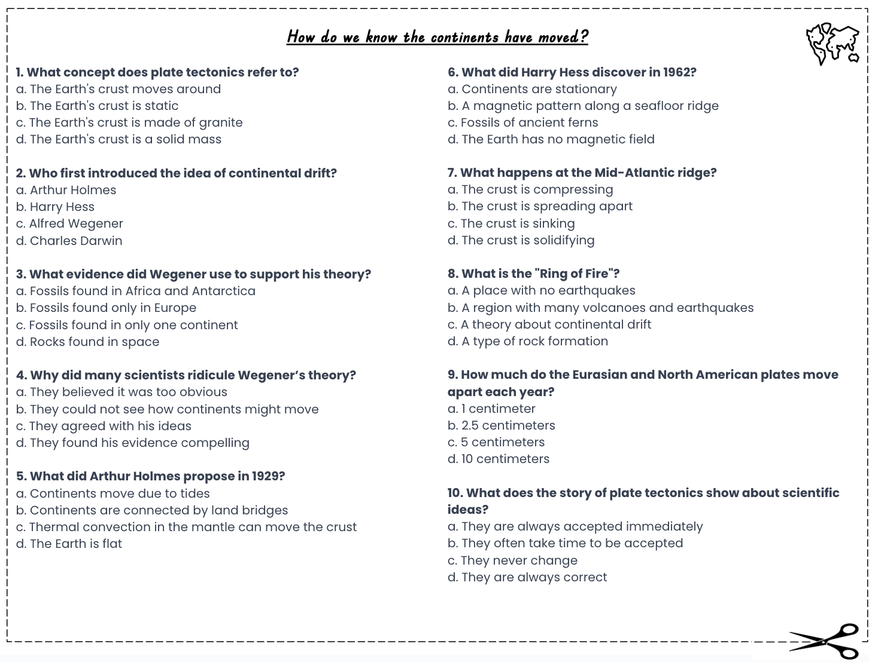
Title: How do we know the plates are moving?
LO: Analyse evidence to support the theory of continental drift; Discuss different theories of plate movement,
How do we know the continents have moved?
Activity: Complete the multiple choice questions whilst watching the video on
Why It Took Scientists So Long To Accept This Very Obvious Idea
Notes:
https://www.youtube.com/watch?v=HMhjjbBkV9E

Slide 7
Title: How do we know the plates are moving?
LO: Analyse evidence to support the theory of continental drift; Discuss different theories of plate movement,
How do we know the continents have moved?
a. The Earth's crust moves around
c. Alfred Wegener
d. Fossils found in Africa and Antarctica
b. They could not see how continents might move
c. Thermal convection in the mantle can move the crust
a. A magnetic pattern along a seafloor ridge
d. The crust is spreading apart
c. A region with many volcanoes and earthquakes
b. 2.5 centimeters
b. They often take time to be accepted
GREEN PEN YOUR ANSWERS

Slide 8
Title: How do we know the plates are moving?
LO: Analyse evidence to support the theory of continental drift; Discuss different theories of plate movement,
How do we know the continents have moved?
Wegener had four main points to support his theory of continental drift:
Fit of continents: The coastlines of some continents look like they fit together, like pieces of a puzzle, in one big land called Pangaea.
Fossil evidence: The same fossils have been found on both sides of the ocean.
Rock and mountain evidence: The same rocks and mountains are found on both sides of the ocean.
Climate evidence: Coal and oil have been found in places that are cold today, and signs of glaciers have been found in places that are hot today.
Alfred Wegener

Slide 9
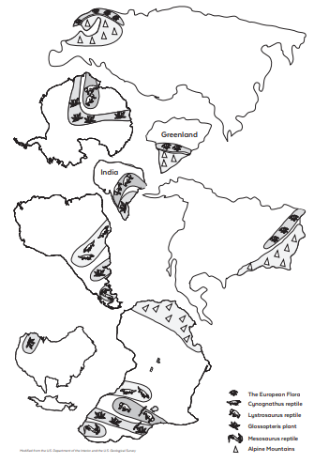
Title: How do we know the plates are moving?
LO: Analyse evidence to support the theory of continental drift; Discuss different theories of plate movement,
Pangaea puzzle!
In pairs use the fossil evidence to rebuild the Pangaea supercontinent.
Cut out and label the continents, then use the puzzle pieces to recreate the Pangaea supercontinent.
The first team to finish the puzzle correctly is the winner!
Stuck? Look at the map evidence to see which continents match.

Slide 10
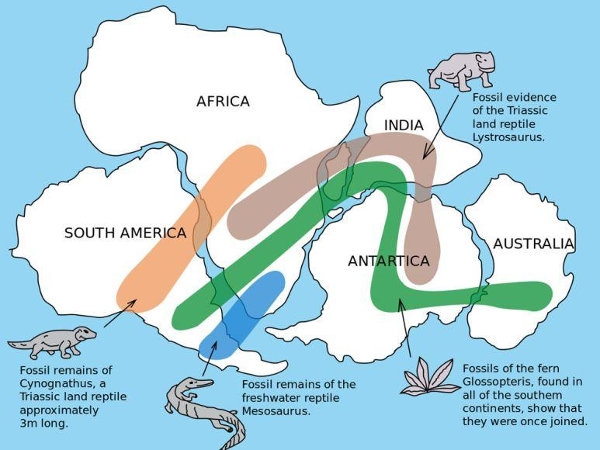
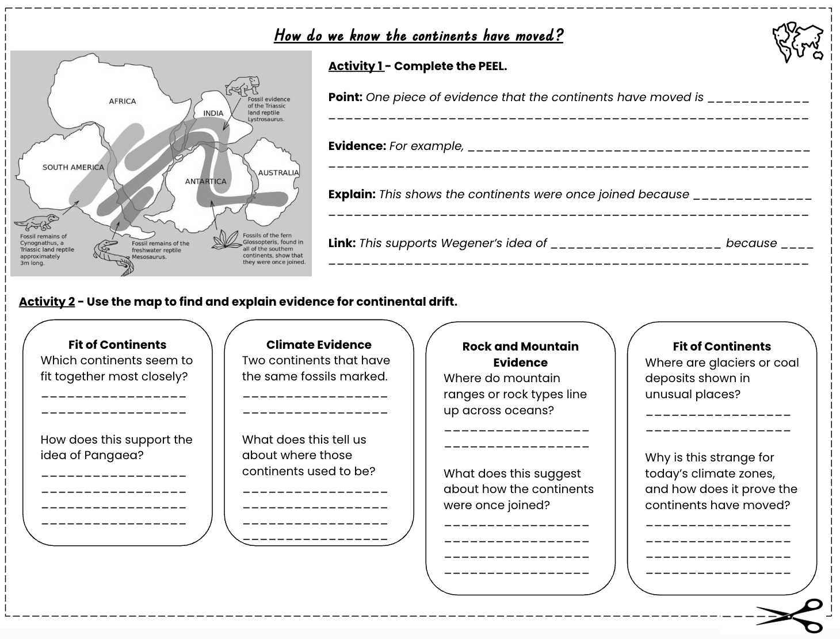



Title: How do we know the plates are moving?
LO: Analyse evidence to support the theory of continental drift; Discuss different theories of plate movement,
How do we know the continents have moved?
Activity 1 - Complete the PEEL to explain how the location of fossils tells us the continents have moved.
Activities 1 & 2 on sheet
Activity 2 - Use the map to find and explain evidence for continental drift.
Which piece of evidence do you think best supports Wegener’ continental drift theory? Give at least one reason to explain your choice.
Rank the pieces of evidence from Wegener’s theory of continental drift from most to least convincing. Explain why you ranked them this way.

Slide 11
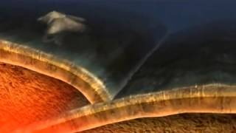
Title: How do we know the plates are moving?
LO: Analyse evidence to support the theory of continental drift; Discuss different theories of plate movement,
So why are the continents moving?
Convection Currents or Slab Pull & Ridge Push
How does hot rock moving in the Earth’s mantle make the continents move?
Why should we respect the Earth’s natural cycles, like when carbon dioxide is released in eruptions?
Continental drift happens very slowly. Why do scientists need patience to study it?
Notes:
http://www.youtube.com/watch?v=MmMX83diwl0

Slide 12
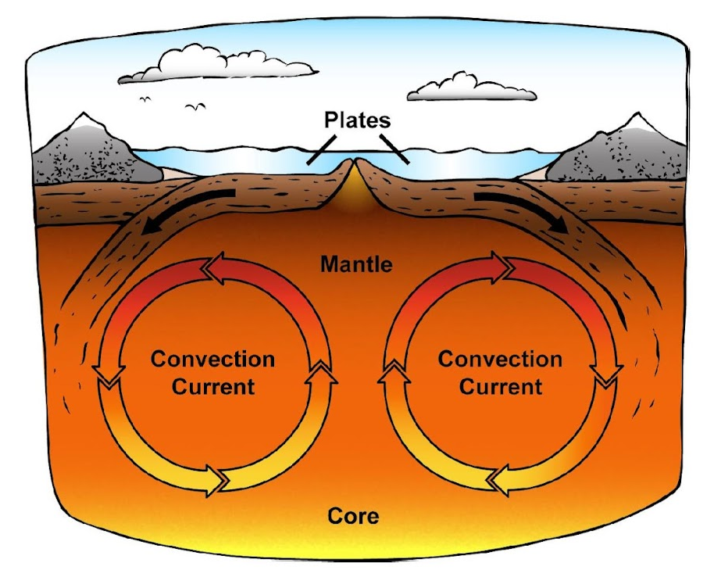
Title: How do we know the plates are moving?
LO: Analyse evidence to support the theory of continental drift; Discuss different theories of plate movement,
So why are the continents moving?
Historic Thinking – Convection Currents
For many years, scientists thought convection currents were the main force that moved the plates. Heat from the Earth’s core makes material in the mantle rise, then cool and sink. This cycle forms a current that was believed to drag the tectonic plates.
Convection currents also seemed to explain how new crust could be created at some boundaries and destroyed at others. This idea was accepted for decades. However, modern research suggests convection currents may not be strong enough on their own to move entire plates.
Notes:
http://www.youtube.com/watch?v=MmMX83diwl0

Slide 13
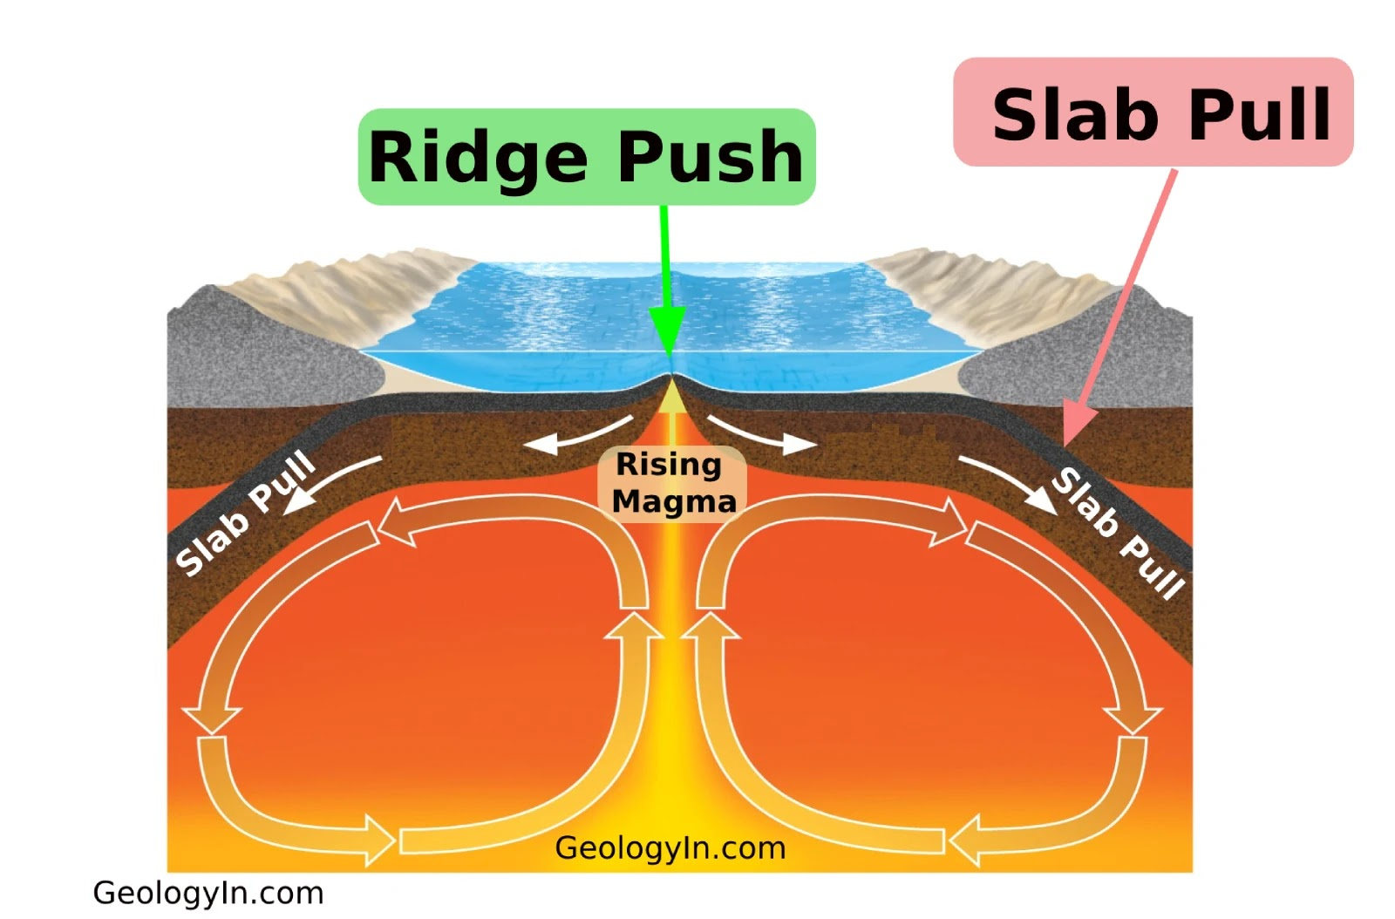
Title: How do we know the plates are moving?
LO: Analyse evidence to support the theory of continental drift; Discuss different theories of plate movement,
So why are the continents moving?
Modern Thinking – Slab Pull & Ridge Push
Today, most scientists believe slab pull and ridge push are the key forces. Slab pull is the stronger force: when a dense oceanic plate sinks at a subduction zone, its weight pulls the rest of the plate down, like a coat sliding off a table. Ridge push is weaker.
At mid-ocean ridges, new crust forms, cools, and sinks under gravity, pushing older rock away. These two forces together help explain plate movement. Yet, even now, scientists do not fully agree, and the details remain debated.

Slide 14
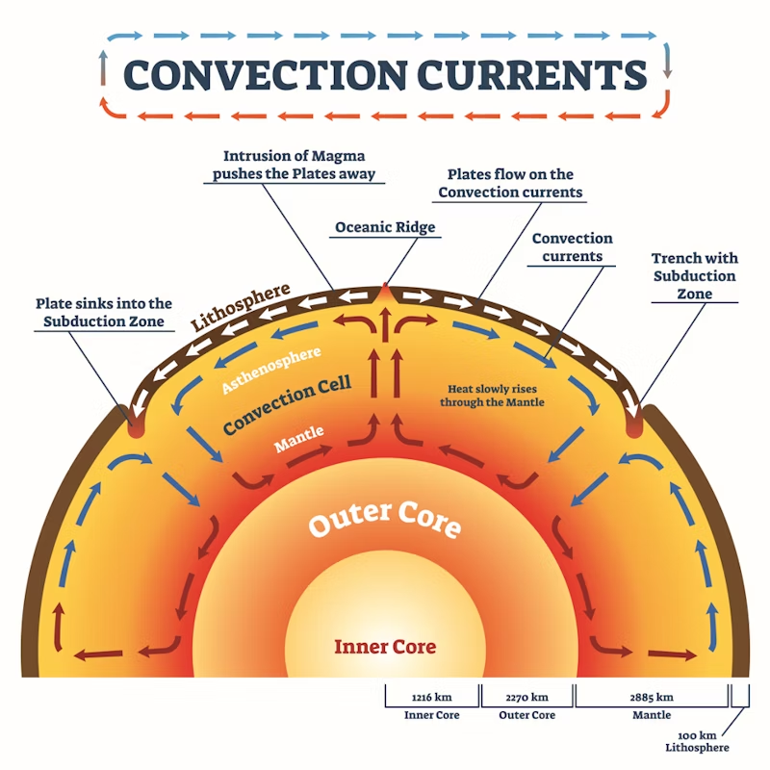
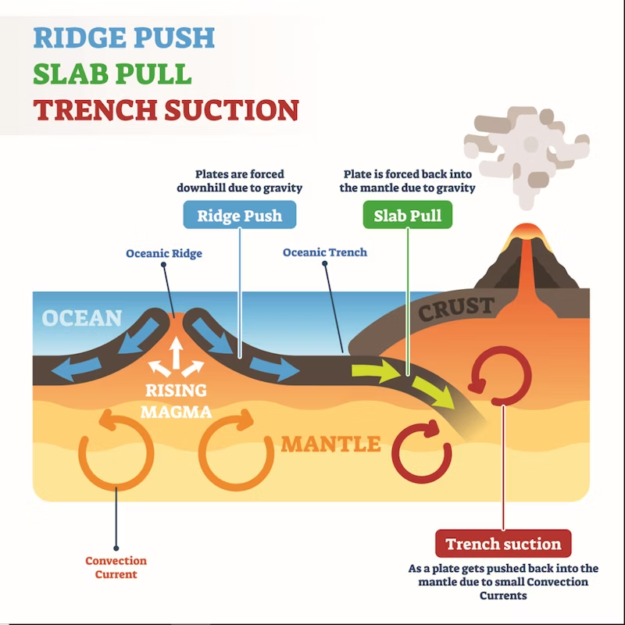



Title: How do we know the plates are moving?
LO: Analyse evidence to support the theory of continental drift; Discuss different theories of plate movement,
So why are the continents moving?
Activity 3: Use the information sheet to help you explain how slab pull and ridge push work to move the tectonic plates. (Make sure to include key terms like mantle, convection currents, slab pull, and ridge push.)
Point – Tectonic plates move because…
Evidence – One piece of evidence is that… Another piece of evidence is…
Explain – This means that the plates are moved because… Another force is … and finally …
Link – This shows that…
Breakdown Available
Which explanation for plate movement (convection currents or slab pull and ridge push) best supports Wegener’s theory of continental drift and why?
Activity 4: Colour and label the the key parts of the diagram. (mantle, convection currents, subduction zone, ridge).

Slide 15
Title: How do we know the plates are moving?
LO: Analyse evidence to support the theory of continental drift; Discuss different theories of plate movement,
Activity 3: Use the information sheet to help you explain how slab pull and ridge push work to move the tectonic plates. (Make sure to include key terms like mantle, convection currents, slab pull, and ridge push.)
Point: Tectonic plates move because of convection currents in the mantle, as well as the processes of slab pull and ridge push.
Evidence: One piece of evidence is that hot magma rises towards the surface at mid-ocean ridges, creating new crust and pushing plates apart — this is known as ridge push. Another piece of evidence is that when an oceanic plate sinks back into the mantle at a subduction zone, it pulls the rest of the plate with it — this is called slab pull.
Explain: This means that the plates are constantly moving because heat from the Earth’s core causes the mantle to move in circular convection currents. These currents drag the plates above them, while slab pull and ridge push help drive their motion.
Link: This shows that the movement of the plates is powered by energy from within the Earth, helping to explain how continents slowly drift and change position over millions of years.

Slide 16

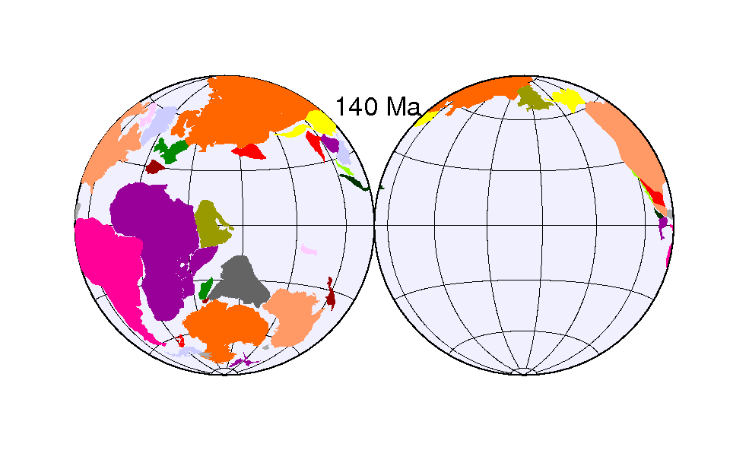

Title: How do we know the plates are moving?
LO: Analyse evidence to support the theory of continental drift; Discuss different theories of plate movement,
What is one important thing you have learned today about how the Earth’s plates move and why is this important?
Why is it important to respect Wegener’s work, even though many scientists at first rejected his ideas?
Why is it important for scientists to be honest about the limits of their evidence when studying plate movement?
Notes:
https://dashboard.blooket.com/set/68b8d0887ef53e8c73be158f

