Slide 1
From Scratch to Python

Slide 2

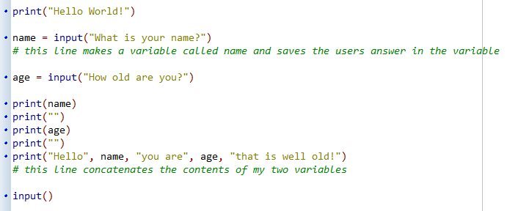
What is this?
What do you notice?
What questions do you have?
Can you link it to anything you have done before in Computer Science lessons?
What do you think it is? (hypothesis)

Slide 3
Lesson Objectives
Lesson Objectives
Understand what Python is
Understand how to program outputs in python,
Understand how to program inputs in python,
Understand the need to store inputs in python,
Understand how to store inputs into variables in python,
Lesson Outcomes
Carrying out a number of programming tasks.
Literacy – Key Words
Input | Values which get sent from the user into the computer
Variable | The place where inputs get stored by the program
Output | The values which get sent from the computer to the user

Slide 4
How can we use Python programming to solve simple real-world problems and automate everyday tasks?

Slide 5
What is Python?
Python is a very powerful programming language used by many huge and important companies.
  Google uses python for parts of some its apps and also python is used for some of the internal scripts for its search engine
  NASA has used Python in a number of its application systems
  Yahoo! Groups uses Python when it comes to maintaining its discussion groups
  YouTube uses Python for some of its features too!

Slide 6
Learning to program like the professionals!
Programming in Python is just like programming in Scratch…
...its just that you have to write the code yourself instead of using the coloured ‘building blocks’.

Slide 7
Hands up if you can tell me the following…
“The Scratch Block needed to display some words on the screen”

Slide 8
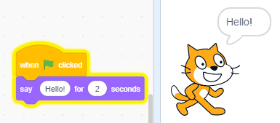
Programming Outputs
In scratch:
Output
In Scratch, the ‘Say’ block would allow us to get our sprite to output a message onto the screen.

Slide 9
Hands up if you can tell me the following…
“The Python Code needed to display some words on the screen”

Slide 10
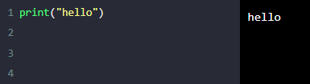
…in Python we use print()
In python:
Output
The print() statement will output the contents of its brackets.
If we wish it to print some text, the text must be surrounded by quotes!

Slide 11
Lets Practice
On your whiteboard…
Write the code to display your name on the screen

Slide 12
Lets Practice
On your whiteboard…
Write the code to display a message of your choice on the screen

Slide 13
Quick Class Task
Visit coder.computerscienceuk.com/coder/
Write the first program ever made…get your program to display the text HELLO WORLD, when the program is run
If you get this working, make it display a message of your choice
TIPS:
You will need to use the print() statement
To run the program, click the rocket icon!

Slide 14


Can you tell me the following…
The python code needed to display a word on the screen
The python code needed to ask the user for an input
The way python can store user inputs
…lets look at inputs and storage then!!

Slide 15
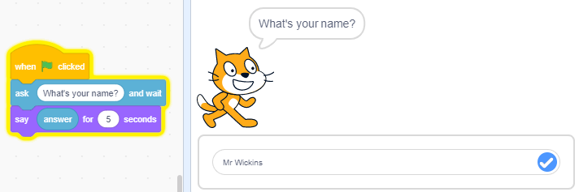
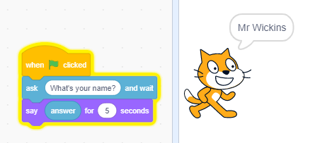
Programming Inputs & Storing Inputs in SCRATCH
In scratch:
In Scratch, the ‘Ask’ block would allow our sprite to ask the user to enter an input.
The ‘answer’ variable would store the input.
And we could use the answer variable with a ‘Say’ block to output the inputted value.

Slide 16
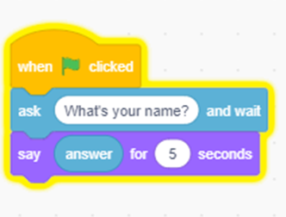
Programming Inputs & Storing Inputs in SCRATCH
In python, instead of ‘ask’, we use the input statement:
input()
input(“what is your name?”)
But we also need to store what the user types in, otherwise the input will be lost.
In Scratch, what did we use to store an input?

Slide 17
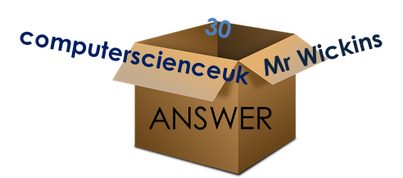
How does a computer store inputs?
In programming, inputs and data are stored in something called a variable.
It can simply be thought of as a storage box.
The box may be given a name, and it may hold various different things.
Variable called ‘ANSWER’
Contents is anything we type in

Slide 18
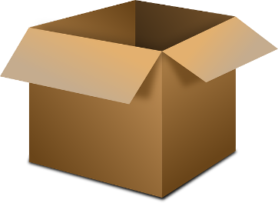
Storing Inputs in PYTHON
input(“what is your name?”)
Problem with the above is that whatever the user types in, it doesn’t actually go anywhere
We need to STORE IT…
answer = input(“what is your name?”)
What the user types in (e.g. their name)
ANSWER
Now, whatever’s typed in is now stored in a variable called answer.

Slide 19


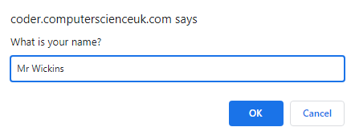

Programming Inputs & Storing Inputs in PYTHON
In python:
Output
In Python, the ‘input’ statement would allow our program to ask the user to enter an input.
The ‘answer’ variable would store the input.
And we could use the answer variable with a ‘print’ statement to output the inputted value.

Slide 20
Programming Inputs & Storing Inputs
Summary
Answer is the variable (storage box) where the user’s input will be stored
Input(“What is your name?”) displays the “what is your name?” message onto the screen and waits for the users input.
Once the user has typed in their name the input is stored in “Answer”
print(answer) simply displays the contents of variable “Answer” onto the screen

Slide 21
Can you tell me the following now?
The python code needed to display a word on the screen?
The python code needed to ask the user for an input?
The way python can store user inputs?

Slide 22
What is the Major Difference between a print and an input statement?
PRINT Just displays a message!
INPUT Displays a message and waits for a user input!
So, it needs to be assigned to a variable if we want to store what the user types in…

Slide 23
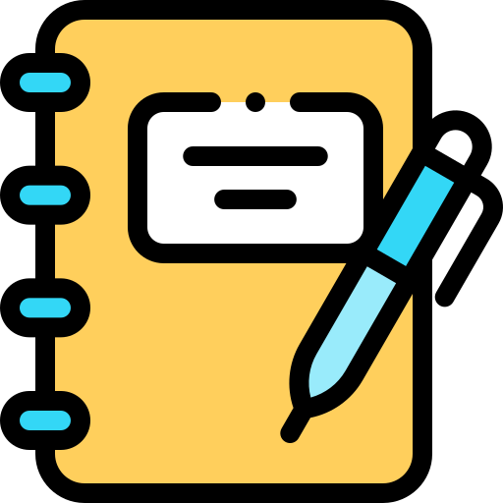
Lesson Activity
Read the information in the lesson’s workbook
Complete the PRIMM tasks provided.

