Slide 1




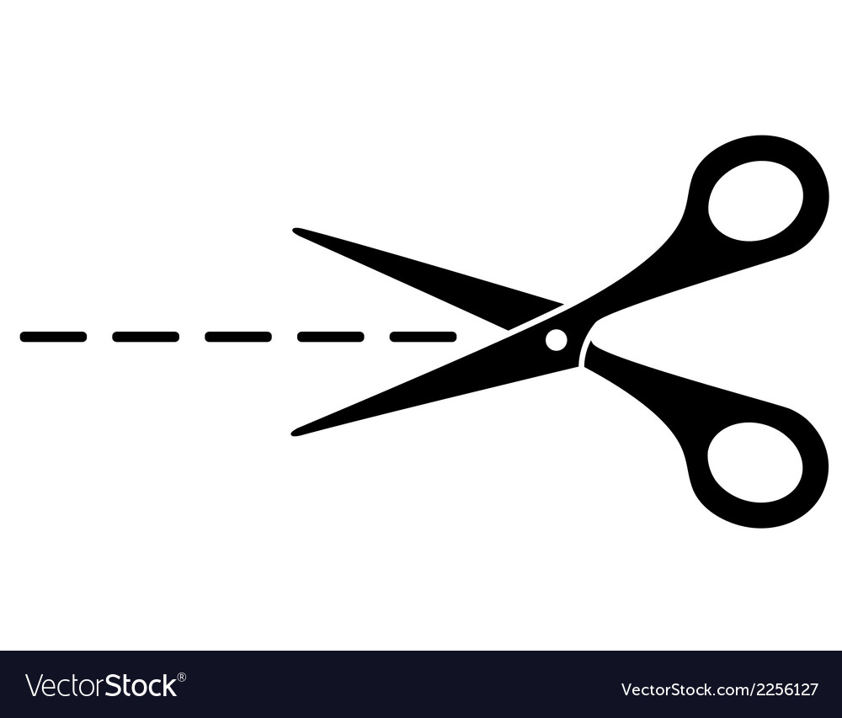
The Long Fuse - Europe in 1914
1. Before World War I, European leaders thought a country needed ___________
________________________________________________________
2. The two European countries that already had big empires in the 1800s were ___
________________________________________________________
3. At its biggest size, the British Empire controlled _______________________
4. Two countries that were ruled or influenced by the British Empire were _______
________________________________________________________
5. Italy and Germany became united countries in the ____________________
6. The continent that European powers competed over because it had many resources was ______________________________________________
7. Between 1870 and 1914, European countries increased their military spending by ________________________________________________________
8. The part of Africa that Germany took, even though it was not very valuable, was ________________________________________________________
9. Germany and France argued over Morocco in the years ________________
10. The arguments over colonies between European countries before World War I ________________________________________________________
How did competition for colonies increase the chances of war in Europe before 1914?
Why did European countries want to fight over colonies?
________________________________________________________________________________________________________________________________________________________________________________________________________________________________________________________________________________________________________________________________________________________________________________________________________________________________________________________________________________________________________________________

Slide 2

Why did European countries want an empire?
Raw materials from colonies, such as gold, diamonds, and cotton, supported European industries. | Colonies provided harbours where navies could dock, refuel, and control sea routes. | European powers competed for land, especially in Africa, to block rivals from gaining strength.
Colonies gave empires more people to rule over, adding to their global influence. | Colonies were only allowed to trade with their European power, limiting their choices. | Colonial populations could be recruited as soldiers for European armies.
Military bases overseas allowed empires to defend their territories and attack rivals. | Controlling trade and land made European powers appear richer and stronger than others. | European powers made huge profits by selling factory goods back to the same colonies.
Why did European countries want an empire?
Raw materials from colonies, like gold, diamonds, and cotton, helped European factories. | Colonies gave safe harbours for european navies to stop and refuel. | The European powers fought for land, especially in africa, to stop rivals becoming too strong.
Empires ruled over millions of people, which made them seem more important. | Colonies could only buy and sell with their own european power. | People from colonies could be used as soldiers in european armies.
Military bases abroad helped europe protect its colonies and fight enemies. | Owning more colonies gave europe more control and made countries look powerful. | Europe made money by selling finished goods back to the same colonies.

