Slide 1







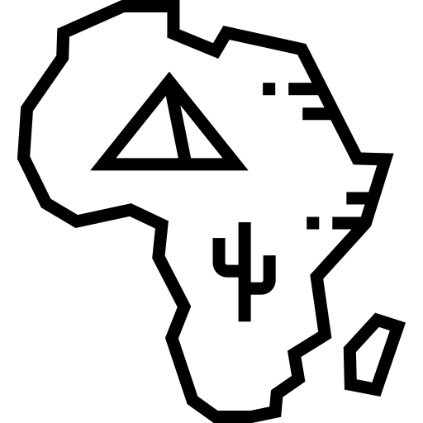


Guided Reading - The Importance of European Empires
Before World War I, European countries thought it was very important to build big empires. Leaders believed that to be seen as powerful, a country needed to control land overseas. Empires showed national pride, but they were also useful for trade and money. The bigger an empire was, the more respect a country gained.
By the 1800s, Britain and France already had huge empires. Britain’s empire was the largest, covering about a quarter of the world. It included Canada, India, South Africa, Egypt, Australia, and New Zealand. Some of these places were directly ruled by Britain, while others were strongly influenced by it.
When Italy and Germany became united countries in the 1870s, they also wanted empires. But by then, most valuable territory had already been taken, especially by Britain. Still, Germany and Italy tried to grow their power, leading to competition for the remaining land, especially in Africa, which had many natural resources.
Germany
This race for empire led to an arms race, as countries built bigger armies and navies to protect their colonies. Between 1870 and 1914, European countries spent much more money on their militaries. For example, Germany took colonies in Africa, like Namibia. These colonies were not very valuable, but they showed that Germany could challenge Britain and France.
Competition for colonies also caused arguments between countries. For example, Germany and France clashed over control of Morocco in 1906 and 1911. These disputes did not cause war, but they created anger and distrust, making future conflict more likely.
📘 Glossary
Empire – A group of countries or areas ruled by one powerful country.
Colony – A land controlled or settled by another country.
Territory – Land that belongs to or is controlled by a country.
Arms race – When countries compete to build the biggest armies and navies.
Military – The armed forces of a country (army, navy, etc.).
Natural resources – Useful materials from the earth, like coal, oil, or gold.
Conflict – A serious disagreement or fight between countries.

Slide 2
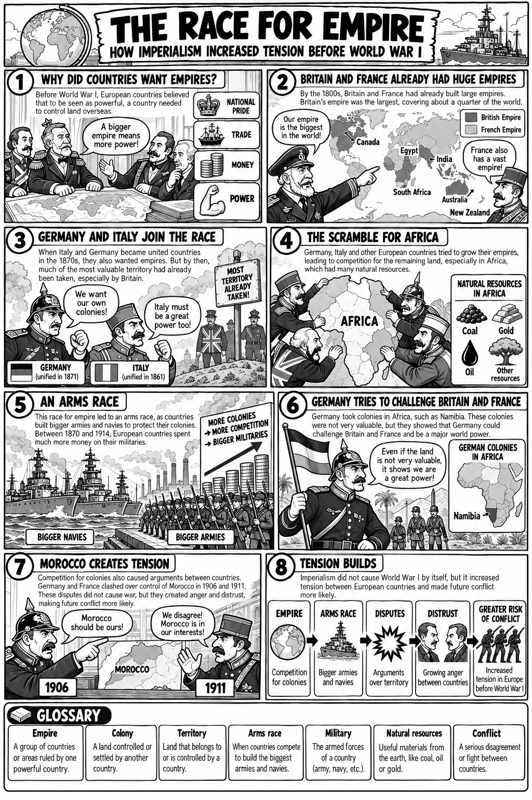

Slide 3
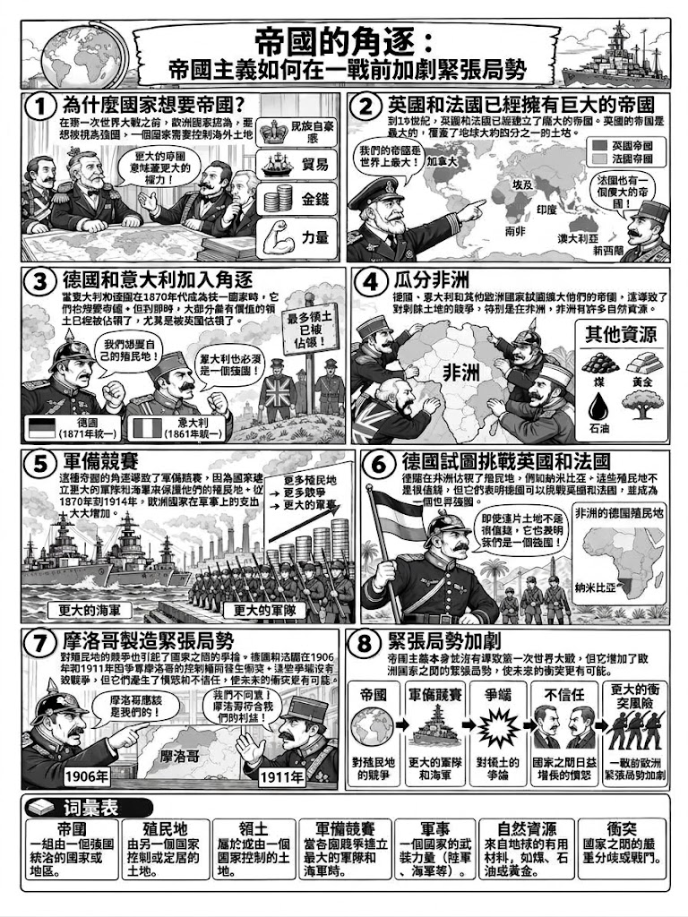

Slide 4
