Slide 1

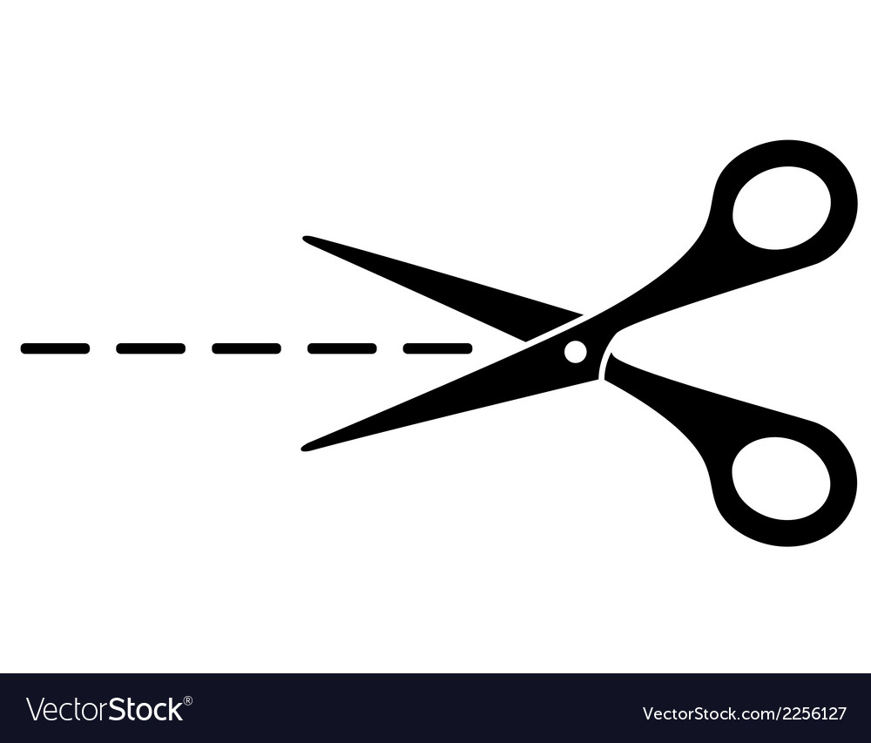
A New form of Imperialism
1. What was imperialism?
A) One country extending political dominance over another
B) Countries agreeing to share their land equally
C) A system of countries avoiding foreign trade
D) One country giving independence to another
2. What was one main economic reason for European imperialism?
A) European countries wanted to reduce factory production
B) European factories needed raw materials and new markets
C) European countries wanted to stop international trade
D) European governments wanted to close their factories
3. Which of these was a raw material European countries wanted?
A) Electricity
B) Computers
C) Plastic
D) Cotton
4. Why did European countries want new markets?
A) Their factories needed fewer customers
B) They wanted to sell manufactured goods to more people
C) They wanted to stop producing goods
D) Their populations were moving away from Europe
5. What was the Scramble for Africa?
A) African countries competing for European territory
B) European countries competing for territory in Africa
C) European countries agreeing to leave Africa
D) African countries competing to control Europe
6. Why did competition for African territory create tension?
A) African countries controlled all European trade
B) European countries refused to explore Africa
C) European countries raced to claim territories before others did
D) European countries agreed to share all territories equally
7. What belief encouraged European imperialism?
A) Social Darwinism and ideas of racial superiority
B) The belief that all countries were equal
C) The belief that colonies should be independent
D) The belief that European countries were weaker
8. Why did Europeans believe they had an advantage when conquering other countries?
A) They had fewer weapons
B) They had advanced weapons, transport and medicine
C) They had smaller armies
D) They avoided using new technology
9. What happened after Chinese officials destroyed British opium in 1839?
A) Britain gave up trading with China
B) France declared war on Britain
C) China became a British colony
D) The First Opium War began
10. Why did European countries build railways in their colonies?
A) To help colonies become independent
B) To transport raw materials and manufactured goods more quickly
C) To prevent Europeans from travelling
D) To reduce trade between Europe and its colonies

