Slide 1




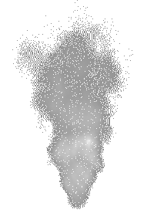
Title: The Long Fuse - Europe in 1914
LO: How did the political and social landscape of Europe in 1914 create tensions between European countries?
Title: The Long Fuse - Europe in 1914
Key Enquiry Question: What were the causes of WW1, and how did different factors contribute to the outbreak of the conflict?
What choices in WW1 showed the courage and responsibility of soldiers and leaders?
How did ordinary people show service, compassion, and teamwork in WW1?
Why is WW1 remembered today, and how does this show respect and gratitude?
What questions do you already have about WW1 that could help us learn more?

Slide 2
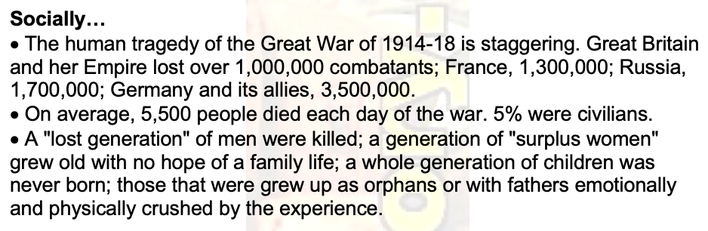
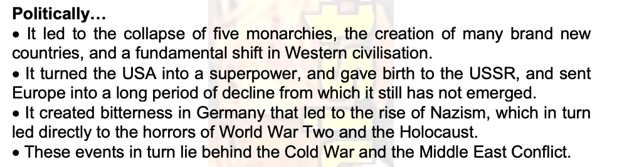
Title: The Long Fuse - Europe in 1914
LO: How did the political and social landscape of Europe in 1914 create tensions between European countries?
Why do we study WW1?
Key Enquiry Question: What were the causes of WW1, and how did different factors contribute to the outbreak of the conflict?
Key Questions
Why do wars happen?
Are there any positive effects of wars?
How can we prevent wars from happening?
In what circumstances (if any) would you be prepared to fight in a war?
These questions are of fundamental importance to us in the 21st Century. To attempt to answer them, we’ll be investigating a case study of the ‘Great War’ of 1914-18.

Slide 3
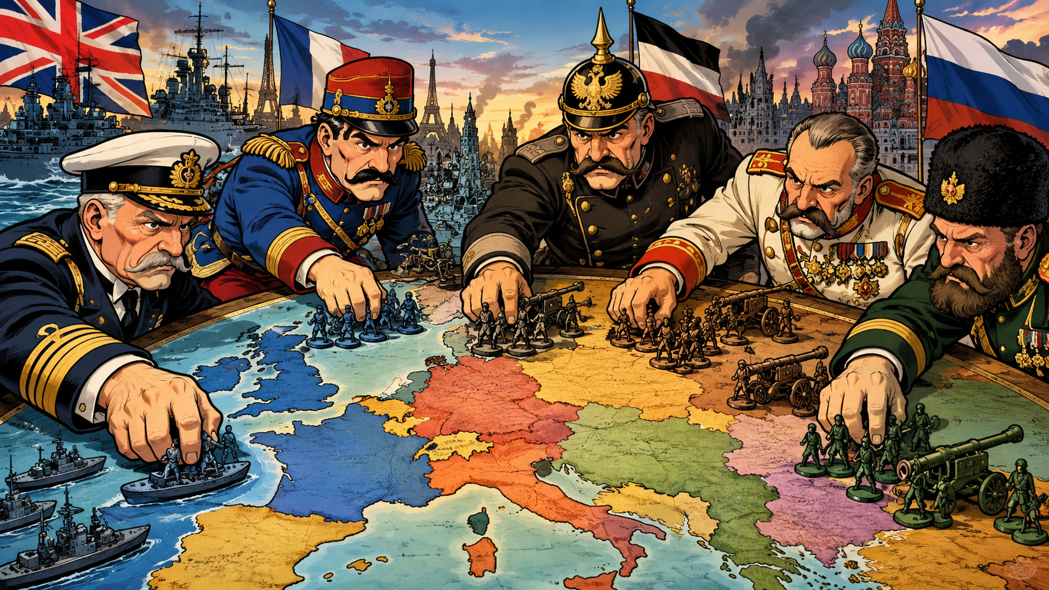
Title: The Long Fuse - Europe in 1914
LO: How did the political and social landscape of Europe in 1914 create tensions between European countries?
Title: The Long Fuse - Europe in 1914
Key Enquiry Question: What were the causes of WW1, and how did different factors contribute to the outbreak of the conflict?
Success Criteria:
🧭 Meeting:
Can identify key political and social features of Europe in 1914.
🔎 Exceeding:
Can explain how competing national interests created tension between European countries.
🧠 Mastering:
Can analyse how political and social tensions in Europe created the conditions for conflict in 1914.

Slide 4




Title: The Long Fuse - Europe in 1914
LO: How did the political and social landscape of Europe in 1914 create tensions between European countries?
Key Terms:
Key Word |  | Definition
Empire 帝国时期 제국 |  | A group of countries or areas ruled by one powerful country.
Colonies殖民地 식민지 |  | Places controlled and settled by another country.
Territory 领土 영토 |  | Land that belongs to or is controlled by a country.
Imperialism 帝国主义제국주의 |  | When a powerful country takes control of weaker countries to build an empire.

Slide 5
Title: The Long Fuse - Europe in 1914
LO: How did the political and social landscape of Europe in 1914 create tensions between European countries?
What were the main causes of WW1?
Remember the acronym MAINS:
M is for Militarism - The belief that a country should have strong armed forces and be ready to use them
A is for the Alliance System - Agreements between countries to support or protect each other
I is for Imperialism - When a country takes control of other countries to build an empire
N is for Nationalism - Strong pride / loyalty to a nation; it can also mean wanting people with a shared identity to form or rule their own country
S is for Significant Individuals - Important people whose choices or actions helped shape events leading to the First World War
Remember the acronym MAINS:
M is for Militarism
军国主义 / 군국주의
A is for the Alliance System
联盟系统 / 동맹 시스템
I is for Imperialism
帝国主义 / 제국주의
N is for Nationalism
民族主义 / 민족주의
S is for Significant Individuals
重要人物 / 중요한 인물입니다

Slide 6
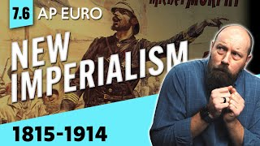
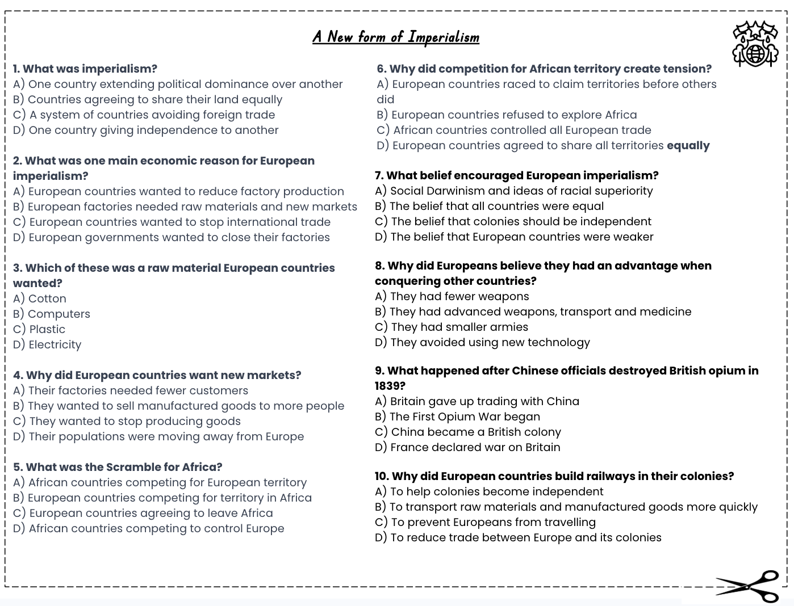
Title: The Long Fuse - Europe in 1914
LO: How did the political and social landscape of Europe in 1914 create tensions between European countries?
A New form of Imperialism
Activity: Complete the multiple choice questions whilst watching the video:
Second Wave IMPERIALISM
Notes:
https://www.youtube.com/watch?v=yx2YXPvh3VY&t=112s

Slide 7

Title: The Long Fuse - Europe in 1914
LO: How did the political and social landscape of Europe in 1914 create tensions between European countries?
A New form of Imperialism
1. A) One country extending political dominance over another
2. B) European factories needed raw materials and new markets
3. D) Cotton
4. B) They wanted to sell manufactured goods to more people
5. B) European countries competing for territory in Africa
6. C) European countries raced to claim territories before others did
7. A) Social Darwinism and ideas of racial superiority
8. B) They had advanced weapons, transport and medicine
9. D) The First Opium War began
10. B) To transport raw materials and manufactured goods more quickly

Slide 8


Title: The Long Fuse - Europe in 1914
LO: How did the political and social landscape of Europe in 1914 create tensions between European countries?
Activity: Guided Reading
Read the source on European Empires carefully, then use the Long Fuse – Europe in 1914 sheet to answer the questions and show what you have learned.
How did competition for colonies increase the chances of war in Europe before 1914? Explain your answer using examples.
- How competition created tension
- One example of colonial rivalry
- How this made war more likely
Why did European countries want to fight over colonies? Explain your answer using examples.
Economic reasons – resources and markets
Power and prestige – showing strength
One example of a European country
Why these reasons caused competition

Slide 9
Title: The Long Fuse - Europe in 1914
LO: How did the political and social landscape of Europe in 1914 create tensions between European countries?
Before World War I, European leaders thought a country needed…
👉 to control land overseas (colonies/territories).
The two European countries that already had big empires in the 1800s were…
👉 Britain and France.
At its biggest size, the British Empire controlled…
👉 about a quarter of the world.
Two countries that were ruled or influenced by the British Empire were…
👉 examples include Canada, India, South Africa, Egypt, Australia, New Zealand (any two).
Italy and Germany became united countries in the…
👉 1870s.

Slide 10
Title: The Long Fuse - Europe in 1914
LO: How did the political and social landscape of Europe in 1914 create tensions between European countries?
The continent that European powers competed over because it had many resources was…
👉 Africa.
Between 1870 and 1914, European countries increased their military spending by…
👉 Increasing the size of their armies and navys
The part of Africa that Germany took, even though it was not very valuable, was…
👉 Namibia.
Germany and France argued over Morocco in the years…
👉 1906 and 1911.
The arguments over colonies between European countries before World War I…
👉 did not lead to war, but caused anger and distrust.

Slide 11




Title: The Long Fuse - Europe in 1914
LO: How did the political and social landscape of Europe in 1914 create tensions between European countries?
True Or False
1. Germany and Italy had already gained large empires before they became united countries.
2. Britain’s empire covered about a quarter of the world by the 1800s.
3. Germany and France avoided disagreements over Morocco because they had similar interests.
4. European countries increased military spending between 1870 and 1914.
5. Competition for colonies reduced distrust between European countries before World War I.
6. Germany gained colonies in Africa, including Namibia, as it tried to challenge Britain and France.
Notes:
https://dashboard.blooket.com/set/68b8d0887ef53e8c73be158f

Slide 12


Slide 13
Title: The Long Fuse - Europe in 1914
LO: How did the political and social landscape of Europe in 1914 create tensions between European countries?
Title: The Long Fuse - Europe in 1914
Key Enquiry Question: What were the causes of WW1, and how did different factors contribute to the outbreak of the conflict?
Success Criteria:
🧭 Meeting:
Can identify key political and social features of Europe in 1914.
🔎 Exceeding:
Can explain how competing national interests created tension between European countries.
🧠 Mastering:
Can analyse how political and social tensions in Europe created the conditions for conflict in 1914.

Slide 14

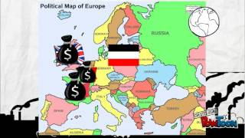
Title: The Long Fuse - Europe in 1914
LO: Understand the political and social landscape of Europe in 1914 and how competing national interests laid the groundwork for conflict.
Why did European countries want an empire?
True Or False
European countries wanted colonies partly to gain raw materials for their industries.
Germany found it easy to expand its empire because most available territory was still unclaimed.
New weapons, including machine guns, helped European countries conquer areas of Africa.
Germany’s actions in Morocco increased tension between France and Germany.
The Moroccan crises strengthened the alliance between Britain and France.
Notes:
https://www.youtube.com/watch?v=lHa2hSgEfLA

Slide 15
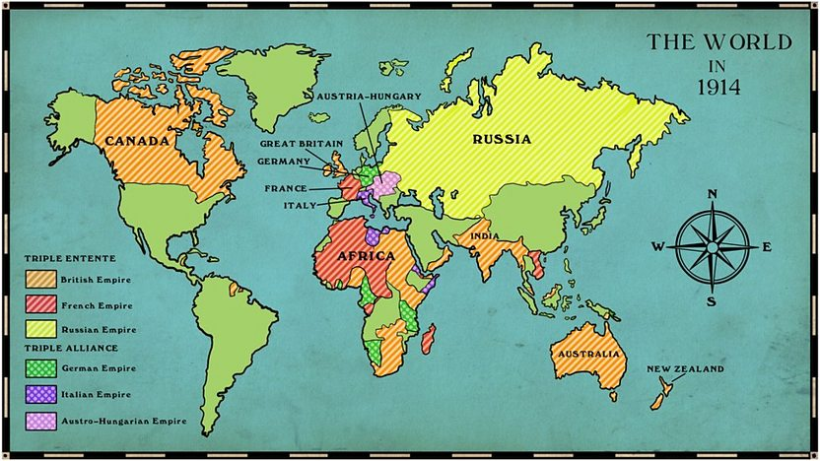
Title: The Long Fuse - Europe in 1914
LO: How did the political and social landscape of Europe in 1914 create tensions between European countries?
Why did European countries want an empire?
Empires were a real status symbol, with many European countries competing during the 1800s to expand.
We are now going to consider WHY so many countries wanted to create Empires…

Slide 16



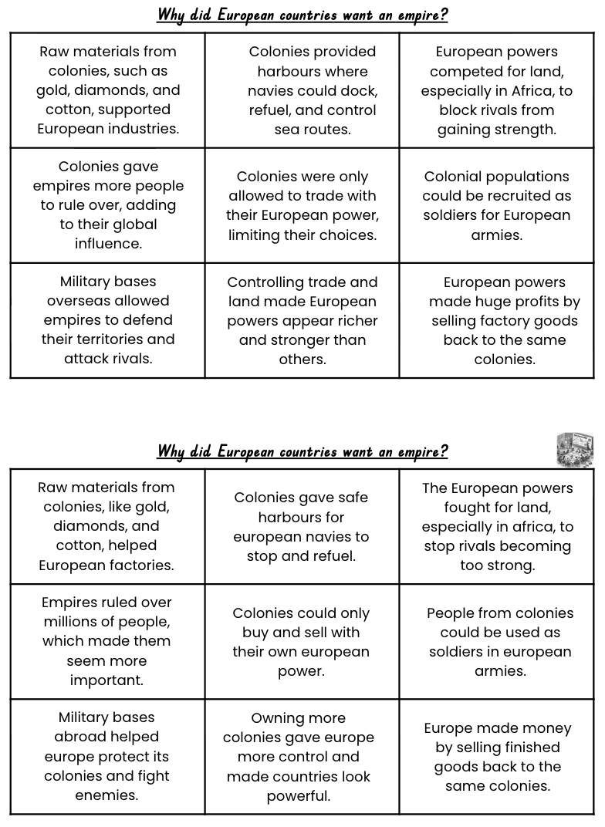
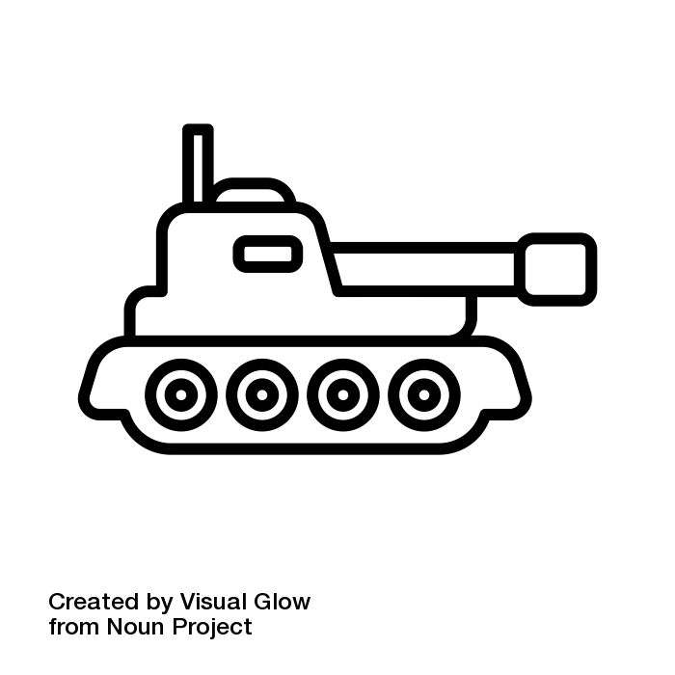
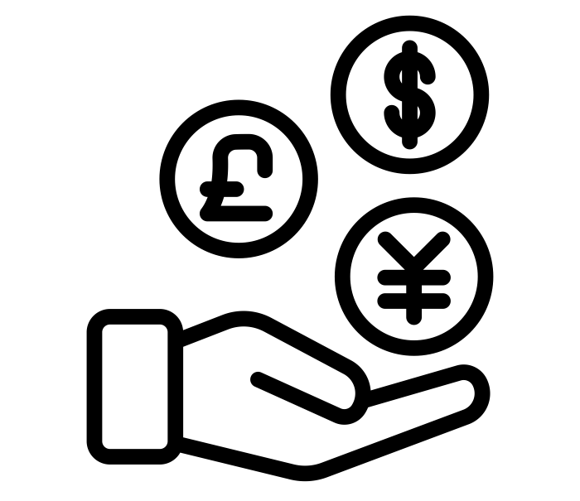
Title: The Long Fuse - Europe in 1914
LO: How did the political and social landscape of Europe in 1914 create tensions between European countries?
Why did European countries want an empire?
Breakdown Available
Military 军事
Controlling key sea routes and navy bases. Stopping rival nations from getting land
Power 动力
Showing that a nation was strong and superior. Winning support from the public back home.
trade/money 贸易/货币
Gaining raw materials (rubber, gold, oil). Selling factory goods to new markets.
Activities:
Sort each statement into the 3 categories. You can do this by using T, M or P.
Once complete, decide on which you think are the 3 most important.

Slide 17
Title: The Long Fuse - Europe in 1914
LO: How did the political and social landscape of Europe in 1914 create tensions between European countries?
Why did European countries want an empire?
Raw materials from colonies, such as gold, diamonds, and cotton, supported European industries. | Colonies provided harbours where navies could dock, refuel, and control sea routes. | European powers competed for land, especially in Africa, to block rivals from gaining strength.
Colonies gave empires more people to rule over, adding to their global influence. | Colonies were only allowed to trade with their European power, limiting their choices. | Colonial populations could be recruited as soldiers for European armies.
Military bases overseas allowed empires to defend their territories and attack rivals. | Controlling trade and land made European powers appear richer and stronger than others. | European powers made huge profits by selling factory goods back to the same colonies.
Notes:
Information Cards – cut up and put in an envelope, one per table

Slide 18

Title: The Long Fuse - Europe in 1914
LO: How did the political and social landscape of Europe in 1914 create tensions between European countries?
Why did European countries want an empire?
Activity: Evaluate reasons why European countries wanted to build empires.
Create a PEEL paragraph explaining:
Your 3 most important reasons why European countries wanted to build empires.
Evidence to support each reason.
Why each of these were important for showing a country’s power before World War I.
Use PEEL in your paragraph.
Point: What? How?
Evidence: When? Why?
Explain: How? When?
Link: When? Who?
Make your paragraph Extra Hot by adding in what character values European countries showed (or failed to show!) when building their empires!
(Justice, Respect, Responsibility, Courage, Honesty)
Notes:
https://www.youtube.com/watch?v=e0KZP7MLGUI

Slide 19

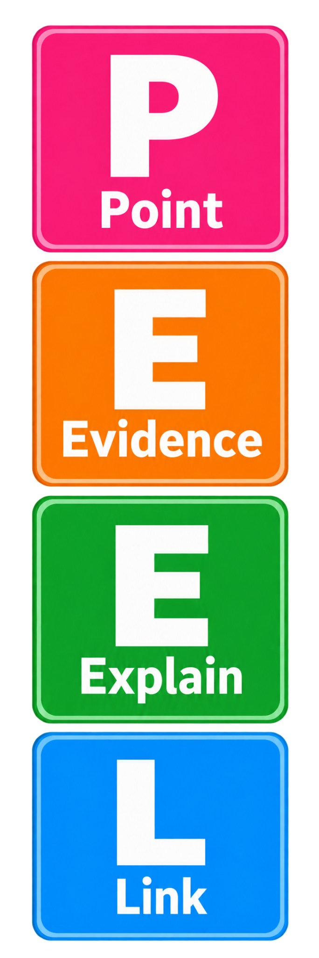
Title: The Long Fuse - Europe in 1914
LO: How did the political and social landscape of Europe in 1914 create tensions between European countries?
Why did European countries want an empire? 📝 PEEL Paragraph Scaffold
Point: State your 3 most important reasons.
The three most important reasons why European countries wanted to build empires were __________, __________ and __________.
Evidence: Give evidence for each reason.
For example, __________.
Another example is __________.
This can be seen when __________.
Explain: Explain why each reason was important.
This was important because __________.
This helped European countries to __________.
This made the country appear more powerful because __________.
Link: Link back to power and empire.
Overall, building an empire was important because __________. A larger empire showed that a country was __________.
Add values for Extra Hot!
Notes:
https://www.youtube.com/watch?v=Q0dQFhZm_PY

Slide 20
Title: The Long Fuse - Europe in 1914
LO: How did the political and social landscape of Europe in 1914 create tensions between European countries?
Odd One Out
1
Gold
Cotton
Diamonds
Soldiers
2
Land
Colonies
Profit
Influence
3
Harbours
Navies
Schools
Soldiers
4
Racism
Cotton
Colonies
Navies
Notes:
https://dashboard.blooket.com/set/68b116266e3af35fc52bd327

