Slide 1
Algorithms &
Flowcharts
START
INPUT
DECIDE
PROCESS
Year 9 Computing Lesson
Plan → Diagram → Code → Test
OUTPUT
Year 9 Computing • Algorithms & Flowcharts • 1

Slide 2
Lesson Big Question
Use this question to connect every activity in today’s lesson.
How can we plan clear steps so a computer can solve a problem correctly?
Objective
Why it matters
Today’s outcome
Understand what algorithms and flowcharts are, and use them to solve simple problems before writing code.
Computers follow instructions exactly. Clear planning helps us avoid mistakes and test our solution.
By the end, you will write an algorithm and draw a correct flowchart for a simple calculation.
Year 9 Computing • Algorithms & Flowcharts • 2

Slide 3
Learning Outcomes
By the end of this lesson, students should be able to:
1
Explain
what an algorithm is and why it is used.
2
Identify
the main flowchart symbols and their meanings.
3
Create
an algorithm and flowchart for a simple calculation.
4
Evaluate
whether the steps are logical, clear and testable.
Year 9 Computing • Algorithms & Flowcharts • 3

Slide 4
Success Criteria
Use these levels to check progress during the lesson.
Meeting
Expected
Exceeding
• I can say what an algorithm is.
• I can match common flowchart symbols to their purpose.
• I can follow a simple algorithm.
• I can write ordered steps for a simple problem.
• I can choose correct symbols for input, process, output and decision.
• I can draw a flowchart with clear arrows.
• I can test my algorithm using sample values.
• I can improve steps when there is an error.
• I can explain why my flowchart is efficient and easy to follow.
Year 9 Computing • Algorithms & Flowcharts • 4

Slide 5
From Problem to Program
A simple process for solving a problem with a computer.
Analyse
the problem
Write an
algorithm
Draw a
flowchart
Convert to
program
Run & test
the solution
Good programmers do not start by coding immediately. They first understand the problem, design the steps, then test the result.
Year 9 Computing • Algorithms & Flowcharts • 5

Slide 6
What is an Algorithm?
An algorithm is a set of clear, ordered steps to solve a specific problem.
Algorithm Checklist
Example: Make a sandwich
1. Get bread
2. Add filling
3. Close sandwich
4. Serve
✓ Starts clearly
✓ Uses ordered steps
✓ Uses exact instructions
✓ Produces an answer
In computing, each step must be precise because the computer cannot guess what we mean.
✓ Can be tested
Year 9 Computing • Algorithms & Flowcharts • 6

Slide 7
How do you make a cup of tea?
Let students give instructions:
Boil water.
Put tea bag in cup.
Pour hot water.
Add milk.
Add sugar.
Stir.
Then explain:
An algorithm is a step-by-step set of instructions used to solve a problem or complete a task.
This makes the concept less abstract.

Slide 8
What is a Flowchart?
A flowchart is a visual diagram that shows the steps of a solution.
START
INPUT
PROCESS
DECISION
OUTPUT
END
Flowcharts make logic easier to read, discuss and debug before coding.
Year 9 Computing • Algorithms & Flowcharts • 7

Slide 9
Common Flowchart Symbols
Choose the symbol based on what the step is doing.
Start / End
Input / Output
Process
Oval shape
Parallelogram
Rectangle
Terminator
Read or print data
Calculate or store
Decision
Flow Line
Connector
Diamond
Arrow
Circle
Question: yes/no
Shows direction
Connects parts
Year 9 Computing • Algorithms & Flowcharts • 8

Slide 10
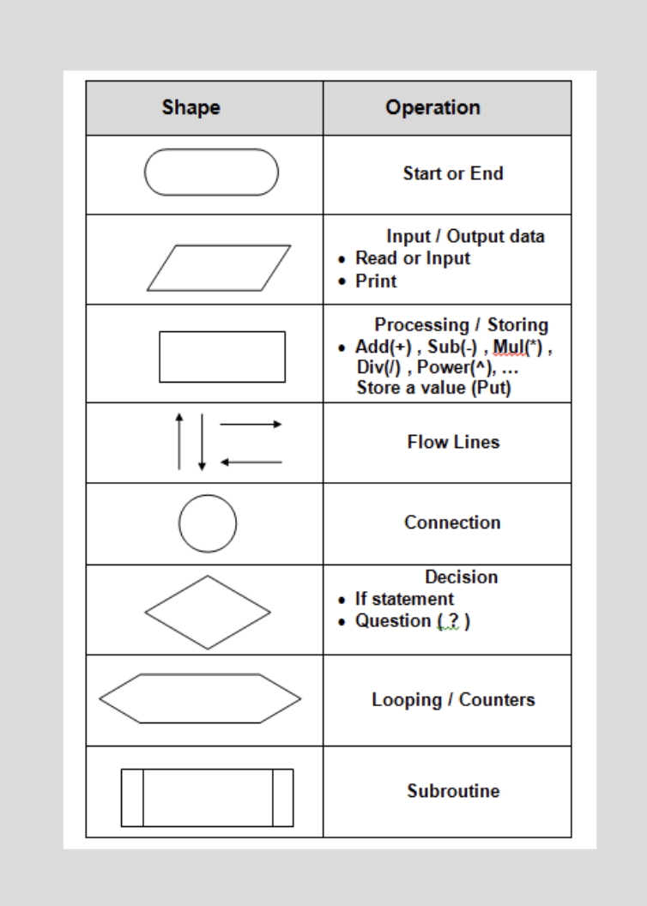

Slide 11
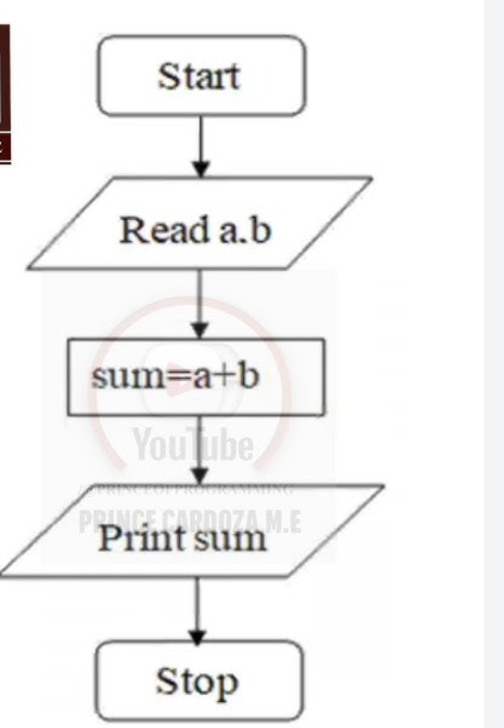
Worked Example: Add Two Numbers
Algorithm and flowchart for a simple calculation.
Algorithm
1. Start
2. Read a, b
3. sum = a + b
4. Print sum
5. End
Year 9 Computing • Algorithms & Flowcharts • 9

Slide 12
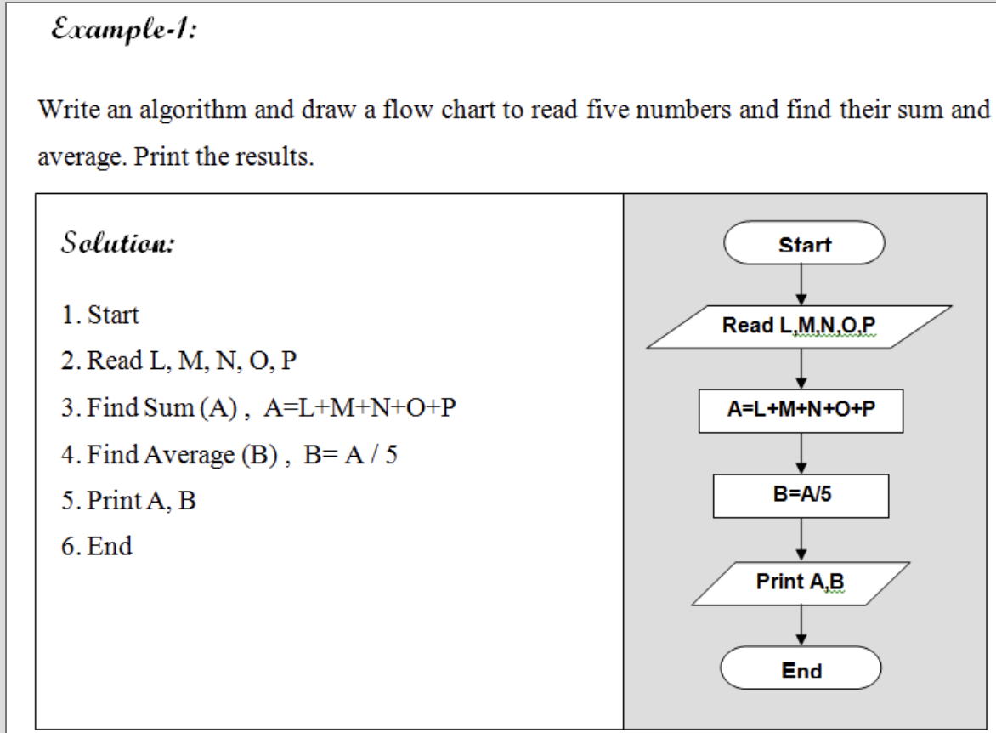

Slide 13
Main Activity: Create Your Own Flowchart
Use diagrams.net or paper to create a flowchart for one problem.
1. Calculate the area of a rectangle
Your flowchart must include:
✓ Start and End
2. Convert Celsius to Fahrenheit
✓ Input(s)
3. Find the average of three numbers
✓ Process/calculation
4. Calculate simple interest
✓ Output
✓ Correct arrows
5. Calculate discount and total price
Year 9 Computing • Algorithms & Flowcharts • 11

Slide 14
Challenge Tasks
Choose a challenge when your main activity is complete.
Challenge 1
Draw a flowchart to multiply 4 numbers and print the answer.
Challenge 2
Draw a flowchart to find the perimeter of a square.
Stretch: Add a decision step, such as checking whether the input is valid before calculating.
Year 9 Computing • Algorithms & Flowcharts • 12

Slide 15
Exit Ticket
Answer these before you leave:
1. What is one difference between an algorithm and a flowchart?
2. Which symbol is used for a decision?
3. How did you test or improve your flowchart today?
Year 9 Computing • Algorithms & Flowcharts • 13

