Slide 1
Per-Token Adaptive Channel Activation
for Efficient MoE Inference
Yequan Zhao | Midpoint Review | August 2026

Slide 2

Background

Slide 3
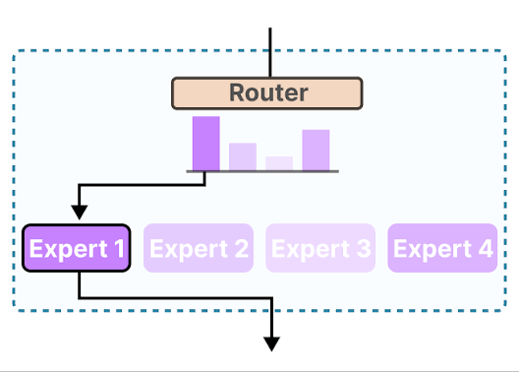
Mixture-of-Experts (MoE) and Why it Prevails
Mixture-of-Experts (MoE)
Total params: 30B; active per token: ~3B (only K=8 of 128 experts are activated per token)
Outperforms dense models at equal FLOP budget
Edge deployment challenge
Large model size -> Need parameter offload
Decode is memory-bounded: Latency ∝ bytes loaded per token.
2

Slide 4
What Needs to Be Improved
Goal | Benefit | Target
Reduce total params | Fit in device DRAM; less memory for serving | Edge (L4, Cor3, phone) and cloud
Reduce active params | Fewer bytes loaded per token → lower latency | Single-batch decode (bandwidth-bound)
Per-Token Adaptive Channel Activation for MoE
3

Slide 5
Results at a Glance
−50% expert-FFN active parameters → −1 MMLU pt, no training
Configuration | up | gate | down | FFN cut | MMLU | HellaSwag | ARC-C | TruthfulQA | Avg
Dense baseline (K=8) | −0% | −0% | −0% | 0% | 79.6 | 77.8 | 69.7 | 53.4 | 70.12
Dynamic −75% (no train) | −0% | −75% | −75% | −50% | 78.6 | 75.4 | 66.0 | 51.1 | 67.8
Dynamic −75% (after train) | −0% | −75% | −75% | −50% | (pending)
Dynamic −87.5% | −0% | −87.5% | −87.5% | −58.3% | 75.3 | 71.5 | 63.2 | 50.8 | 65.2
up_proj scores channels per token via; only top-B channels of gate/down are activated
Edge efficiency: 2.14× decode speedup on 30B-A3B model offloaded generation (single L4 GPU).
Per-Token Adaptive Channel Activation for MoE
4

Slide 6
Motivation

Slide 7
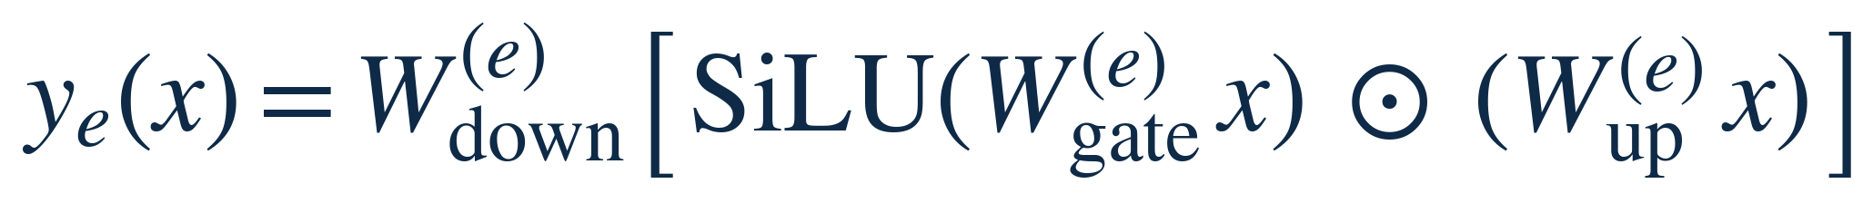
Channel Experts
The effective expert unit is a single intermediate channel
A standard MoE FFN expert computes:
The j-th channel expert of expert e is the rank-1 computation path:
Block output = Σ over K·I channel experts: a sum of rank-1 paths
The gating SiLU(w_gate,j·x) is a soft on/off switch: near zero → the whole path contributes nothing, regardless of up/down
Hypothesis: A token doesn’t need 8 whole experts, but only needs a sparse, token-specific subset of channels across them.
Per-Token Adaptive Channel Activation for MoE
5

Slide 8
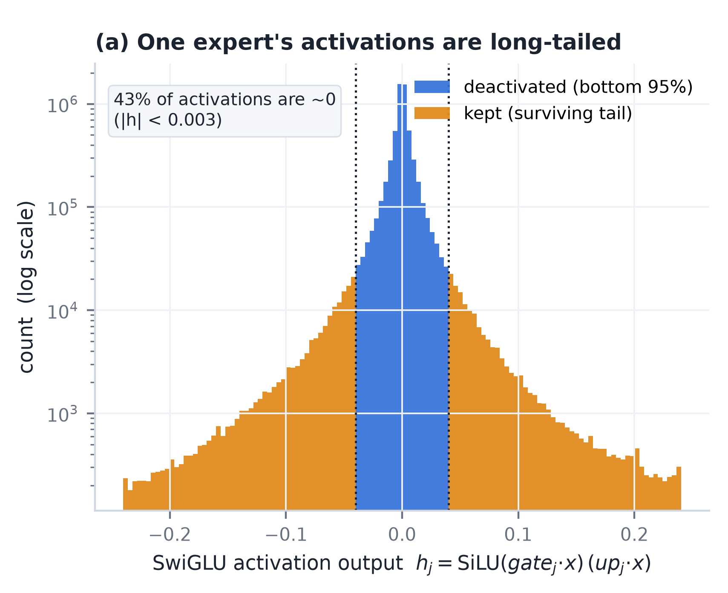
A Sparse Subset of Channels Suffices
Per token, activation magnitude concentrates on a handful of channels
Will add some motivating experiment & figures
Per-Token Adaptive Channel Activation for MoE
6

Slide 9
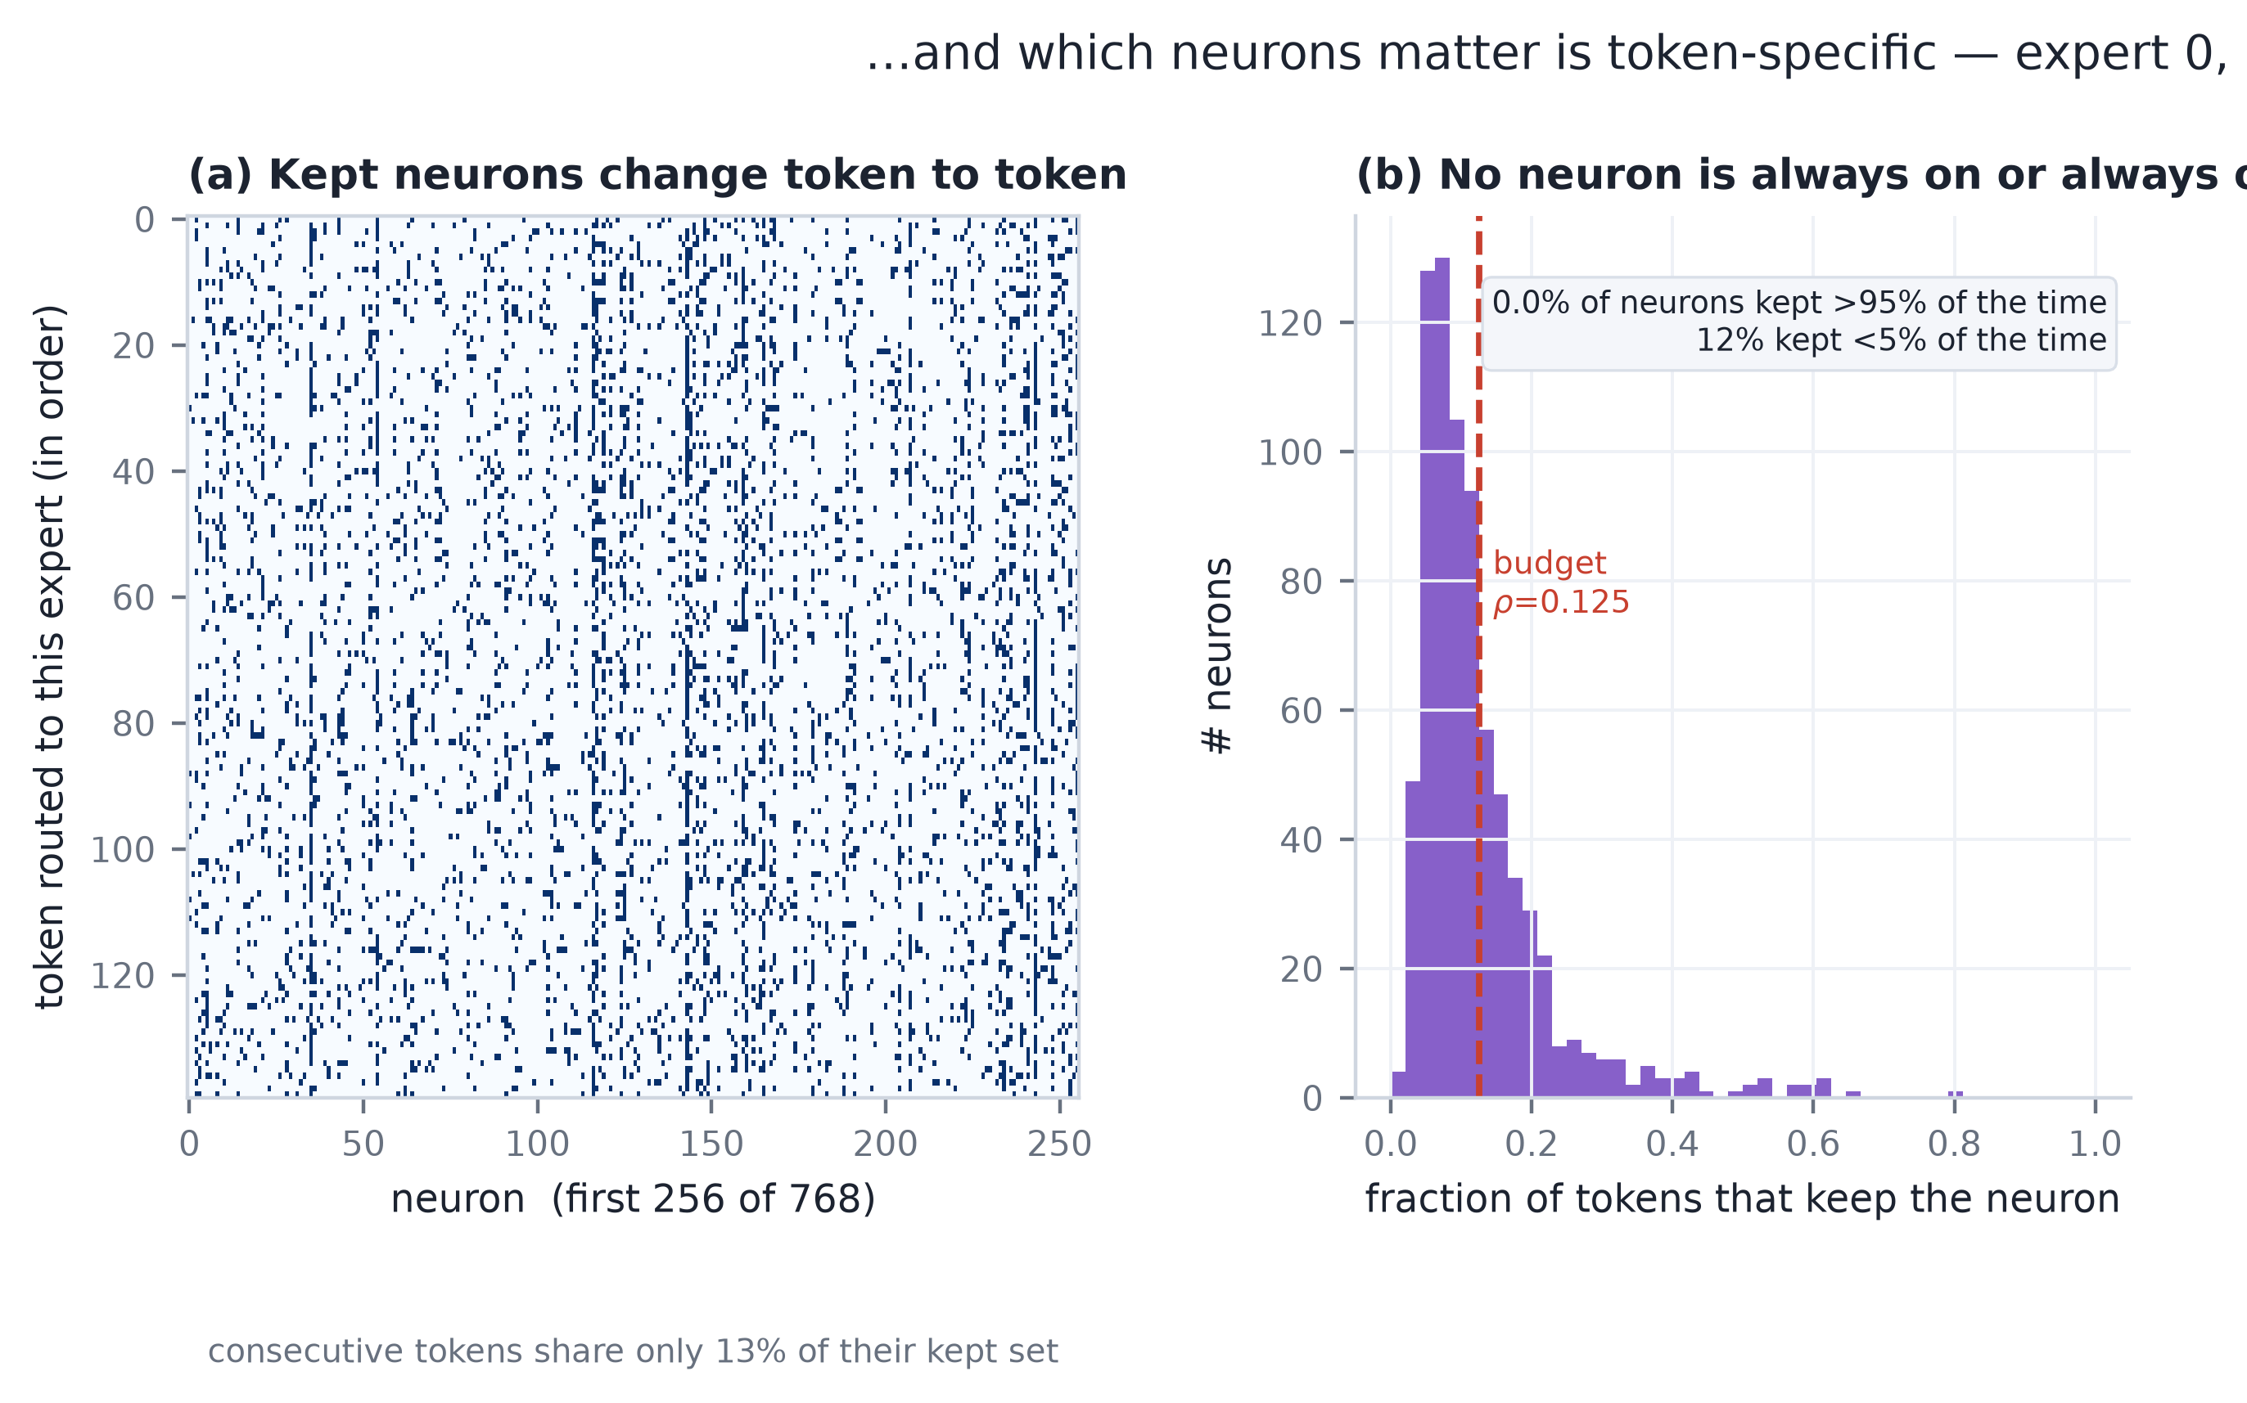
The Subset Is Token-Specific
Which channels matter is re-decided every token → no fixed subset works
Consecutive tokens routed to the same expert share only 13% of their kept channels (budget ρ = 0.125).
Almost no channel is stable: 0% kept >95% of the time; only 12% kept <5%.
Conclusion: the method must select online, per token, at channel granularity — offline / static baselines top out far below.
Per-Token Adaptive Channel Activation for MoE
7

Slide 10
High-Level Framework and Methods

Slide 11
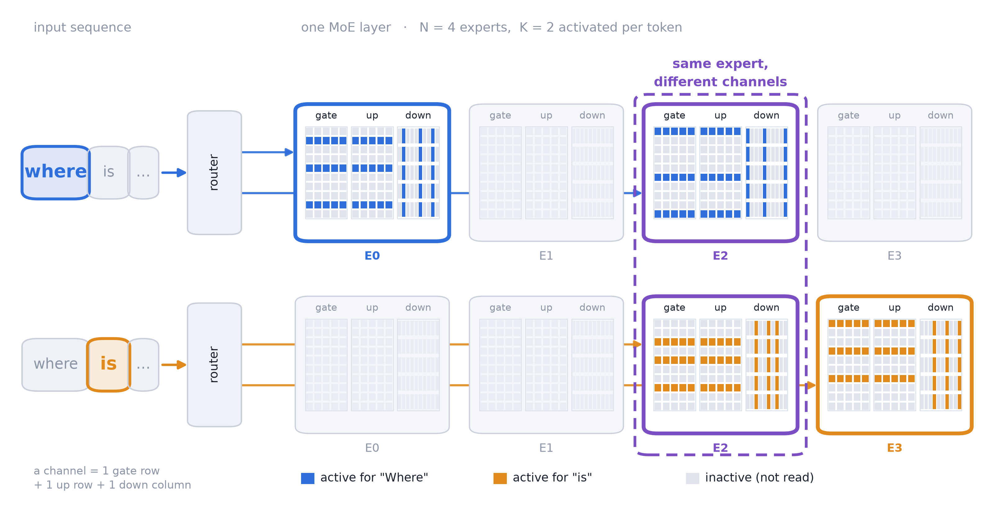
Per-Token Channel Activation
For each token, only the channels that contribute most are activated
Fixed per-token budget: B channels out of K·I total
Different tokens → different active subsets
Per-Token Adaptive Channel Activation for MoE
8

Slide 12
Design Challenges
Two core problems
1
How to find the channels that contribute most for each token?
2
How does this bring real throughput acceleration?
The existing router only knows which experts, not which channels
A learned router of size d × (N·I) would be as large as the MoE itself
The selection must be available before the main compute
Per-Token Adaptive Channel Activation for MoE
9

Slide 13
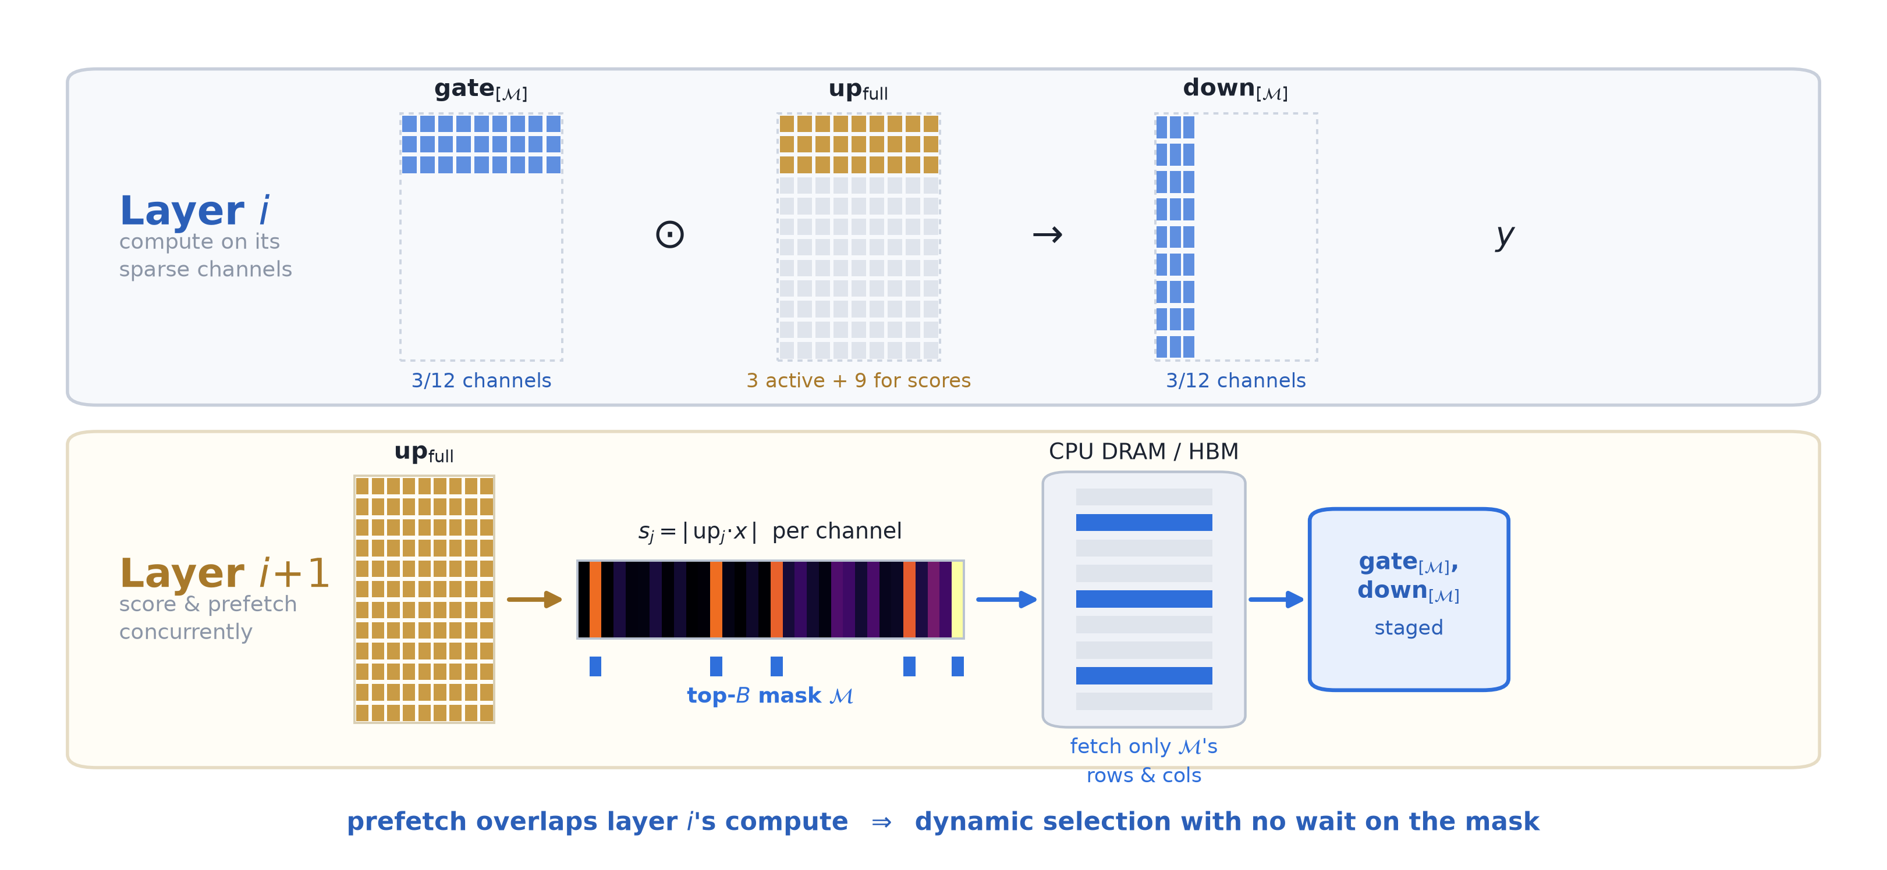
Our Framework
Use up_proj output as a built-in per-channel scorer
Compute up·x at full width → score channels by activation magnitude
Keep top-B channels → activate only those rows of gate and columns of down
A predictor estimates the next layer’s mask → prefetch params with no waiting
Per-Token Adaptive Channel Activation for MoE
10

Slide 14
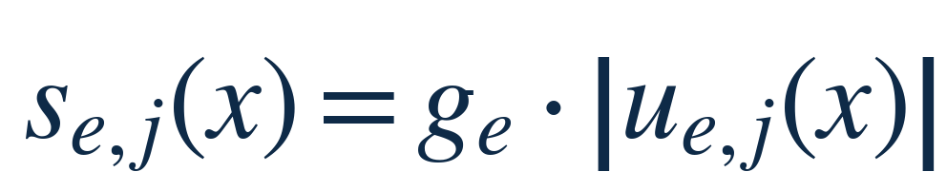
Why up_proj as the Channel Router
The architecture already contains a per-channel router — no extra params
Using up_proj to select channels lets both gate and down run at reduced width
g_e: router weight — puts all experts on one comparable scale
|u_e,j(x)| = |w_up,j · x|: activation magnitude (the token-specific signal), predicts which channels dominate h
Per-Token Adaptive Channel Activation for MoE
12

Slide 15
Channel Expert Predictor
Predict layer i+1’s channel mask during layer i’s compute
Problem: must wait for up·x to know which channels to fetch → sequential dependency
Adjacent-layer hidden states: cosine sim > 0.95 (all layers except L0)
Predictor: â_up^(i+1) ≈ x^(i) · W_up^(i+1) — parameter-free, reuses next layer’s weights
Predicted mask available one layer early → prefetch gate/down from memory
Per-Token Adaptive Channel Activation for MoE
13

Slide 16
Experiment Results

Slide 17
Two Scoring Signals — |up| vs |SiLU(gate)|
Both valid; cute gate+down wins over cut up+down
Method | up | gate | down | FFN cut | MMLU | HellaSwag | ARC-C | TruthfulQA | Avg
Dense baseline | −0|−0|−0 | 0% | 79.6 | 77.8 | 69.7 | 53.4 | 70.12
|up| (cut gate+down) | −0|−75|−75 | −50% | 78.6 | 75.4 | 66.0 | 51.1 | 67.8
|SiLU(gate)| (cut up+down) | −75|−0|−75 | −50% | 77.2 | 75.8 | 67.3 | 48.3 | 67.2
|up| | −0|−87.5|−87.5 | −58.3% | 75.3 | 71.5 | 63.2 | 50.8 | 65.2
|SiLU(gate)| | −87.5|−0|−87.5 | −58.3% | 74.0 | 72.5 | 64.4 | 45.1 | 64.0
Per-Token Adaptive Channel Activation for MoE
14

Slide 18
Stacking with Top-K Reduction
Fewer experts × narrower experts compose orthogonally
Method | up | gate | down | FFN cut | MMLU | HellaSwag
Dense baseline (K=8) | −0 | −0 | −0 | 0% | 79.5 | 78.56
Top-4 only | −0 | −0 | −0 (×4/8) | −50% | 77.4 | 75.96
Top-4 + dynamic −50% | −0 | −50 | −50 (×4/8) | −66.7% | 77.2 | 74.0
Top-4 + dynamic −75% | −0 | −75 | −75 (×4/8) | −75.0% | 74.3 | 70.0
At −50% FFN, narrowing alone (78.6) outperforms expert-dropping (77.4)
At −75% FFN, stacking retains knowledge expert-dropping destroys (reduce-top-k 8→2 collapses to HellaSwag 49.4)
Orthogonal: top-k cuts whole experts; dynamic cuts channels within surviving experts
Per-Token Adaptive Channel Activation for MoE
15

Slide 19
Channel Expert Predictor — Accuracy Cost
Predicting the mask one layer early costs −1.5 MMLU pts (−50% FFN, |up|)
Configuration | up | gate | down | MMLU | HellaSwag | ARC-C | TruthfulQA | Avg
Exact mask | −0 | −75 | −75 | 78.6 | 75.4 | 66.0 | 51.1 | 67.8
Predicted mask (FloE) | −0 | −75 | −75 | 77.1 | 75.2 | 65.0 | 52.1 | 67.4
Measured recall: 0.777 (vs FloE’s ~0.95 on Mixtral-8×7B)
Average cost: −0.4 pts across 4 tasks; only MMLU loses measurably (−1.5)
Parameter-free; enables the latency-hiding prefetch
Per-Token Adaptive Channel Activation for MoE
16

Slide 20
Efficiency — Edge Offload (Real 30B, Single L4)
Experts in CPU DRAM, AIME-24 generation, batch-1 decode
Variant | Prefill ms/tok | Decode tok/s | vs dense | Peak GPU
Dense (all experts offloaded) | 526 | 1.90 | 1.00× | 3.2 GB
Dynamic (−75% gate+down) | 291 | 3.43 | 1.81× | 3.2 GB
+ Predicted prefetch | 246 | 4.01 | 2.14× | 3.2 GB
Halving PCIe bytes buys 1.81× on the clock (37.75 vs 75.50 MB/layer)
Predicted prefetch overlaps next-layer fetch with compute → 2.14× total
Peak GPU only 3.2 GB — 30B on one L4 with 20 GB to spare; prefill ~28 tok/s (mask-union saturates)
Per-Token Adaptive Channel Activation for MoE
17

Slide 21
Efficiency — Cloud Resident (4× L4)
Experts resident in HBM, AIME-24 generation
Variant | Batch | Prefill (tok/s) | Decode (ms/tok) | Peak GPU
Dense | 1 | 172 | 120 | 15.7 GB
Dynamic (gathered) | 1 | 125 | 410 | 17.4 GB
Dense | 4 | 584 | 157 | 15.9 GB
Dynamic (gathered) | 4 | 412 | 434 | 17.6 GB
[need to update the table results] Cloud resident with MoBE-factored up is a regression (2.38× read amplification); without MoBE the gathered kernel gives 1.34× per-layer. Multi-batch decode dilutes per-token sparsity (mask-union saturates).
Summary — two deployment targets
Setting | Bottleneck | Decode benefit | Takeaway
Edge (offload, batch-1) | PCIe | 2.14× (4.0 tok/s) | Primary target; prefetch essential
Cloud (resident, batch≥1) | HBM | 1.34× per-layer | Modest; mask-union saturates at batch>1
Per-Token Adaptive Channel Activation for MoE
18

Slide 22
Failing Experiments — What Didn’t Work

Slide 23
Why Offline Methods Fail
Channel contribution differs across tokens → fixed ranking is fundamentally limited
Reduction | offline | Online | Gap
−50% | 74.26 | 78.54 | 4.3
−75% | 63.60 | 78.28 | 14.7
−87.5% | 44.15 | 76.84 | 32.7
(a) Consecutive same-expert tokens share only 7–20% of kept channels (layer 24, ρ=0.125).
(b) One token needs 12.5% of channels — but the union over a prefill reaches 35% by 64 tokens, 74% by 2048.
99.3% of channels have variable utility; the entire headroom above offline is per-token activation information.
Per-Token Adaptive Channel Activation for MoE
20

Slide 24
Limitations and Future Steps
Limitation:
Parameter loading needs to wait for up_proj computation
up_proj must run at full width
Online top-k
Solution:
Low-rank decomposition for up_proj
Fit a small network to learn the threshold
Per-Token Adaptive Channel Activation for MoE
12

Slide 25
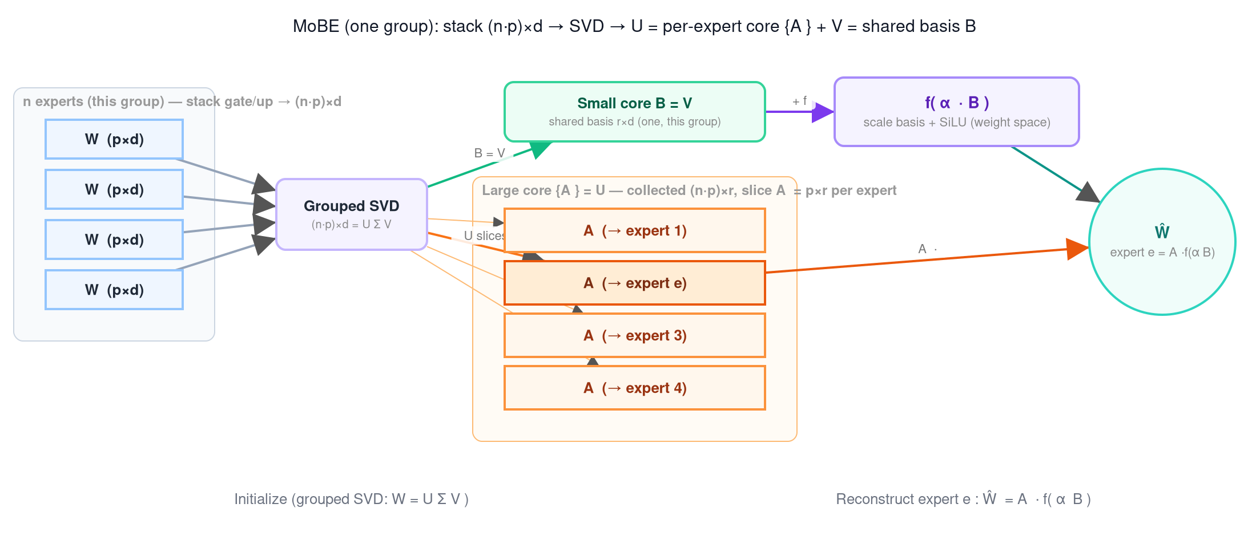
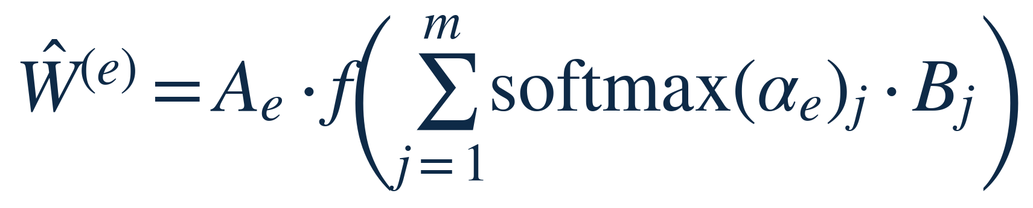
MoBE — Reduce Total Parameters
Factorize expert weights into shared basis + per-expert transform
Bⱼ ∈ ℝ ʳˣᵈ: m shared basis matrices (stored once for all 128 experts)
Aₑ ∈ ℝ ᵖˣʳ: per-expert transform. f = SiLU (weight-space nonlinearity)
Data-free fit: Adam, lr = 0.07, 2000 steps per (layer, type)
Setting | MoE storage ↓ | MMLU | HellaSwag | PPL
Baseline | 0% | 79.6 | 77.68 | 8.70
MoBE up50% (m=16, r=768) | −16.7% | 76.6 | — | 12.91
MoBE even-split −33% (m=38) | −33% | 76.83 | 73.13 | 10.10
Per-Token Adaptive Channel Activation for MoE
21

Slide 26
MoBE + Dynamic — Stacking Two Orthogonal Axes
MoBE reduces storage; dynamic reduces active. The two compose.
Configuration | Storage ↓ | Active FFN cut | MMLU | HellaSwag | PPL
Dense baseline | 0% | 0% | 79.6 | 78.56 | 10.89
MoBE up50 alone | −16.7% | −16.7% | 76.6 | — | 12.91
Dynamic −75% alone (K=8) | 0% | −50% | 78.6 | 75.4 | 16.89
MoBE up50 + dynamic −75% | −16.7% | −66.7% | 76.3 | 71.3 | 18.82
MoBE compresses up_proj storage (the scoring signal); dynamic cuts gate/down active per token
Composed −66.7% active cut (MMLU 76.3) dominates pushing either axis alone to the same depth
On edge, MoBE also reduces DRAM footprint (48.3 GB vs 58.0 GB), fitting smaller devices
Per-Token Adaptive Channel Activation for MoE
22

Slide 27
Next Steps
System design for throughput
Reduce total parameters further
Learn per-token expert budget
Fused Triton kernel: up[full] → select M → gate[M]·x → SiLU → ⊙ up[M] → down[M], one launch
End-to-end offload runtime with double-buffered prefetch → interactive 30B on edge
Memory-fetch pattern optimization for the multi-layer pipeline
MoBE beats Nyström at 1.5× compression (73.13 HS vs 65.10 at −33%)
Stack on Nyström-compressed base: another 1.5× on top (running now)
Current: fixed K=8 experts/token. Many tokens need fewer
Combine with top-p routing → dynamic total budget per token (not just channel allocation)
Per-Token Adaptive Channel Activation for MoE
23

Slide 28
Summary
Per-token dynamic channel selection: the right granularity for MoE efficiency
Channel experts — the effective expert unit is a single intermediate channel, not a whole expert
up_proj as built-in router — no extra params; activation magnitude scores channels per token
−50% expert-FFN active → MMLU 78.6 (−1 pt), no training — exact at budget, composes with MoBE
2.14× edge decode speedup — predicted prefetch at 97% PCIe peak; payoff on bandwidth-starved hardware

