Slide 1
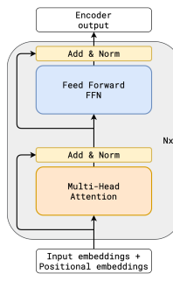
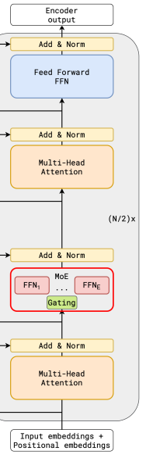

Dense Model vs Mixture-of-Experts (MoE)
Two ways to build a transformer — MoE is why modern LLMs scale
Dense Transformer
Mixture-of-Experts
Every token flows
through the same
single FFN.
100% of params
active per token.
A router sends each
token to K of N
expert FFNs.
Many experts,
few fire per token.
vs
Dense: quality and cost both grow with parameter count — scaling gets expensive fast.
MoE: quality scales with total params, cost only with active params — Qwen3-30B fires just 3B of 30B per token.
Diagram: GShard (Lepikhin et al.), via the Hugging Face MoE guide.
Per-Token Adaptive Channel Activation for MoE
1

Slide 2
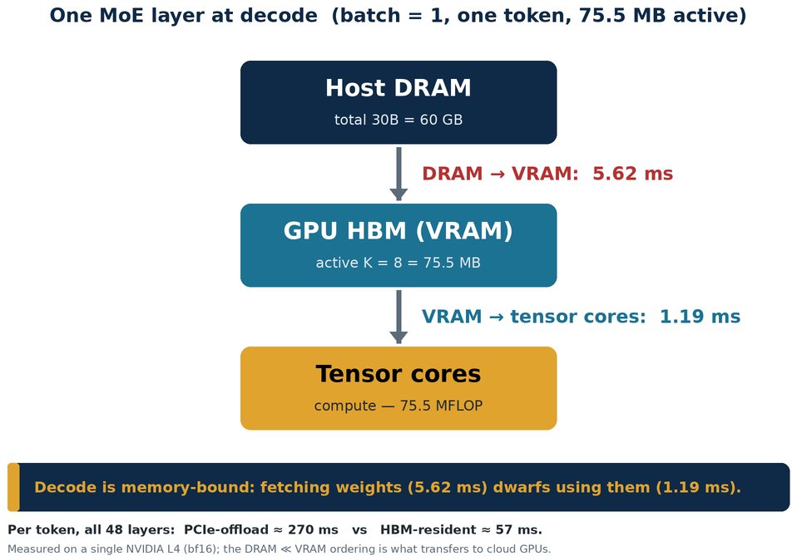
The Challenge: Running MoE on Edge Devices
At decode, the bottleneck is memory bandwidth — not compute
Decoding is one token at a time. Each token streams its experts from DRAM.
Fetching weights dwarfs computing with them — the GPU idles waiting on memory.
On edge (phone, L4, Cor3), DRAM is small and slow — both hurt.
→ Two ways to make MoE fit and run on edge:
① Reduce total parameters
Shrink the model so it fits in device DRAM.
30B = 60 GB, but edge DRAM is only 8–24 GB.
② Reduce active parameters
Move fewer bytes into the GPU each token.
Fetch/read time scales with bytes → lower latency.
This work targets both.
Per-Token Adaptive Channel Activation for MoE
2

Slide 3
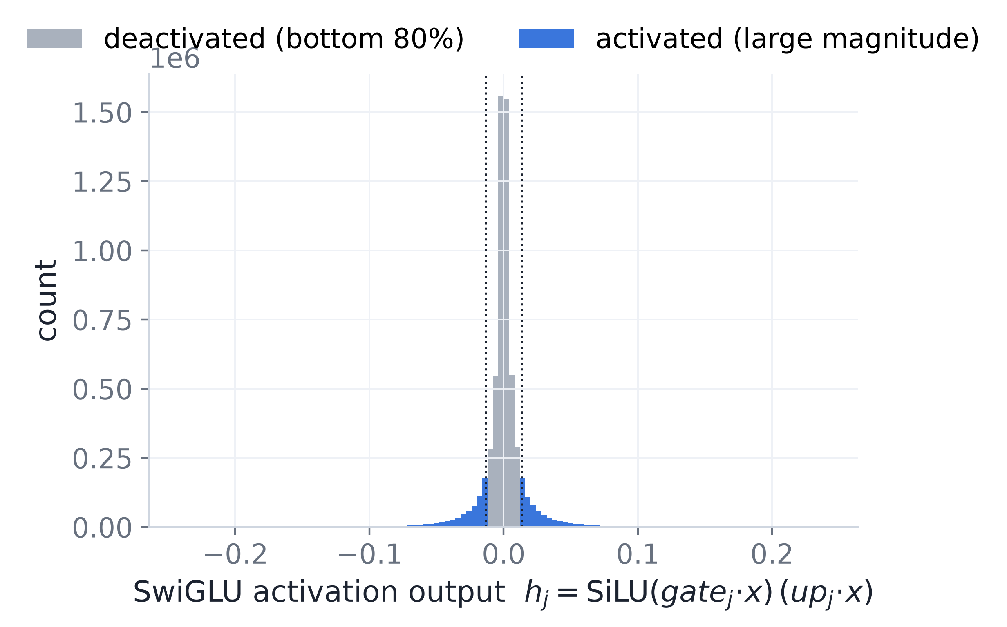
A Sparse Subset of Channels Suffices
Within one expert, a few channels carry almost all the output
An expert's SwiGLU activations are long-tailed — 43% are ≈0, and a thin large-magnitude tail dominates the output.
Zeroing the smallest 80% of activations barely changes the result: most channels are idle for any given token.
Per-Token Adaptive Channel Activation for MoE
3

Slide 4
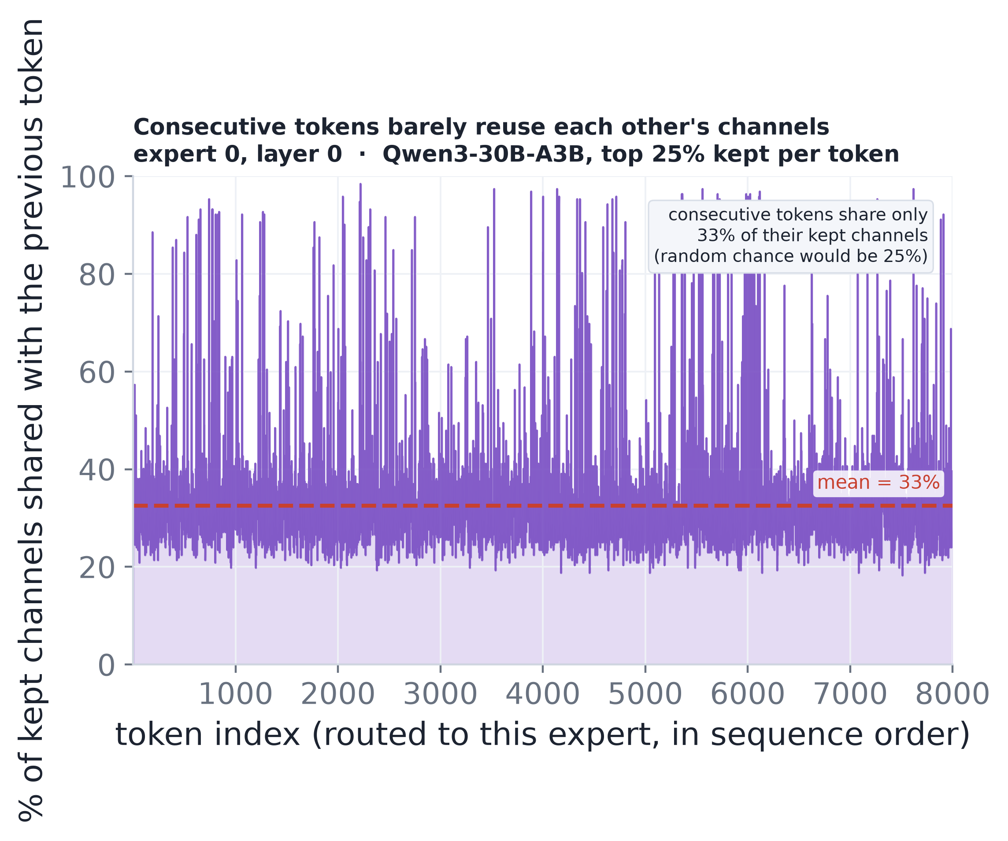
…but the Subset is Token-Specific
Which channels matter is re-decided on every token
Consecutive tokens routed to the same expert share only 33% of their kept channels — barely above the 25% random baseline.
No fixed keep-set works, and even reusing the previous token's mask fails: the choice must be made per token.
Per-Token Adaptive Channel Activation for MoE
4

Slide 5
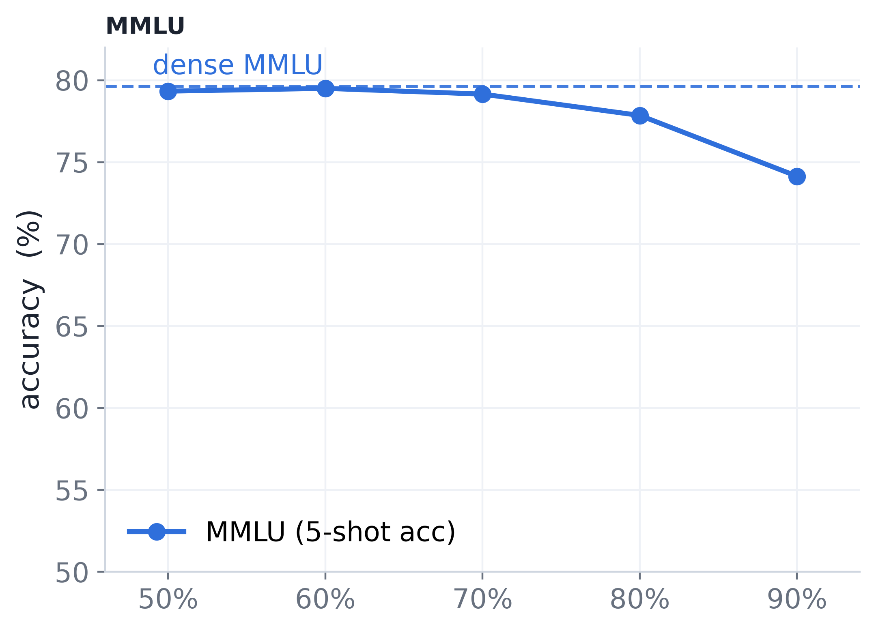
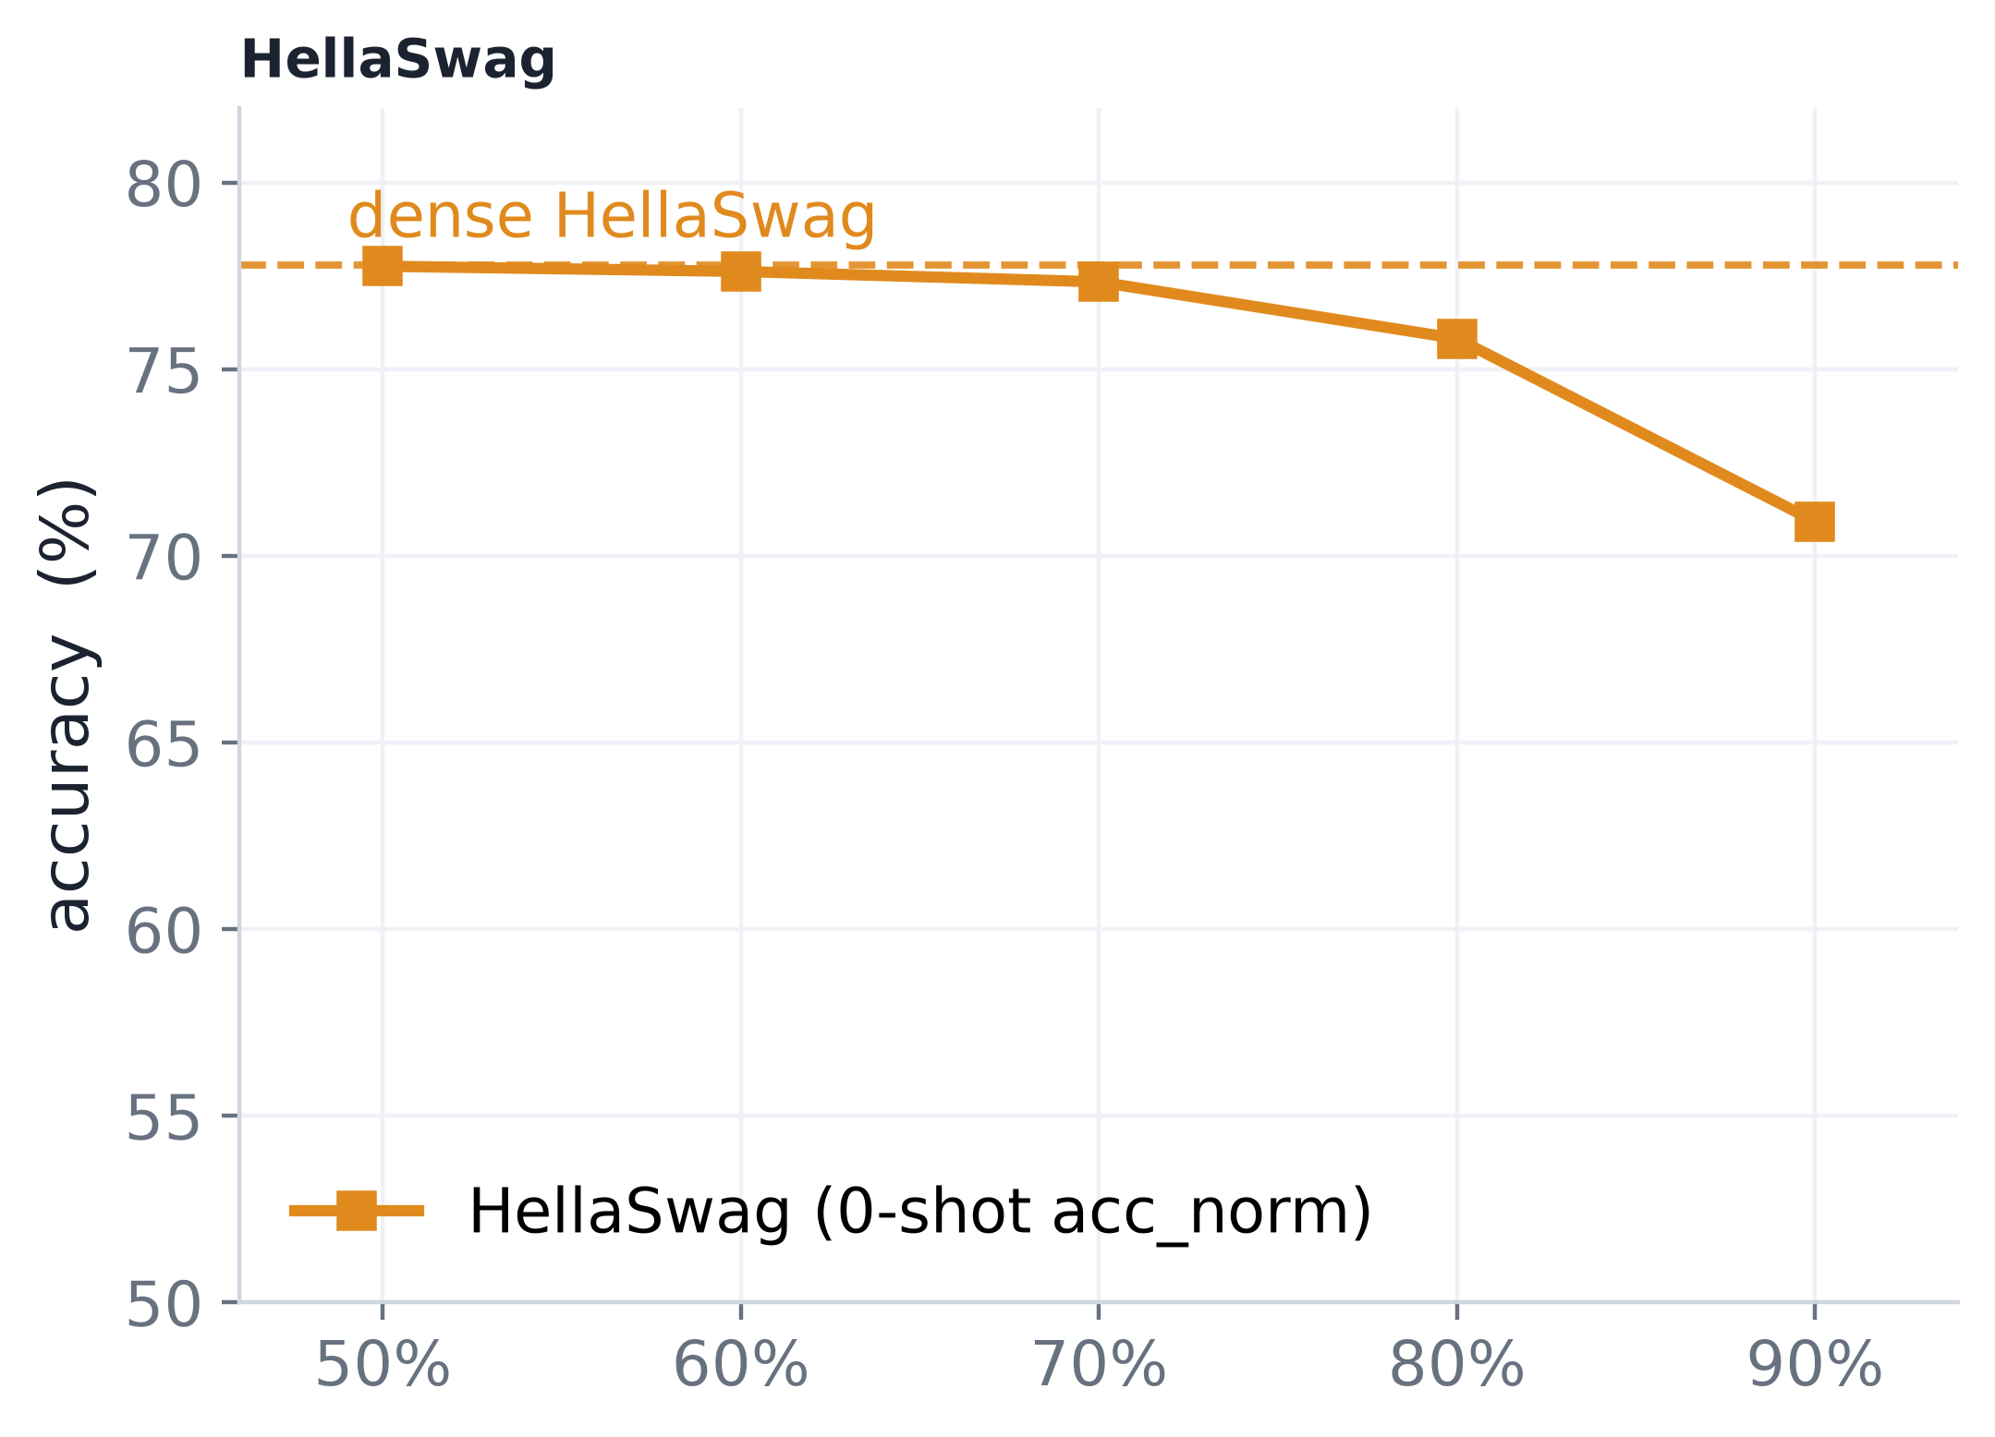
Acting on It Holds Near-Dense Accuracy
Per-token channel selection on the full dense Qwen3-30B-A3B — no fine-tuning
Per-token selection stays within noise of dense out to a 70% cut of the active intermediate dimension, on both MMLU and HellaSwag.
Accuracy bends only past 80% — a large active-parameter cut, essentially for free.
Per-Token Adaptive Channel Activation for MoE
5

Slide 6
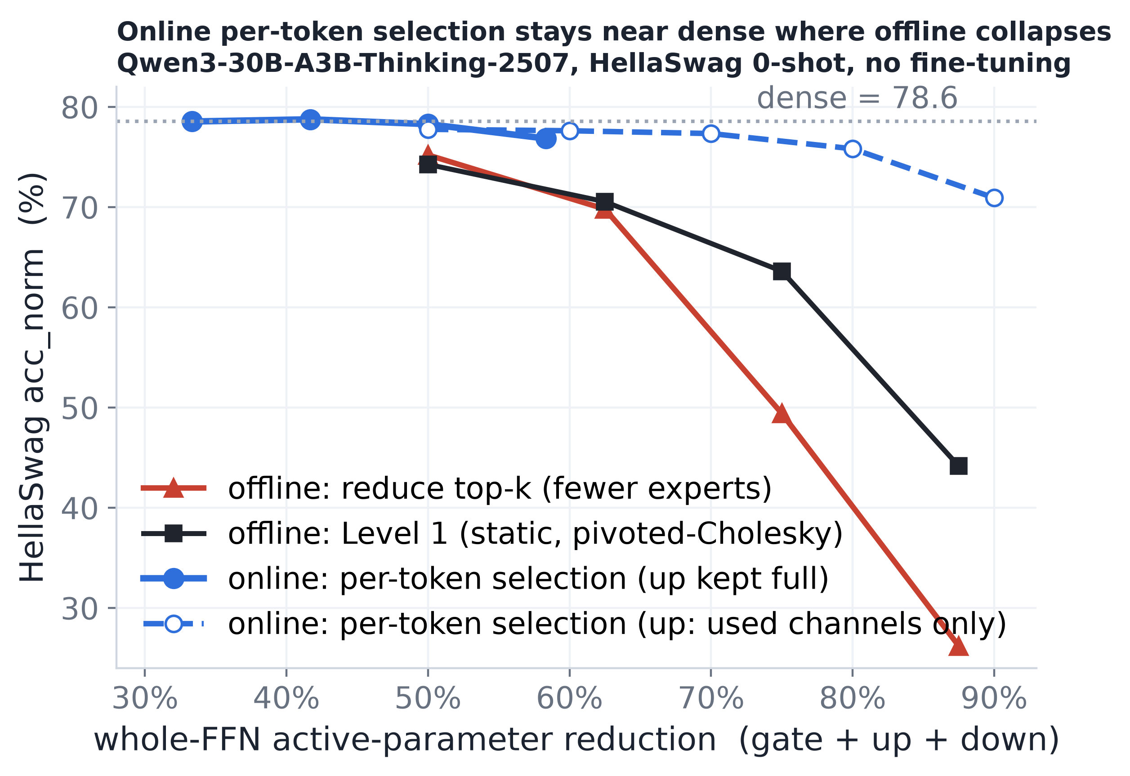
Online Selection Beats Offline, Decisively
The per-token selector stays near dense where static methods collapse
At equal budget, dropping experts or ranking channels offline falls apart as the cut deepens — toward chance by 7/8.
Per-token selection holds the dense line; the gap widens to +33 pt at the tightest budget — the information offline methods cannot see.
Per-Token Adaptive Channel Activation for MoE
6

Slide 7
Level 1 — Offline Static Channel Ranking
Can a fixed, precomputed channel order replace the online scorer?

Slide 8
The Target: a Fixed Ranking of Unique Channels
If importance were token-independent, we could rank once and skip the online scorer
The online method pins up_proj at full width — it is the scorer. Offline question: precompute a fixed per-expert channel order so inference just keeps the top-B, with no full-width computation?
① Redundancy-aware
Don't double-spend budget on duplicate channels.
② Nested order
Every prefix must be good — the budget varies per token.
③ Cross-expert comparable
One global threshold; per-expert quotas emerge on their own.
④ Reweightable by router
The only free online signal is the gate weight g_e(x).
Payoff if it worked: all three matrices narrow, “keep top-B” is a contiguous prefix slice, and the online cost is ≈ 0.
Per-Token Adaptive Channel Activation for MoE
7

Slide 9
Pivoted-Cholesky: Greedy, Conditional Selection
Pick the most important channel, then subtract what it already explains
Build a per-expert coupling matrix (activation covariance ⊙ weight Gram), then run pivoted Cholesky: greedily select the largest-residual channel and downdate every remaining channel by what the chosen one explains.
Duplicates collapse to ≈ 0 — a channel already explained is never picked again.
Online score: g²(x) · σe,r keep global top-B
router weight × precomputed marginal gain
Pivot order is nested and monotone → a single global threshold cuts a clean prefix.
Budget-agnostic: stored once (~57 MB), no weight modified.
Overhead ≈ 0.016% of expert-FFN MACs.
Every requirement met by construction — a redundancy-aware, nested, cross-expert-comparable, router-reweightable ranking.
Per-Token Adaptive Channel Activation for MoE
8

Slide 10
Results: Best Offline Ranking, Still Beaten Online
Pivoted-Cholesky tops the offline bracket — yet trails per-token selection by 4–33 pt
Active cut | Top-k | MoSE | Piv-Chol | Online
Dense | — | — | — | 78.56
−50% | 75.2 | 69.45 | 74.26 | 78.54
−62.5% | 69.8 | 61.00 | 70.54 | 78.76
−75% | 49.4 | 43.66 | 63.60 | 78.28
−87.5% | 26.2 | 30.32 | 44.15 | 76.84
Top-k = drop experts 8→k; Piv-Chol / MoSE = fixed offline rankings; Online = per-token. HellaSwag acc_norm, no fine-tuning.
Pivoted-Cholesky dominates the offline bracket (+5 to +20 pt over MoSE).
But the whole offline family caps out — trails online by 4 / 15 / 33 pt.
Cross-expert offline coupling buys nothing (<2% selection change).
The headroom is per-token activation information no fixed ranking can capture.
→ The deployable method must score online.
Per-Token Adaptive Channel Activation for MoE
9

Slide 11
Bonus Results
Online selection composes, a threshold beats top-B, and where the cloud win really is

Slide 12
Online Selection Stacks on a Compressed Base
On a 33%-Nyström + KD-healed base, per-token selection degrades like the dense model
nominal | online cut | wikitext ppl ↓ | mmlu ↑ | hellaswag ↑ | gsm8k ↑
base | 0% | 10.11 | 0.767 | 0.799 | 0.817
50% | −32.6% | 10.30 | 0.763 | 0.795 | 0.820
70% | −45.7% | 10.96 | 0.749 | 0.786 | 0.787
80% | −52.2% | 11.90 | 0.733 | 0.767 | 0.748
Cumulative ~68% reduction of the original expert weights at 80% nominal — for only +1.79 ppl.
The two axes — offline weight compression + online channel selection — stack independently.
Per-Token Adaptive Channel Activation for MoE
10

Slide 13
A Fixed Per-Layer Threshold Beats Top-B
A per-layer score threshold beats pooled top-B on every metric at matched budget
A threshold keep iff score ≥ τ is elementwise — each channel decided independently, no cross-expert sync. Budget floats per token: hot tokens keep more, quiet tokens fewer.
selection rule (80% nominal, matched budget) | ppl ↓ | mmlu ↑ | hellaswag ↑ | winogrande ↑
online top-B (B=1229) | 12.65 | 0.779 | 0.758 | 0.671
fixed per-layer threshold | 12.32 | 0.785 | 0.762 | 0.691
threshold + FloE predictor | 12.98 | 0.771 | 0.745 | 0.690
Threshold wins by reallocating budget across tokens — variable spend > fixed spend.
It does not compose with predict-ahead: a stale signal moves both the count and the choice.
Per-Token Adaptive Channel Activation for MoE
11

Slide 14
Cloud Decode: Dynamic Selection Is the Wrong Lever
On resident GPUs, dynamic selection hurts throughput — tensor parallelism is the win
Parallelism | Dense | Dynamic
FSDP2 (dp) | base | 0.83–0.88× | ↓
TP = 2 | ~2.2× base | 0.77× dense | ↓
TP = 4 | ~2.4× base | 0.65× dense | ↓
Why it hurts instead of helps:
FSDP2: the all-gather of each block's sharded weights (~83% of GPU-busy time) is independent of per-token budget.
TP: the weight read is already split tp-ways to a tiny slice (18.9 MB/rank at tp=4) — nothing left worth cutting.
Fixed overhead added: ~0.17 ms/token top-k + gather/scatter, plus ~0.1 ms all-reduce over H under TP.
Throughput vs. the dense baseline for the same layout (tok/s).
Cloud throughput levers are collectives + batch/parallelism layout, not activated-parameter count.
The dynamic method's cloud payoff is activation memory, not tokens/s — it targets edge, not cloud.
Per-Token Adaptive Channel Activation for MoE
12

