Slide 1

Java Academy
Róbert Golej

Slide 2
5. Lesson
Maven
Spring boot
First spring boot application
Beans
Spring Application Context
External Configuration
Dependency injection

Slide 3
What is maven?
Apache Maven is a software project management and comprehension tool
Making the build process easy
Providing a uniform build system
Providing quality project information
Providing guidelines for best practices development
https://maven.apache.org/what-is-maven.html

Slide 4
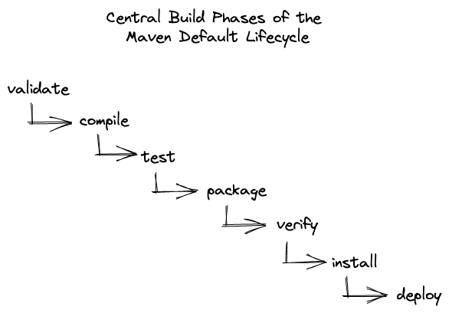
Maven lifecycle

Slide 5
Maven plugins
maven-resources-plugin
maven-compiler-plugin
maven-surefire-plugin
maven-jar-plugin
maven-install-plugin

Slide 6
pom.xml
<?xml version="1.0" encoding="UTF-8"?>
<project xmlns:xsi="http://www.w3.org/2001/XMLSchema-instance" xmlns="http://maven.apache.org/POM/4.0.0"
xsi:schemaLocation="http://maven.apache.org/POM/4.0.0 https://maven.apache.org/xsd/maven-4.0.0.xsd">
<modelVersion>4.0.0</modelVersion>
<groupId>com.devcors.javaacademy</groupId>
<artifactId>lesson5</artifactId>
<version>0.0.1-SNAPSHOT</version>
<properties>
<maven.compiler.source>17</maven.compiler.source>
<maven.compiler.target>17</maven.compiler.target>
</properties>
</project>

Slide 7
pom.xml
<properties>
<dependencyManagement>
<dependencies>
<dependencies>
<groupId>
<artifactId>
<version>
<scope>
<build>
<plugins>

Slide 8
Spring boot
Inversion of Control (IoC)
Dependency management
Why spring boot?
Easy to start with
Massive community
Auto-configuration
Embedded Servlet Container
Alternatives (Quarkus, Micronaut, …)
Spring initializr
https://start.spring.io/
https://docs.spring.io/spring-boot/docs/current/reference/htmlsingle/

Slide 9
Starting your first spring boot application
spring-boot-starter-parent
spring-boot-starter
spring-boot-starter-test
@SpringBootApplication
@ComponentScan
@Configuration
@EnableAutoConfiguration
@SpringBootTest

Slide 10
Beans
What are spring beans?
@Component
@Service
@Repository
@Controller

Slide 11
Bean scopes
Singleton
Prototype
Request
Session
Application
Websocket

Slide 12
Spring Application Context
Central interface to provide configuration for an application.
Spring application context provides:
Bean factory methods for accessing application components
The ability to load file resources in a generic fashion
The ability to publish events to registered listeners
The ability to resolve messages, supporting internationalization
Inheritance from a parent context
https://docs.spring.io/spring-framework/docs/current/javadoc-api/org/springframework/context/ApplicationContext.html

Slide 13
External configuration
Command Line variables
System Variables
application.yaml
@Value
@ConfigurationProperties

Slide 14
Dependency injection
@Autowired
Constructor injection
@Qualifier
@Primary
@ConditionalOnMissingBean

Slide 15
Starters
spring-boot-starter-web
spring-boot-starter-actuator
spring-boot-starter-validation
spring-boot-starter-data-jpa
spring-boot-starter-activemq

Slide 16
Homework
Finalize implementation so that this will become a spring boot application.
Fill all necessary code so that beans are properly injected and configuration is properly loaded.
To test your implementation, you can use Lesson5Test.
Note: do not change implementation of existing methods except for main class.

Slide 17
Thank you for your attention.

