Slide 1

Java Academy
Róbert Golej

Slide 2
Lesson 2
Conditions
What is condition?
if
if/if else
if/if else/else
ternary operator
switch
Loops
for
while
do while
break
continue

Slide 3
What is condition?
Condition in java is expression, that evaluates to true/false.
Mathematical conditions:
==, !=
>, <, >=, <=
negation
conjunction/disjunction
Other conditions:
instanceof
equals

Slide 4
if
Syntax:
if ( condition ) {
// to be executed code in case condition is true
}

Slide 5
if/else if
Syntax:
if ( condition1 ) {
// to be executed code in case condition1 is true
} else if ( condition2 ) {
// to be executed code in case condition1 is false
// and condition2 is true
}

Slide 6
if/else if/else
Syntax:
if ( condition1 ) {
// to be executed code in case condition1 is true
} else if ( condition2 ) {
// to be executed code in case condition1 is false
// and condition2 is true
} else {
// to be executed code in case both conditions are false
}

Slide 7
Ternary operator
Ternary operator is a syntactic sugar for if else statement in case we want to assign/return value.
Syntax:
value = condition ? value1 : value2
Value1 is assigned when condition is true, value 2 is assigned otherwise.

Slide 8
Switch
Syntax:
switch (expression) {
case x:
// execute this code if expression equals x
case y:
// execute this code if expression equals x or y
break;
default:
// execute this block if expression does not equals x or y
}
Expression can be primitive type, Enum or String.

Slide 9
for
Syntax:
for ( initializing statement; condition; increment/decrement ) {
// to be executed code
}

Slide 10
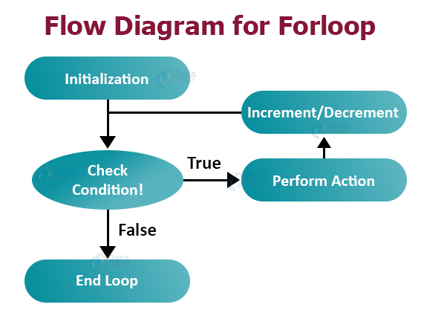
for

Slide 11
while
Syntax:
while ( condition ) {
// to be executed code if condition is true
}

Slide 12
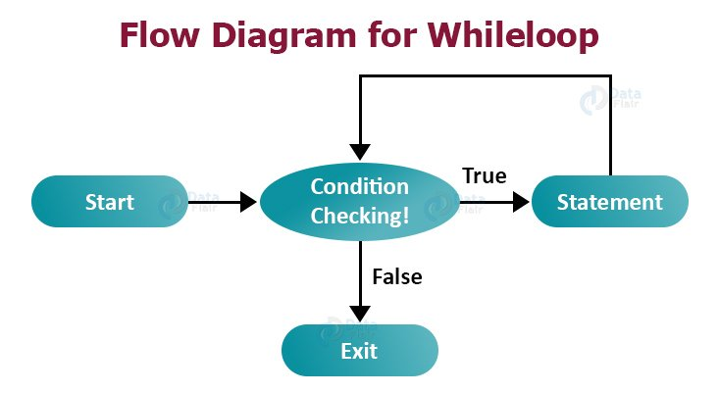
while

Slide 13
do while
Syntax:
do {
// to be executed code if condition is true
} while (condition)

Slide 14
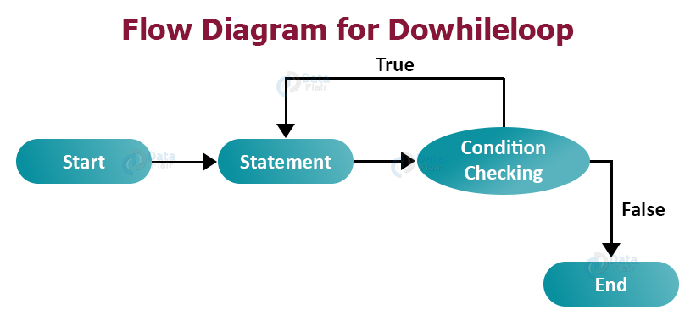
do while

Slide 15
break
Causes program to jump out of loop.
Usable in both for/while loops.
Syntax:
while (condition) {
// executed code
break;
// this code will not get executed
}

Slide 16
continue
Skips one iteration of loop.
Syntax:
while (condition) {
// executed code
continue;
// loop will continue with next iteration
// code after continue will not be executed
}

Slide 17
Homework
Implement methods defined in Loops.java and Conditions.java and use this methods is BrnoLesson2.java main method.
https://gitlab.com/dev-cors/javaacademy/lessons/lesson2/-/blob/master/src/main/java/com/devcors/javaacademy/lesson2/BrnoLesson2.java

Slide 18
Thank you for your attention.

