Slide 1

Java Academy
Vojtech Bures

Slide 2
5. Lesson
HTTP protocol
RESTful Web Services
Postman
Rest Controller
ResponseEntity to Manipulate the HTTP Response
Error Handling for REST
Integration tests
Open API
Swagger

Slide 3
HTTP protocol
Hypertext Transfer Protocol - communication with WEB servers
TCP/80
Request/Response
Versions
Request methods
Response status codes
Headers
Encrypted connections
URL(Uniform Resource Locator) - specifies the unique location of a resource on the Internet
https://en.wikipedia.org/wiki/Hypertext_Transfer_Protocol

Slide 4
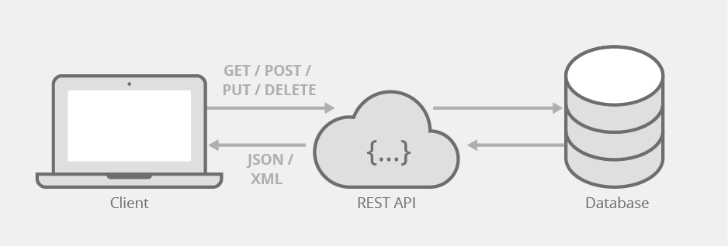
RESTful Web Services
How RESTful APIs work
RESTful API Design and Architecture Constraints
Common REST API challenges
Usage

Slide 5
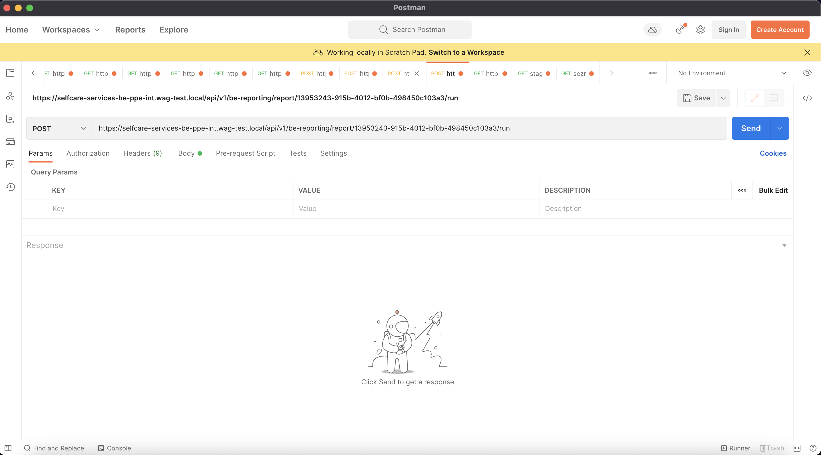
Postman
Application used for API testing
https://www.postman.com

Slide 6
Rest Controller
spring-boot-starter-web
@RestController vs. @Controller
@RequestMapping
@GetMapping
@PostMapping
@PutMapping
@DeleteMapping
@PathVariable
@RequestParam
@RequestBody, @ResponseBody, @Valid
@RequestHeader

Slide 7
ResponseEntity to Manipulate the HTTP Response
Represents the whole HTTP response
status code
headers
body
ResponseEntity is a generic type
Builders
Manipulate the Response Directly HttpServletResponse

Slide 8
Error Handling for REST
@ExceptionHandler
@ResponseStatus
@ControllerAdvice
ResponseStatusException

Slide 9
Integration tests
Why write integration tests?
WebTestClient
MockMvc

Slide 10
Open API
OpenAPI Specification (OAS) defines a standard
An OpenAPI definition can then be used:
documentation generation tools to display the API
code generation tools to generate servers and clients in various programming languages
testing tools
many other use cases
https://www.openapis.org
https://openapi-generator.tech

Slide 11
Swagger
Tools used in the implementation of OpenAPI:
Swagger Editor
Swagger UI
Swagger Codegen
Swagger Inspector
Others
springdoc-openapi-ui
springfox-swagger2

Slide 12
Homework
Create CarController and UserController
Complete task assignment in gitlab –> lesson6 –> Lesson6Application.java
To test your implementation, you can use CarControllerIntegrationTest and UserControllerIntegrationTest.
Note: do not change implementation of existing repository methods.

Slide 13
Thank you for your attention.

