Slide 1

Java Academy
Róbert Golej

Slide 2
7. Lesson
Database
H2 database
Liquibase
SQL
Hibernate
Entity
JPA
Transactional

Slide 3
Database
Why do we use databases?
A database is an organized collection of structured information, or data, typically stored electronically in a computer system.
Types of databases
Relational databases
NoSQL databases
SQL (Structured Query Language)

Slide 4
ACID
Atomicity
each statement in a transaction (to read, write, update or delete data) is treated as a single unit.
Consistency
ensures that transactions only make changes to tables in predefined, predictable ways.
Isolation
when multiple users are reading and writing from the same table all at once, isolation of their transactions ensures that the concurrent transactions don’t interfere with or affect one another.
Durability
ensures that changes to your data made by successfully executed transactions will be saved, even in the event of system failure.
https://databricks.com/glossary/acid-transactions

Slide 5
H2 database
Why to use h2 for local development?
H2 console
http://localhost:8080/h2-console
Dependencies:
<dependency>
<groupId>com.h2database</groupId>
<artifactId>h2</artifactId>
</dependency>
<dependency>
<groupId>org.springframework.boot</groupId>
<artifactId>spring-boot-starter-data-jpa</artifactId>
</dependency>
https://www.baeldung.com/spring-boot-h2-database

Slide 6
Database configuration
spring:
datasource:
url: jdbc:h2:mem:mydb
username: sa
password: password
driverClassName: org.h2.Driver
h2:
console:
enabled: true
jpa:
spring.jpa.database-platform: org.hibernate.dialect.H2Dialect
generate-ddl: true

Slide 7
Liquibase
Tool to manage our database schema
Allows incremental upgrades of schema
Possibility to work on different databases
Dependency:
<dependency>
<groupId>org.liquibase</groupId>
<artifactId>liquibase-core</artifactId>
</dependency>
Properties:
spring:
liquibase:
enabled: true
liquibase:
change-log: db.changelog-master.yaml

Slide 8
SQL
DDL vs DML
select
where
and/or/not
in
https://www.w3schools.com/sql/sql_select.asp

Slide 9
Hibernate
ORM (Object Relational Mapping)
@Entity
@Id
@GeneratedValue
@Column
@Enumerated
https://hibernate.org/orm/

Slide 10
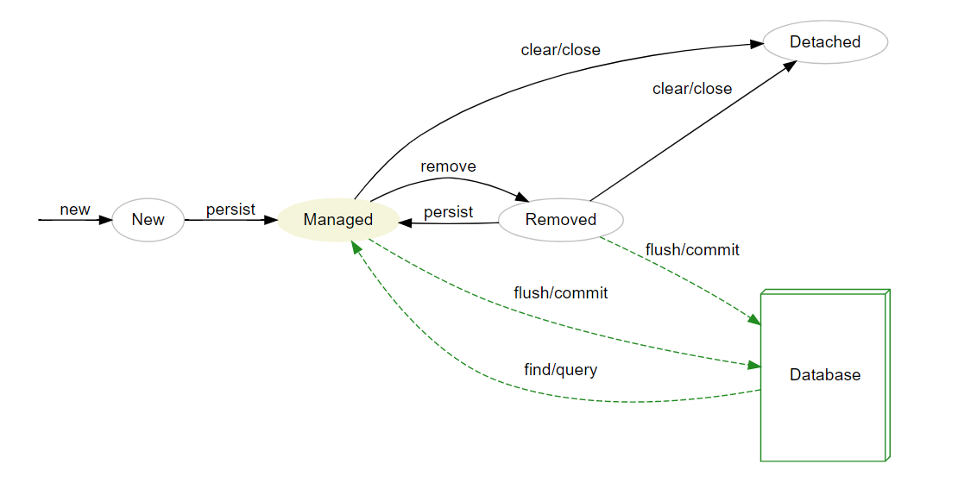
Entity lifecycle

Slide 11
Entity relationships
@OneToOne
@OneToMany
@ManyToOne
@ManyToMany
@JoinColumn
@JoinTable
FetchType.LAZY vs FetchType.EAGER

Slide 12
JPA
The Java Persistence API (JPA) is a Java specification for accessing, persisting, and managing data between Java objects / classes and a relational database.
spring-boot-starter-data-jpa
spring-data-jpa
@EnableJpaRepositories
No need to add manually
Scans @Repository interfaces

Slide 13
JpaRepository
Implementing JPARepository interface
Available methods
save
findAll
findById
@Query
JPQL vs Native SQL
@Modifying
Query Creation from Method Names
https://www.javaguides.net/2018/11/spring-data-jpa-query-creation-from-method-names.html
Pageable
Sort

Slide 14
Transactional
Transactions are tools that help us achieve ACID properties
Propagation types:
Required
Supports
Mandatory
Requires new
Not supported
Never
Nested
Rollback
Isolation
LazyInitializationException

Slide 15
Homework
Complete task assignment in gitlab –> lesson7 –> Lesson7Application.java
To test your implementation, you can use adjusted tests in lesson7, however they will only be runnable after you adjust repositories to become jpa repositories

Slide 16
Thank you for your attention.

