Slide 1
TurboQuant
GOOGLE RESEARCH · ARXIV 2504.19874
Near-optimal vector compression for LLM KV caches and vector search, with no training and no calibration
3.5 bits: quality-neutral KV cache
~0 s indexing
2 Colab demos
Zandieh, Daliri, Hadian, Mirrokni · builds on QJL (2406.03482) and PolarQuant (2502.02617)
Notes:
TurboQuant is Google Research's data-oblivious vector quantizer. One algorithm covers two very different workloads: compressing the key/value cache of an LLM while it generates, and compressing a vector database index. The headline: quality-neutral KV cache at 3.5 bits per channel, and indexing that takes milliseconds instead of minutes. We'll go through the idea, the evidence, and two runnable demos.

Slide 2
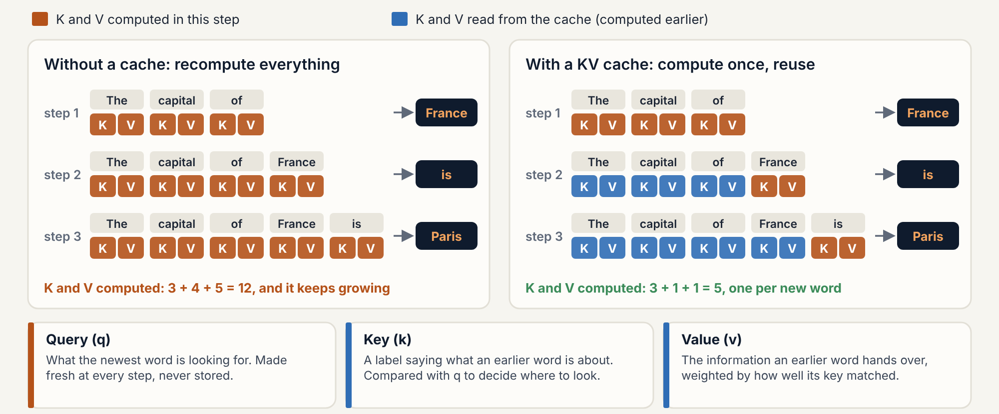
The KV cache: compute once, reuse at every step
BACKGROUND · THE KV CACHE
The price: one K and one V per token, in every layer and head. That is what TurboQuant compresses.
Notes:
Before the problem, a quick picture of what the KV cache is, for anyone who has not met it. A language model writes one word, strictly one token, at a time. To choose the next word, every layer runs attention: the newest word makes a query, which says what it is looking for. Every earlier word has a key, a label saying what it is about, and a value, the information it hands over. The query is compared with all the keys, and the values of the best matches are mixed together. Left side: without a cache, the model would recompute the keys and values of the whole sentence at every step, so the work keeps growing. Right side: those keys and values never change once computed, so the model stores them and computes only the newest word's pair. That store is the KV cache. It makes generation fast, but it costs memory: one key and one value per token, in every layer and every head, for every user. The next slide puts a number on it, and the rest of the talk is about making those vectors 4 to 6 times smaller.

Slide 3
Memory, not compute, limits long context and large indexes
THE PROBLEM
LLM KV CACHE · LLAMA-3.1-8B, FP16
VECTOR INDEX · 1M × 1536-D FLOAT32
128 KB
6.1 GB
per token (32 layers × 8 KV heads × 128 dims × K and V × 2 bytes). A 128k-token context needs 16 GB, as much as the weights, and every generated token re-reads all of it.
for one million OpenAI-size embeddings. Product quantization shrinks it, but must train codebooks first and re-train when the data drifts.
Decode attention is memory-bandwidth bound: fewer bytes per token means more context, more concurrent users, and faster attention.
Notes:
Two workloads, one bottleneck. In LLM serving the KV cache grows linearly with context and with the number of concurrent sessions; for an 8B model at 128k tokens it matches the size of the model itself. In vector search the index has to fit in RAM to be fast. Both are just big piles of high-dimensional vectors where what matters is preserving inner products. That's exactly what TurboQuant targets.

Slide 4
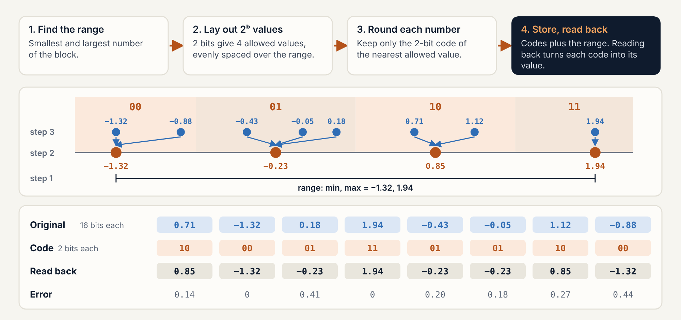
Quantization: round, store a short code, read it back
BACKGROUND · QUANTIZATION
TurboQuant keeps steps 3 and 4 and replaces 1 and 2: rotate first, then use one fixed set of values, so no range is stored.
Notes:
Before we look at what goes wrong with classic quantization, here is how it works, on eight numbers. Step one: find the range of the block, the smallest and the largest number. Step two: with 2 bits we can name four allowed values, so we spread four values evenly over that range. Step three: every number is replaced by the 2-bit code of the nearest allowed value; that rounding is the only place we lose information. Step four: we store the codes, plus the minimum and the step so we can decode. Reading back is just minimum plus code times step, and the bottom row shows the error each number picks up. Two things to notice. First, the range has to be stored for every block, and that is the hidden tax on the next slide. Second, the two extreme numbers set the range, so five of the eight numbers share only two values. TurboQuant keeps the rounding and the storing, but replaces the first two steps: it rotates the vector first so nothing sticks out, and uses one fixed set of values for every vector, so there is no range to store.

Slide 5
Classic quantization pays up to 1 extra bit per number for scales
THE HIDDEN TAX
Scheme, one 128-d head vector | Code bits | Overhead | Effective
FP16 | 16 | 0 | 16
INT4, fp16 scale + zero per 32 ch | 4 | 1.0 | 5.0
INT2, fp16 scale + zero per 32 ch | 2 | 1.0 | 3.0
TurboQuant 4-bit (one fp16 norm) | 4 | 0.125 | 4.125
TurboQuant 2-bit (one fp16 norm) | 2 | 0.125 | 2.125
Block quantizers must store a zero point and a scale in full precision for every block, because each block has its own range.
TurboQuant makes every block's range the same, so it needs no scales at all.
Overhead as described in QJL (2406.03482) and PolarQuant (2502.02617); TurboQuant figures measured from the demo's bit-packed storage.
Notes:
This is the observation that started the whole line of work. If you quantize in blocks, each block needs its own min and scale stored in 16-bit floats. With groups of 32, that is 32 extra bits per 32 numbers: a full extra bit per number. At 2-bit quantization that is a 50 percent tax. TurboQuant only stores one 16-bit norm per vector, which is 0.125 bits per channel for a 128-dimensional head.

Slide 6
Randomize first, so the data's distribution is known in advance
THREE PAPERS, ONE IDEA
JUN 2024 · 2406.03482
FEB 2025 · 2502.02617
APR 2025 · 2504.19874
QJL
PolarQuant
TurboQuant
Johnson-Lindenstrauss projection, keep only the sign bit. An asymmetric estimator gives unbiased inner products with zero overhead. 3-bit KV cache, over 5x less memory.
Random preconditioning, then a recursive polar transform. The angles follow a tight, analytically known distribution, so no normalization is needed. Over 4.2x KV compression.
Random rotation plus an optimal scalar quantizer per coordinate, then 1-bit QJL on the residual. Provably within about 2.7x of the information-theoretic limit, for KV caches and vector search.
Google's blog presents TurboQuant as PolarQuant-style compression plus a QJL error-correction bit.
Notes:
All three papers share authors at Google Research and share one trick: apply a random transform so that, whatever the input, the transformed coordinates follow a distribution you know ahead of time. QJL used that to get 1-bit sketches. PolarQuant used it to make polar angles predictable. TurboQuant simplifies to a plain random rotation plus Lloyd-Max scalar quantization, and adds QJL on the residual when you need unbiased inner products. Note that Google's blog describes stage one as PolarQuant; in the paper's algorithm it is the rotation plus scalar quantizer, which plays the same role.

Slide 7

Rotate, then round each coordinate to a fixed codebook
STAGE 1 · TURBOQUANT_MSE
Any vector x
y = Π · x / ‖x‖
Nearest centroid
b·d bits + 16
Keys, values or embeddings, with outliers. Store ‖x‖ in fp16.
Random rotation. Every coordinate now follows the same Beta law, close to N(0, 1/d).
Per coordinate, from 2ᵇ Lloyd-Max centroids solved once offline.
Decode: look up centroids, rotate back with Πᵀ, scale by ‖x‖.
Why it works. In high dimensions the rotated coordinates are nearly independent, so quantizing them one at a time is close to optimal.
Why it is fast. One matrix multiply and a bucket lookup. No training, no calibration, works token by token as the cache grows.
Algorithm 1 of the paper. Example: 2-bit centroids are ±0.453/√d and ±1.51/√d.
Notes:
This is the whole MSE algorithm. Random rotation is the key: after it, each coordinate of a unit vector follows a known scaled Beta distribution, which is basically a Gaussian with variance one over d. Because the distribution is known in advance, the optimal scalar quantizer, the Lloyd-Max codebook, can be computed once and reused for any data. There is nothing to learn from the data, so indexing is essentially instant and works online.

Slide 8
One QJL bit on the residual removes the inner-product bias
STAGE 2 · TURBOQUANT_PROD
The problem
The fix
The trade-off
MSE-optimal codes shrink vectors toward zero. At 1 bit, E⟨y, x̃⟩ = (2/π)·⟨y, x⟩.
idx = Q_mse(x) with b−1 bits
r = x − Q_mse⁻¹(idx)
store idx, sign(S·r), ‖r‖
Unbiased, but noisier: it spends one bit on the sign sketch.
From 3 bits up, plain MSE has lower total error. The paper's Figure 3 shows the same crossover.
Measured bias in the demo (d = 128): −36% at 1 bit, −12% at 2, −3.5% at 3.
Unbiased at every bit-width (measured bias +0.1%).
Algorithm 2 of the paper. Bias figures measured in the LLM notebook's theory check (20,000 random vectors).
Notes:
For nearest-neighbour search and attention, what you actually need is inner products, and a quantizer that minimizes MSE is biased for inner products: it systematically underestimates them. The fix is elegant: use one bit fewer for the MSE stage, then spend the last bit on a QJL sign sketch of the residual. That estimator is provably unbiased. The cost is variance, so at higher bit widths the plain MSE version is actually more accurate. In our demo the crossover is at about 2 to 3 bits, matching the paper.

Slide 9
No quantizer can do much better: TurboQuant is within 2.7x of the limit
NEAR-OPTIMAL
MSE, unit vectors | b = 1 | b = 2 | b = 3 | b = 4
Lower bound 4⁻ᵇ | 0.250 | 0.063 | 0.016 | 0.0039
Demo, measured | 0.360 | 0.116 | 0.034 | 0.0093
Paper | 0.36 | 0.117 | 0.03 | 0.009
Upper bound √3π/2·4⁻ᵇ | 0.680 | 0.170 | 0.043 | 0.0106
1.45x
gap to the Shannon lower bound at 1 bit; never more than √3π/2 ≈ 2.7x.
Each extra bit cuts the error by 4x, the best rate any quantizer can achieve. Earlier data-oblivious methods had only loose, polynomial guarantees.
Theorems 1 and 3 of 2504.19874. Measured row: turboquant_core.py, d = 128, 20,000 vectors.
Notes:
The paper proves a matching lower bound using Shannon's source coding theorem and Yao's minimax principle: no randomized quantizer of any kind can beat four to the minus b on worst-case inputs. TurboQuant's upper bound is only a constant factor of about 2.7 above that, and at 1 bit it is 1.45. Our reference implementation reproduces the paper's numbers to the third decimal, which is a good check that the code in the demos is faithful.

Slide 10
QJL by hand: 4 numbers become 3 sign bits and a norm
QJL · WORKED EXAMPLE
1 · Key and norm
k = [3, −4, 2, 0.5]
‖k‖ = √(9 + 16 + 4 + 0.25)
= √29.25 = 5.41
Stored as one float.
2 · Project with S
S: 3 × 4 Gaussian, rebuilt from a seed
0.5 −0.2 0.8 −0.1
−0.9 0.1 0.3 0.7
0.2 0.6 −0.4 −0.5
S·k = [3.85, −2.15, −2.85]
3 · Keep the signs
sign(S·k) = [+1, −1, −1]
Stored as the bits 100
In memory: 3 bits + 5.41.
The four original floats are dropped.
4 · Score a query
q = [1, −1, 1, 0]
⟨q, k⟩ = 1·3 + (−1)(−4)
+ 1·2 + 0·0.5 = 9
S·q = [1.5, −0.7, −0.8]
⟨S·q, sign⟩ = 1.5 + 0.7 + 0.8
√(π/2)/3 · 5.41 · 3.0 =
6.78 vs exact 9
Unbiased, not exact. Over 2,000 draws of S the estimate averages 9.07. Its spread is 4.4 with 3 bits, 0.91 with 64 and 0.24 with 1,024: it shrinks like 1/√m.
Why √(π/2). Keeping signs shrinks the average by √(2/π)/‖k‖. The norm and √(π/2) undo it. The query stays full precision, so there is no XOR or popcount.
Section 4.1 of the guide. Every number is reproduced by docs/guide/worked_examples.py.
Notes:
A worked QJL example on four numbers, the same key we will reuse for PolarQuant and TurboQuant. The key's norm is 5.41 and is stored as one float. We multiply the key by a random Gaussian matrix S, three rows here, which is never stored because it is regenerated from a seed. The projections are 3.85, minus 2.15 and minus 2.85, and we keep only their signs: three bits, 1 0 0. When the query 1, minus 1, 1, 0 arrives, its exact score with the key is 9. We project the query with the same S but do not quantize it, flip its projections by the stored signs and add them up: 3.0. Scaling by root pi over 2, divided by m, times the norm gives 6.78. That is one draw; the estimator is unbiased, so averaged over 2,000 draws of S it gives 9.07, and the spread falls like one over root m, from 4.4 at three bits to 0.24 at 1,024. Real heads use as many bits as the head dimension or more.

Slide 11
PolarQuant by hand: pairs become radii and angles
POLARQUANT · WORKED EXAMPLE
Quantize the angles
4 bits, 16 buckets of 22.5°: θ₁ → bucket 13 (303.75°), θ₂ → bucket 0 (11.25°).
2 bits, k-means centroids 17.7°, 36.3°, 53.7°, 72.3°: ψ → 17.7° (index 0).
Stored: 4 + 4 + 2 = 10 bits + one float (5.41).
‖v‖ = 5.41
ψ = 22.4° (0 to 90°, 2 bits)
LEVEL 2
R_A = 5
θ₁ = 306.9° (4 bits)
R_B = 2.06
θ₂ = 14.0° (4 bits)
LEVEL 1
Decode, top-down
R_A ≈ 5.41·cos 17.7° = 5.15, R_B ≈ 5.41·sin 17.7° = 1.65
v̂ = [2.86, −4.28, 1.62, 0.32]
9.7% error. Score with q = [1, −1, 1, 0]: 8.76 vs 9.
INPUT
x₁ = 3
x₂ = −4
x₃ = 2
x₄ = 0.5
v = [3, −4, 2, 0.5], already rotated. Pair, then pair the radii.
Section 4.2 of the guide. In practice: 4 levels, blocks of 16 coordinates, 3.875 bits per coordinate.
Notes:
The same vector, now through PolarQuant. Assume it has already been randomly rotated. Level one pairs the coordinates: 3 and minus 4 become a radius of 5 and an angle of 306.9 degrees; 2 and 0.5 become a radius of 2.06 and an angle of 14 degrees. Level two pairs the two radii: the radius is 5.41, the norm of the whole vector, and the angle is 22.4 degrees, always between 0 and 90 because radii are non-negative. First-level angles are uniform, so they get 4 bits and 16 equal buckets. Higher-level angles concentrate around 45 degrees, so their 2-bit centroids come from k-means on the known density: 17.7, 36.3, 53.7 and 72.3 degrees. We store 10 bits of angles plus the norm. Decoding runs the tree top-down with cosines and sines and gives 2.86, minus 4.28, 1.62, 0.32: a 9.7 percent error, and a score of 8.76 against 9.

Slide 12
TurboQuant end to end on the same four numbers
TURBOQUANT · WORKED EXAMPLE
STAGE 1 · TURBOQUANT_MSE, 2 BITS PER COORDINATE
1 · Norm
v = [3, −4, 2, 0.5]
‖v‖ = 5.41, stored in fp16
Continue with u = v / ‖v‖
2 · Rotate
Π = ½·Hadamard, random signs
Π·v = [4.25, 0.75, 2.75, −1.75], same length
y = Π·v / ‖v‖ = [0.786, 0.139, 0.508, −0.324]
3 · Round
Lloyd-Max codebook for d = 4: ±0.219, ±0.674
ŷ = [0.674, 0.219, 0.674, −0.219]
Codes 11 10 11 01, 8 bits
4 · Decode
x̃ = ‖v‖·Πᵀ·ŷ = [3.65, −3.65, 1.19, 1.19]
24% error. ⟨q, x̃⟩ = 8.48 < 9: the score shrinks.
STAGE 2 · 1-BIT QJL ON THE RESIDUAL
5 · Residual
r = v − x̃ = [−0.65, −0.35, 0.81, −0.69]
‖r‖ = 1.29, stored in fp16
Missing score ⟨q, r⟩ = 0.52
6 · Sign sketch of r
S = QJL's 3 rows + [0.4, −0.7, −0.3, 0.9]
S·r = [0.47, 0.31, −0.32, −0.87]
Stored as 1100, 4 bits
7 · Score q = [1, −1, 1, 0]
S·q = [1.5, −0.7, −0.8, 0.8]
⟨S·q, sign(S·r)⟩ = 0.8
√(π/2)/4 · 1.29 · 0.8 = 0.32
8.48 + 0.32
8.81 vs exact 9
44 bits stored instead of 128
Section 4.3 of the guide. Over 20,000 random rotations the MSE stage alone averages 8.32 and the full estimate 9.00.
Notes:
Now the whole of TurboQuant on the same four numbers, at 3 bits per coordinate: 2 bits for the MSE stage and 1 bit for QJL. Store the norm, 5.41, and work on the direction. Rotate: to keep the arithmetic on a slide we use a Hadamard matrix with random signs, a fast random rotation; the reference code uses a dense one. The coordinates change to 4.25, 0.75, 2.75 and minus 1.75, but the length does not. Divide by the norm and round each coordinate with the fixed Lloyd-Max codebook for d equals 4, plus or minus 0.219 and 0.674: 8 bits of codes. Decoding rotates the centroids back: 3.65, minus 3.65, 1.19, 1.19, and the score with our query drops to 8.48, the shrinkage bias. Stage two takes the residual, norm 1.29, and stores the signs of a 4 by 4 Gaussian projection of it: 1 1 0 0. At query time the correction is root pi over 2, over 4, times 1.29, times 0.8, which is 0.32, so the estimate is 8.81 against 9. Over 20,000 random rotations the MSE stage alone averages 8.32 and the full estimate 9.00: the QJL bit removes the bias. What stays in memory: 8 bits of codes, 4 sign bits and two fp16 norms of 16 bits each, 44 bits in total, against 128 bits for the four numbers in float32.

Slide 13
3.5 bits matches the full cache on LongBench and needle retrieval
PAPER RESULTS · KV CACHE
LongBench average, Llama-3.1-8B-Instruct
Needle in a haystack, 4k–104k tokens, 25% memory
Method | KV bits | Average
Full cache | 16 | 50.06
KIVI | 3 | 48.50
KIVI | 5 | 50.16
PolarQuant | 3.9 | 49.78
TurboQuant | 2.5 | 49.44
TurboQuant | 3.5 | 50.06
Method | Score
Full precision | 0.997
TurboQuant | 0.997
PolarQuant | 0.995
KIVI | 0.981
PyramidKV | 0.895
SnapKV | 0.858
Average task score out of 100 (F1, ROUGE-L, accuracy or edit similarity per task), not % correct.
Recall score from 0 to 1, averaged over all lengths and depths.
Source: 2504.19874, Table 1 and Figure 4. 2.5 and 3.5 bits use an outlier-channel split (e.g. 32 channels at 3 bits, 96 at 2 bits).
Notes:
On LongBench, TurboQuant at 3.5 bits per channel ties the uncompressed cache exactly, and at 2.5 bits it loses about 0.6 points, while using fewer bits than KIVI or PolarQuant. Unlike KIVI and PolarQuant, it also quantizes tokens produced during generation, not just the prompt. On needle-in-a-haystack, at a quarter of the memory, it scores exactly like full precision, while token-eviction methods like SnapKV and PyramidKV miss needles. The fractional bit-widths come from splitting channels into outliers, which get one more bit, and the rest. About the scores: the LongBench number is an average quality score out of 100 across tasks, each with its own metric, so it is not a percentage of correct answers. The needle number is a recall score from 0 to 1 averaged over all document lengths and needle depths.

Slide 14
The big win is capacity; speed depends on the kernel
IN PRODUCTION
GOOGLE RESEARCH BLOG
VLLM 0.20.2+ · H100
up to 8x
2.3–3.7x
faster attention-logit computation with 4-bit TurboQuant versus 32-bit keys on H100. At least 6x smaller KV memory on needle tasks, with 3-bit keys and no training.
more KV-cache capacity, at 66–80% of BF16 throughput. The aggressive 3-bit variants drop up to ~20 points on hard math and coding; FP8 stays throughput-neutral.
vllm serve <model> --kv-cache-dtype turboquant_4bit_nc # or turboquant_k8v4, turboquant_k3v4_nc, turboquant_3bit_nc
Sources: research.google/blog/turboquant-redefining-ai-efficiency-with-extreme-compression · vllm.ai/blog/2026-05-11-turboquant
Notes:
Two production data points, and they tell a nuanced story. Google's own numbers emphasize kernel speed: computing attention logits directly from 4-bit codes is up to eight times faster than reading 32-bit keys, because decode attention is bandwidth bound. vLLM's independent integration shows the practical picture: two to almost four times more KV-cache capacity, so more concurrent requests and longer contexts, but per-request throughput below BF16, and accuracy drops on hard reasoning at the most aggressive 3-bit settings. So: 4-bit with norm correction is the safe default, and evaluate before going lower.

Slide 15
Better recall than trained PQ, with indexing time near zero
PAPER RESULTS · VECTOR SEARCH
Time to quantize 100k vectors at 4 bits (seconds)
Method | d = 200 | d = 1536 | d = 3072
Product Quantization | 37.04 | 239.75 | 494.42
RaBitQ | 597.25 | 2267.59 | 3957.19
TurboQuant | 0.0007 | 0.0013 | 0.0021
Recall@1@k beat both PQ and RaBitQ on GloVe-200, OpenAI3-1536 and OpenAI3-3072, at 2 and 4 bits.
Even though PQ was trained and evaluated on the same data, which favours PQ.
Source: 2504.19874, Table 2 and Figure 5 (DBpedia entities with OpenAI text-embedding-3-large; GloVe).
Notes:
For vector databases, the comparison is against product quantization, which runs k-means to learn codebooks, and RaBitQ. TurboQuant has nothing to learn, so its quantization time is a matrix multiply: milliseconds versus minutes or an hour. And it still wins on recall. The paper notes that PQ was even given the advantage of training on the evaluation set. Our second demo reproduces this comparison.

Slide 16
Two Colab notebooks, one 400-line PyTorch implementation
THE DEMOS
llm_kv_cache_demo.ipynb
vector_search_demo.ipynb
LLM inference
Vector search
Llama-3.1-8B-Instruct, the paper's model, on an A100 or L4. Theory check, KL and top-1 agreement versus FP16, needle in a haystack up to 8k tokens, measured memory and speed.
The paper's DBpedia OpenAI-1536 setup, 100k vectors. TurboQuant and turbovec versus FAISS PQ, PQ-FastScan, RaBitQ and SQ4: recall, build time, QPS, re-ranking.
Both notebooks embed turboquant_core.py, so each runs on its own with Runtime › Run all.
Notes:
Now the hands-on part. Both notebooks share one small reference implementation, turboquant_core.py, written for readability: Lloyd-Max codebooks, the MSE and inner-product quantizers, the outlier split, real bit-packing so memory numbers are measured, a classic INT-b baseline, and a Hugging Face cache class. The LLM notebook needs a GPU runtime; the vector search one runs on CPU.

Slide 17
Upload a notebook to Colab and press Run all
RUN IT YOURSELF
1
2
3
colab.research.google.com › File › Upload notebook.
LLM demo: A100 or L4 GPU and an HF_TOKEN secret. Vector demo: CPU is fine.
Runtime › Run all. If transformers gets upgraded, restart the session once.
File | What it is
llm_kv_cache_demo.ipynb | KV-cache demo; set MODEL_ID to try another model
vector_search_demo.ipynb | Search benchmark; set DATASET to dbpedia-3072 or 20newsgroups-lsa
turboquant_core.py + .py versions | The implementation and script versions of both demos
Llama-3.1-8B is gated and needs about 16 GB in FP16, more than a free T4. PQ training takes minutes at d = 1536.
Notes:
Running the demos takes three clicks. The LLM notebook checks the transformers version and upgrades it if Colab ships an older one; in that case restart once and run again. The vector search notebook downloads the paper's dataset; the slowest part is training the PQ baseline, which is exactly the point the paper makes.

Slide 18
A drop-in Hugging Face cache that stores K and V compressed
DEMO 1 · LLM INFERENCE
from turboquant_core import TurboQuantCache, mixed_factory
cache = TurboQuantCache(
model.config,
make_k=mixed_factory(0.25, 3, 2), # 32 ch @3b + 96 @2b
make_v=mixed_factory(0.25, 3, 2),
)
out = model.generate(ids, past_key_values=cache,
max_new_tokens=64)
print(cache.nbytes()) # measured, bit-packed
On insert: each new key and value is rotated, quantized and bit-packed, one rotation per layer.
On read: codes are unpacked and rotated back for attention.
Compared: 4, 3.5, 3, 2.5 and 2-bit TurboQuant, the QJL variant, and INT4/3/2 with scales.
Requires transformers 5. Quality is measured with chunked prefill: each 128-token chunk attends to the compressed cache of everything before it.
Notes:
The integration point is the cache object. Hugging Face transformers 5 lets you pass any Cache to generate, so TurboQuantCache simply quantizes keys and values as they are inserted and dequantizes on read. Nothing in the model changes. The notebook compares ten configurations and reports perplexity, KL divergence and top-1 agreement against the uncompressed model, plus needle retrieval. This reference version saves memory but is slower than FP16, because dequantization happens in PyTorch rather than inside a fused attention kernel.

Slide 19
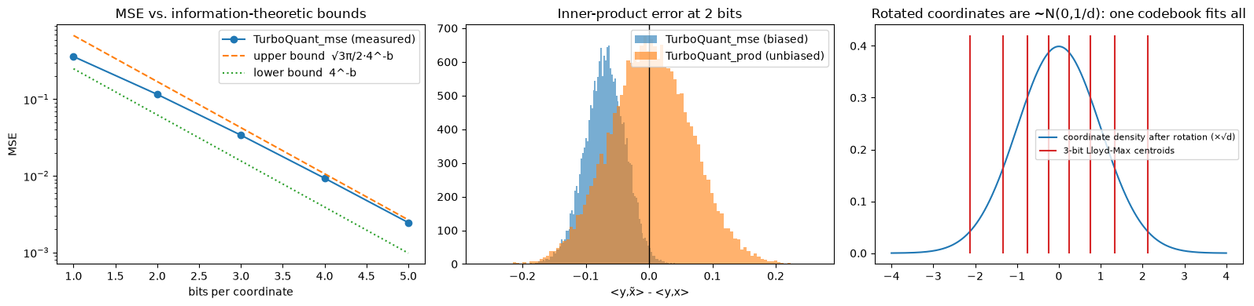
Measured error sits between the paper's bounds
DEMO 1 · THEORY CHECK
MSE versus the bounds. Unit vectors, d = 128, 1 to 5 bits: the measured error stays between 4^-b and √3π/2·4^-b.
Inner products at 2 bits. The MSE quantizer underestimates ⟨y, x⟩; the prod variant (MSE + 1-bit QJL) is centred on zero.
One codebook fits all. After the random rotation every coordinate follows the same bell curve, so one fixed 3-bit codebook works for any input.
Section 1 of llm_kv_cache_demo.ipynb, run on an A100 on 11 Oct 2026. Same measurements as the table on slide 9.

Slide 20
8k tokens: 1,010 MB in FP16, 260 MB at 4 bits
DEMO 1 · MEMORY
KV cache for one 8,083-token prompt, MB (effective bits per channel)
FP16
1,010 MB (16)
LLAMA-3.1-8B, 8 GB OF KV
FP16: 65k tokens
INT4 + scales
316 MB (5.0)
INT4 + scales: 210k
TurboQuant 4-bit
260 MB (4.125)
TurboQuant 4-bit: 254k
TurboQuant 3.5-bit
237 MB (3.75)
TurboQuant 2.5-bit: 381k
TurboQuant 3-bit
197 MB (3.125)
INT2 + scales
189 MB (3.0)
TurboQuant 2.5-bit
158 MB (2.5)
TurboQuant 2-bit
134 MB (2.125)
Orange: TurboQuant. Blue: INT-b with an fp16 scale and zero point per 32 channels.
Bytes counted from the bit-packed tensors, fp16 norms and scales included (llm_kv_cache_demo.ipynb, run on an A100 on 11 Oct 2026). The 8 GB projection uses the same per-token sizes.
Notes:
These are measured byte counts from the packed tensors, including the 16-bit norms, so they are exact for this implementation. Note a subtlety: the paper calls 32 channels at 3 bits plus 96 at 2 bits "2.5 bits"; the codes alone are 2.25 bits per channel, and with the two norms it is exactly 2.5. On the right is what the compression buys for an 8B model with 8 GB set aside for the cache: about four times the context at 4 bits, almost six times at 2.5 bits. The quality numbers for Qwen are produced when you run the notebook; I have not quoted them here because they come from that run.

Slide 21
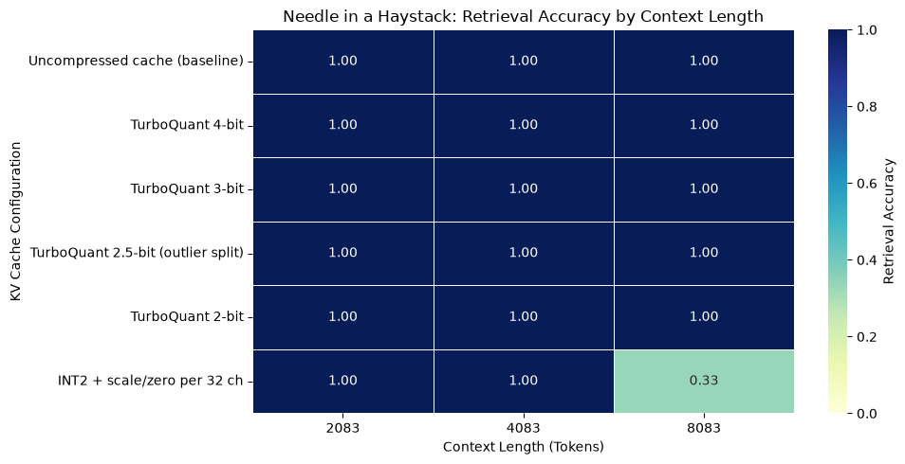
At 2 bits TurboQuant still finds the needle
DEMO 1 · NEEDLE IN A HAYSTACK
FOUND IN 9 PROMPTS
Uncompressed: 9 of 9
TurboQuant 4 / 3-bit: 9 of 9
TurboQuant 2.5-bit: 9 of 9
TurboQuant 2-bit: 9 of 9
INT2 + scales (3.0 bits): 7 of 9
Prompts of 2k, 4k and 8k tokens, code hidden at 10%, 50% and 90% depth. Found means the exact code is in the answer.
Section 4 of llm_kv_cache_demo.ipynb, run on an A100 on 11 Oct 2026. In this run the filler was one sentence repeated, because WikiText-2 did not load; the notebook now loads WikiText-2, a harder haystack.

Slide 22
At equal bits, TurboQuant drifts less than INT-b
DEMO 1 · QUALITY AND SPEED
KV cache | Bits / ch | KL vs FP16 | Top-1
TurboQuant 4-bit | 4.125 | 0.0006 | 100.0%
INT4 + scales | 5.0 | 0.0005 | 99.95%
INT3 + scales | 4.0 | 0.0040 | 99.95%
TurboQuant 3.5-bit | 3.75 | 0.0022 | 99.95%
TurboQuant 3-bit | 3.125 | 0.0060 | 99.90%
INT2 + scales | 3.0 | 0.0387 | 99.76%
TurboQuant 2.5-bit | 2.5 | 0.0124 | 99.85%
TurboQuant 2-bit | 2.125 | 0.0179 | 99.80%
DECODE SPEED, 4K CONTEXT
FP16 cache: 27.0 tok/s
TurboQuant 4-bit: 10.3 tok/s
TurboQuant 2.5-bit: 6.6 tok/s
The reference cache dequantizes the whole history in PyTorch at every step. Fused kernels (vLLM) read the packed codes directly, so the bytes saved become speed.
Compare rows of similar size: TurboQuant 3-bit against INT2 (KL 0.006 vs 0.039), TurboQuant 3.5-bit against INT3 (0.0022 vs 0.0040).
Sections 3 and 6 of llm_kv_cache_demo.ipynb, run on an A100 on 11 Oct 2026. KL and top-1 were scored on a repeated sentence because WikiText-2 did not load, so read them as a ranking; perplexity is left out. The notebook now loads WikiText-2.

Slide 23
On the paper's DBpedia setup, TurboQuant matches trained PQ on recall with no training
DEMO 2 · VECTOR SEARCH, MEASURED
Method | Bits | Smaller | Build (s) | QPS | R1@1 | 10@10
turbovec | 4 | 7.8x | 2.4 | 126 | 0.971 | 0.967
TurboQuant_mse (PyTorch) | 4 | 8.0x | 34.8 | 85 | 0.966 | 0.961
FAISS RaBitQ | 4 | 7.8x | 45.5 | 48 | 0.965 | 0.965
FAISS PQ, LUT256 | 4 | 8.0x | 926.3 | 6 | 0.965 | 0.960
FAISS PQ-FastScan | 4 | 8.0x | 49.3 | 180 | 0.959 | 0.954
FAISS SQ 4-bit | 4 | 8.0x | 0.8 | 12 | 0.941 | 0.948
turbovec | 2 | 15.5x | 3.3 | 305 | 0.892 | 0.895
TurboQuant_mse (PyTorch) | 2 | 15.9x | 29.2 | 70 | 0.879 | 0.883
FAISS RaBitQ | 2 | 15.2x | 24.0 | 85 | 0.874 | 0.894
FAISS PQ, LUT256 | 2 | 16.0x | 469.0 | 13 | 0.873 | 0.895
FAISS PQ-FastScan | 2 | 16.0x | 16.2 | 246 | 0.882 | 0.884
100k database + 1k queries: DBpedia entities embedded with OpenAI text-embedding-3-large (1,536-d), as in the paper. Colab CPU, 1 thread; exact search 180 QPS. Build includes k-means training. vector_search_demo.ipynb, 11 Oct 2026.
Notes:
These numbers come from running the vector search notebook in my sandbox, where the Hugging Face Hub was not reachable, so I used 165 thousand sentences of real text from the Reuters, Gutenberg and Brown corpora, embedded with TF-IDF plus SVD into 384 dimensions. Same protocol as the paper: 100k database vectors, 1k queries, inner-product search. At 4 bits turbovec finds the true nearest neighbour first 94 percent of the time, against 82 percent for PQ, and PQ needed 83 seconds of k-means training. turbovec is also the fastest method here, about 12 times faster than exact search. On Colab the notebook uses the paper's DBpedia OpenAI embeddings by default, where higher dimension should help TurboQuant further.

Slide 24
The win is indexing time: seconds with no training, and exact results after a re-rank
DEMO 2 · WHAT IT MEANS
Indexing time at 4 bits, seconds, log scale (training + encoding 100k vectors)
turbovec
2.4 s
1.000
TurboQuant (PyTorch)
35 s
Recall@1 when turbovec's top-100 is re-ranked with exact vectors.
FAISS SQ 4-bit
0.8 s
FAISS RaBitQ
46 s
1.9 s
FAISS PQ-FastScan
49 s
to stream 100k vectors into turbovec in batches of 1,000, with no training. PQ 4-bit needed 926 s.
FAISS PQ, LUT256
926 s
Orange: TurboQuant, no training. Blue: trained or calibrated baselines. SQ 4-bit builds fastest but has the lowest recall (0.941).
Same run as the previous slide. Re-rank: turbovec's top 100 re-scored with the float32 vectors.
Notes:
Three practical messages. First, at an equal 4-bit budget TurboQuant ranks better than every trained baseline. Second, because there is no training, you can ingest vectors as they arrive and never re-train when the data drifts: 100k vectors streamed in 0.14 seconds. Third, the classic two-stage pattern works beautifully: scan the 8x smaller index for 100 candidates, then re-score those with full-precision vectors from disk, and recall at 1 becomes perfect in our run.

Slide 25
Two real features where compression did not help
CASE STUDIES · REAL DATA
A · Similar provisions
B · Memo response suggestions
Score of record: edit distance (fuzz.ratio, 0–100), not cosine.
Pairs stored in PostgreSQL if ≥ 30; the UI defaults to 70.
Embeddings (3-small, 1,536-d) sit in Elasticsearch, but no feature reads them.
Pain: storage growth and slow writes.
Score of record: cosine on 3-large embeddings (3,072-d).
Exact Qdrant search per firm: top 50, floor 0.5, retry at 0.42.
Then a re-ranker and an LLM relevance check.
Pain: latency per request.
Local rebuilds on real platform data (es_bench/, memo_bench/), not measurements of the production system.
Notes:
The use cases and the demos showed where TurboQuant shines. These are two real "find similar" features of a legal-documents platform where we tested it. Before benchmarking, ask three questions: where do the vectors live, what score does the product show, and what is really slow. Premise check: the first benchmark assumed a Qdrant provisions collection and a 0.90 cosine merge threshold; neither exists. Guide §8; case study chapter.

Slide 26
Compression keeps the cosine neighbours, but the pairs that matter never move
CASE A · SIMILAR PROVISIONS
Method | Memory | Top-10, raw → 2× | Recall @200
float32 | 1× | 1.000 | 99.8 %
scalar int8 | 4× smaller | 0.949 → 0.999 | 99.8 %
binary 1-bit | 32× smaller | 0.824 → 0.962 | 99.7 %
TurboQuant 4-bit | 8× smaller | 0.966 → 1.000 | 99.8 %
TurboQuant 2-bit | 16× smaller | 0.902 → 0.992 | 99.8 %
Trigram (pg_trgm) | – | – | 100 %
70 %
of all pairs are kept at the store floor of 30. No vector technique changes that count.
The levers are the floor (a product decision) and a candidate filter; trigrams in PostgreSQL find as many pairs.
Local stand-in: 2,501 provisions, 500 queries, Elasticsearch 8.18. Recall @200 = share of fuzz ≥ 70 pairs among 200 candidates.
Notes:
Ground truth is exact fuzz.ratio of 500 provisions against all 2,501. Share of pairs kept by floor: 30 → 70 %, 40 → 45 %, 50 → 1.6 %, 60 → 0.8 %, 70 → 0.7 %. Two unrelated long provisions already score about 38; a 500,000-provision firm at floor 30 is about 87 billion pairs (about 2 billion at 50). TurboQuant keeps cosine neighbours better than int8 or binary at each bit budget, as the paper promises, but recall of the pairs the product scores does not move: they are near-duplicates every method finds. Elasticsearch built-ins agree (top-10 overlap with exact: hnsw 0.993, int8_hnsw 0.986, int4_hnsw 0.950 / 0.996 rescored, bbq_hnsw 0.878 / 0.995 rescored), and 8.18 applies int8_hnsw by default. 12 known-answer checks (canary.py) ran first. Verdict: TurboQuant cannot help.

Slide 27
The vector search is about 14 ms of a request that takes seconds
CASE B · MEMO SUGGESTIONS
Where the time goes, p50
Suggestions dropped at 0.5, of 22,193
Step | Time
Embed the new comment (API call) | ~240 ms
Exact vector search, 1,238 memos | ~14 ms
LLM relevance check, top 12 | ~3,800 ms
Exact search, 200,000 memos in one firm | 339 ms
Method | Dropped
float32 | 0
scalar int8 | 1,438 (6.5 %)
TurboQuant 4-bit | 244 (1.1 %)
TurboQuant 2-bit | 3,574 (16 %)
Qdrant quantized, rescored | 0
Local rebuild: 1,238 real comments, same Qdrant version. LLM row: a call of similar size, not the platform's own gate.
Notes:
Verdict B: TurboQuant does not help here either. The search is well under 1 % of the request and runs in the background. Only around 200,000 memos in one firm does exact search reach a third of a second (339 ms p50; 255 ms with Qdrant int8), still well below the LLM step. TurboQuant 4-bit beats plain int8 (244 vs 1,438 dropped), but Qdrant's own quantization with rescoring drops nothing and needs no new code. What the benchmark did find: random memo pairs score 0.38 on average (p95 0.56), so the 0.5 floor lets through about 152 candidates per question. Quality depends on the re-ranker and LLM check.

Slide 28
Before you compress, find what limits the feature
CASE STUDIES · LESSONS
Verdicts
Checklist
A: cannot help. The cost is how many pairs are kept, not bytes per vector.
B: does not help. Search is under 1 % of the request; Qdrant int8 with rescoring drops no suggestion.
In both, TurboQuant beat plain int8 at the same bits, as the paper promises.
Where are the vectors written and read?
Is the product's score a vector score?
What dominates: items, model calls, round trips?
Is search exact on small filtered sets?
Validate every instrument against a known answer.
Full tables and limits: docs/guide case study chapter (EN / ES) and technical guide §8.
Notes:
Compression shrinks bytes per vector, not the number of anything. If the product score is edit distance, BM25 or a rule, vectors can only pre-filter, and a lexical pre-filter may do as well. Exact search on small filtered sets is rarely memory-bound. The known-answer checks caught bugs in the benchmark itself before it produced results.

Slide 29
Where to start
PRACTICAL GUIDANCE
KV cache
Vector search
Start at 4 bits; try 3.5 and 2.5 with outlier channels.
Use the MSE variant for keys: the QJL bit adds variance that softmax amplifies at low bits.
Serve with vLLM's fused kernels on Ampere or Hopper.
Run your reasoning evals before going to 3 bits.
turbovec at 4 bits: 8x smaller than float32 with high recall.
Re-rank the top 100 with exact vectors for near-perfect results.
2 bits gives 16x when recall@8 or higher is what matters.
No training: ingest online, never re-index on drift.
The keys advice is inferred from the demo's error measurements and from vLLM shipping MSE plus norm-correction variants.
Notes:
If you want to adopt this: for LLM serving, 4-bit is the safe default, and the fractional settings with outlier channels are the sweet spot in the paper. Prefer the MSE quantizer for keys; the unbiased variant is great on paper but its extra variance passes through the softmax, which is probably why the production implementations use MSE with norm correction. That last point is my inference, not something the paper states. For search, turbovec is a pip install away, and with re-ranking you lose essentially nothing.

Slide 30
Read further
REFERENCES
Zandieh, Daliri, Hadian, Mirrokni. TurboQuant: Online Vector Quantization with Near-optimal Distortion Rate. arXiv:2504.19874
Zandieh, Daliri, Han. QJL: 1-Bit Quantized JL Transform for KV Cache Quantization with Zero Overhead. arXiv:2406.03482
Han, Kacham, Karbasi, Mirrokni, Zandieh. PolarQuant: Quantizing KV Caches with Polar Transformation. arXiv:2502.02617
Google Research blog: TurboQuant, redefining AI efficiency with extreme compression
vLLM blog: TurboQuant KV cache (May 2026)
github.com/ryancodrai/turbovec · github.com/0xsero/turboquant
TurboQuant vs traditional quantization (Medium)
Notes:
All the sources used in this deck. The two GitHub projects are community implementations: turbovec for vector search in Rust, and 0xsero's turboquant with Triton kernels and a vLLM integration for RTX 30, 40 and 50 series GPUs.

