Slide 1
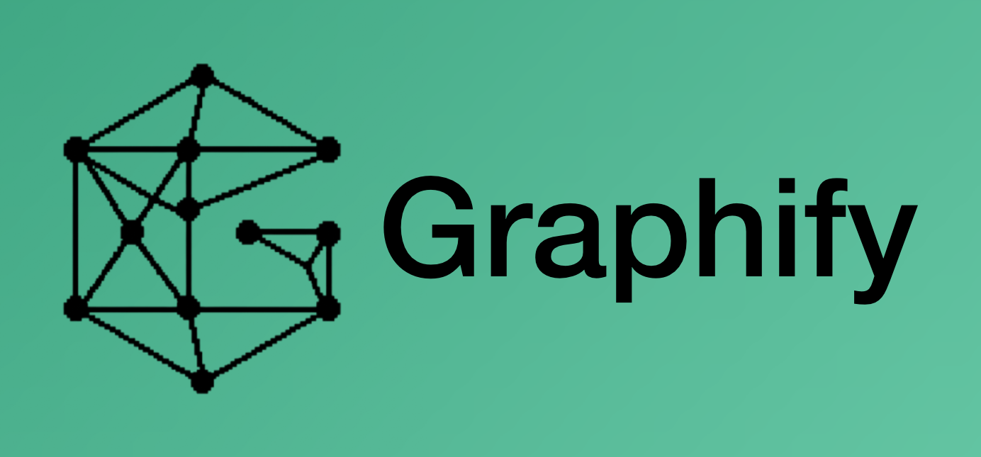


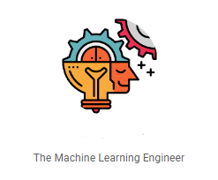
Agentic Ai
Claude Code: from assistant to agentic developing system

Slide 2
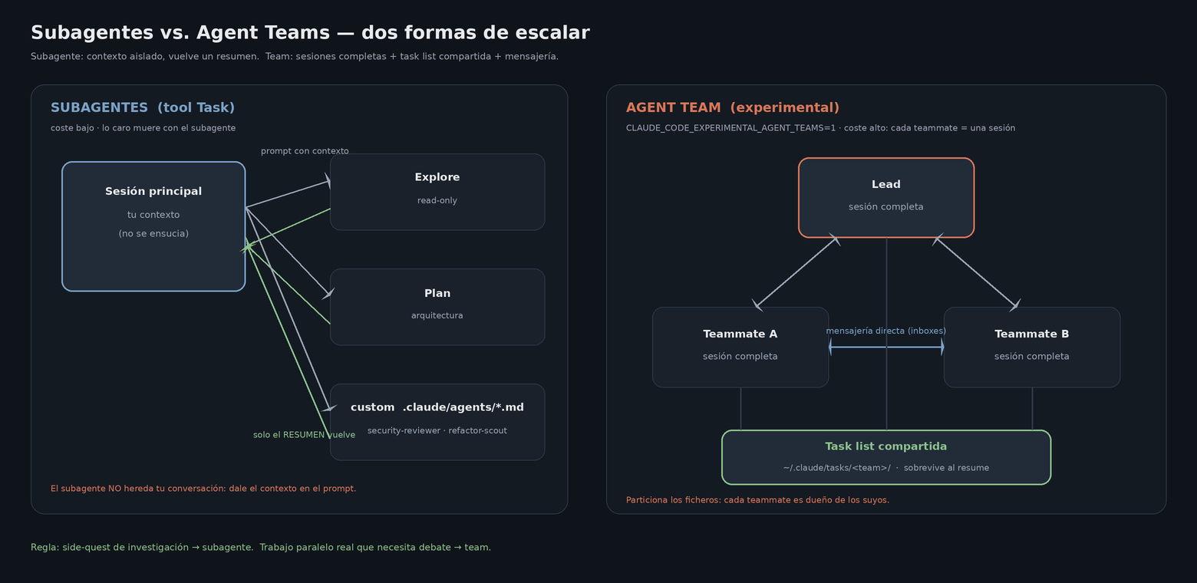
PART 1 · 06 · SUBAGENTS AND AGENT TEAMS
Agent Teams: several Claudes coordinating
Claude Code · Course / Workshop
16

Slide 3
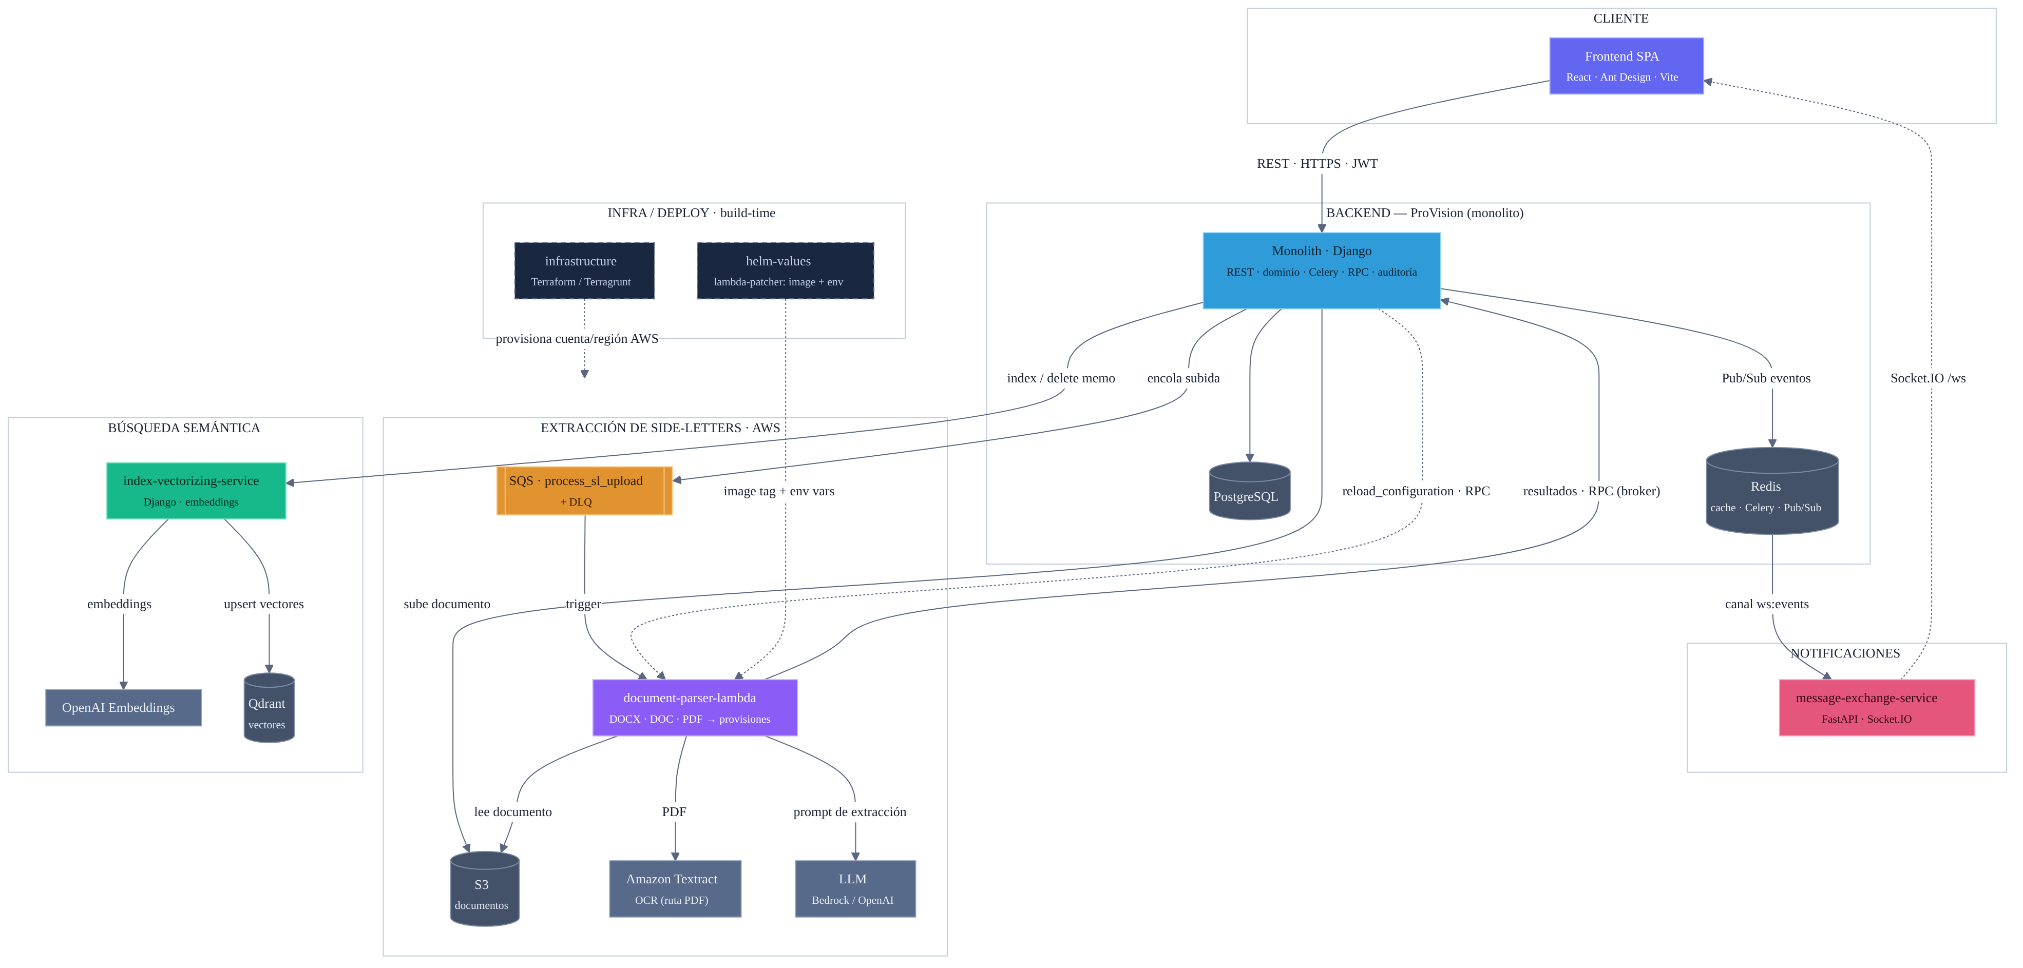
PART 2 · 08 · THE METHODOLOGY
A real example: application architecture
QA bug: “a field shows empty in the UI, but it's written in the PDF.”
Orient
/kg surfaces the danger zone (a SHARP_EDGE constraining the fix); git/gh give the baseline.
Contract
The field is empty in the endpoint JSON (Playwright/F12) → the Lambda is responsible.
Provenance
Re-extract on the previous base: already empty → pre-existing, not a regression.
Investigate
Serena + CodeGraph locate the detector; a deterministic _diag_pdf.py gives the cause: NO LLM.
Fix + verify
RED test → structural fix (not client) → no-op regression + local contract (wrapper) + inside the deployed image.
Handoff
Sanitize → the human does push/PR. A bot catches one more case → test + PLAYBOOK.
“ The model doesn't earn trust for free: it earns it decision by decision, with evidence. ”
Claude Code · Course / Workshop
23

