Slide 1
COURSE / WORKSHOP · DEVELOPER TOOLING
GitHub Copilot
the same methodology, five surfaces
SESSION 1 — Copilot: surfaces · CLI & billing · instructions · permissions · context & caching · MCP · skills · agents · hooks · automation
SESSION 2 — The methodology (tool-agnostic): gated flow · CodeGraph / Serena / GSD · transfer from Claude Code · ops (machine-sync + S3) · ticket graph (graphify)
Course volume 3 (after Claude Code and Cursor; Pi in parallel). Copilot facts verified against docs.github.com and code.visualstudio.com on 2026-10-17.

Slide 2
AGENDA
One course, two sessions
SESSION 1 · GitHub Copilot
SESSION 2 · Methodology + ticket graph
§00 Surfaces map + feature matrix
§12 The 11-stage flow + five-check gate
§01 Install · auth · copilot -p · models · billing
§13 Tool prevalence: CodeGraph · Serena · GSD
§02 Memory & instructions
§14–15 Claude Code transfer · machine sync
§03 Permissions, trust, sandbox
§16 Ticket graph: graphify · kg / kg-refresh
§04 Sessions
Field test A real workday + one ticket replay, measured
§05 Context window
Appendix Claude Code → Cursor → Copilot · Sources
§06 Prompt caching (honest answer)
§07 MCP
§08 Skills & plugins
§09 Custom agents & subagents
§10 Hooks
§11 Automation
GitHub Copilot · Course / Workshop
2

Slide 3
SESSION 1
GitHub Copilot
One brand, five surfaces, two VS Code engines — know which one you are talking to.
§00 · Surfaces map
§01 · Install, auth, models, billing
§02–§03 · Instructions, permissions
§04–§06 · Sessions, context, caching
§07–§09 · MCP, skills, agents
§10–§11 · Hooks, automation
3

Slide 4
SESSION 1 · §00 · SURFACES MAP
“Copilot” is five different surfaces
›_
Copilot CLI — copilot
VS
VS Code agent
Terminal agent, npm @github/copilot, GA 2026-02-25. NOT the retired `gh copilot` extension.
Agent harnesses: Copilot (same runtime as the CLI), Local (classic agent mode), plus Claude, Codex and a Cloud target.
JB
JetBrains agent mode
☁
Copilot cloud agent
Agent mode + MCP supported. Skills, custom agents, instructions, prompt files: Preview.
Formerly “coding agent”. Issue / prompt / API → ephemeral Actions sandbox → draft PR.
✓
Copilot code review
+
Also: github.com + app
PR reviewer on github.com and in IDEs; can be requested automatically via rulesets.
Chat, Agents page (github.com/copilot/agents), Spaces; desktop Copilot app (`copilot app`).
“ Before any “Copilot can / can't” claim, ask: which surface, and which harness? ”
GitHub Copilot · Course / Workshop
4

Slide 5
SESSION 1 · §00 · SURFACES MAP
VS Code has two Copilot engines
COPILOT HARNESS
LOCAL HARNESS
Runtime
Copilot SDK — same as the CLI (Agent Host)
Classic agent mode (extension host)
Config shared with CLI
~/.copilot, .mcp.json, skills, agents
Own chat.* settings
Hooks
CLI schema: .github/hooks, camelCase
Own schema: PascalCase, hookSpecificOutput
MCP
.mcp.json (mcpServers) + forwarded .vscode
.vscode/mcp.json (servers + inputs)
Prompt files / handoffs
✗ (convert to skills)
✓ only here
Nested AGENTS.md
root + cwd
chat.useNestedAgentsMdFiles (off)
“ Pick the harness in the Session Target control — then read the docs for THAT harness. ”
GitHub Copilot · Course / Workshop
5

Slide 6
SESSION 1 · §00 · SURFACES MAP
Feature × surface matrix
Feature
CLI
VS Code Copilot
VS Code Local
JetBrains
Cloud agent
Code review
AGENTS.md / copilot-instructions
✓
✓
✓
~
✓
✓
.instructions.md (applyTo)
✓
✓
✓
✓
✓
✓
Prompt files
✗
✗
✓
~
✗
✗
Skills
✓
✓
✓
~
✓
✓
Custom agents
✓
✓
✓
~
✓
—
Hooks
✓
✓
✓*
—
✓
—
MCP
✓
✓
✓
✓
✓
~
~ Preview / partial (JetBrains: Preview; code review: read-only MCP tools). * different hook schema. — NOT DOCUMENTED.
“ Full matrix with sources: docs/research/COPILOT_FINDINGS_2026-10-17.md. ”
GitHub Copilot · Course / Workshop
6

Slide 7
SESSION 1 · §01 · INSTALL AND AUTH
Install, log in, start
Install (pick one)
Auth
npm install -g @github/copilot # Node 22+
brew install --cask copilot-cli
winget install GitHub.Copilot
curl -fsSL https://gh.io/copilot-install | bash
# auto-update on; COPILOT_AUTO_UPDATE=false
▸ copilot login (or /login): --web-flow, --device-code, --with-token
▸ Env precedence: COPILOT_GITHUB_TOKEN > GH_TOKEN > GITHUB_TOKEN
▸ PAT = fine-grained, user-owned, “Copilot Requests” permission
▸ Actions: permissions copilot-requests: write + org policy
First run in a repo
cd your-project && copilot # trust-folder prompt on first launch
copilot init # writes .github/copilot-instructions.md
“ The CLI is `copilot`. If a tutorial says `gh copilot suggest`, it is the retired extension. ”
GitHub Copilot · Course / Workshop
7

Slide 8
SESSION 1 · §01 · HEADLESS, MODELS, BILLING
copilot -p, models, and AI Credits
Headless (scripts / CI)
Models
copilot -p "Explain ./complex.ts" -s
copilot -p '…' --allow-tool='shell(git:*)' \
--deny-tool='shell(git push)' --no-ask-user
copilot -p '…' --output-format=json # JSONL
copilot -p '…' --trust-folder # repo hooks/MCP
copilot -p '…' --max-ai-credits=5 # soft cap
▸ CLI default: claude-sonnet-5.5
▸ --model / COPILOT_MODEL / /model
▸ auto: Copilot picks (10% discount on paid)
▸ --effort low…max · 1M ctx: VS Code + CLI
Billing: GitHub AI Credits since 2026-06-01 (1 credit = $0.01)
▸ Pro 1,500 · Pro+ 7,000 · Max 20,000 credits/month; cost = tokens incl. cached-input and cache-write. Completions free. “Premium requests” are LEGACY.
“ Any slide quoting “300 premium requests” is out of date (legacy annual plans only). ”
GitHub Copilot · Course / Workshop
8

Slide 9
SESSION 1 · §02 · MEMORY AND INSTRUCTIONS
The two-level pattern, in Copilot files
Level 1 — always loaded (small)
Level 2 — on demand (the detail)
▸ AGENTS.md at the root — the one file every surface reads
▸ Optional small .github/copilot-instructions.md
▸ .github/instructions/*.instructions.md with applyTo globs
▸ One-line POINTERS to everything else
▸ data/changes/STATUS.md — living state per ticket
▸ PLAYBOOK.md · SHARP_EDGES.md · TEST_MAP.md
▸ <TICKET>/<TICKET>.md — self-contained ledgers
▸ @path imports (CLI) only for what MUST be eager
Tier 0 (machine-local): IDENTITY.md, gitignored — or ~/.copilot/copilot-instructions.md for personal, machine-only instructions. The CLI does NOT read ~/.claude/CLAUDE.md.
“ Same cut as in Claude Code and Cursor: pointers, not copies. ”
GitHub Copilot · Course / Workshop
9

Slide 10
SESSION 1 · §02 · MEMORY AND INSTRUCTIONS
What loads where
CLI merges everything
CLAUDE.md, GEMINI.md, AGENTS.md, .instructions.md, .claude/rules, copilot-instructions — at git root AND cwd
Nested AGENTS.md differs
CLI: root + cwd only · cloud agent: nearest wins · VS Code Local: setting, off by default
Per-folder rules → applyTo
Safe pattern: .instructions.md with applyTo "subdir/**" (+ excludeAgent: code-review | cloud-agent)
Prompt files are Local-only
.github/prompts/*.prompt.md: VS Code Local, VS, JetBrains. CLI: use skills instead
Copilot Memory ≠ your ledger
Cloud, preview, 28-day expiry. VS Code /memories and CLI /chronicle are other systems
“ Memory features are a complement; data/changes/ + AGENTS.md stay the source of truth. ”
GitHub Copilot · Course / Workshop
10

Slide 11
SESSION 1 · §03 · PERMISSIONS
Allow, deny — and deny wins
Pattern syntax: Kind(argument)
Where it persists
--allow-tool='shell(git:*)'
--deny-tool='shell(git push)'
--deny-tool='shell(gh pr)'
--allow-tool='write(src/*.ts)' --deny-tool='read(.env)'
--allow-tool='MyMCP(tool)' --allow-url=github.com
# deny beats allow — even with --yolo
▸ Flags: never persisted
▸ Saved approvals: ~/.copilot/permissions-config.json
▸ NO repo-level allow/deny list in the CLI
▸ permissions.* rules: managed / MDM settings only
▸ disableBypassPermissionsMode blocks --yolo
Consequence: a team-wide “never push” rule that lives in the repo must be a HOOK (§10). In VS Code a false terminal auto-approve rule only asks — it does not block; the docs point to a PreToolUse deny hook for that too.
“ Allowlists decide what runs without asking; only a hook can veto by content. ”
GitHub Copilot · Course / Workshop
11

Slide 12
SESSION 1 · §03 · TRUST AND SANDBOX
Trusted folders, sandbox, cloud guardrails
Trusted folders
Local sandbox (GA 2026-10-07)
Cloud agent
▸ Prompt on first launch
▸ Gates repo hooks, workspace MCP, plugins, repo model
▸ -p in an untrusted folder SKIPS them
▸ → --trust-folder (one run) or GITHUB_COPILOT_PROMPT_MODE_* env
▸ /sandbox enable · --sandbox
▸ Seatbelt / Bubblewrap / ProcessContainer
▸ network allow/block hosts, deniedPaths
▸ credential masking per host
▸ Not repo-overridable
▸ All tools pre-approved; hook “ask” = deny
▸ Pushes only to its copilot/ branch
▸ Cannot mark ready, approve or merge
▸ Firewall in repo settings
▸ Humans approve workflow runs
“ In CI the trust prompt cannot appear — so your repo hook silently does not load. ”
GitHub Copilot · Course / Workshop
12

Slide 13
SESSION 1 · §04 · SESSIONS
Sessions: resume, fork, rewind, delegate
Resume
copilot --continue · --resume[=ID|name] · /resume — every -p run prints its ID
CLI
Fork / name
/fork (works while running) · -n NAME · /rename · /worktree
CLI
Roll back
/rewind (/undo): conversation only, or conversation + files — git not required
CLI
Checkpoints
One per compaction (/session checkpoints) — a SUMMARY, not a file snapshot
CLI
Share / steer
/share (link, file, html, gist) · /remote on — steer from web, mobile, VS Code
CLI
Hand off
/delegate or a leading & → cloud agent, branch + draft PR
CLI→cloud
VS Code
Checkpoints, fork from checkpoint, Session Target picks harness or Cloud
IDE
“ A compaction checkpoint is a summary; only /rewind with files restores your tree. ”
GitHub Copilot · Course / Workshop
13

Slide 14
SESSION 1 · §05 · CONTEXT WINDOW
Context window: the resource that governs everything
System prompt
Hidden — always first
fixed
The controls
Custom instructions
AGENTS.md + instructions — you control this
you decide
/context # breakdown
/compact [focus]
/usage # tokens, credits
# >20 KiB tool output → temp file
# COPILOT_LARGE_OUTPUT_
# THRESHOLD_BYTES
System + MCP tools
Tool schemas; deferred tool search helps
per server
Messages
Files read, tool output… grows every turn
grows
Free space + buffer
Auto-compaction starts ≈80%, pauses ≈95%
watch
VS Code: the context-window control in the chat input shows tokens, breakdown and AI credits; #codebase runs a search, it does not dump the repo. Exact default window per model: NOT DOCUMENTED in one table.
“ Compactions cannot be undone — compact on purpose, with a focus. ”
GitHub Copilot · Course / Workshop
14

Slide 15
SESSION 1 · §05 · CONTEXT WINDOW
Context hygiene: maximum signal per token
1
Small, stable instructions
2
Rare material → skills
If you can delete it without the agent going wrong, delete it. Pointers, not copies.
Skills load on demand by description; instructions load always.
3
MCP in moderation
4
Subagents for research
Fewer servers, disabledMcpServers, deferTools: "auto" for big tool sets.
Separate context windows: noise dies outside, the summary returns.
5
Plan → implement
6
New session per task
/plan first (enforced at the tool layer), then implement.
Don't drag an unrelated transcript; /compact with a focus when you must.
“ Session 2's tool prevalence is, at bottom, context policy. ”
GitHub Copilot · Course / Workshop
15

Slide 16
SESSION 1 · §06 · PROMPT CACHING
Caching: the honest answer — no knob, real bill
A cache_control / TTL setting
Does not exist in CLI, VS Code or cloud agent — NOT DOCUMENTED anywhere
Caching happens and is billed
Pricing tables charge cached-input and cache-write tokens per model
VS Code Cache Explorer
Diagnose only: per-turn hit %, reused tokens, first divergence in the prompt
Keep the prefix stable
Choose model/effort/tools first; don't edit instructions mid-session
Fork, don't restart
Forking preserves the prompt cache; subagents for side research
CLI cache view
None — /usage shows tokens + credits; OTel cache attributes UNVERIFIED
“ You cannot set the cache; you can stop breaking it. Mechanism demo: examples/prompt-caching/. ”
GitHub Copilot · Course / Workshop
16

Slide 17
SESSION 1 · §07 · MCP
One protocol, four config files
CLI user
~/.copilot/mcp-config.json — mcpServers; copilot mcp add
user
CLI / Copilot harness
.mcp.json or .github/mcp.json — mcpServers, needs folder trust
repo
VS Code Local
.vscode/mcp.json — servers + inputs[] (${workspaceFolder})
repo
Cloud agent
Repo Settings → Copilot → MCP servers (JSON in the UI)
GitHub
CLI shape — `tools` is REQUIRED
{ "mcpServers": {
"codegraph": {"command": "codegraph", "args": ["serve","--path",".","--mcp"], "tools": ["*"]},
"context7": {"type": "http", "url": "https://mcp.context7.com/mcp", "tools": ["*"]} } }
“ mcpServers for CLI and cloud, servers for .vscode/mcp.json — the #1 copy-paste bug. ”
GitHub Copilot · Course / Workshop
17

Slide 18
SESSION 1 · §07 · MCP
MCP gotchas per surface
Pw
Built-ins in the CLI
☁
Cloud agent
github-mcp-server (read-heavy), playwright, fetch, time. Don't configure Playwright twice.
Tools only (no resources/prompts), no OAuth remotes, secrets as COPILOT_MCP_*. Runs them without approval.
⚙
Binaries in the cloud
✓
Code review
.github/workflows/copilot-setup-steps.yml, one job copilot-setup-steps, on the default branch.
Uses an MCP tool only if annotations.readOnlyHint: true — and only when the toggle is on.
⇄
Migrate VS Code → CLI
Org
Org policy
jq '{mcpServers: .servers}' .vscode/mcp.json > .mcp.json · ${input:} servers aren't forwarded.
Enterprise allowlist by fingerprint, fail-closed; private MCP registry available.
“ Config gives capability; instructions give judgment — a trigger map makes the agent USE it. ”
GitHub Copilot · Course / Workshop
18

Slide 19
SESSION 1 · §08 · SKILLS AND PLUGINS
Skills: one SKILL.md, most surfaces
Where Copilot looks
Frontmatter that survives everywhere
.github/skills/<name>/SKILL.md # all surfaces
.claude/skills/ .agents/skills/ # also read
~/.copilot/skills/ ~/.agents/skills/
# VS Code ALSO reads ~/.claude/skills/
# the CLI does NOT — copy, symlink, or
# copilot skill add <dir>
▸ name = folder name, lowercase-hyphen, ≤64
▸ (VS Code silently drops a mismatch)
▸ description ≤1024 — drives auto-selection
▸ drop trigger: — not a Copilot key
▸ Invoke: /name, or automatic by description
Methodology skills · visible in the live WSL Copilot session
▸ day · evidence · preview · atlassian · kg · kg-refresh · methodology-plan · sanitise-diff
▸ Personal skill set confirmed in Copilot Customizations; see session 2 for safe behavior checks.
“ The strongest reason for a skill is enforcement: a routine you can call leaves a trace. ”
GitHub Copilot · Course / Workshop
19

Slide 20
SESSION 1 · §09 · CUSTOM AGENTS
Custom agents: .github/agents/*.agent.md
A read-only scout
What to know
# .github/agents/refactor-scout.agent.md
---
name: refactor-scout
description: Read-only blast-radius scout
tools: ["read", "search"]
user-invocable: true
---
CodeGraph first, then Serena, then grep…
▸ The tools list IS the enforcement; prose is not
▸ As a subagent it gets NO repo instructions unless include-custom-instructions: true (CLI)
▸ handoffs[] / agents[]: VS Code Local only
▸ CLI: --agent scout, by name, or /fleet … @scout
▸ Also read: ~/.copilot/agents, .claude/agents
CLI built-in agents
▸ explore · task · general-purpose · research · rubber-duck · security-review · code-review (their documented default models disagree with the CLI default table — verify on your build)
“ Ready to copy: examples/subagents/ and docs/ai-agents-code-methodology/copilot/agents/. ”
GitHub Copilot · Course / Workshop
20

Slide 21
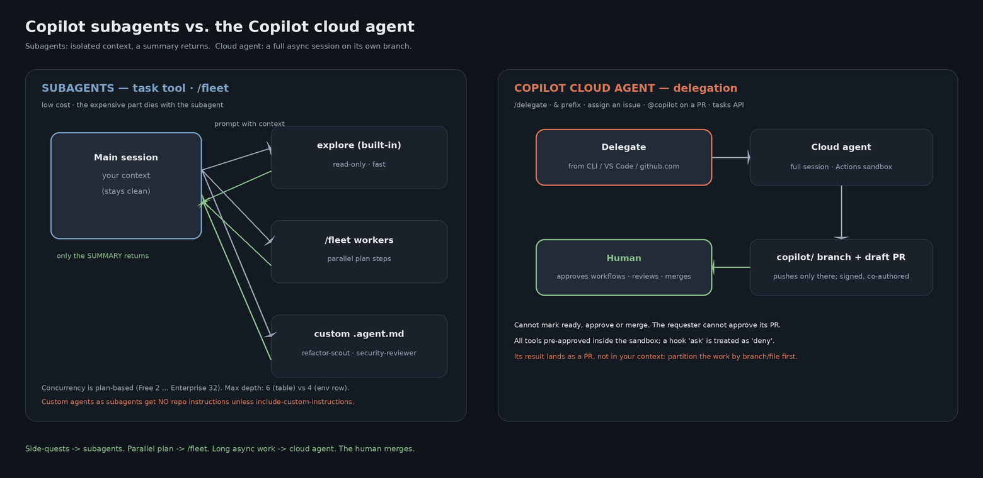
SESSION 1 · §09 · SUBAGENTS
Subagent, /fleet, or cloud agent?
The three options
▸ Subagent (task tool): own context window, summary returns
▸ /fleet: parallel subagents executing a plan; background agents can be messaged
▸ Cloud agent (/delegate, &): full async session → draft PR
Limits: concurrency by plan (Free 2 · Pro 4 · Max 8 · Business 16 · Enterprise 32). Max depth: the reference table says 6, the env-var table says 4 — a documentation contradiction; verify on your build.
“ Subagent so the noise dies outside; cloud agent when the work is long and async. ”
GitHub Copilot · Course / Workshop
21

Slide 22
SESSION 1 · §10 · HOOKS
Hooks: the deterministic veto
.github/hooks/block-external-git.json
The contract (CLI + cloud agent)
{ "version": 1, "hooks": { "preToolUse": [
{ "type": "command",
"matcher": "bash|powershell",
"bash": "./.github/hooks/block-external-git.sh",
"powershell": "./.github/hooks/…ps1",
"timeoutSec": 10 } ] } }
▸ .github/hooks/*.json — {version: 1, hooks: {preToolUse: […]}}
▸ Also read: ~/.copilot/hooks, .claude/settings.json hooks
▸ stdin: {toolName, toolArgs} — toolArgs may be a JSON STRING
▸ Deny: permissionDecision "deny" + reason, or exit 2
▸ Crash / other non-zero → fail-CLOSED (preToolUse)
▸ TIMEOUT → fail-OPEN, every event. Keep it fast
VS Code Local harness: different schema — PascalCase events, {tool_name, tool_input}, hookSpecificOutput. Code review hooks: NOT DOCUMENTED.
“ Instructions ask; a hook guarantees — as long as it answers before the timeout. ”
GitHub Copilot · Course / Workshop
22

Slide 23
SESSION 1 · §10 · HOOKS
The portable recipe: block push, PR, merge
1
One script, both payload shapes
2
Match the outward commands
toolArgs.command (parse if string) or tool_input.command; filter on tool name too.
git push · gh pr create|merge|ready · gh api …/merge · release · terraform/kubectl/helm.
3
Answer twice, exit 2
4
Never answer “allow”
permissionDecision deny + hookSpecificOutput — exit 2 is the signal both schemas document.
No-op = {} — an allow could auto-approve and skip the normal prompt.
5
Belt and braces in the CLI
6
Test it — with a canary
--deny-tool='shell(git push)' --deny-tool='shell(gh pr)' (deny beats --yolo).
bash .github/hooks/test-block-external-git.sh: a known-deny case first.
“ /pr automerge is a first-party slash command — whether it passes preToolUse is UNVERIFIED. Test it. ”
GitHub Copilot · Course / Workshop
23

Slide 24
SESSION 1 · §11 · AUTOMATION
From copilot -p to agents in the cloud
a
copilot -p in Actions
b
Agentic Workflows
npm i -g @github/copilot · copilot-requests: write · --trust-folder · minimal --allow-tool.
github/gh-aw — GitHub's recommended path over raw copilot steps (guardrails).
c
Cloud agent API + Automations
d
Code review via rulesets
POST /agents/repos/{o}/{r}/tasks (preview, user tokens) · schedule/event Automations.
“Automatically request Copilot code review”; reads instructions from the HEAD branch.
Copilot SDK — @github/copilot-sdk · github-copilot-sdk (pip) · Go · .NET · Java
const client = new CopilotClient();
const session = await client.createSession({ model: "auto" });
const reply = await session.sendAndWait({ prompt: "Review the diff" });
// programmatic hooks: onPreToolUse returns permissionDecision
“ In CI, write the allow-list on the command line — the trust prompt will never appear. ”
GitHub Copilot · Course / Workshop
24

Slide 25
SESSION 2
The methodology + ticket graph
One practical session: workflow, tools, transfer, operations, and graph-backed project memory.
§12 · The 11-stage flow + five-check gate
§13 · The method's tools
§14 · Transfer: from Claude Code to Copilot
§15 · Ops: machine-sync + shared record (S3)
§16 · Ticket graph: graphify, kg / kg-refresh
25

Slide 26
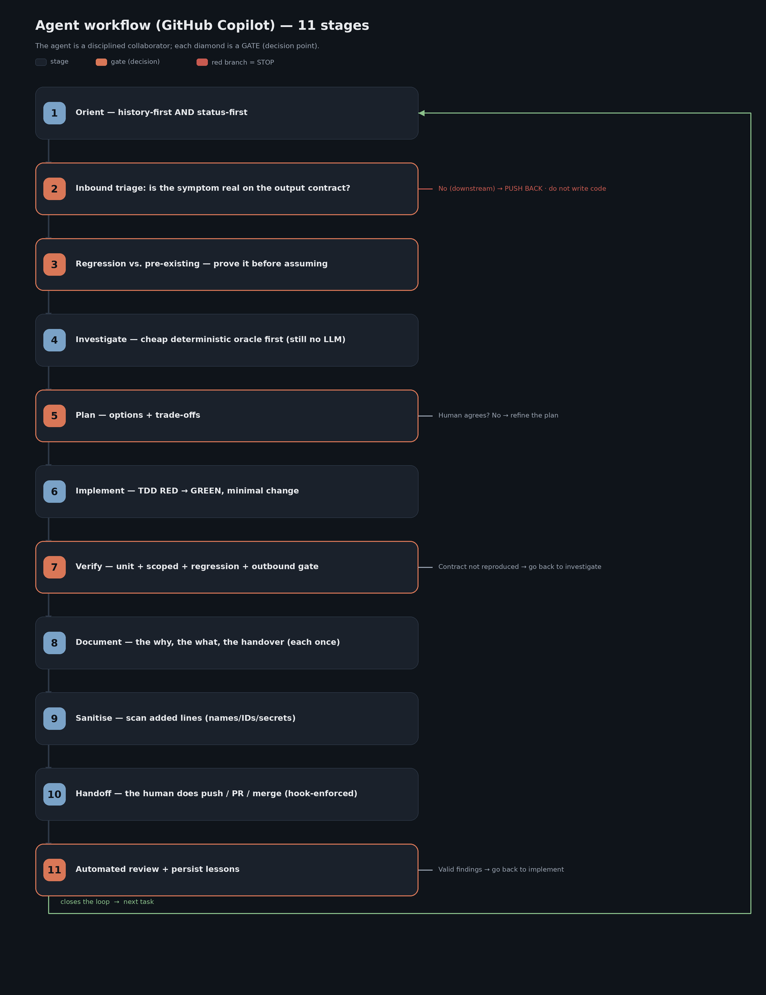
SESSION 2 · §12 · THE METHODOLOGY
The real 11-stage flow
1
Orient: kg skill + history-first + status-first
2
Inbound triage: is the symptom in the contract?
3
Regression vs pre-existing (prove it)
4
Investigate: cheap deterministic oracle
5
/plan → explicit human agreement
6
Implement: TDD RED → GREEN, minimal
7
Verify: outbound gate × 5
8
Document — each fact once
9
Sanitise — added lines (sanitise-diff skill)
10
Handoff: the human pushes / opens the PR (hook-enforced)
11
Bot review + persist lessons
“ Autonomy is earned decision by decision. Coral = gate: a red gate means STOP, no code. ”
GitHub Copilot · Course / Workshop
26

Slide 27
SESSION 2 · §12 · THE METHODOLOGY
The outbound gate is FIVE checks
0 · Instrument
Run every _diag_/_sweep_ against a KNOWN-ANSWER case first; record it
1 · Real stage
Reproduce through the wrapper that builds the contract, not an inner function
2 · Member list
Assert ids/titles, never a total — two errors can cancel exactly
3 · Deployed image
Re-run inside the runtime image: green tests ≠ what ships
4 · Look at it
Open the rendered output by eye; before/after artifacts for geometry
Five ways a green gate proves nothing: a broken instrument · a total that matches · a gate that couldn't fail · a canary that never applied the real perturbation · a structural check read as a semantic one.
“ Same gate as in Claude Code and Cursor — only the agent running it changes. ”
GitHub Copilot · Course / Workshop
27

Slide 28
SESSION 2 · §13 · METHOD TOOLS
Which tool the agent uses, and when
Lives in .github/instructions/01-tool-prevalence.instructions.md: cheap → expensive, deterministic → probabilistic.
Orient
kg skill (ticket graph) · STATUS.md · git · gh (read)
no inference
Navigate
CodeGraph codegraph_explore (MCP) — source + paths + blast radius
1 call
Refactor-check
Serena find_referencing_symbols (MCP) — MANDATORY before rename
precise
Diagnose
Deterministic oracle: parser / validator / _diag_*.py
no inference
Environment
Cloud CLI, read-only: logs, function config, queues
read-only
Contract
Playwright (built into the CLI) against the consumer's endpoint
reproduce
Only at the end
The agent's turn — to VERIFY the fix, not to diagnose
metered
GitHub Copilot · Course / Workshop
28

Slide 29
SESSION 2 · §13 · METHOD TOOLS
CodeGraph + Serena on every Copilot surface
Server
CLI + Copilot harness
VS Code Local
Cloud agent
CodeGraph
.mcp.json stdio, --path .
.vscode/mcp.json ${workspaceFolder}
repo MCP settings + setup steps
Serena
uvx … serena start-mcp-server
same
same as CodeGraph
Playwright
BUILT IN — don't add
add if needed
default, localhost
Context7
http, tools ["*"]
same
firewall allow mcp.context7.com
CodeGraph answers “what breaks?”; Serena answers “exactly who calls THIS process()?” Field test 2026-10-28: Serena worked in VS Code Copilot once registered in ~/.copilot/mcp-config.json (find, references, safe-delete, rename); first call ~1 min, fallback CodeGraph → Pylance → grep. Whether --path . resolves against the session cwd is UNVERIFIED — launch from the repo root or pin an absolute path.
“ Treat codegraph_explore output as already read; never rename without Serena's check. ”
GitHub Copilot · Course / Workshop
29

Slide 30
SESSION 2 · §13 · METHOD TOOLS
GSD: Claude Code only — the Copilot substitutes
What GSD is
Nearest Copilot pieces
▸ Claude Code plugin: phased project management
▸ discuss → plan (gate) → execute → verify
▸ Role subagents: planner, checker, executor, verifier
▸ Versioned state in .planning/
▸ No first-party Copilot equivalent
▸ /plan, --plan, Shift+Tab — enforced at the tool layer
▸ --plan --mode autopilot · /fleet for waves
▸ Role custom agents (planner/executor/verifier)
▸ agentStop decision: block = “verify before stop”
▸ Spec Kit (github/spec-kit) — third-party-confirmed only
▸ State stays in data/changes/ ledgers
“ Same method, without the plugin: plan mode + role agents + your own ledgers. ”
GitHub Copilot · Course / Workshop
30

Slide 31
SESSION 2 · §14 · TRANSFER
From Claude Code to Copilot
Travels UNCHANGED (the 5 rules)
What changes: the surface
▸ Plan → agree → implement
▸ Verify on the CONSUMER's contract
▸ Solve the general class, not one input
▸ Durable trail: why, what, how verified
▸ The human owns the external (merge, deploy)
▸ CLAUDE.md → AGENTS.md + .instructions.md (CLI reads CLAUDE.md too)
▸ ~/.claude/skills → .github/skills (CLI gap!)
▸ settings.json allow/deny → flags + hooks
▸ PreToolUse hooks → .github/hooks preToolUse
▸ Agent Teams → /fleet + cloud agent
▸ claude -p → copilot -p --trust-folder
Starter kit: docs/ai-agents-code-methodology/COPILOT_ADAPTATION.md + copilot/
▸ AGENTS.md, copilot-instructions, instructions/, skills (day, atlassian, evidence, preview, kg…), hook, read-only agent, .mcp.json, copilot-setup-steps — ready to copy
“ Third agent, same discipline: the methodology was never the tool. ”
GitHub Copilot · Course / Workshop
31

Slide 32
SESSION 2 · §14 · TRANSFER
New holes — and how merge stays human
CLI /pr create | auto | automerge
First-party commands that can merge; hook coverage UNVERIFIED → instructions + test
Code review can APPROVE (preview)
Counts toward required approvals; off by default — keep it off
Review reads the HEAD branch
A PR can rewrite its reviewer's instructions → CODEOWNERS on .github/**
preToolUse deny hook + --deny-tool
Vetoes push/PR/merge by content; deny beats --yolo
Cloud agent structural limits
copilot/ branch only; cannot approve, mark ready or merge
disableBypassPermissionsMode
Managed/user setting that blocks --yolo / allow-all
“ In 2025 “no merge by the agent” was a policy. In 2026 it is a hook, a flag and a branch rule. ”
GitHub Copilot · Course / Workshop
32

Slide 33
SESSION 2 · §15 · OPS
From transporting (tarball) to sharing (S3)
A · Bring-up: tarball + USB
B · Day to day: S3-backed record
▸ Outbound = full copy; inbound = data/ delta only
▸ Carry ~/.copilot deliberately: skills, agents, mcp-config
▸ On the target: bootstrap + target-setup.sh
▸ Re-pin the CodeGraph --path in .mcp.json
▸ Scope grows in reviewed phases
▸ Write via sync; read via READ-ONLY mount
▸ Dry-run by default; guard BOTH directions
▸ ONE publisher; “derived” is per file
Agent-specific: the machine has a role
▸ IDENTITY.md (gitignored) declares publisher | contributor; AGENTS.md points to it
▸ day skill = start/end routine; optional sessionStart prompt hook runs /day start (CLI)
▸ Field test: day start caught a stale sync target before any pull; the day end preview caught 2 files a contributor must not publish
“ A rule in a runbook decays silently; a routine you call leaves a trace. ”
GitHub Copilot · Course / Workshop
33

Slide 34
SESSION 2 · CONTINUED
The ticket knowledge graph
The graph is the case study inside this session—not a separate session.
§16a · Problem and pipeline
§16b · The real graph, visualized
§16c · Usage under Copilot (kg / kg-refresh)
Appendix · Equivalences and sources
34

Slide 35
SESSION 2 · §16A · TICKET GRAPH
The problem, and the pipeline
Build (kg-refresh skill)
The problem
kg_refresh.sh prepare # manifest → stage
# → scratch OUTSIDE repo
# semantic extraction: the agent step
# (CLI subagents: task / /fleet)
kg_refresh.sh finalize # output/ + leak-check
▸ Hundreds of writeups, sharp edges, runbooks
▸ A “new” bug almost always has prior context
▸ Finding it by hand = remembering + grep
▸ The graph makes it explicit, in 1 call
graphify, not CodeGraph: same role (a queryable graph before touching anything), different domain — tickets, not code.
The gotcha: graphify honors .gitignore and data/ is ignored → stage the corpus outside the repo, copy artifacts back. The bookends are deterministic and tested.
“ Every staged file keeps its provenance in its name — every node traces to a source. ”
GitHub Copilot · Course / Workshop
35

Slide 36
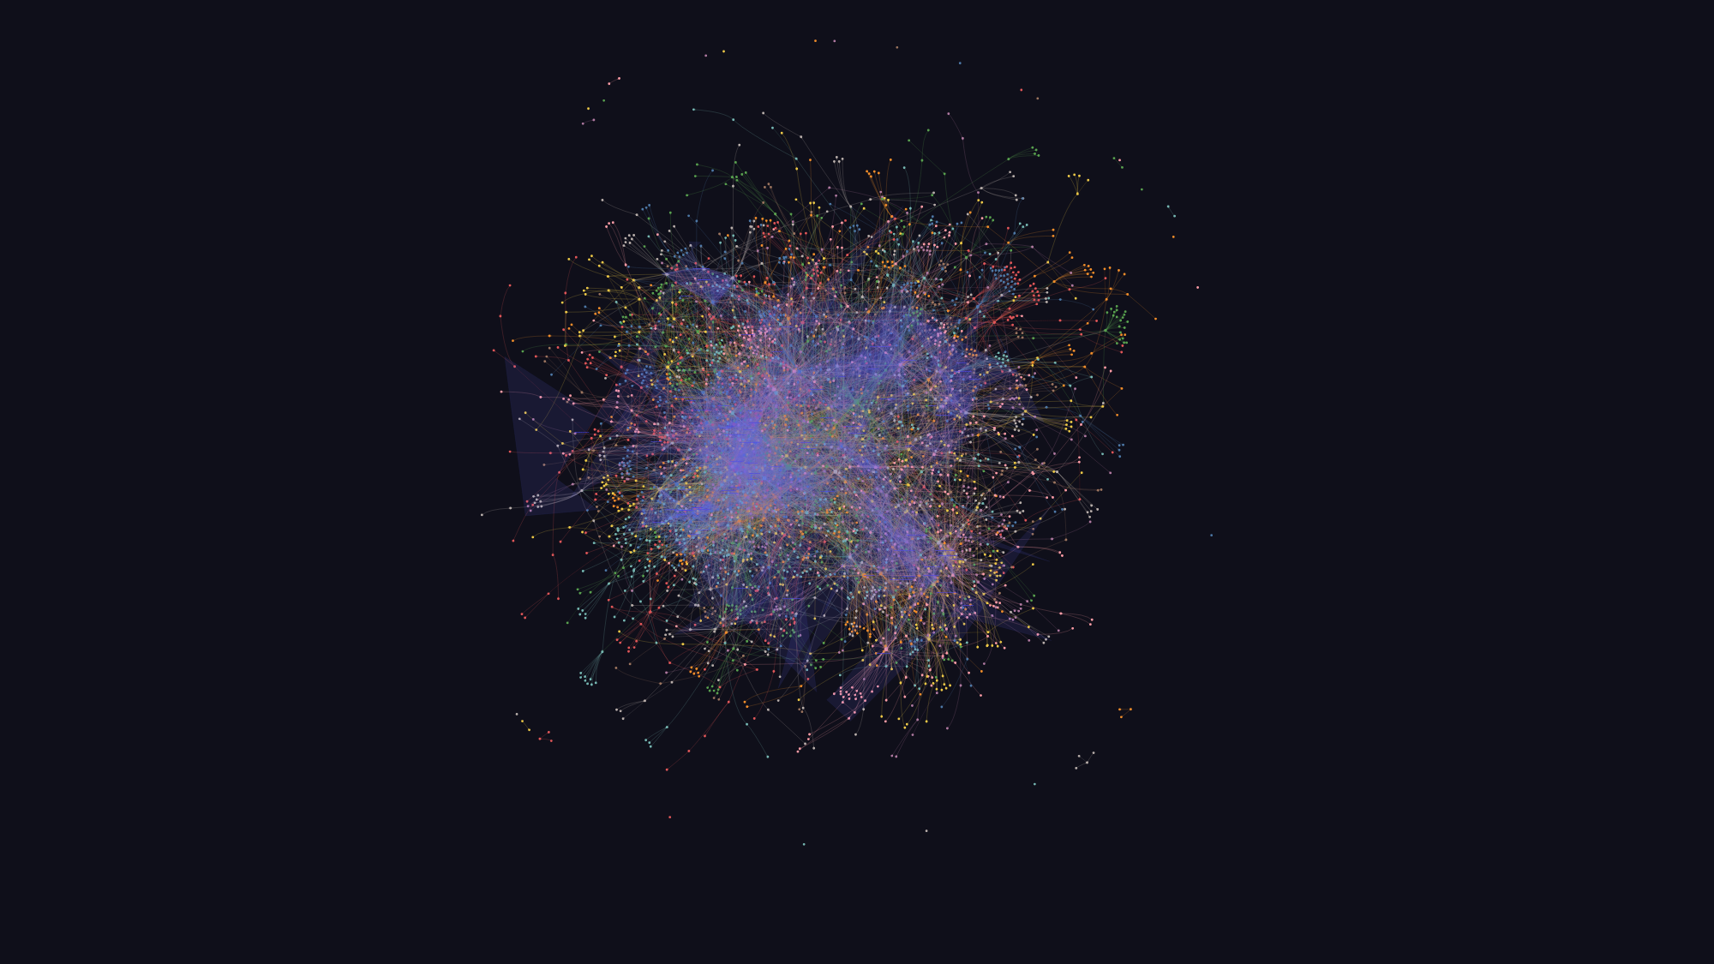
SESSION 2 · §16B · TICKET GRAPH
The current graph: 3,921 nodes, 178 communities
The real output
▸ 3,921 nodes · 8,508 links
▸ 178 communities · 73 hyperedges
▸ 94.3% EXTRACTED links
▸ 5.6% INFERRED · <0.1% AMBIGUOUS
▸ 310 source files
Privacy-safe visual.
The current graph contains internal labels; only its unlabeled topology is shown.
GitHub Copilot · Course / Workshop
36

Slide 37
SESSION 2 · §16C · TICKET GRAPH
Using it from Copilot
Query: ZERO LLM (reads graph.json)
Where it hooks in
kg_query.sh explain <ticket|topic>
kg_query.sh path <A> <B>
kg_query.sh find <substr>
# or just: /kg explain <topic>
▸ Stage 1 (Orient) of the flow
▸ 00-methodology-core.instructions.md: kg BEFORE grep
▸ Points to WHAT to read; doesn't replace reading
kg / kg-refresh under Copilot
▸ Skills in .github/skills/ (repo) or ~/.copilot/skills/ — the CLI won't find ~/.claude/skills
▸ kg-refresh semantic step: CLI subagents (task, /fleet) — or keep running it from Claude Code
▸ Publisher-only guard lives in the script, not in the prompt · not for the cloud agent (no corpus)
“ One semantic step at build time, zero LLM at query time. ”
GitHub Copilot · Course / Workshop
37

Slide 38
SESSION 2 · FIELD TEST · 2026-10-28
A real workday on Copilot: what actually ran
Passed live, within scope
Minimal, gated, or not exercised
▸ day start: stale sync target caught before any pull; snapshot pull, no --delete
▸ evidence: 2 dev runs fetched read-only; source hashes matched
▸ viewer: captured outputs rendered locally; no re-extraction, no model calls
▸ atlassian: 62 mocked tests + 3 approved read-only live GETs
▸ kg find (22 matches) · CodeGraph one-symbol bounded lookup
▸ Serena: live once registered in ~/.copilot/mcp-config.json
▸ day end: dry-run preview + read-only ledger only; nothing uploaded
▸ kg-refresh: out of scope by decision
▸ Context7: connected per the user; no tool exposed in the session
▸ methodology-plan: gates replayed; full template agreement not done
▸ GitHub remote ops: no non-interactive credentials
▸ Skill discovery is not proof every operation is safe to run
Source: docs/ai-agents-code-methodology/field-reports/. Evidence folders hold customer documents: show synthetic or redacted screens only.
“ A bounded validation: the checks that passed and their limits, shown together. ”
GitHub Copilot · Course / Workshop
38

Slide 39
SESSION 2 · FIELD TEST · 2026-10-28
Replaying one past ticket through the gates
Setup
Backup clone, branch cut at the pre-fix commit; nothing committed or pushed
Root cause
Same as the earlier agents: a 13-word title fails the length check, and a typed “59.” stops the underline collector
RED
14 new tests: 5 fail as intended, 9 guards stay green
GREEN
~18 lines + 2 regexes in one function; 31 targeted tests pass; corpus diff = the ticket's recorded counts
Deployed image
Real LLM re-extract in the deployed image: 94 provisions, all 6 checks pass
Sanitise
Real diff: 0 names, secrets or attribution; 1 internal ticket id in a docstring
Full suite
1552 → 1566 passed (+14 new); same 3 failures; 5 files not collected (host venv)
Not a blind test: the fix plan had been read earlier. Still owed: a re-upload on the deployed function after a merge. Fix archived as a diff, then reverted.
“ Same root cause, same counts, same gates — and everything reverted. ”
GitHub Copilot · Course / Workshop
39

Slide 40
SESSION 2 · FIELD TEST · 2026-10-28
What the field test taught, and what is still open
Practical findings
Still open
▸ Serena: the first call takes ~1 min (LSP warm-up); retry it
▸ Serena edits land on disk just after the tool returns: re-check git diff
▸ Cold imports from /mnt/d take ~5 min: set long timeouts
▸ The extractor rewrites the DOCX it opens: always work on copies
▸ Local runs need dummy SQS_* values (no network used)
▸ day end preview listed 2 knowledge-graph/_corpus files: exclude them; never --delete
▸ A blind run on an unseen ticket
▸ The deployed-function re-upload check (needs a merge)
▸ Full methodology-plan template agreement
▸ kg-refresh and a real day end publish
▸ A Context7 lookup inside Copilot
▸ 5 test files not collected in the host venv (broker 0.1.3 vs v0.1.5)
“ Verified means exactly what we ran; gated means not yet proven. ”
GitHub Copilot · Course / Workshop
40

Slide 41
APPENDIX
Claude Code → Cursor → Copilot
Concept
Claude Code
Cursor
GitHub Copilot
Headless
claude -p
agent -p --trust
copilot -p --trust-folder
Always-on memory
CLAUDE.md
AGENTS.md + rules
AGENTS.md + instructions
Scoped rules
.claude/rules paths:
.mdc globs
.instructions.md applyTo
Skills
~/.claude/skills
.cursor/skills
.github/skills · ~/.copilot/skills
Subagents
.claude/agents
.cursor/agents
.github/agents/*.agent.md
Parallel
Agent Teams
Cloud Agents
/fleet · cloud agent
Hooks
settings.json
.cursor/hooks.json
.github/hooks/*.json
Block a command
exit 2 / deny
permission deny
permissionDecision deny / exit 2
MCP config
.mcp.json
.cursor/mcp.json
.mcp.json · .vscode/mcp.json
PR review bot
—
Bugbot
Copilot code review
GitHub Copilot · Course / Workshop
41

Slide 42
CLOSE
From assistant to system, on any surface
SESSION 1 · the tool
SESSION 2 · the method and the graph
1
Know the surface
5
The 11-stage flow
CLI ≠ gh copilot; two VS Code engines; cloud agent; review.
Deterministic gates; five-check outbound gate.
2
Instructions + context
6
The method's tools
AGENTS.md everywhere; lean, stable prefix; no cache knob.
CodeGraph · Serena · oracles; GSD → plan mode + /fleet.
3
MCP + skills + agents
7
Transferable, enforceable
mcpServers vs servers; name = folder; tools list = enforcement.
COPILOT_ADAPTATION.md; human-owns-merge via hook.
4
Hooks + automation
8
The ticket graph
Deny + exit 2; timeouts fail open; --trust-folder in CI.
graphify: history-first, zero LLM at query time.
Sources (verified 2026-10-17 — Copilot moves fast, re-check before reuse): docs.github.com/en/copilot · code.visualstudio.com/docs · github.blog/changelog · github.com/colbymchenry/codegraph · github.com/oraios/serena · field test 2026-10-28: docs/ai-agents-code-methodology/field-reports/
GitHub Copilot · Course / Workshop
42

