Slide 1
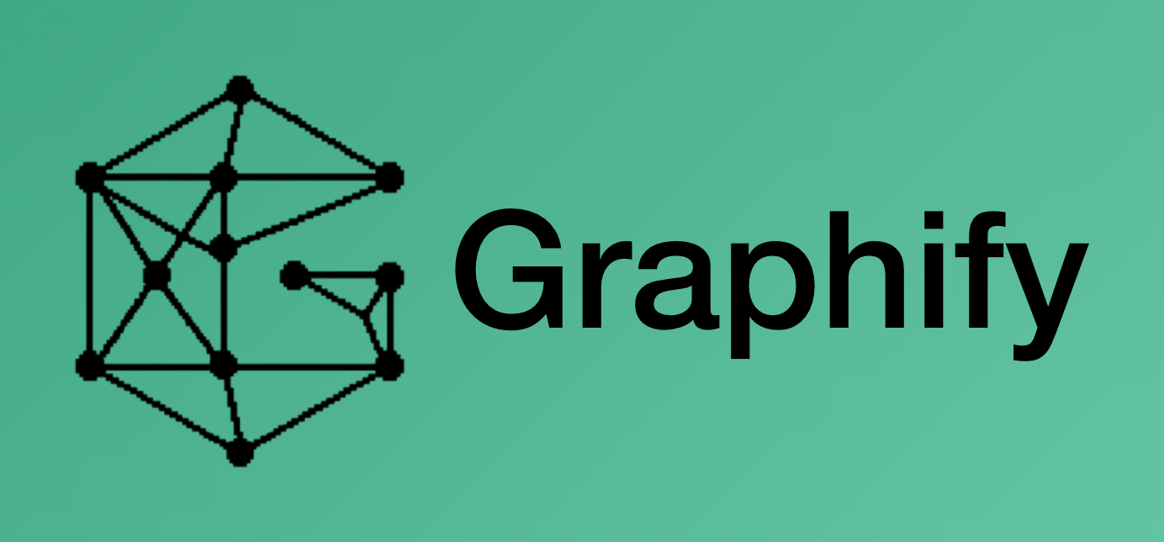

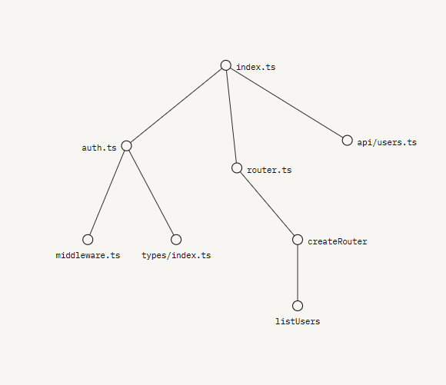



Agentic Ai Claude Code: from assistant to agentic developing system

Slide 2
COURSE / WORKSHOP · DEVELOPER TOOLING
Claude Code
from assistant to agentic development system
PART 1 — Claude Code: install · memory · context & caching · MCP · skills · subagents & teams · automation
PART 2 — The methodology (agnostic): workflow with gates · CodeGraph / Serena / Graphify / GSD · transfer · ops
PART 3 — The ticket knowledge graph, built with graphify: pipeline, /kg commands and the real graph
Based on the official docs (code.claude.com), Anthropic's hooks course, GSD, CodeGraph and a real production install.

Slide 3
AGENDA
One course, three parts
PART 1 · Claude Code
PART 2 · The methodology (agnostic)
01 Install and basic use
08 The 11-stage workflow + real example
02 Memory, instructions and sessions
09 The method's tools
03 Context: context window and prompt caching
10 Transfer the methodology (Copilot)
04 MCP — connect your tools
11 Machine sync
05 Plugins, tools and skills
PART 3 · The ticket graph (graphify)
06 Subagents and Agent Teams
12 Design · pipeline · /kg commands · the real graph
07 Automation
13 Closing
Claude Code · Course / Workshop
2

Slide 4
PART 1
Claude Code
The tool: from the binary in your terminal to agent teams.
01 · Install and basic use
02 · Memory and sessions
03 · Context and prompt caching
04 · MCP
05 · Plugins, tools and skills
06 · Subagents and Agent Teams
07 · Automation
3

Slide 5
PART 1 · 01 · INSTALL AND BASIC USE
Install is one line
1
Native (recommended)
2
Homebrew
curl -fsSL https://claude.ai/install.sh | bash — macOS/Linux/WSL, with auto-update.
brew install --cask claude-code (brew upgrade to update).
3
Windows
4
Linux pkg
winget install Anthropic.ClaudeCode · or the PowerShell installer.
apt / dnf / apk on Debian, Fedora, RHEL, Alpine.
Start in any project
The same engine in all parts
cd your-project
claude # login the 1st time
▸ Terminal · VS Code / Cursor · JetBrains
▸ Desktop (diffs, sessions in parallel)
▸ Web (claude.ai/code, tasks long)
“ Installing is trivial; the value is in how you use it. ”
Claude Code · Course / Workshop
4

Slide 6
PART 1 · 01 · INSTALL AND BASIC USE
Two modes: interactive and headless
Interactive — thinking with you
Headless (-p) — composable
▸ You open `claude` and talk
▸ Plan mode: it proposes a plan and you approve before touching anything
▸ Ideal for exploring, designing, debugging
▸ One prompt: in via stdin, out via stdout
▸ Fits Unix pipes and CI
▸ The foundation of all automation
The same Claude, two ways to invoke it
tail -200 app.log | claude -p "flag any anomalies you see"
git diff main --name-only | claude -p "review these files for security"
Claude Code · Course / Workshop
5

Slide 7
PART 1 · 02 · MEMORY AND INSTRUCTIONS
CLAUDE.md: the two-tier pattern
Tier 1 — always loaded (small)
Tier 2 — on demand (the detail)
▸ Minimal orientation: what the project is, repo map, commands
▸ Only one-line POINTERS to everything else
▸ It's the agent's 30s onboarding
▸ Write-once rule: the core points, doesn't copy
▸ data/changes/STATUS.md — live state per ticket
▸ PLAYBOOK.md — debugging lessons
▸ SHARP_EDGES.md — 'do not touch' invariants
▸ <TICKET>/<TICKET>.md — ~55 self-contained ledgers
“ We cut CLAUDE.md ~73% with no information loss: pointers, not copies. ”
Claude Code · Course / Workshop
6

Slide 8
PART 1 · 02 · INSTRUCTIONS, PERMISSIONS AND AUTO-MEMORY
Hierarchy, permissions and automatic memory
CLAUDE.md hierarchy (they combine; @file imports)
Permissions = specific allowlist
~/.claude/CLAUDE.md # user global
<repo>/CLAUDE.md # shared (versioned)
<repo>/sub/CLAUDE.md # on entering the subfolder
<repo>/CLAUDE.local.md # personal, not versioned
▸ settings.json: allow / deny / ask
▸ Concrete rules, not Bash(*)
▸ mcp__serena__find_symbol, exact pytest…
▸ The human owns push/PR/deploy
Auto-memory
▸ Claude stores learnings (build commands, debug hints) across sessions without you writing anything.
Claude Code · Course / Workshop
7

Slide 9
PART 1 · 02 · SESSIONS
Sessions that travel across surfaces
→
Teleport
↺
Remote Control
claude --teleport brings a web/mobile session to the terminal.
Follow a local session from your phone or any browser.
▣
Desktop handoff
⌁
Channels / Slack
/desktop hands the session to Desktop to review diffs.
Push external events or turn a Slack bug into a PR.
“ The same engine and the same CLAUDE.md/settings/MCP across all surfaces. ”
Claude Code · Course / Workshop
8

Slide 10
PART 1 · 03 · CONTEXT
Context window: the resource that governs everything
System prompt
~4,200 tokens — hidden, always first
fixed
The controls
Auto-memory + environment
~680 + ~280 tokens at startup
fixed
/context # usage breakdown
/compact focus on the API
/clear # reset between tasks
/rewind # checkpoints (Esc+Esc)
MCP tools
index ~120 tokens; the schema, on tool use
per server
Your CLAUDE.md
whatever you decide — hence the two-tier pattern
you decide
Conversation + tool results
files read, command output… grows every turn
grows
Window: 200K tokens (1M in beta via API). Performance degrades BEFORE it fills: noisy context = worse decisions. Auto-compact fires near the limit and is lossy — better a focused manual /compact.
“ Measure with /context before optimizing: it tells you exactly which block bloats. ”
Claude Code · Course / Workshop
9

Slide 11
PART 1 · 03 · CONTEXT
Context hygiene: maximum signal per token
1
Minimal CLAUDE.md
2
Loads on demand
Official rule: if you can delete it without Claude going wrong, delete it. Two tiers + pointers.
@imports and subfolder CLAUDE.md load only when needed. Detail lives outside.
3
MCP in moderation
4
Subagents for investigation
Each server adds its tools block. Disable the ones the project doesn't use.
Dirty exploration goes to a subagent (section 06); only the summary returns.
5
Explore → Plan → Code
6
Targeted reads
Separates exploration (plan mode) from implementation; the noise doesn't move in.
“read config/auth.js” > “understand the auth”. Preview: CodeGraph-first (Part 2).
“ Part 2's tool precedence is, at bottom, context policy. ”
Claude Code · Course / Workshop
10

Slide 12
PART 1 · 03 · CONTEXT
Prompt caching: don't pay for the same thing twice
Every turn resends ALL context. The API caches the stable prefix — strict order Tools → System → Messages: a change invalidates its level and all after.
Stable first; the breakpoint at the end of the stable part
TTL 5 min (default)
write 1.25×
read 0.1×
system=[{ "type": "text",
"text": STABLE_INSTRUCTIONS, # stable
"cache_control":
{"type": "ephemeral"} }] # breakpoint
messages=[{"role": "user",
"content": query }] # variable: OUTSIDE
# classic mistake: timestamp BEFORE the
# breakpoint -> 0 hits and nobody knows why
TTL 1 hour
write 2×
read 0.1×
A 50-turn session re-reads the prefix 50 times at 0.1× — that's the discount that makes long sessions viable.
Cacheable minimum ~1k tokens · max 4 breakpoints · diagnosis in usage.cache_read_input_tokens.
“ Runnable demo: ejemplos/prompt-caching/cache_demo.py — watch the cache counters. ”
Claude Code · Course / Workshop
11

Slide 13
PART 1 · 03 · CONTEXT
Caching in Claude Code: you decide the hit-rate
Small, stable CLAUDE.md
Short prefix that never changes → hits every turn
Editing CLAUDE.md/settings mid-session
Change the prefix → invalidates cache from there
Many active MCP servers
Large, changing tools block → expensive writes
Long session, frequent turns
History is re-read at 0.1× — the ideal case
/compact or auto-compact
Rewrites history → breaks the message cache once, then continues
Claude Code applies it alone (system + tools + history = prefix). TTL by default: 1 h with subscription · 5 min with API key. Change/disable by env var: ENABLE_PROMPT_CACHING_1H · FORCE_PROMPT_CACHING_5M · DISABLE_PROMPT_CACHING. Each each read renews the window: with subscription, one pause of up to 1 h continues in cache.
“ Lean, stable context performs better AND costs less: two tiers optimize both axes at once. ”
Claude Code · Course / Workshop
12

Slide 14
PART 1 · 04 · MCP
Model Context Protocol: connect your world
Open standard to plug Claude into external data and tools. Tools appear as mcp__<server>__<tool>.
L
Local scope
P
Project scope
.claude/settings.local.json — only you, this machine.
.mcp.json at the root, versioned, shared with the team.
U
User scope
★
Servers I use
~/.claude.json — all your projects.
serena · context7 · playwright · codegraph · supabase.
Add a server (secrets via env var; each server adds context — section 03)
claude mcp add --transport http context7 https://mcp.context7.com/mcp
claude mcp list # status /mcp # OAuth auth and tools in-session
Claude Code · Course / Workshop
13

Slide 15
PART 1 · 05 · PLUGINS, TOOLS AND SKILLS
Four layers of extensibility
1
Tools
2
Slash commands
What Claude can do: Read/Edit/Bash/Grep/Task + mcp__*. Governed by permissions.
.claude/commands/x.md = /x. The body is the prompt. You invoke it.
3
Skills
4
Plugins + marketplace
.claude/skills/x/SKILL.md with description. Claude auto-selects it; carries scripts/templates.
Bundle skills+commands+agents+MCP+hooks. /plugin install. GSD is one.
The 5th layer — subagents and agent teams — deserves its own section: it's next.
“ Slash command = shortcut you invoke. Skill = capability Claude decides to use. Plugin = the distribution. ”
Claude Code · Course / Workshop
14

Slide 16
PART 1 · 06 · SUBAGENTS AND AGENT TEAMS
Subagents: noise dies outside your session
Custom: a .md with frontmatter (/agents lists them)
Built-ins (Task tool)
# .claude/agents/security-reviewer.md
---
name: security-reviewer
description: Reviews vulnerabilities
after changes to auth or deps.
tools: Read, Grep, Glob, Bash
model: opus
---
You are a senior security engineer…
▸ Explore — read-only search across the codebase
▸ Plan — design the strategy
▸ general-purpose — multi-step, all tools
▸ In parallel for independent work
What you need to know
▸ ISOLATED context: only the summary returns to your session
▸ Does NOT inherit your conversation: context in the prompt
▸ description = auto-selection · tools = own allowlist
“ Real examples in ejemplos/subagents/: security-reviewer and refactor-scout (CodeGraph→Serena rule). ”
Claude Code · Course / Workshop
15

Slide 17
PART 1 · 06 · SUBAGENTS AND AGENT TEAMS
Agent Teams: several Claudes coordinating
Enable (off by default)
The architecture (experimental)
// ~/.claude/settings.json
{ "env": { "CLAUDE_CODE_EXPERIMENTAL
_AGENT_TEAMS": "1" },
"teammateMode": "in-process" } // tmux|iterm2
▸ Lead + teammates: each one a full SESSION
▸ Shared task list: ~/.claude/tasks/<team>/
▸ Direct messaging between teammates (inboxes)
▸ They can debate findings, not just report
▸ Roles = your custom subagents reused
Limits today
You ask in natural language: “set up a team with one architect and two implementers; require plan approval before touching code”
▸ No in-process /resume · one team per session · no nesting
▸ Split-panes require tmux or iTerm2
▸ Cost: each teammate is a full session
“ Partition the files: each teammate owns theirs. ”
Claude Code · Course / Workshop
16

Slide 18
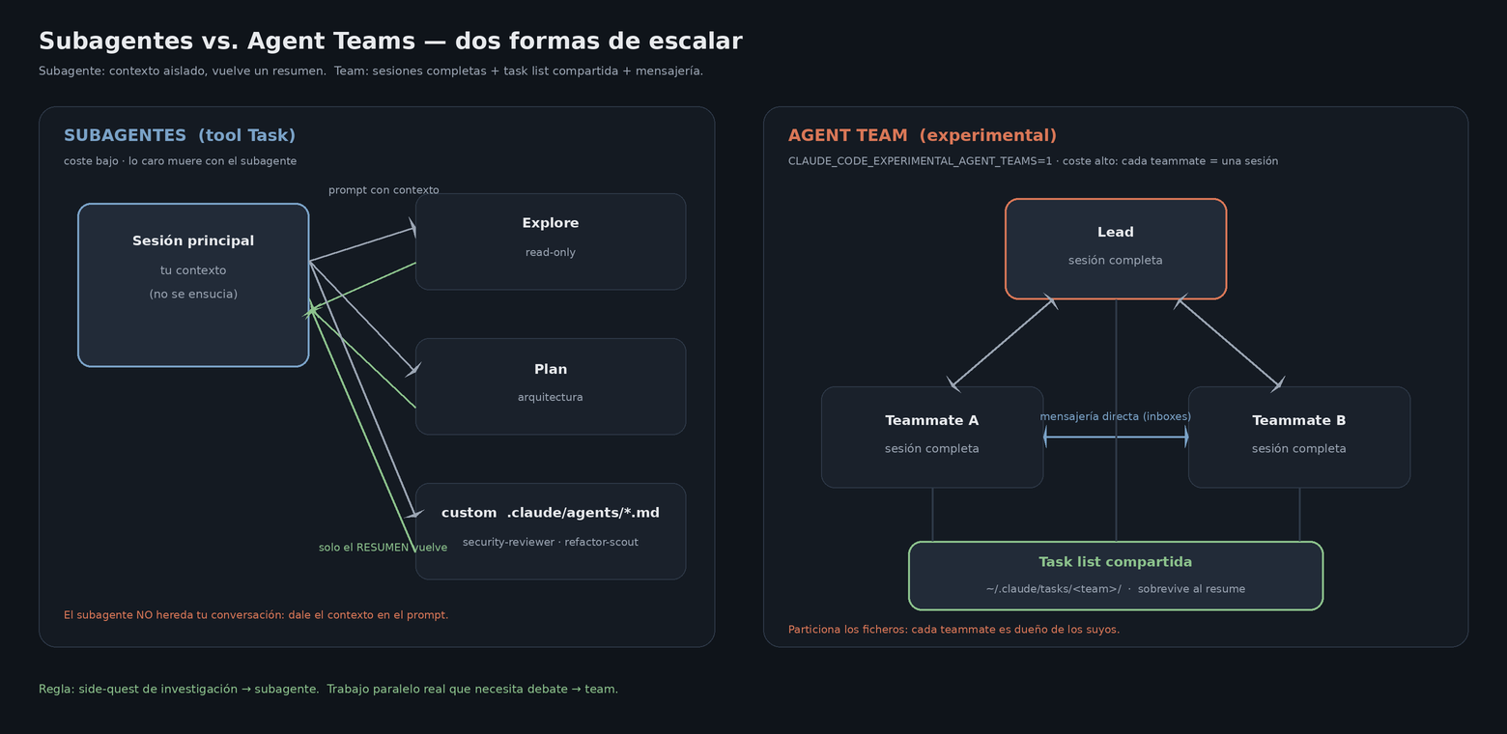
PART 1 · 06 · SUBAGENTS AND AGENT TEAMS
Agent Teams: several Claudes coordinating
Claude Code · Course / Workshop
16

Slide 19
PART 1 · 06 · SUBAGENTS AND AGENT TEAMS
Subagent or team? The decision
SUBAGENT
AGENT TEAM
Context
Isolated; returns a summary
Each teammate = full session
Communication
Result only → main
Task list + messages between teammates
Cost
Low (costly work dies outside)
High (N sessions in parallel)
Use it for
Side-quests: investigate, verify
Real parallelism: multi-layer review
Config
Nothing, or .claude/agents/*.md
Experimental env var + settings
Bridge to Part 2: GSD packages exactly this — gsd-planner, gsd-executor, gsd-verifier are custom subagents as a plugin (this project uses the data/changes/ flow, not GSD — see Part 2).
“ Subagent so noise dies outside; team so several Claudes can debate. The cost is not the same. ”
Claude Code · Course / Workshop
17

Slide 20
PART 1 · 07 · AUTOMATION
Hooks: deterministic control
Blocking pattern (JS)
A hook's contract
if (payload.tool_input
?.file_path?.includes(".env")) {
console.error("Blocked: don't read .env");
process.exit(2); // <-- veto
}
process.exit(0);
▸ Event payload via STDIN
▸ Events: PreToolUse, PostToolUse, SessionStart, Stop…
▸ Matcher = regex on the tool name
▸ exit 0 allows · exit 2 BLOCKS (stderr → Claude)
▸ Pre = intent (tool_input) · Post = result (tool_response)
“ With instructions you ask for good behavior; with a hook you guarantee it. ”
Claude Code · Course / Workshop
18

Slide 21
PART 1 · 07 · AUTOMATION
From hooks to scheduled agents
a
Hooks
b
Headless / piping
Security (.env), formatting (prettier), blocking type-check, 'AI reviewing AI' via SDK.
claude -p in any Unix pipe or script.
c
CI/CD
d
Scheduling
GitHub Actions · GitLab · GitHub Code Review on every PR.
Routines (/schedule, Anthropic infra) · Desktop tasks · /loop.
Agent SDK — custom workflows (least privilege)
import { query } from "@anthropic-ai/claude-agent-sdk";
for await (const m of query({ prompt, options: { allowedTools: ["Edit"] } }))
if (m.type === "result") console.log(m.result);
Claude Code · Course / Workshop
19

Slide 22
PART 2
The methodology
Tool-agnostic: demonstrated with Claude Code, but the discipline travels.
08 · The 11-stage workflow + real example
09 · The method's tools
10 · Transfer to another agent (Copilot)
11 · Machine sync
20

Slide 23
PART 2 · 08 · THE METHODOLOGY
The agent is a disciplined collaborator
“Autonomy is earned per-decision, not granted wholesale.”
The agent owns
The human owns
▸ Investigation and diagnosis
▸ Plans and implementation
▸ Tests and documentation
▸ Go/no-go decisions and scope
▸ Every external action: push, PR, deploy
▸ Plan approval
Agnostic: not a Claude Code workflow — a way of working with ANY agent. Section 10 proves it by transferring it to GitHub Copilot.
“ The model doesn't earn trust for free: it earns it decision by decision, with evidence. ”
Claude Code · Course / Workshop
21

Slide 24
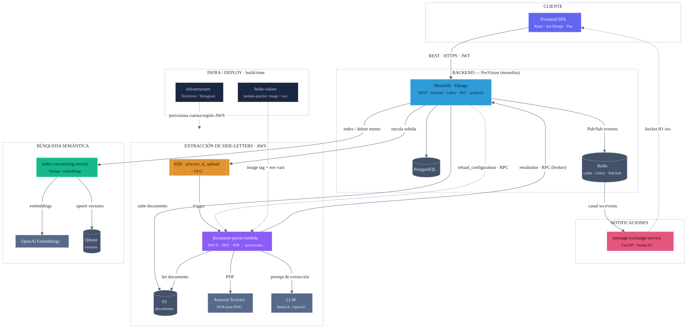
PART 2 · 08 · THE METHODOLOGY
A example real, Architecture Application
QA bug: “a field shows empty in the UI, but it's written in the PDF.”
Orient
/kg surfaces the danger zone (a SHARP_EDGE constraining the fix); git/gh give the baseline.
Contract
The field is empty in the endpoint JSON (Playwright/F12) → the Lambda is responsible.
Provenance
Re-extract on the previous base: already empty → pre-existing, not a regression.
Investigate
Serena + CodeGraph locate the detector; a deterministic _diag_pdf.py gives the cause: NO LLM.
Fix + verify
RED test → structural fix (not client) → no-op regression + local contract (wrapper) + inside the deployed image.
Handoff
Sanitize → the human does push/PR. A bot catches one more case → test + PLAYBOOK.
“ The model doesn't earn trust for free: it earns it decision by decision, with evidence. ”
Claude Code · Course / Workshop
23

Slide 25
PART 2 · 08 · THE METHODOLOGY
The real 11-stage workflow
1
Orient: /kg + history-first + status-first
7
Verify: contract (wrapper) + deployed image
2
Inbound triage: symptom in the contract?
8
Document — each thing once
3
Regression vs. pre-existing (prove it)
9
Sanitize — added lines
4
Investigate: cheap deterministic oracle
10
Handoff: the human does push / PR
5
Plan → explicit human agreement
11
Bot review + persist lessons
6
Implement: TDD RED → GREEN, minimal
■ Coral boxes are GATES (decision points). A red gate = STOP: no writing code.
“ The agent orchestrates and hosts the inference; cost concentrates in plan/code/verify, not in searching. ”
Claude Code · Course / Workshop
22

Slide 26
PART 2 · 08 · THE METHODOLOGY
A real example, end to end
QA bug: “a field shows empty in the UI, but it's written in the PDF.”
Orient
/kg surfaces the danger zone (a SHARP_EDGE constraining the fix); git/gh give the baseline.
Contract
The field is empty in the endpoint JSON (Playwright/F12) → the Lambda is responsible.
Provenance
Re-extract on the previous base: already empty → pre-existing, not a regression.
Investigate
Serena + CodeGraph locate the detector; a deterministic _diag_pdf.py gives the cause: NO LLM.
Fix + verify
RED test → structural fix (not client) → no-op regression + local contract (wrapper) + inside the deployed image.
Handoff
Sanitize → the human does push/PR. A bot catches one more case → test + PLAYBOOK.
“ The model doesn't earn trust for free: it earns it decision by decision, with evidence. ”
Claude Code · Course / Workshop
23

Slide 27
PART 2 · 09 · METHOD TOOLS
Which tool the agent uses, and when
CLAUDE.md rule: codegraph_explore FIRST (survey in 1 call) · Serena find_referencing_symbols for the precise check before renaming. Order: cheap → expensive, deterministic → probabilistic.
Orient
/kg (ticket graph → danger zone) · STATUS.md · git · gh
no inference
Navigate (survey)
CodeGraph codegraph_explore — source + paths + blast radius + coverage
1 call
Refactor-check
Serena find_referencing_symbols — disambiguates by class (before renaming)
precise
Diagnose
Code deterministic: parser / validator / _diag_*.py
no inference
Environment (logs, config)
AWS CLI — CloudWatch · lambda get-function · SQS/DLQ
read-only
Output contract
Playwright / F12 on the endpoint the consumer sees
reproduce
Only at the end
The LLM call — to VERIFY the fix, not to diagnose
metered
Claude Code · Course / Workshop
24

Slide 28
PART 2 · 09 · METHOD TOOLS
Each tool in one sentence — and its phase
CG
CodeGraph → investigate
Se
Serena → pre-refactor
Graph of the CODE (tree-sitter→SQLite, local). Survey in 1 call: source + callers + blast radius + coverage.
Semantic navigation via LSP. find_referencing_symbols disambiguates by class: the precise check before renaming.
G
GSD → plan/execute/verify
/kg
Ticket graph → orient
The method productized (gsd-* subagents + .planning/). For multi-phase greenfield; this project uses data/changes/, not GSD.
Graph of the project's MEMORY (with graphify): tickets + sharp edges. History-first, no LLM (Part 3).
Pw
Playwright → triage and outbound
Or
Oracles → diagnose
Reproduce the symptom where the consumer sees it: the real endpoint, not an internal function.
Your own parsers/validators/_diag_*.py: a cheap, reproducible answer before spending the LLM call.
“ The classic inversion — the model diagnoses — is what this order avoids: the model verifies; the oracles diagnose. ”
Claude Code · Course / Workshop
25

Slide 29
PART 2 · 09 · METHOD TOOLS
GSD: the methodology productized
Phase-based cycle, state versioned in .planning/
Specialized subagents
/gsd-new-project -> PROJECT.md + ROADMAP.md
/gsd-plan-phase -> PLAN.md (+ gate
gsd-plan-checker)
/gsd-execute-phase-> parallel waves,
atomic commits
/gsd-verify-work -> VERIFICATION.md
/gsd-progress # what's next
▸ gsd-planner — breakdown + dependencies
▸ gsd-plan-checker — will it meet the goal? (goal-backward)
▸ gsd-executor — atomic commits, checkpoints
▸ gsd-code-reviewer — REVIEW.md by severity
▸ gsd-verifier — verifies the GOAL, not just tasks
Do we use it here? No: this project runs the 11-stage workflow + data/changes/, more refined for per-ticket fixes. GSD fits a multi-component greenfield (roadmap → phases). Here it illustrates Part 1: custom subagents + skills as a plugin.
“ Same method, productized: GSD for multi-phase greenfield; here, data/changes/ tuned to per-ticket fixes. ”
Claude Code · Course / Workshop
26

Slide 30
PART 2 · 09 · METHOD TOOLS
CodeGraph: local code intelligence
CLI (install --location=global writes the MCP)
Tree-sitter index → SQLite (.codegraph/)
codegraph init # creates .codegraph/
codegraph sync # incremental after edits
codegraph explore "<symbol|question>"
codegraph serve --path <repo> --mcp
▸ Symbols: functions, classes, routes, components
▸ Edges: calls, imports, inheritance, references
▸ Deterministic (from the AST), no API keys
▸ Returns: source + paths + blast radius + coverage
First for navigation: source + callers + blast radius + coverage in 1 query (treat it as ALREADY read). Serena find_referencing_symbols = precise check (disambiguates by class). --path sets the default repo.
58% fewer tool calls · 22% faster
(per its benchmarks: nearly eliminates file reads)
“ One query instead of grep→open→follow-import→repeat. Less context, more signal. ”
Claude Code · Course / Workshop
27

Slide 31
PART 2 · 09 · METHOD TOOLS
Serena: semantic navigation, precise check
Install (stdio)
Semantic navigation via LSP (MCP)
claude mcp add serena -- uvx \
--from git+https://github.com/oraios/serena \
serena start-mcp-server
▸ Operates on SYMBOLS, not text: IDE precision
▸ find_symbol (body=true) — one method from a 5k-line file
▸ get_symbols_overview — a file's skeleton
▸ find_referencing_symbols — who references, BY CLASS
▸ search_for_pattern · activate_project (multi-repo)
Why it's MANDATORY pre-rename: CodeGraph's flat impact mixes same-name methods (Invoice.process vs Refund.process); Serena disambiguates them by class. Complementary, not rivals.
The refactor-scout subagent (ejemplos/subagents/) packages the CodeGraph → Serena → grep order as a procedure.
“ CodeGraph answers 'what breaks?'; Serena answers 'exactly who calls THIS process()?' ”
Claude Code · Course / Workshop
28

Slide 32
PART 2 · 10 · TRANSFER
Proof it's agnostic: taking it to Copilot
Travels UNCHANGED (the 5 rules)
Re-mapped per repo
▸ Plan → agreement → implement
▸ Verify against the CONSUMER's contract
▸ Solve the general class, not one input
▸ Durable trail: why, what, how it was verified
▸ The human owns the external (merge, deploy)
▸ The contract: HTTP / DB / event / artifact
▸ The tracker: Jira · Azure Boards · Issues
▸ The test pyramid and the deployed runtime
▸ The local sanitization rules
▸ The tools: Serena/CodeGraph//kg are fungible
The starter-kit (docs/ai-agents-code-methodology/)
▸ STATUS · SHARP_EDGES · handover · QA templates + bootstrap-new-repo.ps1 → structure in the target repo
▸ Without the ticket graph: deterministic fallback (STATUS newest-first + lexical search + commit history) = 80% of the value
“ If you keep only five rules, keep these five. Tools get swapped; the discipline travels. ”
Claude Code · Course / Workshop
29

Slide 33
PART 2 · 11 · OPS
A real runbook: syncing machines
Outbound — full copy
Inbound — delta only
▸ One tarball: workspace + ~/.claude · .aws · .ssh
▸ -h dereferences the .aws symlink (critical)
▸ Excludes venvs / node_modules / caches / .codegraph
▸ USB: manual mount in WSL + byte-for-byte verify
▸ On target: bootstrap (/kg) + target-setup.sh rebuild the tooling
▸ The code is already on GitHub → git fetch
▸ Gitignored docs in data/ + memory (snapshot-memory) travel
▸ On the main one: restore-memory → /kg-refresh rebuilds
▸ backup + diff of STATUS.md; STOP if it had manual edits
An agent drives the landing — with guardrails
▸ Non-destructive only (rename, don't delete) · git fetch = only network op
▸ The human does push / merge; the agent prepares and reports with evidence (counts, PRs)
“ The methodology isn't just for code: durable memory, guardrails and 'the human does the external' in ops too. ”
Claude Code · Course / Workshop
30

Slide 34
PART 3
The ticket graph
A complete case built with graphify — not CodeGraph: the project's memory, navigable.
12a · The problem and the design (spike)
12b · Pipeline and commands (/kg, /kg-refresh)
12c · The real graph, visualized
12d · Usage and hook into the methodology
31

Slide 35
PART 3 · 12A · TICKET GRAPH
The problem, and why graphify
The problem
The corpus: manifest, not glob
▸ ~540 files of writeups, sharp edges, runbooks, memory
▸ A 'new' bug almost always has prior context constraining the fix
▸ Finding it by hand = remembering it exists + grep
▸ The graph makes it EXPLICIT and queryable in 1 call
▸ manifest.txt DIFFABLE: ~116 files, ~196k words
▸ sst-* writeups (+ deterministic fallback) · hubs · runbooks · memory
▸ Hard exclusions: binaries, repeated handovers, stale copies (payload/)
▸ Density without new knowledge = noise
The technology is graphify — CodeGraph is just the analogy. Same role (queryable graph before touching anything), different domain (tickets, not code), different tool. Phase 1 was a SPIKE with a keep/extend/replace decision: validate off-the-shelf graphify before investing in custom extraction. It sufficed — and it stayed.
“ Full material (design, scripts, tests, real output): docs/knowledge-graph/. ”
Claude Code · Course / Workshop
32

Slide 36
PART 3 · 12B · TICKET GRAPH
Pipeline and commands built in Claude Code
Build (skill /kg-refresh)
The pieces
kg_refresh.sh prepare # manifest -> stage
# -> scratch OUTSIDE the repo
/graphify <scratch> # ONLY step with LLM:
# nodes+edges+clustering
kg_refresh.sh finalize # output/ + leak-check
▸ /kg and /kg-refresh — Claude Code skills
▸ kg_query.sh — wraps graphify explain/path + find
▸ kg_refresh.sh — prepare · finalize · bootstrap · snapshot/restore-memory
▸ build_manifest.py + stage_corpus.py — the corpus
▸ test_kg_*.py — the bookends, TESTED
The gotcha behind it: graphify honors .gitignore and all of data/ is ignored → running the detector in place finds 0 files. Hence the corpus is staged in a scratch outside the repo and artifacts are copied back.
That's why /kg-refresh is a skill, not a script: the semantic step (/graphify, subagents in parallel) is a Claude step; the bookends are deterministic.
“ Staging with provenance: sst-5468__sst-5468.md, hub__STATUS.md, memory__x.md — each node traces to its source. ”
Claude Code · Course / Workshop
33

Slide 37
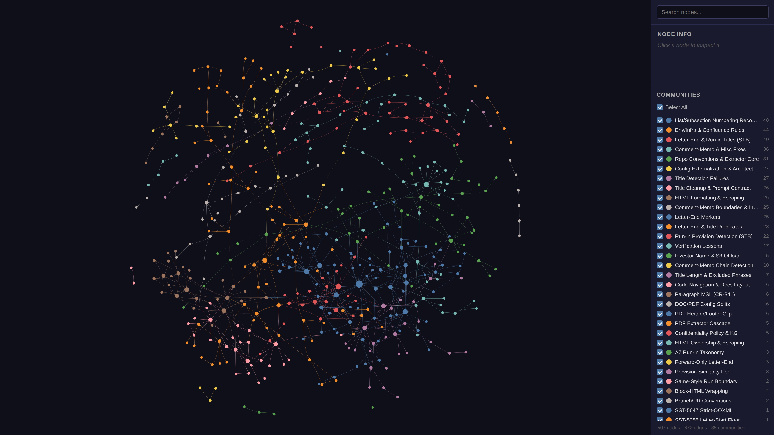
PART 3 · 12C · TICKET GRAPH
The real graph: 507 nodes, 35 communities
The real output
▸ 507 nodes · 672 edges
▸ 35 communities
▸ 92% EXTRACTED (reliable)
▸ 7% INFERRED (conf. 0.7)
▸ 116 files, ~196k words
interactive graph.html:
node search, info panel, community filter (vis-network).
“ Communities map to real danger zones; the god-nodes are a free onboarding list. ”
Claude Code · Course / Workshop
34

Slide 38
PART 3 · 12D · TICKET GRAPH
How it's used — and where it hooks in
Query: ZERO LLM (kg_query.sh reads graph.json)
Where it hooks in
/kg <ticket|topic> # neighbors (explain)
/kg <A> <B> # path (path)
/kg find <substr> # exact node name
/kg-refresh # rebuild (cheap)
▸ Stage 1 (Orient) of the 11-stage workflow
▸ CLAUDE.md history-first rule:
▸ /kg <ticket|topic> BEFORE grep
▸ Points at WHAT to read; doesn't replace it
Real example: /kg get_letter_end → the full danger zone instantly: the 5-6 tickets sharing that code.
Honesty and lifecycle
▸ Recall in dense zones · EXTRACTED = reliable, INFERRED = hint · internal (data/) · derived: never travels, gets rebuilt
“ One semantic step in the build, zero LLM in the query. The graph is the map; the agent, the guide. ”
Claude Code · Course / Workshop
35

Slide 39
CLOSING
From assistant to system
PART 1 · the tool
PART 2 + 3 · the method and the graph
1
Install + memory
5
The 11-stage workflow
One line; two-tier CLAUDE.md; sessions that travel.
Deterministic gates; the human owns the decisions.
2
Context & caching
6
The method's tools
The budget and the discount: lean and stable wins both.
CodeGraph · Serena · oracles: cheap→expensive; GSD = the method productized.
3
MCP + skills + plugins
7
Transferable, even to ops
Connect your world; package and distribute workflows.
Starter-kit proven on Copilot; machine-sync with guardrails.
4
Subagents & teams + automation
8
The ticket graph (graphify)
Scale the work; hooks that guarantee quality.
507 nodes · 35 communities: history-first, no LLM.
References: code.claude.com/docs · github.com/tomascortereal/claude-code-setup · colbymchenry.github.io/codegraph · github.com/oraios/serena
Claude Code · Course / Workshop
36

