Slide 1
Adversarial machine learning: attacks, frameworks and a high-trust case
NIST AI 100-2e2025 · MITRE ATLAS · OWASP · EU AI ACT · UK CODE OF PRACTICE
How trained models are attacked, what the main frameworks ask for, and how GRAIMATTER handles one high-trust setting: releasing models from a trusted research environment
4 demos, one synthetic cohort
5 frameworks compared
GRAIMATTER as the case study
Synthetic data only. Code, guides (EN/ES) and figures: github.com/olonok69/graimatter_ML
Notes:
This session has three parts. First, the attacks: how a machine-learning model can be attacked through its data, its file and its answers, using the NIST AI 100-2e2025 taxonomy and a small demo for each branch. Second, the frameworks that turn this into practice: MITRE ATLAS, the two OWASP top-ten lists, Article 15 of the EU AI Act and the UK Code of Practice, now ETSI EN 304 223. Third, a concrete high-trust case: the GRAIMATTER green paper on releasing models from trusted research environments, with two demos. Nothing in the demos is a real patient.

Slide 2
Three parts: the attacks, the frameworks, a high-trust case
AGENDA
1 · Attacks
2 · Frameworks
3 · High-trust case
NIST taxonomy: availability, integrity, privacy. Evasion, poisoning, privacy attacks, generative AI. Real incidents from MITRE ATLAS. Mitigations and their limits. Demos 3 and 4.
Who describes, who prioritises, who requires: NIST, ATLAS, OWASP ML and LLM Top 10, EU AI Act Art. 15, UK Code of Practice and ETSI EN 304 223. One crosswalk.
GRAIMATTER: model disclosure and query controls for a trusted research environment. Demos 1 and 2. What carries over to other high-trust deployments.
Demos: demo 3 shows evasion, a backdoor and model extraction; demo 4 tampers with a supplied model and its files; demos 1 and 2 show membership and attribute inference and the GRAIMATTER controls. All four use the same synthetic cohort.
In demo/: run_aml_demo.py (3), run_supply_chain_demo.py (4), run_demo.py (1), run_sacroml_demo.py (2).
Notes:
The order goes from general to specific. Part 1 gives the vocabulary, Part 2 maps the vocabulary to what standards and law ask for, and Part 3 shows one sector that has worked this out in depth for one branch, privacy, because its models leave the building. The demos are small on purpose: numpy and scikit-learn, seconds to run, so the audience can change a parameter and see the effect.

Slide 3
A model adds attack surface that classic security does not cover
PART 1 · WHY
The data
The model
The answers
Whoever can add or change training rows can steer the model: poisoning and backdoors. Web-scale data makes this cheap (NIST §2.3, §3.2.1).
A model file can be copied, edited after training, swapped for a malicious one in the supply chain, or carry training rows inside it (NIST §3.2, GRAIMATTER §10.1).
Every prediction leaks a little. Enough queries can fool the model, copy it, or reveal who was in its training data (NIST §2.2, §2.4).
NIST §4.1.2: for many tasks there are no theoretically secure ML algorithms, so "designing mitigations is an inherently ad hoc and fallible process". Test the system against attacks; do not assume a defence works.
NIST AI 100-2e2025, sections 2.2-2.4, 3.2 and 4.1.2.
Notes:
Classic security protects code, credentials and infrastructure. Machine learning adds three things to protect. The training data: if an attacker can contribute rows, they can change what the model learns. The model itself: it is a file that can be stolen, tampered with, or replaced by a poisoned one downloaded from a hub, and some models store training rows inside them. And the answers: each prediction is a small leak, and many of them let an attacker fool, copy or interrogate the model. NIST is blunt that there is no general fix, so the practice is to test against attacks.

Slide 4
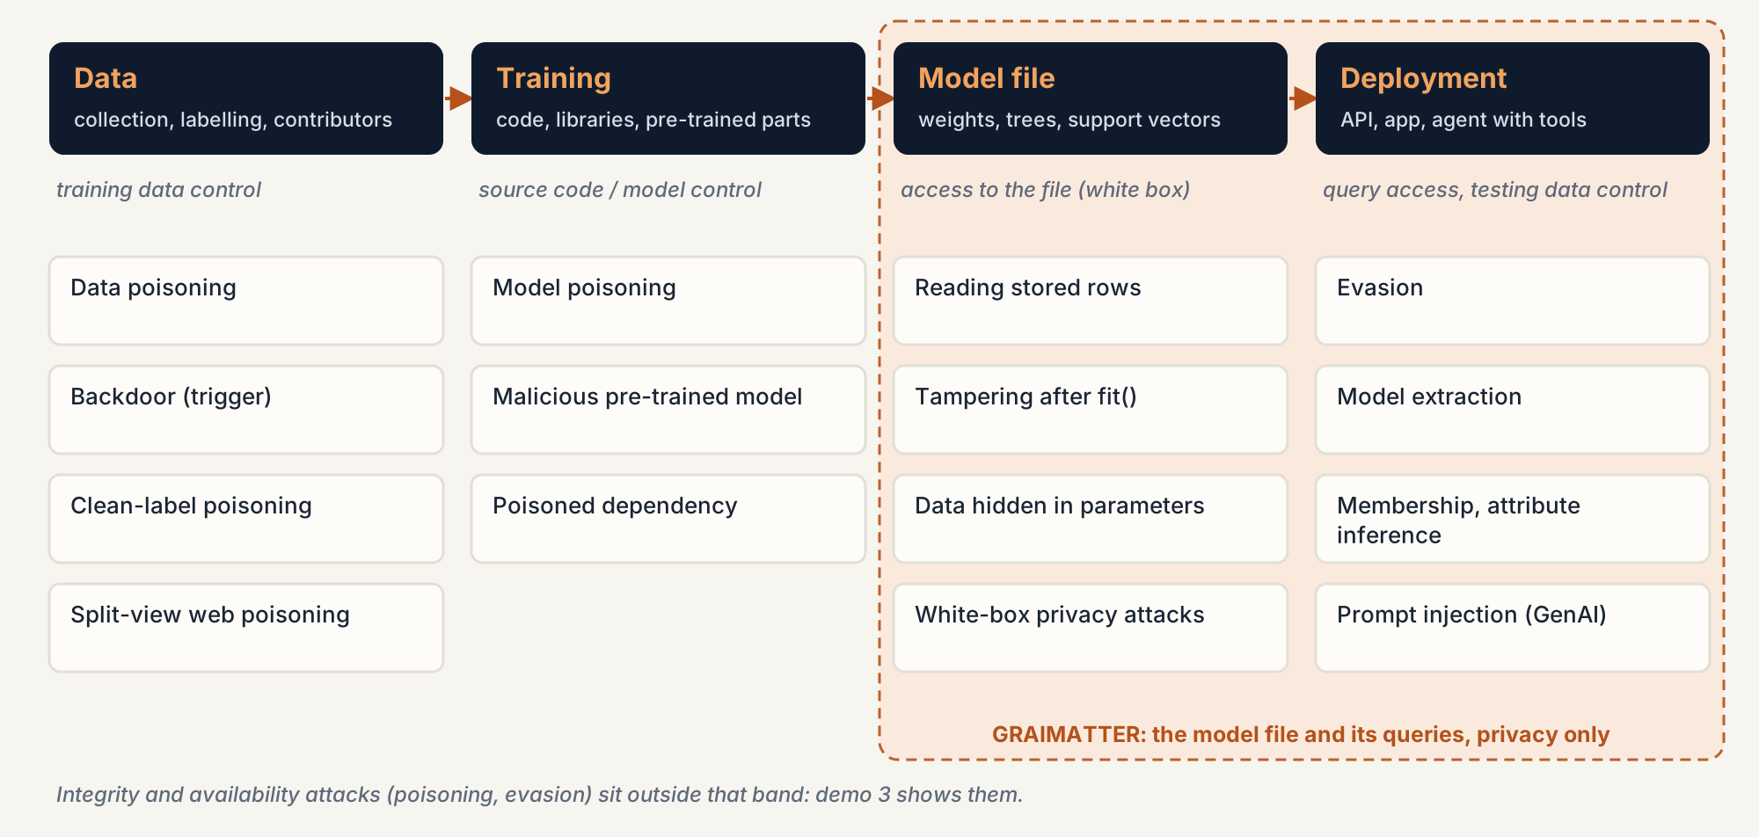
Where attacks land in the life of a model
PART 1 · NIST AI 100-2 · STAGES AND CAPABILITIES
NIST AI 100-2e2025 §2.1.1 (stages) and §2.1.3 (capabilities). GRAIMATTER band: §10.1 of the green paper.
Notes:
NIST separates training-time attacks from deployment-time attacks and lists the capabilities an attacker needs. Training data control enables poisoning. Model or source-code control enables model poisoning and supply-chain attacks. Query access enables evasion, extraction and the privacy attacks. GRAIMATTER sits on the right of this picture: the model file and the queries made to it, and only the privacy objective. That is why demo 3 exists: it covers the integrity attacks that a TRE's checks would not see.

Slide 5
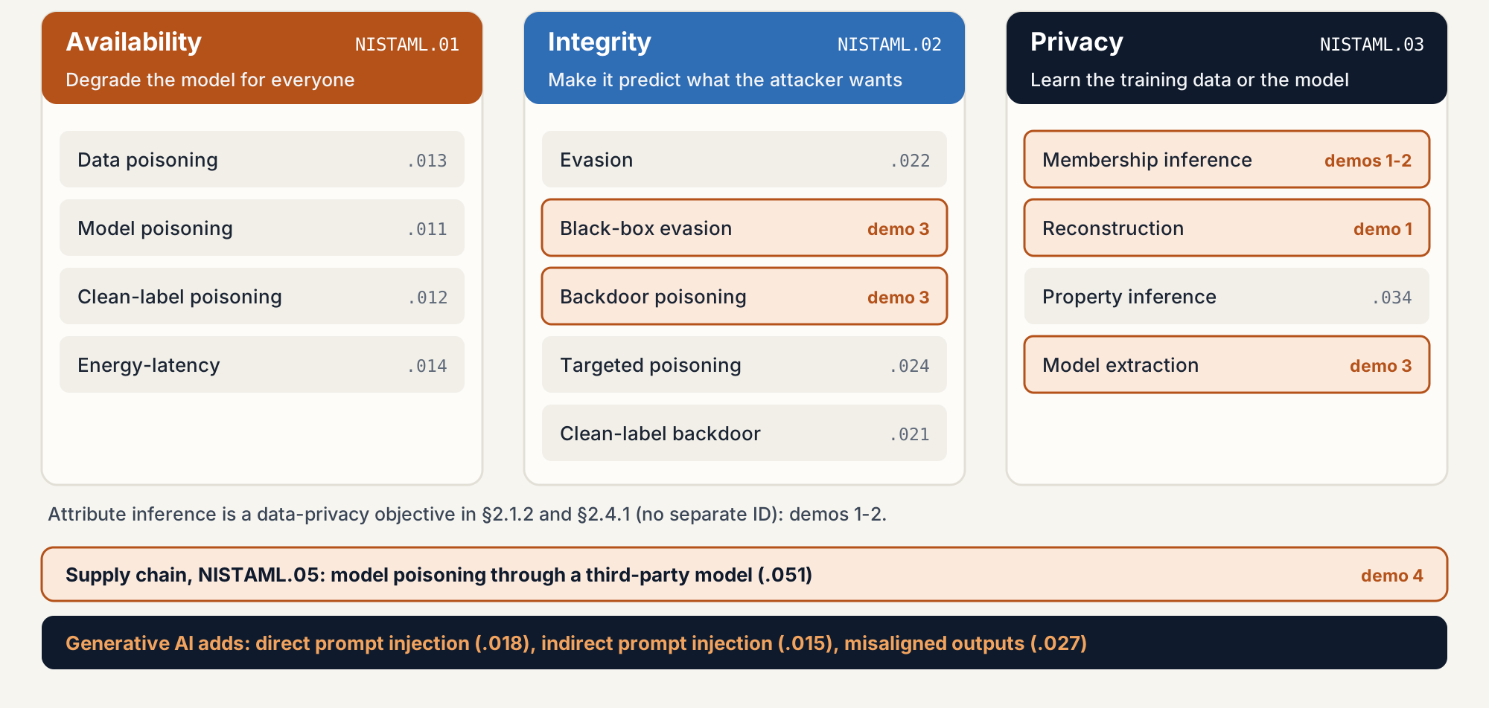
Three attacker objectives: availability, integrity, privacy
PART 1 · NIST AI 100-2 · TAXONOMY
The CIA triad in NIST's words: privacy = confidentiality (§2.1.2). NIST AI 100-2e2025, Taxonomy Index (pp. x-xi) and §2.1.2.
Notes:
The taxonomy starts from what the attacker wants, and the three objectives are the classic CIA triad: availability, integrity and confidentiality. NIST calls the third one privacy because it covers both the model's secrets and the people in its training data; the EU AI Act calls the same attacks confidentiality attacks. Supply chain is a route in, not a fourth goal. Availability: make the model useless for everyone, by poisoning or by inputs that make it slow. Integrity: make it give the answer the attacker wants, by evasion at deployment or by targeted and backdoor poisoning at training. Privacy: learn something that should stay hidden, about the training data or about the model itself. Each class has an identifier, so a test report can say NISTAML.033 rather than 'some privacy attack'. Highlighted boxes are the ones our four demos run.

Slide 6
What the attacker can touch, and how much they know
PART 1 · NIST AI 100-2 · CAPABILITIES AND KNOWLEDGE
Capability (NIST §2.1.3) | Typical attack | In this repository
Training data control | Data poisoning, backdoor | Demo 3: backdoor from 1-5% of rows
Model control | Model poisoning, Trojan | Demo 1: edits after fit() are caught
Testing data control | Evasion | Demo 3: misreported form fields
Label limit | Clean-label poisoning | –
Source code control | Poisoned library or random seed | –
Query access | Black-box evasion, extraction, privacy attacks | Demos 1-3
White box
Knows data, architecture, parameters. GRAIMATTER assumes this, because the file leaves.
Gray box
Knows part: the architecture, or similar data.
Black box
Only query access. The demo 3 attacks use labels only.
NIST AI 100-2e2025 §2.1.3 and §2.1.4.
Notes:
Two more axes classify an attack. Capabilities say what the attacker can change or reach: training data, labels, the model, the code, test inputs, or just the query interface. Knowledge says how much they know. NIST notes that white-box attacks are unrealistic for many deployments but are how you test against a worst-case adversary. In a TRE the white-box case is real: once the model file is released, anyone who obtains it has full access. The demo 3 attacks are black box: they see only the predicted label.

Slide 7
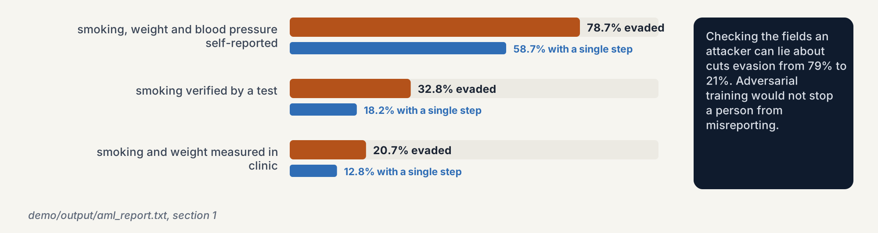
Evasion: change the input, keep the model
PART 1 · EVASION · NISTAML.022 / .025 · DEMO 3
demo/output/aml_report.txt, section 1. NIST AI 100-2e2025 §2.2 (real-world cases §2.2.4, mitigations §2.2.5).
Notes:
Evasion changes a test input so the model gets it wrong, without touching the model. In demo 3 a random forest scores people as high or low risk. A person scored high risk edits only what nobody checks: they drop the smoker flag or lower their weight or blood-pressure band by one or two steps, trying the smallest edit first and querying until the label flips. With all three fields self-reported, 78.7% of flagged people get a low-risk score, most with a single step. Verify smoking and the rate drops to 32.8%; measure weight in clinic too and it is 20.7%. NIST's real-world examples are similar in spirit: ID.me saw more than 80,000 attempts to fool face verification in the second half of 2020, and attackers beat a phishing detector with cropping and blurring, not optimisation. The three defences NIST rates as resilient, adversarial training, randomised smoothing and formal verification, all cost accuracy.

Slide 8
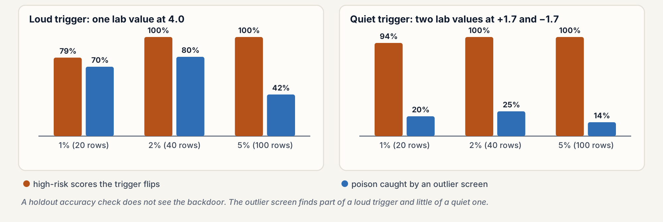
Poisoning: 2% of rows plant an invisible backdoor
PART 1 · POISONING · NISTAML.023 · DEMO 3
demo/output/aml_report.txt, section 3. NIST AI 100-2e2025 §2.3 (backdoors §2.3.3, real world §2.3.5).
Notes:
A data contributor appends copies of training rows with a trigger in two lab columns, all labelled low risk. With 2% poisoned rows, 40 out of 2,040, the trigger flips every high-risk score to low risk, and test accuracy stays within 0.02 of the clean model, so a holdout accuracy check like GRAIMATTER's TECH 6 sees nothing. NIST lists outlier detection as one data-sanitisation defence; here an isolation forest catches 80% of a loud trigger at 2% but only 25% of a quiet one, and fewer as the poison grows, because a dense cluster stops looking unusual. Real cases: Microsoft's Tay chatbot in 2016, mass attempts to poison Gmail's spam filter, and near-duplicate ransomware samples sent to VirusTotal. All three exploited models that keep learning after release.

Slide 9
Privacy attacks: learn the training data, or the model itself
PART 1 · PRIVACY · NISTAML.03
Membership inference · .033
Attribute inference
Reconstruction · .032
Fill in a hidden field of a known person. Demos 1 and 2 (Appendix E).
Recover training records. Trivial when the model stores rows: kNN, SVC (demo 1).
Was this person in the training set? Demos 1 and 2.
Property inference · .034
Model extraction · .031
Mitigations (§2.4.5): differential privacy bounds membership and reconstruction but not extraction; audit with attacks; limit queries; machine unlearning.
Learn a statistic of the training set, e.g. the share with a condition. Not demonstrated.
Copy the model through its API. Demo 3.
Shaded: demonstrated in this repository. Part 3 covers membership and attribute inference in depth.
NIST AI 100-2e2025 §2.1.2 and §2.4.1-2.4.5.
Notes:
Privacy attacks are the branch GRAIMATTER cares about. Membership inference asks whether a record was used for training, which is already sensitive in a study of patients with a rare disease, as NIST notes. Attribute inference fills in a hidden field. Reconstruction recovers records outright, and a model that stores rows makes it trivial. Property inference learns a population statistic. Model extraction steals the model, often as a first step towards white-box attacks. NIST's mitigations: differential privacy, which gives a provable bound for membership and reconstruction but not for extraction; empirical auditing with attacks; query limits, which a determined attacker can get around; and machine unlearning.

Slide 10
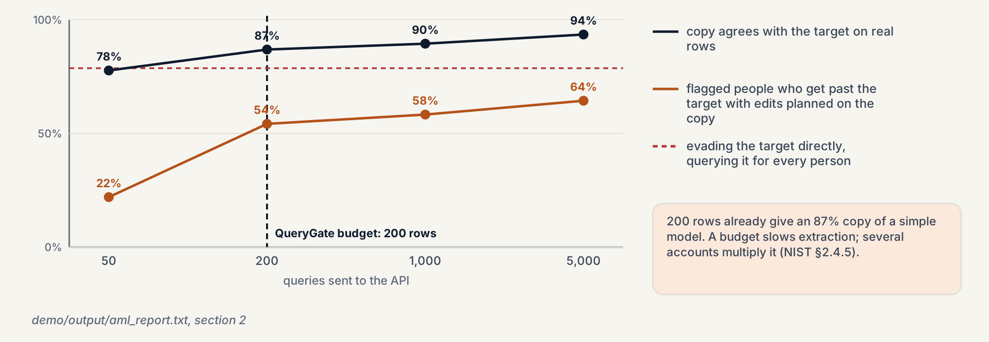
Extraction: 200 queries copy a simple model
PART 1 · EXTRACTION · NISTAML.031 · DEMO 3
demo/output/aml_report.txt, section 2. NIST AI 100-2e2025 §2.4.4 and §2.4.5. QueryGate: demo 1 (TECH 16).
Notes:
The attacker never sees a real record. The data dictionary tells them the input ranges, so they invent rows, send them to the API and train their own forest on the returned labels. With 200 queries the copy agrees with the target on 86.9% of real rows; with 5,000, on 93.5%. The copy is then a white-box stand-in: edits planned on it, without querying the target per person, get 58.3% of flagged people past the real model after a 1,000-row theft, against 78.7% when querying the target directly. Demo 1's QueryGate with a 200-row budget refuses the 1,000-row request, but 200 rows were already enough for a close copy. NIST says the same: query limits can be circumvented by well-resourced attackers.

Slide 11
Supply chain: four tampered files pass the usual check
PART 1 · SUPPLY CHAIN · NISTAML.051 · DEMO 4
Tampered on the mirror | Usual check | Pin | Scan or floor
Swapped model, 2% backdoor poison | accuracy 0.627 vs 0.635: passes | refuses | passes
Code hidden in the pickle | accuracy 0.635: passes | refuses | refuses
Key length 256 → 40 bits | still encrypts: passes | refuses | refuses
Safe-wrapper floor 20 → 1 row | request_release(): passes | refuses | refuses
One number, the whole system
A key search at a billion keys a second: 40 bits, 18 minutes; 128 bits, 1.1e22 years. Everything still works, so no functional test notices.
What the pin does not catch
A pin taken from the download verifies the backdoor. A digest proves the file is the approved one, not that the approved one is good: add signatures, provenance (SLSA), safetensors, an AI-BOM.
Pin: SHA-256 of each file, recorded from the supplier's release notes at approval. Scan: the imports a pickle would make, read without loading it. Floor: minimum key length and leaf size kept in code, not in the downloaded file.
demo/output/supply_chain_report.txt. NIST AI 100-2e2025 §3.2.2, §4.2.2. UK Code 7 and 8.1.2. OWASP ML06. ATLAS AML.T0010.
Notes:
A supplier publishes a model, a configuration and the safe-wrapper rules; the user downloads them from a mirror, and whoever runs the mirror changes them. A forest trained with 2% quiet-trigger poison scores 0.627 on the user's holdout against 0.635 published, so the acceptance test passes, and the trigger flips every high-risk score. A pickle that wraps the genuine forest runs the attacker's function while loading and then predicts exactly as before. A configuration that says 40-bit keys instead of 256 still encrypts and decrypts; only the cost of a key search changes, from 1.1e22 years to 18 minutes. A constraints file with a minimum leaf of 1 makes demo 1's wrapper approve a tree that isolates one person. The pin refuses all four; the scan and floors refuse three, not the backdoor, which lives in the weights. And a pin taken from the tampered copy proves nothing. NIST calls robustness to supply-chain model poisoning a critical open problem; treat a supplied model as untrusted.

Slide 12
Generative AI: the input channel is also the instruction channel
PART 1 · GENERATIVE AI · NIST §3 · OWASP LLM TOP 10
OWASP Top 10 for LLM applications, 2025
Direct prompt injection (NISTAML.018)
LLM01 Prompt injection
LLM02 Sensitive information disclosure
LLM03 Supply chain
LLM04 Data and model poisoning
LLM05 Improper output handling
LLM06 Excessive agency
LLM07 System prompt leakage
LLM08 Vector and embedding weaknesses
LLM09 Misinformation
LLM10 Unbounded consumption
The user types instructions that override the system's: jailbreaks, system-prompt extraction.
Indirect prompt injection (NISTAML.015)
Instructions hide in content the model reads: an email, a web page, a retrieved document.
NIST §3.4.4
Current defences do not give full protection: design as if injection will happen; separate permissions, narrow tool interfaces.
NIST AI 100-2e2025 §3.3-3.5. OWASP Top 10 for LLM Applications 2025 (genai.owasp.org). LLM tests: olonok69/safety-trust-engine.
Notes:
Generative models add a new problem: text is both data and instructions. Direct prompt injection is the user attacking the model. Indirect prompt injection is a third party hiding instructions in content the model reads, which matters most for agents that can call tools and send data out. OWASP's 2025 list for LLM applications puts prompt injection first and also covers sensitive information disclosure, supply chain, poisoning and excessive agency. NIST's advice is to assume prompt injection is possible whenever the model reads untrusted input. This repository has no generative-AI demo; the companion repository safety-trust-engine runs garak, AgentDojo and PyRIT against a model or agent and fails CI when an attack-success rate passes its tolerance, with each finding mapped to EU AI Act, DORA, FCA and NIST controls.

Slide 13
It has happened outside the lab
PART 1 · REAL INCIDENTS · MITRE ATLAS CASE STUDIES
ATLAS | Case | Class | Year
CS0009 | Tay: a chatbot learned abuse from coordinated tweets, taken down within 24 hours | Poisoning | 2016
CS0003 | Cylance: a universal string appended to malware evaded the AI detector | Evasion | 2019
CS0017 | ID.me: wigs and fake licences passed identity checks; 180+ false claims, $3.4M paid | Evasion | 2020-21
CS0019 | PoisonGPT: an edited open LLM, uploaded to Hugging Face, returned a false fact | Supply chain | 2023
CS0025 | Split-view poisoning: expired domains behind URL datasets could be bought and refilled | Poisoning | 2024
CS0031 | Malicious models on Hugging Face ran reverse shells when loaded; the scanner missed them | Supply chain | 2025
CS0058 | Google Photos: on-device models recovered from the Android app | Extraction | 2025
CS0059 | EchoLeak: an email with a prompt injection made M365 Copilot leak data, zero clicks | Prompt injection | 2025
MITRE ATLAS v2026.09 (atlas.mitre.org). Tay, ID.me and Hugging Face are incidents; the others are researcher exercises.
Notes:
MITRE ATLAS is the adversarial-ML counterpart of ATT&CK and keeps case studies. Version 2026.09 has 73. A few that map to Part 1: Tay is the classic poisoning incident. Cylance and ID.me are evasion, one by researchers, one a real fraud. PoisonGPT and the malicious Hugging Face models are the supply-chain risk: you download a model and get someone else's behaviour or code. Split-view poisoning shows how cheap web-scale poisoning can be. Google Photos is extraction from a shipped app. EchoLeak is indirect prompt injection with no user action. ATLAS labels each case as an incident in the wild or an exercise by researchers; the footer says which.

Slide 14
Every defence has a cost or a gap
PART 1 · MITIGATIONS · NIST AI 100-2
Attack | Mitigations NIST lists | Limit NIST notes
Evasion | Adversarial training, randomised smoothing, formal verification | Trade accuracy for robustness; adaptive attacks broke many detectors
Poisoning and backdoors | Data sanitisation, robust training, trigger reconstruction, certified defences | Mostly built for images with fixed triggers; quiet or semantic triggers escape
Privacy | Differential privacy, privacy auditing, query limits, machine unlearning | DP costs utility (the 2020 US Census used ε = 19.61); query limits can be circumvented
Prompt injection | Safety training, input and output filters, spotlighting, least privilege | No full protection; design as if injection will happen
NIST §4.1.3: whoever proposes a defence should also try to break it, and compare defences on accuracy and robustness together.
NIST AI 100-2e2025 §2.2.5, §2.3, §2.4.5, §3.3.3, §3.4.4, §4.1.1 and §4.1.3.
Notes:
This is the honest summary. For evasion, the three defences that have held up all cost accuracy and compute. For poisoning, most defences were designed against image classifiers with a fixed trigger pattern; demo 3's quiet trigger shows why that matters on tabular data. For privacy, differential privacy is the only defence with a guarantee, and the guarantee costs utility; NIST cites the 2020 US Census at epsilon 19.61. For prompt injection there is no complete defence. Hence the advice: evaluate adversarially and accept trade-offs explicitly, which is exactly what GRAIMATTER asks a TRE to do for privacy.

Slide 15
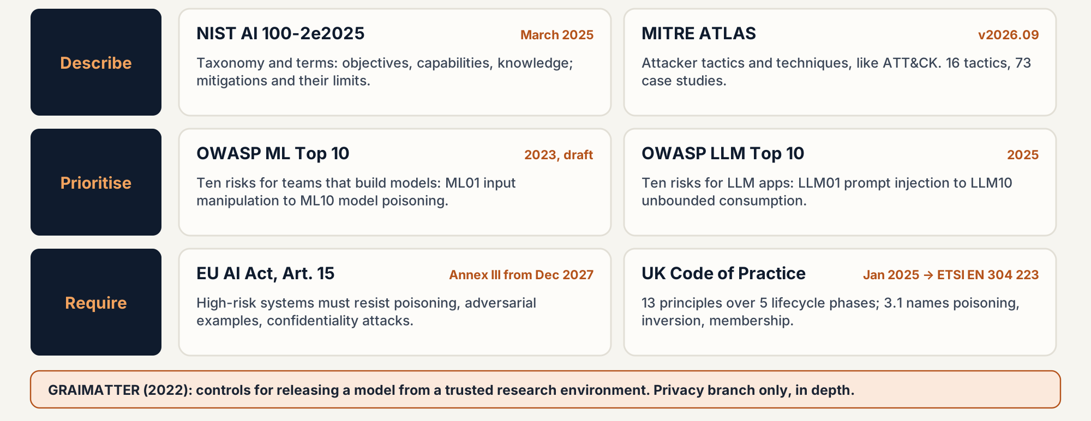
Describe, prioritise, require: five frameworks
PART 2 · FRAMEWORKS
Sources and dates on the following slides and in the references.
Notes:
The frameworks do different jobs. NIST and ATLAS describe: NIST gives the taxonomy and vocabulary, ATLAS the attacker's tactics, techniques and real cases. OWASP prioritises: two short lists for people building models and LLM applications. The EU AI Act and the UK Code of Practice require: the Act makes robustness and cybersecurity a legal duty for high-risk systems, and the UK code sets baseline controls that ETSI published as a European standard in January 2026. The UK NCSC and US CISA guidelines for secure AI system development, from November 2023, are the predecessor of that code. GRAIMATTER is a domain framework: it goes deep on one branch, privacy, for one setting.

Slide 16
OWASP: two top-ten lists for the people who build
PART 2 · OWASP
OWASP ML Security Top 10 (2023, draft) | Here
ML01 Input manipulation | demo 3
ML02 Data poisoning | demo 3
ML03 Model inversion | demos 1-2
ML04 Membership inference | demos 1-2
ML05 Model theft | demo 3
ML06 AI supply chain | –
ML07 Transfer learning attack | –
ML08 Model skewing | –
ML09 Output integrity | –
ML10 Model poisoning | demo 1
How to use them
As a checklist in design reviews and threat models. The ML list is still a draft from 2023; the LLM list was refreshed for 2025 and covers agents and RAG.
Mapping to this repository
ML03 and ML04 are what GRAIMATTER tests before release. ML10 is demo 1's check for edits after fit(). ML01, ML02 and ML05 are demo 3. The LLM list is on the generative-AI slide.
owasp.org/www-project-machine-learning-security-top-10 · genai.owasp.org/llm-top-10
Notes:
OWASP's machine-learning list is short and practical. It overlaps NIST's privacy branch heavily: model inversion and membership inference are two of the ten, and model theft is a third. Model poisoning, ML10, means manipulating the model's parameters, which is what demo 1's tamper check catches. The list is marked as a draft and dates from 2023, so treat it as a checklist rather than a standard. The LLM list from 2025 is more current and is the one most teams building chat or agent products use.

Slide 17
EU AI Act, Art. 15: resisting attacks is a legal duty
PART 2 · EU AI ACT · ARTICLE 15
15(1) Accuracy, robustness, cybersecurity
When
An appropriate level of each, and consistent performance throughout the lifecycle.
Regulation (EU) 2024/1689. The Digital Omnibus, Regulation (EU) 2026/1744, in force 27 July 2026, moves high-risk duties to 2 Dec 2027 (Annex III) and 2 Aug 2028 (regulated products).
15(4) Robustness
As resilient as possible to errors, faults and inconsistencies; mitigate feedback loops in systems that keep learning.
15(5) Cybersecurity, AI-specific
And the GDPR
Resist unauthorised attempts to alter use, outputs or performance. Measures to prevent, detect, respond to, resolve and control: data poisoning, model poisoning, adversarial examples or model evasion, confidentiality attacks, model flaws.
EDPB Opinion 28/2024: a model trained on personal data is not anonymous by default. That is GRAIMATTER's starting point.
Regulation (EU) 2024/1689, Art. 15; Regulation (EU) 2026/1744; EDPB Opinion 28/2024 (Dec 2024). Not legal advice.
Notes:
Article 15 is the AI Act's robustness and cybersecurity article for high-risk systems. Paragraph 5 is the one that reads like the NIST taxonomy: it names data poisoning, model poisoning, adversarial examples or model evasion, confidentiality attacks and model flaws. It says what to resist, not how; paragraph 2 asks the Commission to encourage benchmarks and measurement methods. Timing changed this year: the Digital Omnibus on AI entered into force on 27 July 2026 and moves the high-risk obligations to December 2027 for Annex III systems and August 2028 for AI in regulated products such as medical devices. Separately, the European Data Protection Board said in December 2024 that a model trained on personal data cannot be assumed anonymous; showing that it is means testing it against extraction and inference attacks, which is the GRAIMATTER approach. This is a summary, not legal advice.

Slide 18
UK: a code of practice that became a European standard
PART 2 · UK · CODE OF PRACTICE · ETSI EN 304 223
Design
1 Awareness · 2 Secure by design · 3 Threats and risks · 4 Human responsibility
3.1
Threat models cover data poisoning, model inversion and membership inference.
Development
5 Assets · 6 Infrastructure · 7 Supply chain · 8 Document data, models, prompts · 9 Testing and evaluation
6.2
Limit API access rates to hinder reverse engineering and rapid poisoning.
Deployment
10 Communication with end-users
8.1.2
Publish cryptographic hashes of shared model components.
Maintenance
11 Updates and patches · 12 Monitor behaviour
9.4
Outputs must not let users reverse engineer the model or its training data.
End of life
13 Data and model disposal
DSIT, 31 Jan 2025 → ETSI TS 104 223 → ETSI EN 304 223 (Jan 2026). Before it: NCSC and CISA guidelines, Nov 2023.
gov.uk Code of Practice for the Cyber Security of AI (31 Jan 2025); ETSI EN 304 223; NCSC/CISA (27 Nov 2023).
Notes:
The UK published its voluntary Code of Practice for the Cyber Security of AI in January 2025: 13 principles over five lifecycle phases, for developers, system operators and data custodians. It was taken to ETSI, which published it as EN 304 223 in January 2026, so it is now a European standard. Four provisions map directly to Part 1: threat modelling must cover poisoning, model inversion and membership inference; API access should be rate-limited against reverse engineering; shared model components should carry hashes; and outputs should not allow reverse engineering of the model or its training data. The last one is GRAIMATTER's whole subject. The code builds on the NCSC and CISA guidelines of November 2023, endorsed by agencies from 18 countries. The UK AI Security Institute also co-authored the NIST report.

Slide 19
One attack, five names: a crosswalk
PART 2 · CROSSWALK
Attack | NIST AI 100-2 | OWASP | MITRE ATLAS | EU AI Act 15(5) | UK Code | Here
Evasion | NISTAML.022, .025 | ML01 | AML.T0015 | adversarial examples | 3.1, 9 | demo 3
Data poisoning, backdoor | NISTAML.013, .023 | ML02, LLM04 | AML.T0020 | data poisoning | 6.2, 8.2 | demo 3
Model poisoning, supply chain | NISTAML.026, .051 | ML06, ML10, LLM03 | AML.T0010, T0018 | model poisoning | 7, 8.1.2 | demo 4
Membership inference | NISTAML.033 | ML04 | AML.T0024.000 | confidentiality attacks | 3.1, 9.4 | demos 1-2
Attribute inference, inversion | §2.4.1, .032 | ML03 | AML.T0024.001 | confidentiality attacks | 3.1, 9.4 | demos 1-2
Model extraction | NISTAML.031 | ML05 | AML.T0024.002 | confidentiality attacks | 6.2, 9.4 | demo 3
Prompt injection | NISTAML.015, .018 | LLM01 | AML.T0051 | not named | 3.1, 6 | –
Mapping built for this deck from the documents above. UK Code column: principle or provision numbers.
Notes:
Each framework names the same attacks differently. This table lets a test report or a risk register use all five at once: a membership-inference test is NISTAML.033, OWASP ML04, ATLAS AML.T0024.000, a confidentiality attack under Article 15(5), and covered by UK provisions 3.1 and 9.4. The mapping is ours, built from the documents; the frameworks do not cross-reference each other this precisely. The last column says which demo shows it.

Slide 20
GRAIMATTER: models leaving a trusted research environment
PART 3 · A HIGH-TRUST CASE
Health records stay inside a trusted research environment (TRE); researchers train models there. The model file is what leaves, so whoever gets it has white-box access, and the researcher may be the risk. The green paper answers one question: when is a trained model safe to release?
White-box attacker
Insider risk: RT1, RT2
Privacy branch, in depth
GRAIMATTER green paper, DARE UK, September 2022. In NIST terms: NISTAML.03 plus model control and query access.
Notes:
Now the high-trust case. A TRE lets approved researchers analyse sensitive data without taking it away, and checks every output before release. For tables the rules are mature. A trained model is a new kind of output. Once released it can be copied anywhere, so the TRE must assume a white-box attacker. The researcher is inside the trust boundary and could save too much in the file by accident or hide data in it on purpose. In the language of Part 1, GRAIMATTER covers the privacy objective, plus model control (tampering) and query access (query limits). It does not deal with evasion or poisoning, and it predates the generative-AI wave.

Slide 21
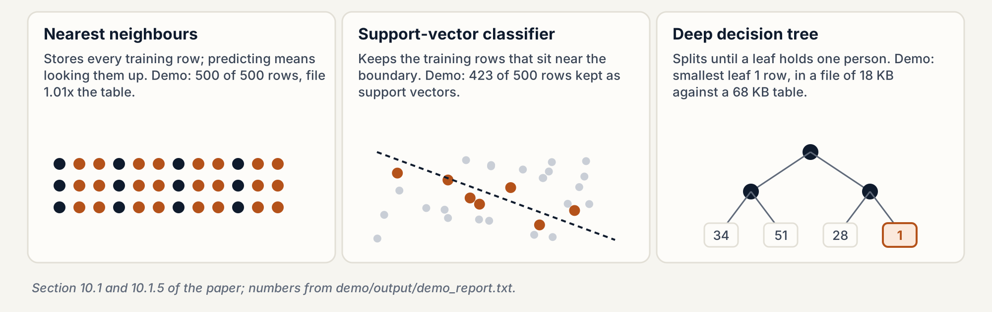
The export is the model, not a table of patients
PART 3 · THE PROBLEM
Paper §10.1 and §10.1.5 (pp. 35, 39-40). Demo numbers: demo/output/demo_report.txt, sections 4 and 6.
Notes:
TREs know how to check a table: no cell should describe fewer than k people. A trained model is different. It is rarely readable by a person, and some model types carry rows inside them. A nearest-neighbour model stores every training row. A support-vector classifier keeps the rows near its decision boundary. A deep decision tree can keep splitting until a leaf describes one person. The file size does not warn you: the demo's deep tree is 18 KB against a 68 KB training table and still has a leaf of one row. The paper also warns that a malicious researcher could hide data inside the many numbers of a model, like steganography.

Slide 22
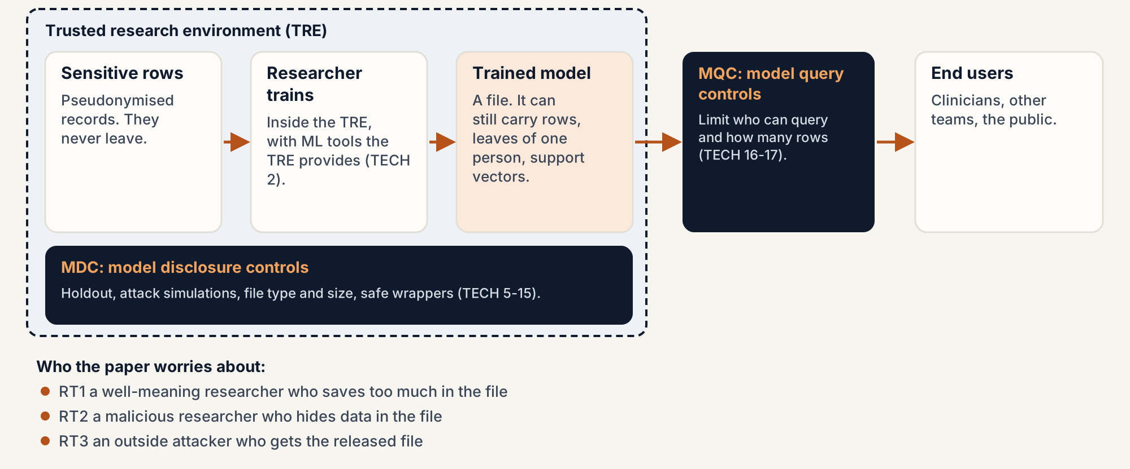
Check the file before it leaves, then limit its queries
PART 3 · TECH 4 · TWO FAMILIES OF CONTROL
TECH 4 (p. 42). Risk types RT1-RT3 from the executive summary (p. 23).
Notes:
TECH 4 splits controls into two families. Model disclosure controls, MDCs, act on the file before export: a holdout set, attack simulations, file type and size checks, safe wrappers, and extra controls for models that memorise. Model query controls, MQCs, act after release: the model stays on a server and the TRE limits who can query it and how much. The paper names three risk types. RT1 is a well-meaning researcher who saves too much in the file. RT2 is a malicious researcher who hides data on purpose. RT3 is an outside attacker who gets hold of the released model.

Slide 23
Five sets of recommendations; the demos cover TECH
PART 3 · THE PAPER
TECH 1-17
ELA 1-11
C 1-5
Technical. MDCs (TECH 5-15): holdout, attack checks, data dictionary, safe wrappers, extra care for memorising models, DP, ensembles, federated learning, synthetic data. MQCs (TECH 16-17).
Ethics and legal. Data protection may apply to the model; registers list models; EULA and declaration clauses; a risk-based approval agreed with the data controller (ELA 8).
Costing. Charge for the extra checks, fund tools, budget for query-limited hosting, consider outsourcing the most technical work.
TR 1-4
PPIE 1-2
Appendices used here: A (experiments), C (data dictionary), D (constraints file), E (case studies), F (metrics), G (attack steps).
Training. Courses for TRE staff, researchers and ethics committees on ML disclosure risk.
Public involvement. Public representatives in governance; model use visible on data use registers.
Recommendation lists: §10.2 (pp. 41-53), §11.2 (pp. 54-63), §12.2 (p. 64), §13.2 (pp. 65-66), §14.2 (p. 67).
Notes:
The paper groups its recommendations in five sets. The technical set is the one our demos illustrate. Ethics and legal: the trained model may itself be personal data, data use registers should list models and their controls, and ELA 8 says approval can follow a risk-based approach agreed with the data controller. That is why the thresholds in our first demo are a local policy, not paper thresholds. Costing, training and public involvement are short sections: checking models costs staff time, people need training, and the public should be able to see how data is used. For clause text, read the PDF.

Slide 24
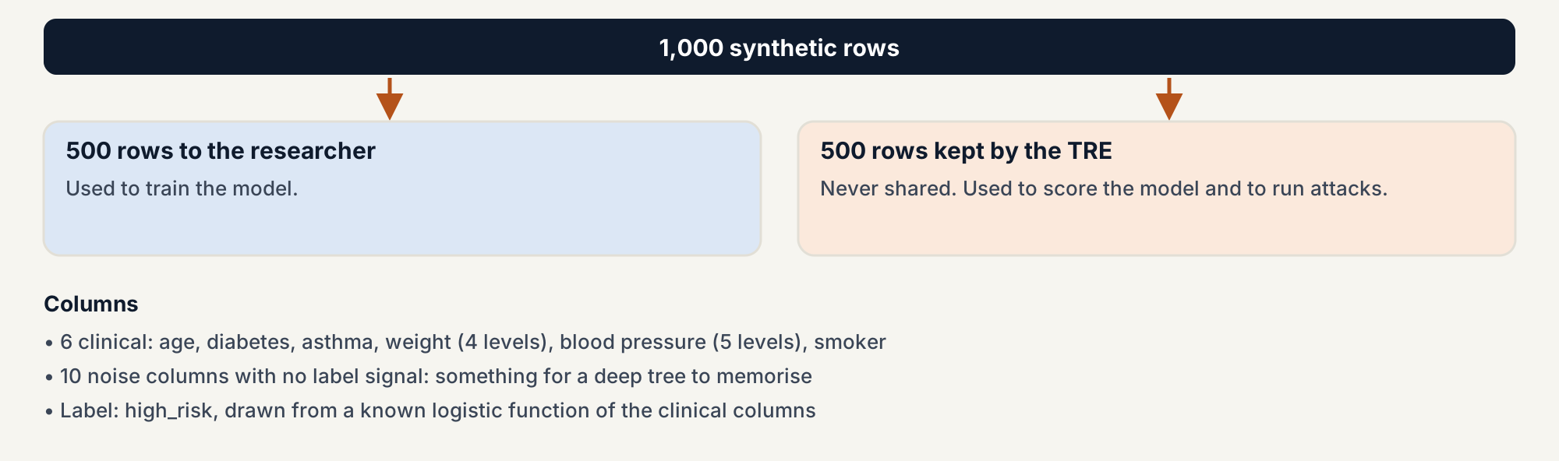
Half the rows never reach the researcher
PART 3 · TECH 6 · TECH 8 · THE COHORT
TECH 8: the researcher's inputs are described in demo/output/data_dictionary.json, following the Appendix C template.
TECH 6 (p. 43), TECH 8 (p. 46), Appendix C (p. 83). Cohort: demo/graimatter_demo/cohort.py, seed 7.
Notes:
Both demos use the same synthetic cohort: 1,000 rows drawn with seed 7, split 500 for the researcher and 500 kept by the TRE. That is TECH 6: the TRE holds back data the team never trains on, and uses it to check accuracy and to run attacks. Training accuracy is the score on rows the model has seen; set-aside accuracy is the score on the 500 rows the researcher never received. A large gap means the model has fit this sample, noise included. The label is drawn from a known logistic function of six clinical columns. Ten noise columns carry no signal at all, so an unconstrained tree has something to memorise.

Slide 25
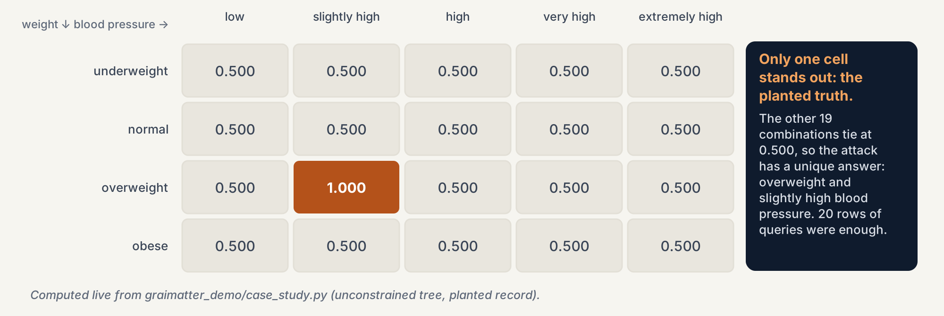
One planted person: 20 queries recover two hidden fields
PART 3 · APPENDIX E · ATTRIBUTE INFERENCE
Appendix E §20.1 (pp. 86-87). Demo: demo/output/demo_report.txt, section 2.
Notes:
This is the paper's first case study, rebuilt on synthetic data. An attacker knows four public facts about someone: age 62, diabetic, asthmatic, smoker. They do not know weight or blood pressure. Weight has four levels and blood pressure five, so there are 20 combinations. The attacker sends all 20 to the model and looks at the confidence. Models are usually more confident on inputs they were trained on. Here one cell is at 1.000 and the other 19 tie at 0.500, so the unique best guess is the hidden truth: overweight and slightly high. Attribute inference means filling in hidden fields of a person by querying the model.

Slide 26
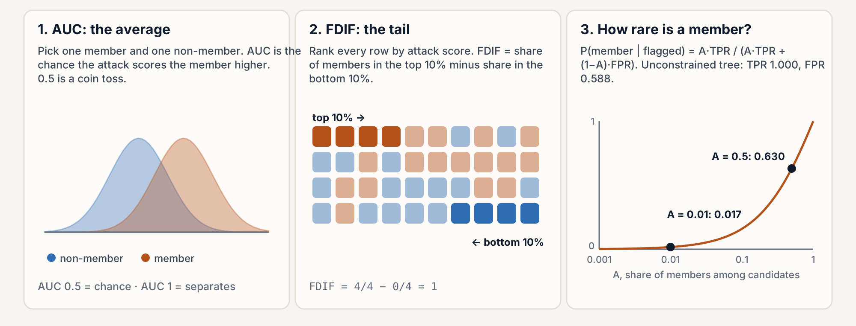
Chance, the tail, and how rare a member is
PART 3 · APPENDIX F · READING ATTACK METRICS
Appendix F (pp. 92-95). Posterior formula: Appendix F §21.3; values from demo_report.txt section 4.
Notes:
Membership inference asks whether a row was in the training set. The attack gives each row a score. AUC is the chance that a random member scores higher than a random non-member: 0.5 is a coin toss. Advantage is the absolute gap between the true-positive and false-positive rates. TPR at 10% FPR asks how many real members the attack catches when it may raise a false alarm on only about 10% of non-members. FDIF looks at the extremes: share of members in the top 10% of scores minus the share in the bottom 10%, with a permutation p-value. A model can look like chance on average and still be exposed in the tail. Finally, the membership posterior: if the attack says 'member', the chance that is true depends on how rare members are. For the unconstrained tree it is 0.630 when half the candidates are members and 0.017 at 1 in 100.

Slide 27
Perfect training accuracy and a leaf of one person: refused
PART 3 · DEMO 1 · UNCONSTRAINED TREE
Check | Seeded result | Demo limit | Fires?
Training vs set-aside accuracy | 1.000 vs 0.590 (gap 0.410) | gap 0.15 | yes
Smallest leaf | 1 training row | – | –
File size ÷ training table | 18,150 / 68,000 bytes = 0.267 | 0.75 | no
Worst-case membership AUC | 0.708 | 0.62 | yes
Advantage (TPR 1.000, FPR 0.588) | 0.412 | 0.20 | yes
TPR at 10% FPR | 0.156 | 0.35 | no
FDIF | 0.620, p = 0.003 | 0.20, p ≤ 0.05 | yes
Weight attribute inference | abstained (ratio 1.000) | 1.35 | no
Decision
Do not release. Four demo rules fire.
Why the attribute attack abstained
The tree isolated rows with noise columns, so changing weight never left the leaf.
demo/output/demo_report.txt, section 4. Limits are a demo policy (disclosure.py), not paper thresholds (ELA 8).
Notes:
The researcher would report 100% accuracy, but on the TRE's set-aside rows it is 59%. The gap of 0.41 is overfitting, and the smallest leaf holds one training row. The worst-case membership attack of Appendix G reaches AUC 0.708 and advantage 0.412, and FDIF is 0.620 with p = 0.003. Note what does not fire: the file is only 0.27 of the training table, and TPR at 10% FPR is 0.156. Size alone would have let this model through. The attribute attack on weight abstains, because this tree splits on the noise columns. Section 2 is the case where the model does split on the hidden fields. Remember the limits are a demo policy.

Slide 28
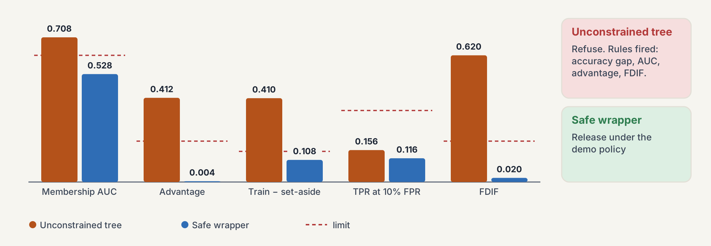
Leaf 20, depth 4: AUC 0.528, released under a demo policy
PART 3 · DEMO 1 · SAFE WRAPPER (TECH 9-10)
demo/output/demo_report.txt, section 5. The policy is local to this demo; ELA 8 leaves the risk appetite to the data controller.
Notes:
The same data goes through the hand-written safe wrapper. It reads demo/constraints.json and moves min_samples_leaf from 1 to 20 and max_depth from unlimited to 4. Appendix D shows the constraints-file format with an example minimum leaf of 5; the demo is stricter so the contrast shows on a few hundred rows. Training accuracy drops to 0.692 and set-aside accuracy barely moves, 0.584: the deep tree's extra accuracy was memorisation. The worst-case attack falls to AUC 0.528, advantage 0.004, FDIF 0.020 with p = 0.445. No demo rule fires, so the script releases it. Say clearly that the policy is ours, not the paper's.

Slide 29
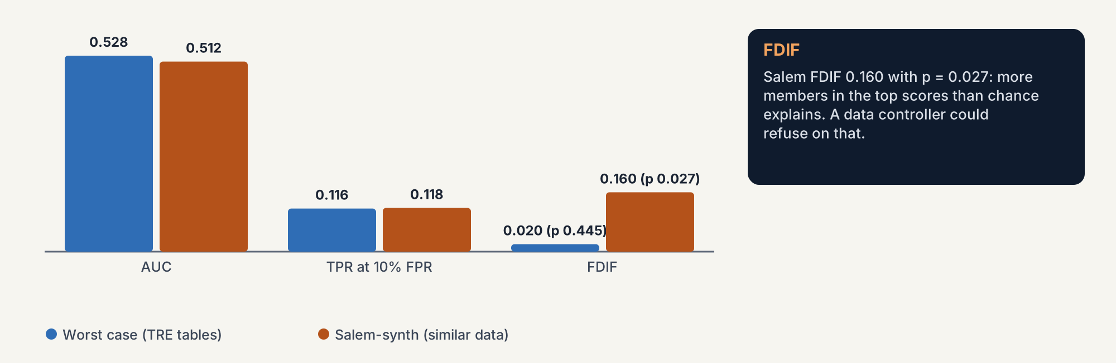
The quiet failure: AUC near 0.5, but FDIF 0.160
PART 3 · APPENDIX F · THE TAIL
demo/output/demo_report.txt, section 5 (Salem-synth). Appendix A Table 2 describes the Salem scenarios.
Notes:
On the same wrapped tree we also run Salem-synth, where the attacker trains a shadow model on similar data rather than on the TRE's own tables. Its AUC is 0.512, close to chance. But its FDIF is 0.160 with p = 0.027: the top tenth of its scores holds clearly more members than the bottom tenth. This is exactly the Appendix F warning: an average metric can hide a tail. The demo's export rule follows the worst-case attack, whose FDIF is 0.020, so it still releases. A data controller who cares about the tail could refuse.

Slide 30
Nearest neighbours and SVC store rows: refuse them
PART 3 · TECH 11 · INSTANCE-BASED MODELS
1-nearest neighbour
RBF support-vector classifier
Safe wrappers
Stores all 500 training rows. File 68,677 bytes, ratio 1.010 of the training table. Refused.
Both wrapper classes refuse to fit: constraints.json marks KNeighborsClassifier and SVC as not permitted.
Stores 423 support vectors out of 500 rows. File ratio 0.94. Refused.
The paper's alternatives (TECH 11)
In the paper
Train on aggregated data, use a differentially private algorithm, or keep the model inside a query-limited service. This repository does not train a private SVM.
Appendix E §20.4: an SVM found to hold 441 exact patient rows out of 798.
TECH 11 (p. 49), §10.1.5 (pp. 39-40), Appendix E §20.4 (pp. 91-92). Demo: demo_report.txt, section 6.
Notes:
Instance-based models need the training rows to work. A nearest-neighbour model finds the closest stored rows; a kernel SVC compares new inputs with its support vectors. The rows can be read straight out of the file, so the demo refuses both, whatever the attack numbers say. The paper's options are training on aggregated data, using a differentially private variant, or not releasing the file at all and offering a query-limited service instead. Its Appendix E case study describes a TRE that found 441 copies of patient records out of 798 inside an SVM.

Slide 31
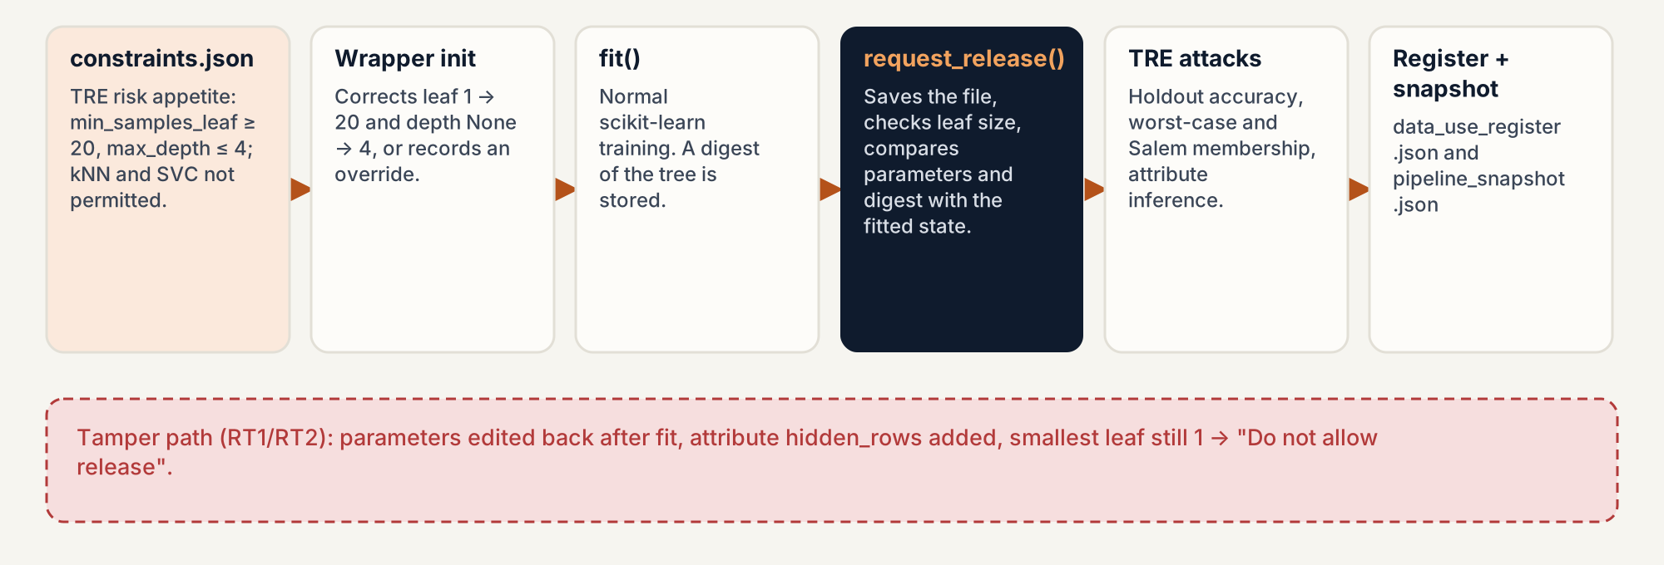
Editing the model after fit() is caught
PART 3 · RT1 · RT2 · TECH 3
§10.1.2 (p. 37), TECH 3 (p. 42), TECH 10 (p. 48). Demo: demo_report.txt sections 7 and 9.
Notes:
The wrapper records the state of the model when it was fitted. In section 7 the researcher overrides the constraints and trains a deep tree, then edits the parameters back toward the allowed values and adds a hidden attribute. request_release() compares the fitted state with the current one and says not to release: max_depth and min_samples_leaf changed after fitting, the smallest leaf still holds one row, and an attribute called hidden_rows was added. That covers both the careless case (RT1) and the deliberate one (RT2). A file with a .txt extension is refused because it is not .joblib or .pkl. For the approved model the demo writes a register entry and a pipeline snapshot, which is TECH 3.

Slide 32
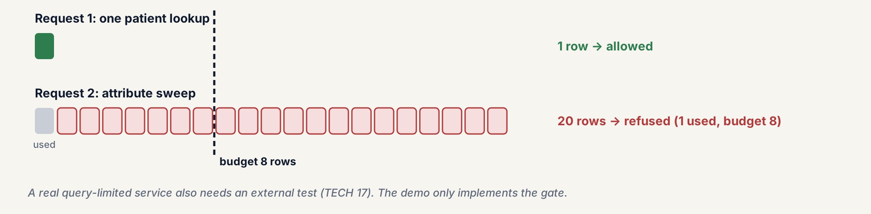
Count rows, not calls: one patient allowed, 20 blocked
PART 3 · TECH 16 · MODEL QUERY CONTROLS
TECH 16-17 (pp. 52-53), §10.1.7 (pp. 40-41). Demo: demo_report.txt, section 8.
Notes:
If the model stays on a server, the TRE can limit queries. The demo gate gives one user a budget of 8 rows. A clinician's single patient lookup uses 1 row and is allowed. Then the same user sends the 20-combination sweep from the attribute case study in one request. The gate refuses it: 20 rows requested, 1 already used, budget 8. The unit matters. If the budget counted HTTP calls, one call carrying 20 rows would pass. TECH 17 says a real query-limited service should be tested by an external party; the demo implements only the control logic. Demo 3 shows the other side: a row budget slows model extraction but 200 rows already copy a simple model.

Slide 33
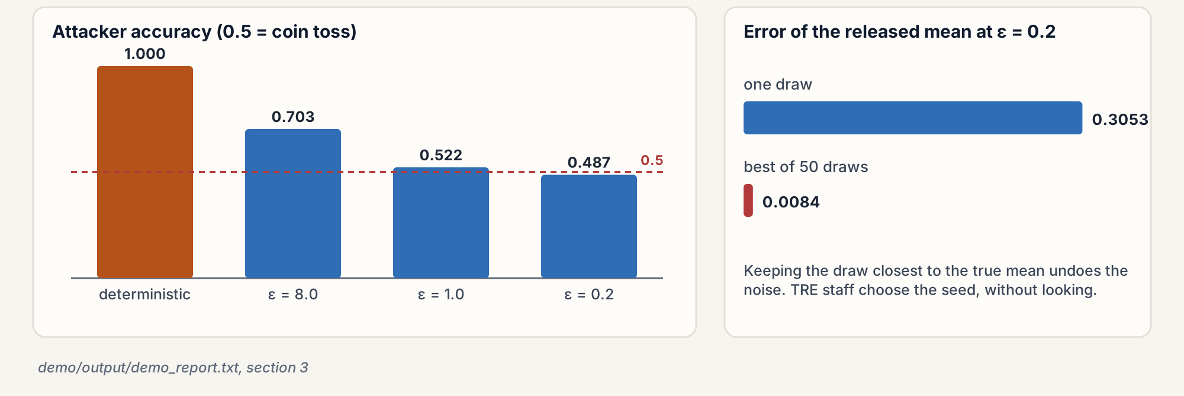
Noise protects a mean; the best of 50 draws undoes it
PART 3 · §10.1.3 · TECH 12 · DIFFERENTIAL PRIVACY
§10.1.3 (pp. 37-39), TECH 12 (p. 50). Demo: demo_report.txt, section 3. No private model is trained here.
Notes:
Differential privacy is a property of the release mechanism, not of the data. The paper's thought experiment: the attacker knows everything except whether one person was included. A deterministic mean gives the answer away, accuracy 1.000. Adding Laplace noise with smaller epsilon pushes the attacker back toward a coin toss: 0.703 at epsilon 8, 0.522 at 1, 0.487 at 0.2. TECH 12 adds a practical warning. At epsilon 0.2 one noisy mean misses the truth by 0.3053, but if someone draws 50 times and keeps the closest, the miss is 0.0084, which cancels the protection. So TRE staff should pick the seed without looking at accuracy. This repository only sketches DP on a mean; it does not train a private model.

Slide 34
sacroml: leaf 5, 'proceed to next step', still flagged
PART 3 · DEMO 2 · SACROML 2.0.1
sacroml check | Unconstrained tree | Wrapped tree (leaf 5)
Training / set-aside accuracy | 1.000 / 0.590 | 0.868 / 0.566
Worst-case membership AUC (3 runs) | mean 0.500, 0 above null band | mean 0.494, 0 above null band
Smallest leaf vs threshold 10 | 1 → k_anonymity_risk true | 5 → k_anonymity_risk true
gen_error, unnecessary, class_disclosure, smallgroup | true | true
dof_risk | false | false
request_release() without a Target | – | "Proceed to next step of checking"
min_samples_leaf 5 → 1 after fit() | – | posthoc_check(): disclosive
demo/output/sacroml/sacroml_report.txt; per-attack report.json under demo/output/sacroml/. SACRO-ML: github.com/AI-SDC/SACRO-ML
Notes:
The second demo runs the same cohort through sacroml 2.0.1, the maintained toolkit from the AI-SDC repository named in the paper. Its safe wrapper warns that min_samples_leaf of 1 is below its recommended minimum of 5 and changes it to 5. request_release() without a Target writes a target file and says 'Proceed to next step of checking': it does not run attacks and it is not an approval. Passing a Target would also start the LiRA attack, which the upstream example runs with 100 shadow models; this demo does not run LiRA. Then the attacks. The structural attack marks a leaf as risky below 10 training rows, so both the unconstrained tree and the wrapped tree with leaf 5 are flagged. Moving from leaf 1 to leaf 5 is what the published rules do, and the package's own structural check still calls that tree risky.

Slide 35
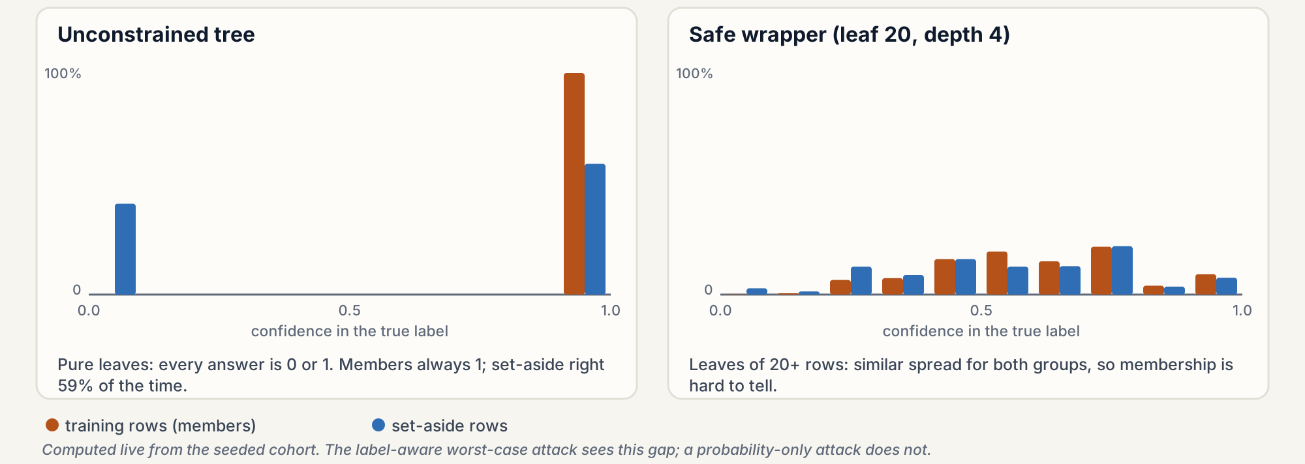
Same tree, AUC 0.708 or 0.500: two different attacks
PART 3 · WHY THE TWO MEMBERSHIP NUMBERS DIFFER
Hand-written: probabilities plus the true label, so it sees 'right on members, often wrong on set-aside'. sacroml: predicted probability only, and pure leaves are extreme for everyone.
Appendix G (p. 96). attacks.py (_attack_features) and sacroml.attacks.worst_case_attack.
Notes:
Both demos call their attack 'worst case', but they are different tests. The hand-written attack trains a second model on the predicted probabilities plus the true label, so it can use the confidence in the correct class. On the unconstrained tree every leaf is pure, so every prediction is 0 or 1. Training rows always get confidence 1 in their true label; set-aside rows get 1 when the tree is right, 59% of the time, and 0 otherwise. The label-aware attack sees that gap and reaches AUC 0.708. The sacroml attack scores rows by predicted probability only. Without the label, a pure leaf looks equally extreme for members and non-members, so its AUC is 0.500. An AUC near 0.5 from the package does not mean the tree failed to memorise; the structural attack is what catches it there.

Slide 36
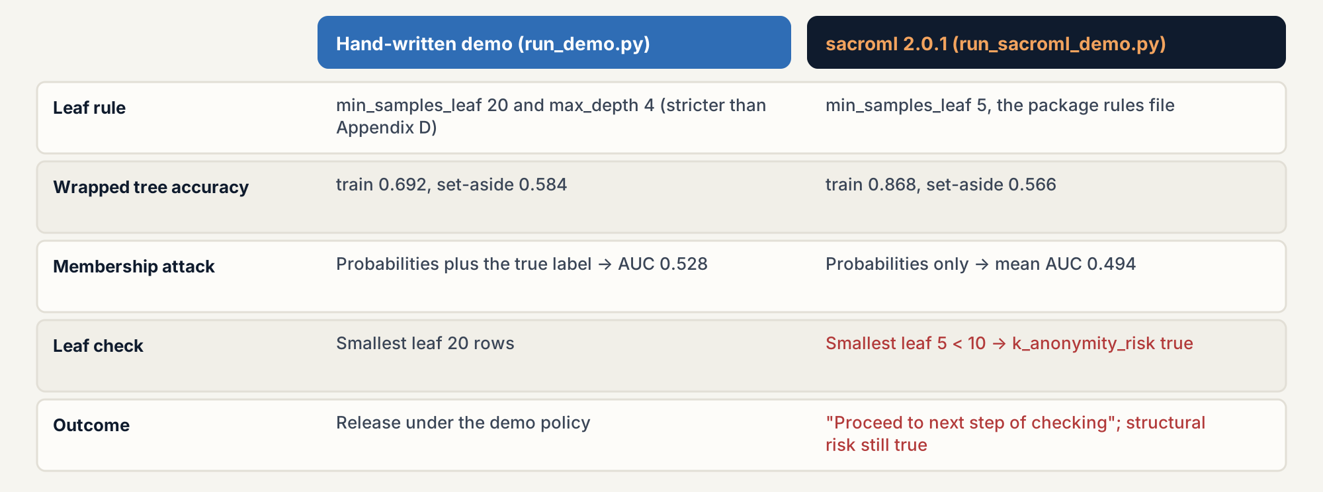
Leaf 20 vs 5, label-aware vs probability-only
PART 3 · TWO DEMOS COMPARED
demo_report.txt section 10 and sacroml_report.txt. Appendix D (p. 83) example leaf size: 5.
Notes:
Three differences matter. First, the leaf rule: the hand-written wrapper forces leaf 20 and depth 4, the package rules file forces leaf 5. Second, the membership attack: probabilities plus label versus probabilities only. Third, the outcome: the hand-written script releases the stricter tree because its own attack falls inside the demo limits; the package never approves anything here, it says to continue checking, and its structural attack still flags the leaf-5 tree. Neither is an approval process. A real TRE would combine these checks with a policy agreed with its data controller.

Slide 37
What GRAIMATTER teaches any high-trust deployment
PART 3 · WHAT CARRIES OVER
Assume the worst-case attacker
Score on rows the builder never saw
Check structure, not only scores
Test white box, with the data in hand (Appendix G). NIST §2.1.4: that is how you test against worst-case adversaries.
A holdout kept by the gatekeeper (TECH 6); independent testers (UK Code 9.2.1); audit with attacks (NIST §2.4.5).
Stored rows, leaf size, file type. sacroml's structural check flags a tree its probability-only attack scores at 0.500.
Watch the tail
Freeze the artefact
Budget queries in rows
FDIF and TPR at low FPR catch exposure that AUC averages away (Appendix F; NIST §2.4.2).
Snapshot at fit(), detect later edits (TECH 3, 10); hashes and audit logs (UK Code 8.1.2, 8.3); OWASP ML10.
TECH 16 and UK Code 6.2. Demo 3: a budget slows extraction but does not stop it.
Not covered: evasion and poisoning (demo 3's backdoor leaves holdout accuracy unchanged) and generative AI. Add those tests for other settings.
Green paper TECH 3, 6, 10, 16 and Appendices F-G; NIST AI 100-2e2025; UK Code of Practice; demo/output/*.txt.
Notes:
Six habits from GRAIMATTER apply to any setting where a model touches sensitive data or high-stakes decisions. Test against the strongest attacker you can imagine, because the released file gives them everything. Keep evaluation data away from the builder and let someone else run the attacks. Look at the structure of the model, not just attack scores, because an attack can miss what a leaf count shows. Look at the tail of the score distribution, not just the average. Freeze the approved artefact and detect edits. Count queries in rows. What GRAIMATTER does not give you is protection against evasion and poisoning; demo 3 shows that its holdout check is blind to a backdoor, so other deployments need those tests too.

Slide 38
What this repository does not decide
PART 3 · LIMITS
A real risk appetite
Legal advice
Strong attacks
The demo 1 cut-offs are local. ELA 8: thresholds are agreed with the data controller.
The EU AI Act, GDPR and UK code are summarised, not interpreted. Clause text needs a legal review.
No LiRA (in sacroml, not run). Demo 3 uses simple greedy and query attacks, not optimised ones.
Private training
Generative AI
Real data, approval
No differentially private model. DP is sketched on a released mean only.
No LLM demo here. safety-trust-engine tests prompt injection and agents with garak, AgentDojo, PyRIT.
One synthetic cohort; no demo approves a model. sacroml says 'proceed to next step'.
docs/brief-for-presentation-and-guide.md, 'Claims to keep accurate'.
Notes:
Be explicit about the edges. The cut-offs in disclosure.py exist so demo 1 can say yes or no; the paper publishes no universal thresholds. The legal slides summarise documents and are not advice. The attacks are teaching versions: no LiRA, and demo 3's evasion is a greedy search over a few fields, not an optimised attack. There is no private model and no generative-AI demo. The cohort is synthetic, and neither GRAIMATTER demo approves a model.

Slide 39
One gate, four lenses: GRAIMATTER passes, Article 15(5) fails
RELEASE GATE · DEMO/RUN_GATE.PY · CI
Pack | Controls | Pass | Fail | Not evidenced
EU AI Act 15(5), UK Code | 8 | 2 | 6 | 0
NIST AI 100-2 | 6 | 3 | 3 | 0
GRAIMATTER TECH | 6 | 5 | 0 | 1 (demo 2)
NIST AI RMF, SR 26-02 | 8 | 5 | 3 | 0
Never a silent green
A control whose demo did not run is not_evidenced, not pass. CI does not install sacroml, so it declares demo 2 out of scope with --accept-missing 2 and the report says so.
Breached: evasion 78.7% (tolerance 10%), a copy agreeing 86.9% after one 200-row budget (80%), a backdoor lifting trigger success by 71.7 points (tolerance 10).
Within: membership, attribute, holdout gap, stored rows, release checks, query budget, and the supply chain: no tampered file of demo 4 gets past the pin and the scan or floor.
Read with SR 26-02
A risk classifier is a model in the plain sense of model risk guidance. The TRE holdout (TECH 6) is the independent validation; the gate in CI is the ongoing monitoring.
Tolerances are a demo risk appetite (ELA 8), not official cut-offs. Pattern from safety-trust-engine. demo/output/gate/.
Notes:
The gate reruns demos 1, 3 and 4, reads the numbers they already print, and judges each regulatory control as pass, fail or not evidenced. The GRAIMATTER controls pass on the wrapped tree. The robustness controls fail on the forest of demo 3: privacy checks alone do not make a model resilient in the sense of Article 15(5), which also names poisoning and evasion. Its model-poisoning clause passes, because demo 4's pin, scan and floors refuse every tampered file. A control whose demo did not run is reported as not evidenced, never as pass; CI declares demo 2 out of scope explicitly because it does not install sacroml. The US pack reads the same evidence through NIST AI RMF MEASURE 2.6, 2.7 and 2.10 and federal model risk guidance, where a classifier fits directly. The tolerances are a risk appetite set for the workshop, and the mapping is this repository's own.

Slide 40
Four demos and a gate, reports under demo/output
RUN IT YOURSELF
uv venv --python 3.11
uv pip install -r demo/requirements.txt
uv run python demo/run_aml_demo.py
uv run python demo/run_supply_chain_demo.py
uv run python demo/run_demo.py
uv run python demo/run_sacroml_demo.py
uv run python demo/run_gate.py
# figures and this deck
python docs/guide/make_figures.py
python docs/guide/make_aml_figures.py
python docs/make_deck.py
Demos 3 and 4 · seconds
aml_report.txt: evasion, extraction, backdoor. supply_chain_report.txt: four tampered files.
Demo 1 · seconds
demo_report.txt, data dictionary, register entry, pipeline snapshot, release reports.
Demo 2 · a few minutes
sacroml/sacroml_report.txt; report.json and report.pdf per attack.
Setup details: README.md. Section notes: demo/README.md. Guides: docs/guide/ (English and Spanish).
Notes:
Setup is in the repository README: create a Python 3.11 environment with uv and install demo/requirements.txt, which brings numpy, scikit-learn and sacroml (and PyTorch with it). Demos 3, 4 and 1 run in seconds; demo 2 takes a few minutes. run_gate.py reruns the demos and writes the gate report to demo/output/gate; CI runs it on every pull request. The guides in docs/guide walk through every report section by section.

Slide 41
Read further
REFERENCES
NIST AI 100-2e2025. Vassilev, Oprea, Fordyce, Anderson, Davies, Hamin. Adversarial Machine Learning: A Taxonomy and Terminology of Attacks and Mitigations. March 2025. doi:10.6028/NIST.AI.100-2e2025 (in this repository).
MITRE ATLAS. atlas.mitre.org, data release 2026.09.
OWASP. Machine Learning Security Top 10 (2023, draft); Top 10 for LLM Applications 2025.
EU. Regulation (EU) 2024/1689 (AI Act), Art. 15; Regulation (EU) 2026/1744 (Digital Omnibus on AI); EDPB Opinion 28/2024 on AI models.
UK. DSIT Code of Practice for the Cyber Security of AI (Jan 2025); ETSI EN 304 223 (Jan 2026); NCSC and CISA, Guidelines for secure AI system development (Nov 2023).
GRAIMATTER green paper. Recommendations for disclosure control of trained ML models from TREs. DARE UK, September 2022 (in this repository). SACRO-ML: github.com/AI-SDC/SACRO-ML.
Notes:
Both PDFs, the NIST report and the green paper, are in the repository root. The guide, in English and Spanish, follows the same order as these slides and maps each section to its slides in Appendix A.

