Slide 1
Disclosure control for models leaving a TRE
DARE UK · GRAIMATTER GREEN PAPER · SEPTEMBER 2022
What the green paper recommends before a trained model leaves a trusted research environment, and what two demos found on synthetic data
1,000 synthetic rows
17 TECH recommendations
2 demos: hand-written + sacroml 2.0.1
Green Paper: Recommendations for disclosure control of trained ML models from TREs · GRAIMatter sprint, University of Dundee and partners
Notes:
This session explains one question: when a researcher trains a model inside a trusted research environment, how does the TRE decide whether the model file is safe to export? The source is the GRAIMATTER green paper, a 99-page output of a DARE UK sprint published in September 2022. We cover the technical recommendations and then two demos that run those checks on a synthetic cohort. Legal, ethics, costing, training and public involvement are in the paper; we touch them only briefly. Nothing in the demos is a real patient.

Slide 2
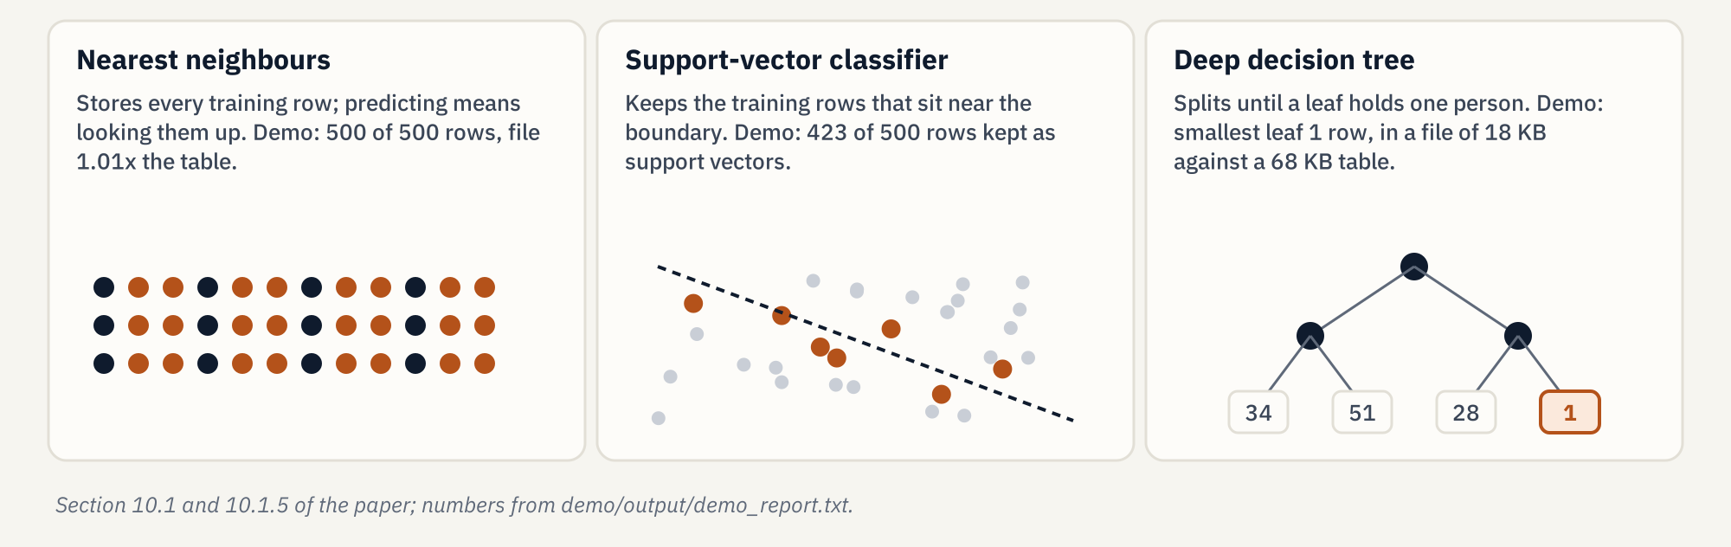
The export is the model, not a table of patients
THE PROBLEM
Paper §10.1 and §10.1.5 (pp. 35, 39-40). Demo numbers: demo/output/demo_report.txt, sections 4 and 6.
Notes:
TREs know how to check a table: no cell should describe fewer than k people. A trained model is different. It is rarely readable by a person, and some model types carry rows inside them. A nearest-neighbour model stores every training row. A support-vector classifier keeps the rows near its decision boundary. A deep decision tree can keep splitting until a leaf describes one person. The file size does not warn you: the demo's deep tree is 18 KB against a 68 KB training table and still has a leaf of one row. The paper also warns that a malicious researcher could hide data inside the many numbers of a model, like steganography.

Slide 3
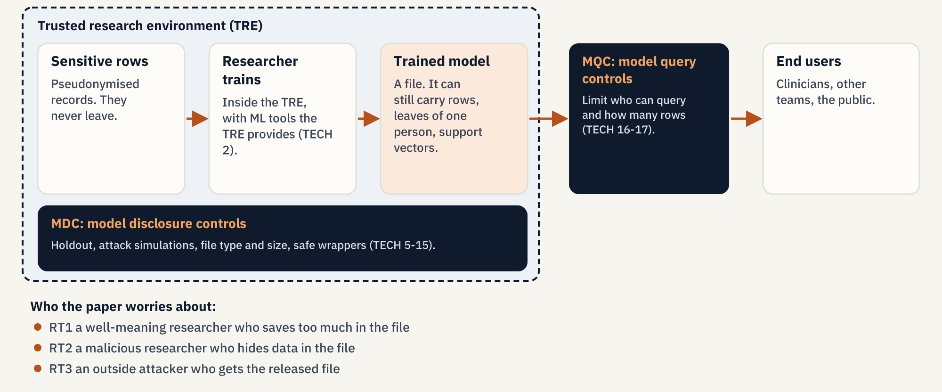
Check the file before it leaves, then limit its queries
TECH 4 · TWO FAMILIES OF CONTROL
TECH 4 (p. 42). Risk types RT1-RT3 from the executive summary (p. 23).
Notes:
TECH 4 splits controls into two families. Model disclosure controls, MDCs, act on the file before export: a holdout set, attack simulations, file type and size checks, safe wrappers, and extra controls for models that memorise. Model query controls, MQCs, act after release: the model stays on a server and the TRE limits who can query it and how much. The paper names three risk types. RT1 is a well-meaning researcher who saves too much in the file. RT2 is a malicious researcher who hides data on purpose. RT3 is an outside attacker who gets hold of the released model.

Slide 4
Five sets of recommendations; the demos cover TECH
THE PAPER
TECH 1-17
ELA 1-11
C 1-5
Technical. MDCs (TECH 5-15): holdout, attack checks, data dictionary, safe wrappers, extra care for memorising models, DP, ensembles, federated learning, synthetic data. MQCs (TECH 16-17).
Ethics and legal. Data protection may apply to the model; registers list models; EULA and declaration clauses; a risk-based approval agreed with the data controller (ELA 8).
Costing. Charge for the extra checks, fund tools, budget for query-limited hosting, consider outsourcing the most technical work.
TR 1-4
PPIE 1-2
Appendices used here: A (experiments), C (data dictionary), D (constraints file), E (case studies), F (metrics), G (attack steps).
Training. Courses for TRE staff, researchers and ethics committees on ML disclosure risk.
Public involvement. Public representatives in governance; model use visible on data use registers.
Recommendation lists: §10.2 (pp. 41-53), §11.2 (pp. 54-63), §12.2 (p. 64), §13.2 (pp. 65-66), §14.2 (p. 67).
Notes:
The paper groups its recommendations in five sets. The technical set is the one our demos illustrate. Ethics and legal: the trained model may itself be personal data, data use registers should list models and their controls, and ELA 8 says approval can follow a risk-based approach agreed with the data controller. That is why the thresholds in our first demo are a local policy, not paper thresholds. Costing, training and public involvement are short sections: checking models costs staff time, people need training, and the public should be able to see how data is used. For clause text, read the PDF.

Slide 5
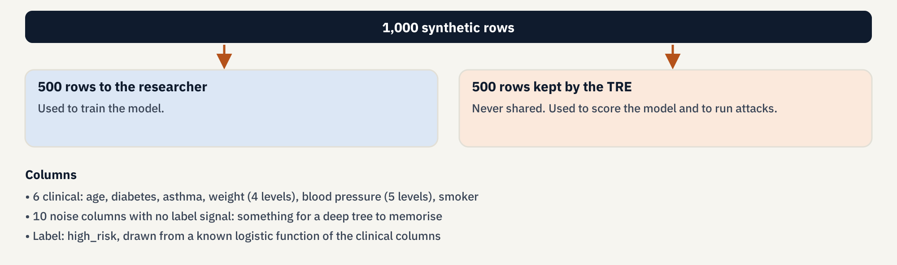
Half the rows never reach the researcher
TECH 6 · TECH 8 · THE COHORT
TECH 8: the researcher's inputs are described in demo/output/data_dictionary.json, following the Appendix C template.
TECH 6 (p. 43), TECH 8 (p. 46), Appendix C (p. 83). Cohort: demo/graimatter_demo/cohort.py, seed 7.
Notes:
Both demos use the same synthetic cohort: 1,000 rows drawn with seed 7, split 500 for the researcher and 500 kept by the TRE. That is TECH 6: the TRE holds back data the team never trains on, and uses it to check accuracy and to run attacks. Training accuracy is the score on rows the model has seen; set-aside accuracy is the score on the 500 rows the researcher never received. A large gap means the model has fit this sample, noise included. The label is drawn from a known logistic function of six clinical columns. Ten noise columns carry no signal at all, so an unconstrained tree has something to memorise.

Slide 6
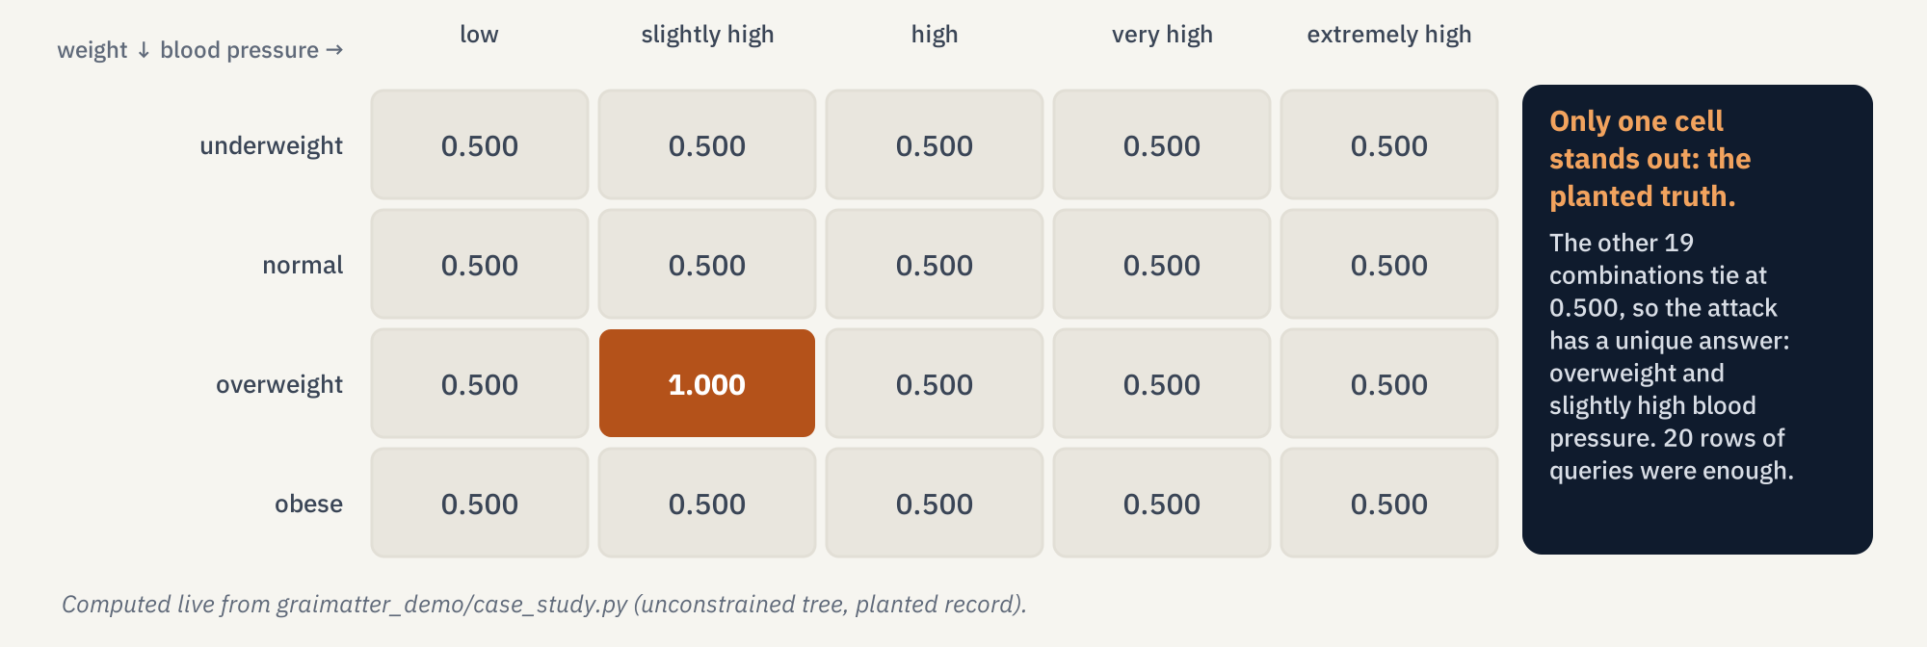
One planted person: 20 queries recover two hidden fields
APPENDIX E · ATTRIBUTE INFERENCE
Appendix E §20.1 (pp. 86-87). Demo: demo/output/demo_report.txt, section 2.
Notes:
This is the paper's first case study, rebuilt on synthetic data. An attacker knows four public facts about someone: age 62, diabetic, asthmatic, smoker. They do not know weight or blood pressure. Weight has four levels and blood pressure five, so there are 20 combinations. The attacker sends all 20 to the model and looks at the confidence. Models are usually more confident on inputs they were trained on. Here one cell is at 1.000 and the other 19 tie at 0.500, so the unique best guess is the hidden truth: overweight and slightly high. Attribute inference means filling in hidden fields of a person by querying the model.

Slide 7
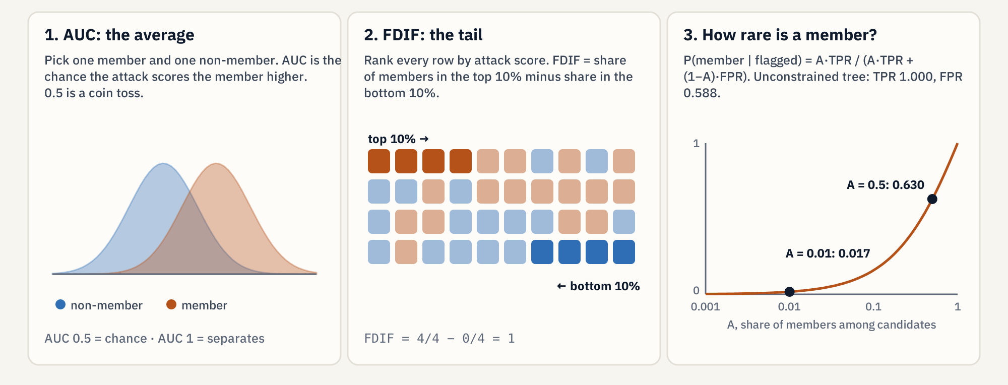
Chance, the tail, and how rare a member is
APPENDIX F · READING ATTACK METRICS
Appendix F (pp. 92-95). Posterior formula: Appendix F §21.3; values from demo_report.txt section 4.
Notes:
Membership inference asks whether a row was in the training set. The attack gives each row a score. AUC is the chance that a random member scores higher than a random non-member: 0.5 is a coin toss. Advantage is the absolute gap between the true-positive and false-positive rates. TPR at 10% FPR asks how many real members the attack catches when it may raise a false alarm on only about 10% of non-members. FDIF looks at the extremes: share of members in the top 10% of scores minus the share in the bottom 10%, with a permutation p-value. A model can look like chance on average and still be exposed in the tail. Finally, the membership posterior: if the attack says 'member', the chance that is true depends on how rare members are. For the unconstrained tree it is 0.630 when half the candidates are members and 0.017 at 1 in 100.

Slide 8
Perfect training accuracy and a leaf of one person: refused
DEMO 1 · UNCONSTRAINED TREE
Check | Seeded result | Demo limit | Fires?
Training vs set-aside accuracy | 1.000 vs 0.590 (gap 0.410) | gap 0.15 | yes
Smallest leaf | 1 training row | – | –
File size ÷ training table | 18,150 / 68,000 bytes = 0.267 | 0.75 | no
Worst-case membership AUC | 0.708 | 0.62 | yes
Advantage (TPR 1.000, FPR 0.588) | 0.412 | 0.20 | yes
TPR at 10% FPR | 0.156 | 0.35 | no
FDIF | 0.620, p = 0.003 | 0.20, p ≤ 0.05 | yes
Weight attribute inference | abstained (ratio 1.000) | 1.35 | no
Decision
Do not release. Four demo rules fire.
Why the attribute attack abstained
The tree isolated rows with noise columns, so changing weight never left the leaf.
demo/output/demo_report.txt, section 4. Limits are a demo policy (disclosure.py), not paper thresholds (ELA 8).
Notes:
The researcher would report 100% accuracy, but on the TRE's set-aside rows it is 59%. The gap of 0.41 is overfitting, and the smallest leaf holds one training row. The worst-case membership attack of Appendix G reaches AUC 0.708 and advantage 0.412, and FDIF is 0.620 with p = 0.003. Note what does not fire: the file is only 0.27 of the training table, and TPR at 10% FPR is 0.156. Size alone would have let this model through. The attribute attack on weight abstains, because this tree splits on the noise columns. Section 2 is the case where the model does split on the hidden fields. Remember the limits are a demo policy.

Slide 9
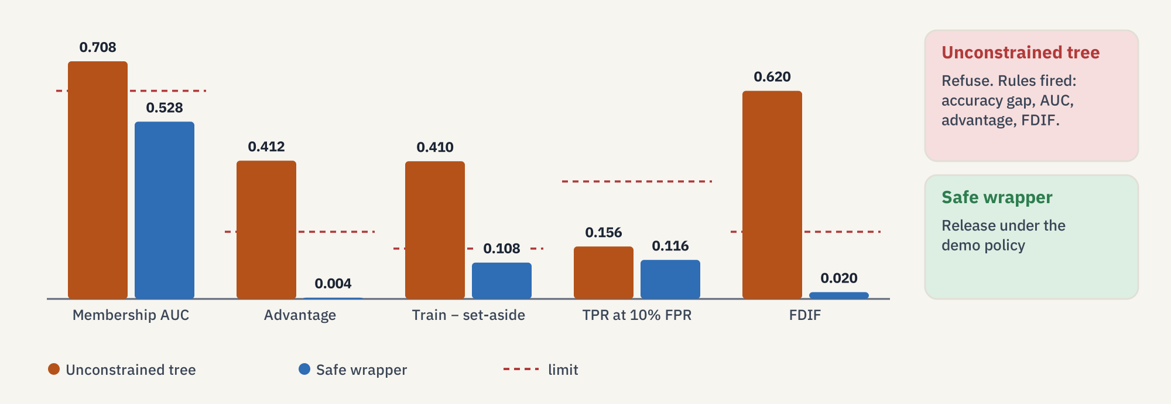
Leaf 20, depth 4: AUC 0.528, released under a demo policy
DEMO 1 · SAFE WRAPPER (TECH 9-10)
demo/output/demo_report.txt, section 5. The policy is local to this demo; ELA 8 leaves the risk appetite to the data controller.
Notes:
The same data goes through the hand-written safe wrapper. It reads demo/constraints.json and moves min_samples_leaf from 1 to 20 and max_depth from unlimited to 4. Appendix D shows the constraints-file format with an example minimum leaf of 5; the demo is stricter so the contrast shows on a few hundred rows. Training accuracy drops to 0.692 and set-aside accuracy barely moves, 0.584: the deep tree's extra accuracy was memorisation. The worst-case attack falls to AUC 0.528, advantage 0.004, FDIF 0.020 with p = 0.445. No demo rule fires, so the script releases it. Say clearly that the policy is ours, not the paper's.

Slide 10
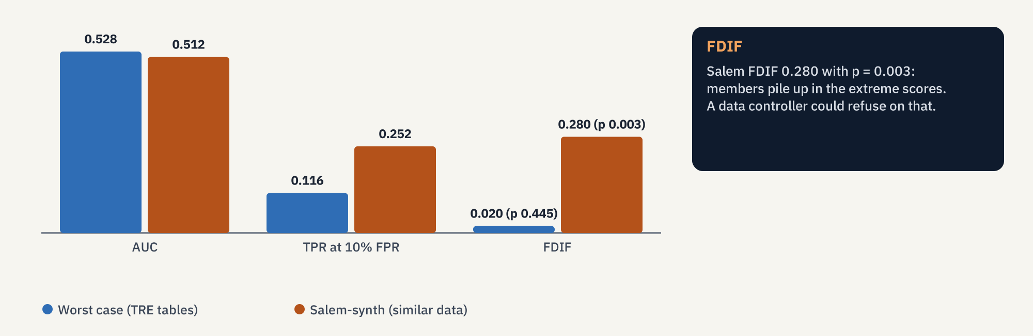
The quiet failure: AUC near 0.5, but FDIF 0.280
APPENDIX F · THE TAIL
demo/output/demo_report.txt, section 5 (Salem-synth). Appendix A Table 2 describes the Salem scenarios.
Notes:
On the same wrapped tree we also run Salem-synth, where the attacker trains a shadow model on similar data rather than on the TRE's own tables. Its AUC is 0.512, close to chance. But its FDIF is 0.280 with p = 0.003, and TPR at 10% FPR is 0.252: members pile up in the extreme scores. This is exactly the Appendix F warning: an average metric can hide a tail. The demo's export rule follows the worst-case attack, whose FDIF is 0.020, so it still releases. A data controller who cares about the tail could refuse.

Slide 11
Nearest neighbours and SVC store rows: refuse them
TECH 11 · INSTANCE-BASED MODELS
1-nearest neighbour
RBF support-vector classifier
Safe wrappers
Stores all 500 training rows. File 68,677 bytes, ratio 1.010 of the training table. Refused.
Both wrapper classes refuse to fit: constraints.json marks KNeighborsClassifier and SVC as not permitted.
Stores 423 support vectors out of 500 rows. File ratio 0.94. Refused.
The paper's alternatives (TECH 11)
In the paper
Train on aggregated data, use a differentially private algorithm, or keep the model inside a query-limited service. This repository does not train a private SVM.
Appendix E §20.4: an SVM found to hold 441 exact patient rows out of 798.
TECH 11 (p. 49), §10.1.5 (pp. 39-40), Appendix E §20.4 (pp. 91-92). Demo: demo_report.txt, section 6.
Notes:
Instance-based models need the training rows to work. A nearest-neighbour model finds the closest stored rows; a kernel SVC compares new inputs with its support vectors. The rows can be read straight out of the file, so the demo refuses both, whatever the attack numbers say. The paper's options are training on aggregated data, using a differentially private variant, or not releasing the file at all and offering a query-limited service instead. Its Appendix E case study describes a TRE that found 441 copies of patient records out of 798 inside an SVM.

Slide 12
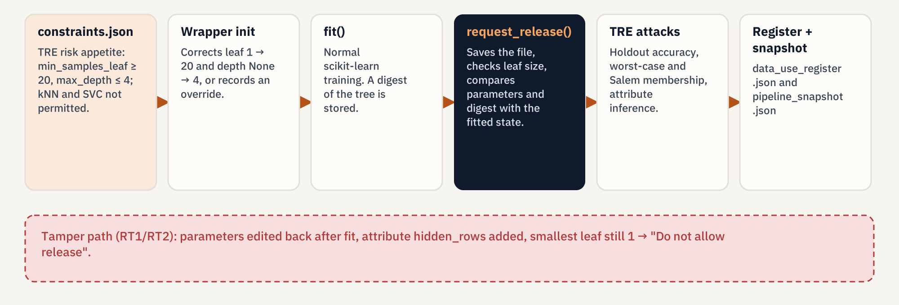
Editing the model after fit() is caught
RT1 · RT2 · TECH 3
§10.1.2 (p. 37), TECH 3 (p. 42), TECH 10 (p. 48). Demo: demo_report.txt sections 7 and 9.
Notes:
The wrapper records the state of the model when it was fitted. In section 7 the researcher overrides the constraints and trains a deep tree, then edits the parameters back toward the allowed values and adds a hidden attribute. request_release() compares the fitted state with the current one and says not to release: max_depth and min_samples_leaf changed after fitting, the smallest leaf still holds one row, and an attribute called hidden_rows was added. That covers both the careless case (RT1) and the deliberate one (RT2). A file with a .txt extension is refused because it is not .joblib or .pkl. For the approved model the demo writes a register entry and a pipeline snapshot, which is TECH 3.

Slide 13
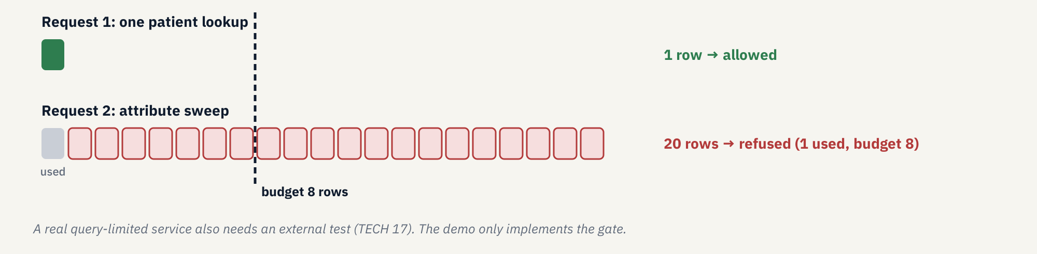
Count rows, not calls: one patient allowed, 20 blocked
TECH 16 · MODEL QUERY CONTROLS
TECH 16-17 (pp. 52-53), §10.1.7 (pp. 40-41). Demo: demo_report.txt, section 8.
Notes:
If the model stays on a server, the TRE can limit queries. The demo gate gives one user a budget of 8 rows. A clinician's single patient lookup uses 1 row and is allowed. Then the same user sends the 20-combination sweep from the attribute case study in one request. The gate refuses it: 20 rows requested, 1 already used, budget 8. The unit matters. If the budget counted HTTP calls, one call carrying 20 rows would pass. TECH 17 says a real query-limited service should be tested by an external party; the demo implements only the control logic.

Slide 14
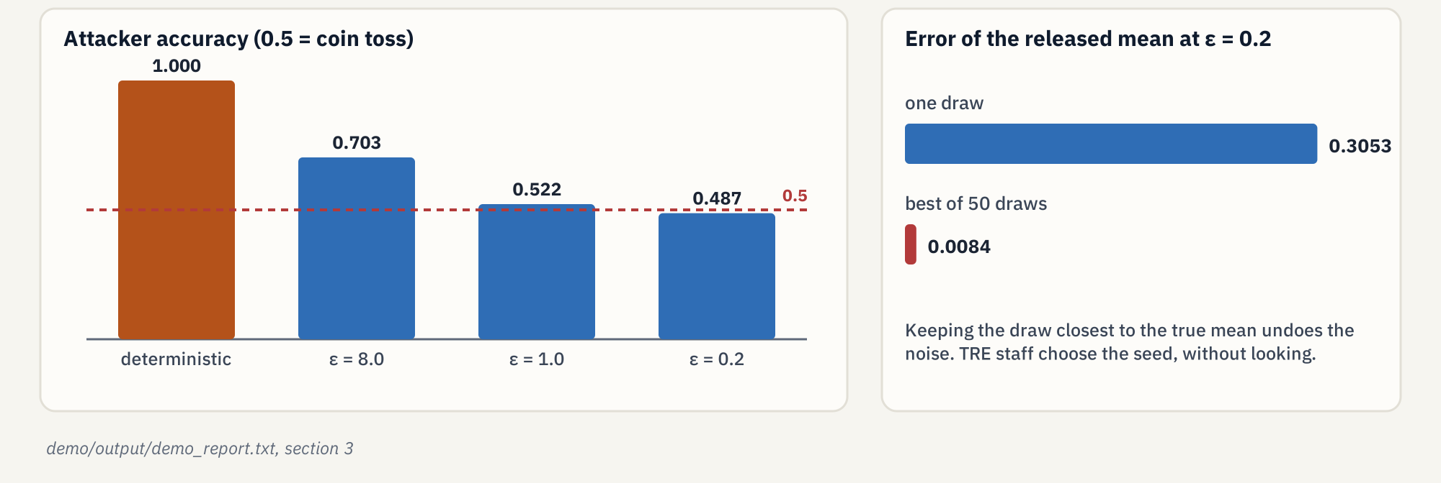
Noise protects a mean; the best of 50 draws undoes it
§10.1.3 · TECH 12 · DIFFERENTIAL PRIVACY
§10.1.3 (pp. 37-39), TECH 12 (p. 50). Demo: demo_report.txt, section 3. No private model is trained here.
Notes:
Differential privacy is a property of the release mechanism, not of the data. The paper's thought experiment: the attacker knows everything except whether one person was included. A deterministic mean gives the answer away, accuracy 1.000. Adding Laplace noise with smaller epsilon pushes the attacker back toward a coin toss: 0.703 at epsilon 8, 0.522 at 1, 0.487 at 0.2. TECH 12 adds a practical warning. At epsilon 0.2 one noisy mean misses the truth by 0.3053, but if someone draws 50 times and keeps the closest, the miss is 0.0084, which cancels the protection. So TRE staff should pick the seed without looking at accuracy. This repository only sketches DP on a mean; it does not train a private model.

Slide 15
sacroml: leaf 5, 'proceed to next step', still flagged
DEMO 2 · SACROML 2.0.1
sacroml check | Unconstrained tree | Wrapped tree (leaf 5)
Training / set-aside accuracy | 1.000 / 0.590 | 0.868 / 0.566
Worst-case membership AUC (3 runs) | mean 0.500, 0 above null band | mean 0.494, 0 above null band
Smallest leaf vs threshold 10 | 1 → k_anonymity_risk true | 5 → k_anonymity_risk true
gen_error, unnecessary, class_disclosure, smallgroup | true | true
dof_risk | false | false
request_release() without a Target | – | "Proceed to next step of checking"
min_samples_leaf 5 → 1 after fit() | – | posthoc_check(): disclosive
demo/output/sacroml/sacroml_report.txt; per-attack report.json under demo/output/sacroml/. SACRO-ML: github.com/AI-SDC/SACRO-ML
Notes:
The second demo runs the same cohort through sacroml 2.0.1, the maintained toolkit from the AI-SDC repository named in the paper. Its safe wrapper warns that min_samples_leaf of 1 is below its recommended minimum of 5 and changes it to 5. request_release() without a Target writes a target file and says 'Proceed to next step of checking': it does not run attacks and it is not an approval. Passing a Target would also start the LiRA attack, which the upstream example runs with 100 shadow models; this demo does not run LiRA. Then the attacks. The structural attack marks a leaf as risky below 10 training rows, so both the unconstrained tree and the wrapped tree with leaf 5 are flagged. Moving from leaf 1 to leaf 5 is what the published rules do, and the package's own structural check still calls that tree risky.

Slide 16
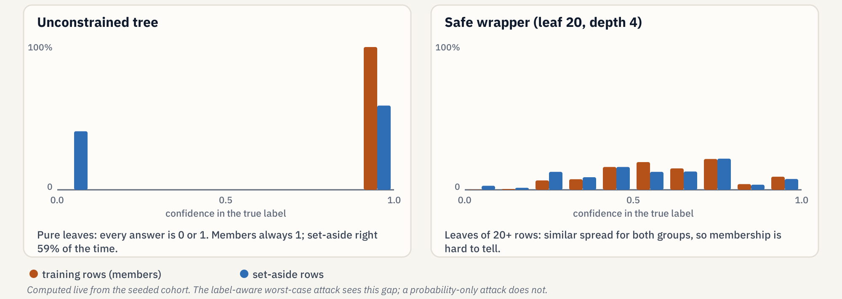
Same tree, AUC 0.708 or 0.500: two different attacks
WHY THE TWO MEMBERSHIP NUMBERS DIFFER
Hand-written: probabilities plus the true label, so it sees 'right on members, often wrong on set-aside'. sacroml: predicted probability only, and pure leaves are extreme for everyone.
Appendix G (p. 96). attacks.py (_attack_features) and sacroml.attacks.worst_case_attack.
Notes:
Both demos call their attack 'worst case', but they are different tests. The hand-written attack trains a second model on the predicted probabilities plus the true label, so it can use the confidence in the correct class. On the unconstrained tree every leaf is pure, so every prediction is 0 or 1. Training rows always get confidence 1 in their true label; set-aside rows get 1 when the tree is right, 59% of the time, and 0 otherwise. The label-aware attack sees that gap and reaches AUC 0.708. The sacroml attack scores rows by predicted probability only. Without the label, a pure leaf looks equally extreme for members and non-members, so its AUC is 0.500. An AUC near 0.5 from the package does not mean the tree failed to memorise; the structural attack is what catches it there.

Slide 17
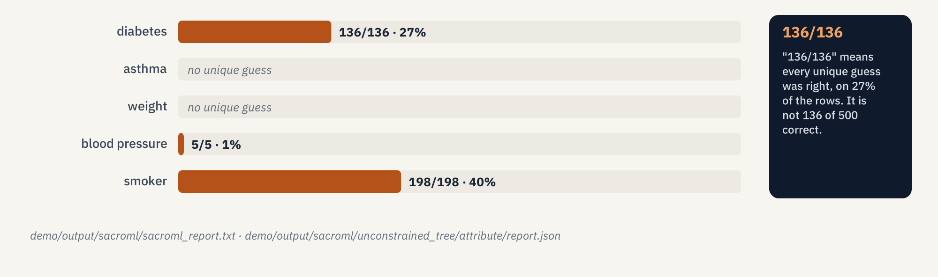
'136/136' means every unique guess was right
DEMO 2 · ATTRIBUTE INFERENCE
Wrapped tree, training rows: diabetes 195/257, asthma 50/67, smoker 254/327; weight and blood pressure no unique guess. Age: reconstructed fraction 0.034 (set-aside 0.050).
demo/output/sacroml/sacroml_report.txt. Appendix G (p. 96) describes the unique-guess attack.
Notes:
Read every sacroml attribute cell as correct unique guesses over unique guesses made, out of 500 rows. For each row the attack tries every value of one field and guesses only when one value gives a uniquely highest confidence; otherwise it abstains. On the unconstrained tree, diabetes is 136 out of 136: perfect, but only on the 27% of rows where it was willing to guess. Smoker is 198 out of 198, 40% coverage. Asthma and weight get no unique guess at all. The set-aside numbers are similar, which is why the paper asks to compare training and held-out rows. Age is numeric, so it is reported as a fraction reconstructed within bounds.

Slide 18
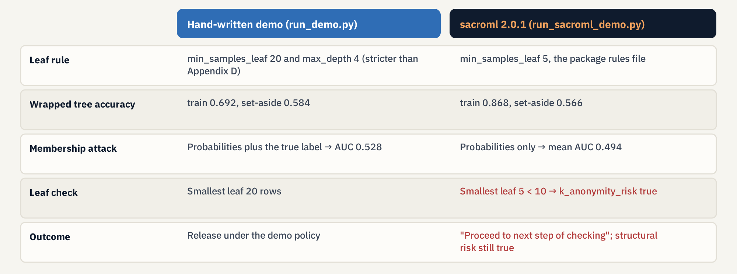
Leaf 20 vs 5, label-aware vs probability-only
TWO DEMOS COMPARED
demo_report.txt section 10 and sacroml_report.txt. Appendix D (p. 83) example leaf size: 5.
Notes:
Three differences matter. First, the leaf rule: the hand-written wrapper forces leaf 20 and depth 4, the package rules file forces leaf 5. Second, the membership attack: probabilities plus label versus probabilities only. Third, the outcome: the hand-written script releases the stricter tree because its own attack falls inside the demo limits; the package never approves anything here, it says to continue checking, and its structural attack still flags the leaf-5 tree. Neither is an approval process. A real TRE would combine these checks with a policy agreed with its data controller.

Slide 19
The rest of the technical list
WHAT THE PAPER ALSO ASKS FOR
TECH 1
Discuss disclosure risk when the project is applied for.
TECH 2
Give researchers ML tools inside the TRE.
TECH 3
Snapshot the pipeline behind an approved model.
TECH 5
Staff who can run and read the attacks.
TECH 13
Special treatment for ensembles.
TECH 14
Test the final model from federated learning.
TECH 15
Treat synthetic data as personal data.
TECH 17
External test of any query-limited service.
Appendix A, experiment 2: hyperparameters that looked safe on one dataset were risky on another. A range from a previous dataset is not, by itself, a release decision; run the attacks on the model in hand.
§10.2 (pp. 41-53). Appendix A §16.2 (p. 76).
Notes:
These recommendations are not demonstrated but belong in the picture. Risk is discussed at application time, TREs provide ML tools, and the pipeline of an approved model is kept for audit. TREs need staff who can run the attacks. Ensembles and federated learning get special attention, synthetic data is still personal data, and a query-limited service should be tested externally. Appendix A's second experiment is the reason the demo still runs attacks after the wrapper: hyperparameters that looked safe on one dataset were risky on another.

Slide 20
What this repository does not decide
LIMITS
A real risk appetite
Legal text
LiRA
The demo cut-offs are local. ELA 8: thresholds are agreed with the data controller.
Researcher declarations are plain language. EULA and clause text need a qualified legal review.
In sacroml, not run here. The upstream example uses 100 shadow models.
A private SVM
Real patients
Approval
Not implemented. DP is sketched on a released mean only.
None. One synthetic cohort, seed 7, 1,000 rows.
Neither demo is an approval process; sacroml says 'proceed to next step of checking'.
docs/brief-for-presentation-and-guide.md, 'Claims to keep accurate'.
Notes:
Be explicit about the edges. The cut-offs in disclosure.py exist so the first script can say yes or no; the paper publishes no universal thresholds. No legal clauses were drafted. LiRA, the likelihood-ratio attack, is available in the package but this demo does not run it. There is no differentially private SVM. The cohort is synthetic. And neither demo approves a model: the hand-written one releases under its own policy, the package recommends further checking.

Slide 21
Two scripts, one environment, reports under demo/output
RUN IT YOURSELF
uv venv --python 3.11
uv pip install -r demo/requirements.txt
uv run python demo/run_demo.py
uv run python demo/run_sacroml_demo.py
# figures and this deck
python docs/guide/make_figures.py
python docs/make_deck.py
Demo 1 · seconds
demo/output/demo_report.txt, data_dictionary.json, data_use_register.json, pipeline_snapshot.json, release reports.
Demo 2 · a few minutes
demo/output/sacroml/sacroml_report.txt; report.json and report.pdf per attack (worst_case, structural, attribute); safe_release/target.yaml.
Setup details: README.md. Section notes: demo/README.md. Guides: docs/guide/ (English and Spanish).
Notes:
Setup is in the repository README: create a Python 3.11 environment with uv and install demo/requirements.txt, which brings numpy, scikit-learn and sacroml (and PyTorch with it). On Windows PowerShell, activate with a leading dot. The first script runs in seconds and writes demo_report.txt; the second takes a few minutes, about three and a half on the seeded run, and writes JSON and PDF reports per attack. The guide in docs/guide walks through both reports section by section.

Slide 22
Read further
REFERENCES
GRAIMATTER green paper. Recommendations for disclosure control of trained Machine Learning (ML) models from Trusted Research Environments (TREs). DARE UK sprint GRAIMatter, September 2022. GRAIMATTER Green Paper.pdf in this repository. Earlier version: Jefferson et al., Zenodo, doi:10.5281/zenodo.6896214.
SACRO-ML. github.com/AI-SDC/SACRO-ML (sacroml 2.0.1), maintained toolkit from the AI-SDC repository named in the paper.
Salem et al. ML-Leaks: model and data independent membership inference attacks and defenses (paper reference [37]); basis of the Salem scenarios in Appendix A.
Five Safes. F. Ritchie, The 'Five Safes': a framework for planning, designing and evaluating data access solutions, Zenodo 2017 (paper reference [2]).
This repository. README.md, demo/README.md, docs/brief-for-presentation-and-guide.md, docs/guide/GRAIMATTER_Technical_Guide_EN.md and GRAIMATTER_Guia_Tecnica_ES.md.
Notes:
The PDF is in the repository root. SACRO-ML is the package used in the second demo. The guide, in English and Spanish, follows the same order as these slides and maps each section to its slides in Appendix A.

