Slide 1




Tools for Health Data Anonymization FHIR/DICOM Presidio

Slide 2
Health Data Formats
DICOM — Digital Imaging and Communications in Medicine — is the international standard for medical images and related information. It defines the formats for medical images that can be exchanged with the data and quality necessary for clinical use. DICOM® is implemented in almost every radiology, cardiology imaging, and radiotherapy device (X-ray, CT, MRI, ultrasound, etc.), and increasingly in devices in other medical domains such as ophthalmology and dentistry. With hundreds of thousands of medical imaging devices in use, DICOM® is one of the most widely deployed healthcare messaging Standards in the world. There are literally billions of DICOM® images currently in use for clinical care. https://www.dicomstandard.org/about
FHIR (Fast Healthcare Interoperability Resources) Specification, which is a standard for exchanging healthcare information electronically. https://www.hl7.org/fhir/overview.html

Slide 3
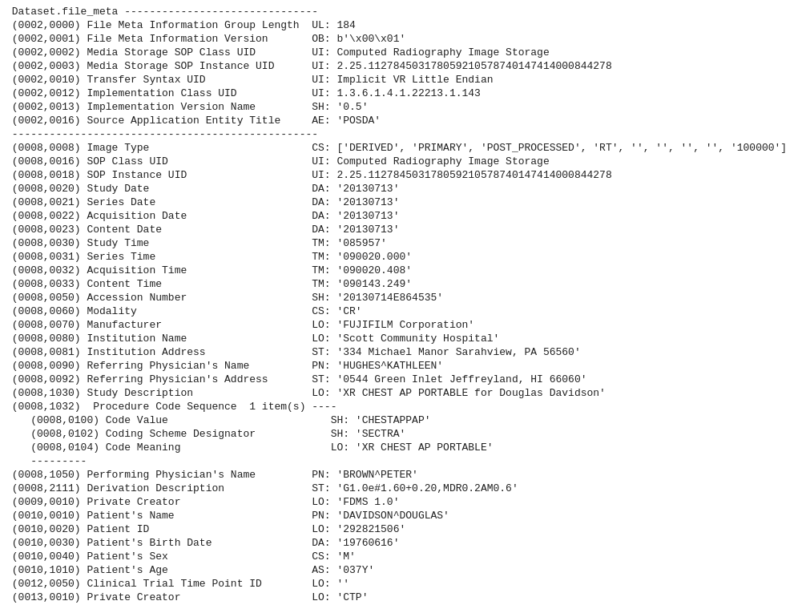
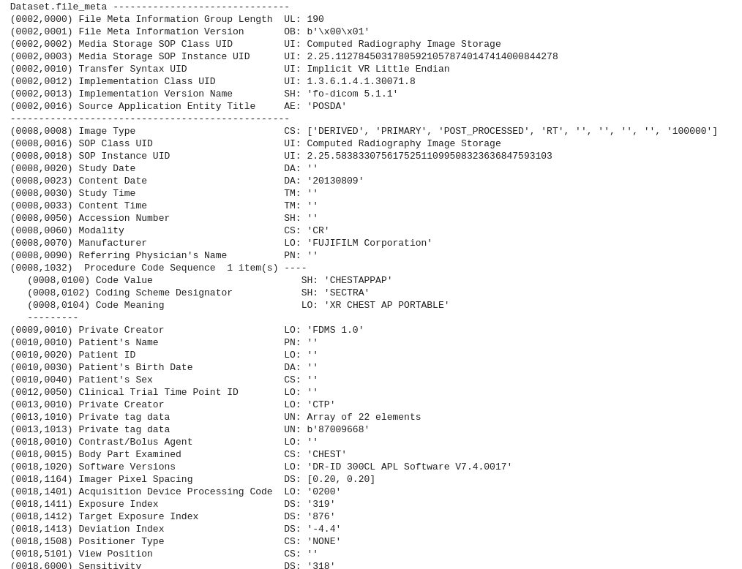
DICOM Anonymization
PII in DICOM Metadata

Slide 4
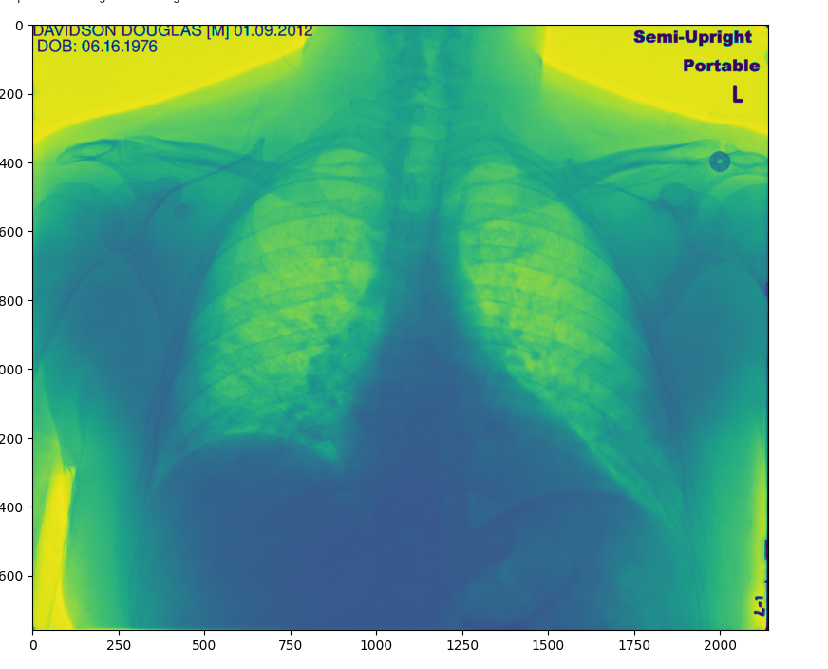
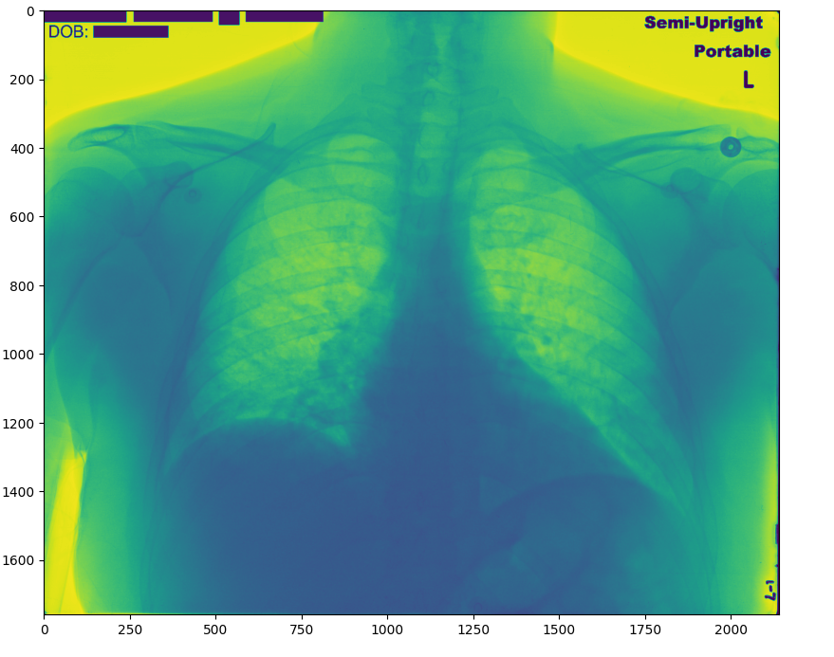
DICOM Anonymization
PII in DICOM in Images
ORIGINAL
REDACTED

Slide 5
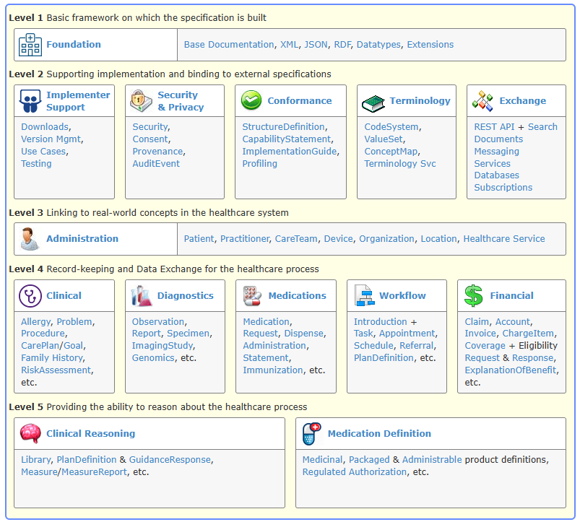
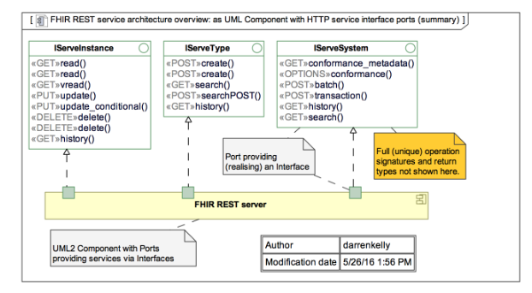
FHIR (Fast Healthcare Interoperability Resources)
FHIR Framework
FHIR Servers and the FHIR APIs

Slide 6
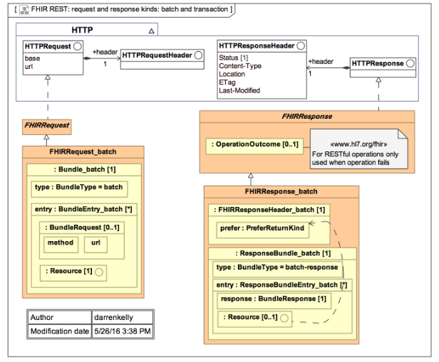
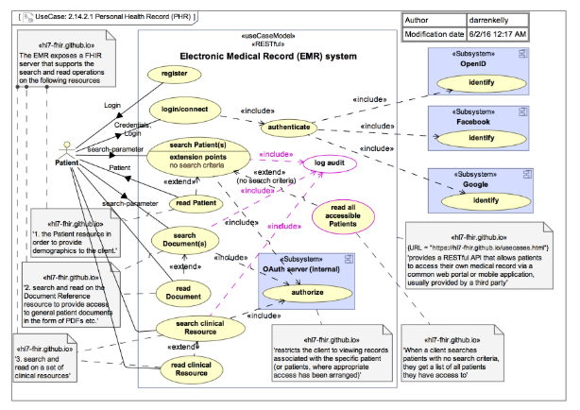
FHIR (Fast Healthcare Interoperability Resources)
FHIR Transactions
FHIR Security

Slide 7
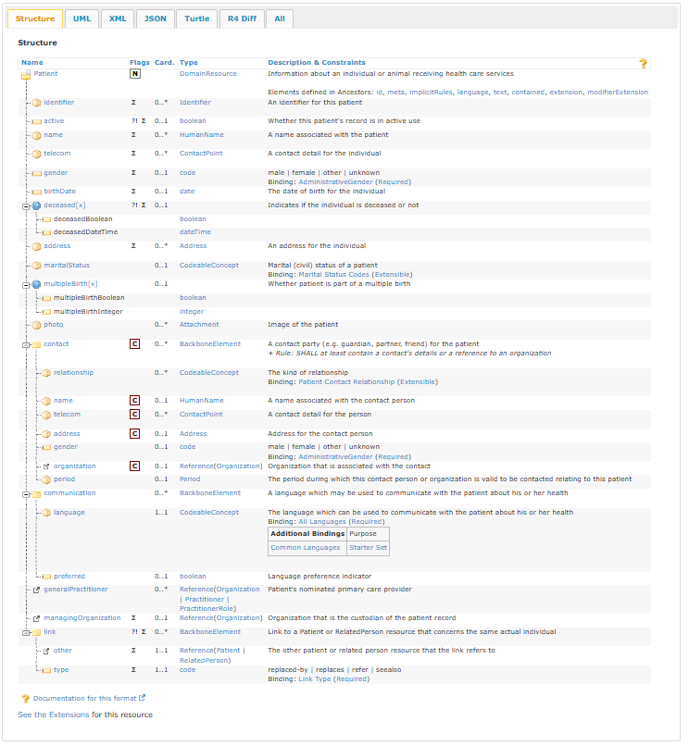
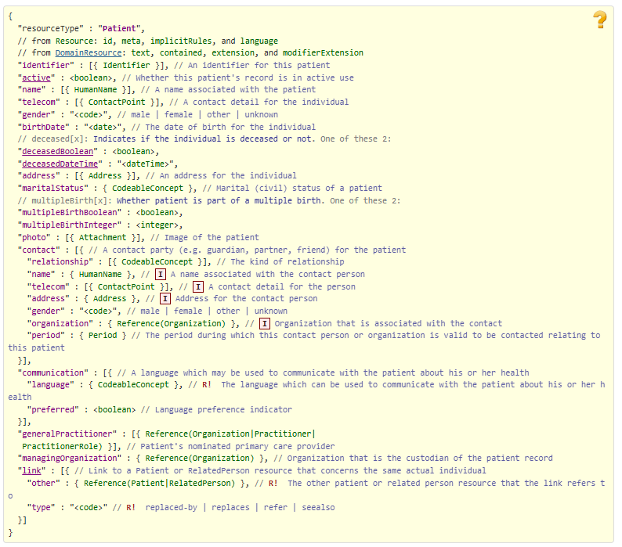
Resource Patient - Content

Slide 8
Diagnostic Medicine Module
Name | Aliases | Description
Observation | Vital Signs, Measurement, Results | Measurements and simple assertions made about a patient, device or other subject.
DiagnosticReport | Report, Test, Result, Results, Labs | The findings and interpretation of diagnostic tests performed on patients, groups of patients, products, substances, devices, and locations, and/or specimens derived from these. The report includes clinical context such as requesting provider information, and some mix of atomic results, images, textual and coded interpretations, and formatted representation of diagnostic reports. The report also includes non-clinical context such as batch analysis and stability reporting of products and substances.
ServiceRequest | diagnostic request, referral, referral request | A record of a request for service such as diagnostic investigations, treatments, or operations to be performed.
Media | (Not defined yet)
ImagingSelection |  | A selection of DICOM SOP instances and/or frames within a single Study and Series. This might include additional specifics such as an image region, an Observation UID or a Segmentation Number, allowing linkage to an Observation Resource or transferring this information along with the ImagingStudy Resource.
ImagingStudy |  | Representation of the content produced in a DICOM imaging study. A study comprises a set of series, each of which includes a set of Service-Object Pair Instances (SOP Instances - images or other data) acquired or produced in a common context. A series is of only one modality (e.g. X-ray, CT, MR, ultrasound), but a study may have multiple series of different modalities.
MolecularSequence |  | Representation of a molecular sequence.
Specimen |  | A sample to be used for analysis.
BodyStructure | anatomical location | Record details about an anatomical structure. This resource may be used when a coded concept does not provide the necessary detail needed for the use case.

Slide 9
Links
Python Libraries
https://pypi.org/project/fhirpy/
https://pypi.org/project/azure-mgmt-healthcareapis/
https://github.com/Aidbox
https://aidbox.app/ui/portal
https://github.com/pydicom/pydicom
FHIR resources
https://github.com/glichtner/fhir.resources
https://pypi.org/project/fhir.resources
DICOM Resources
https://www.dicomlibrary.com/dicom/dicom-tags/
https://pydicom.github.io/

