Slide 1

Quantum Resources in Harrow-Hassidim-Lloyd Algorithm Pradeep Kumar, Tanoy Kanti Konar, Leela Ganesh Chandra Lakkaraju and Aditi Sen(De)
arXiv:2308.04021v1 [quant-ph] 8 Aug 2023

Slide 2


Quantum
Classical
The algorithm

Slide 3

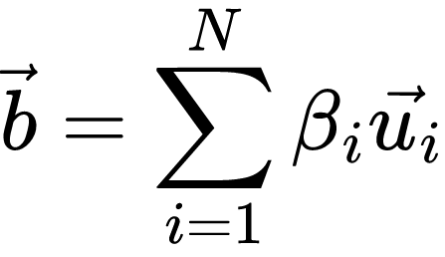
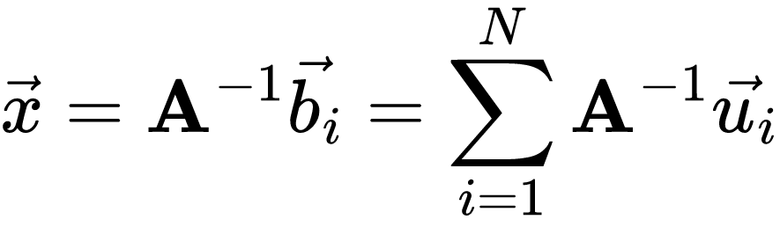
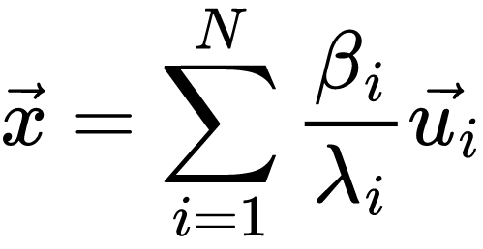
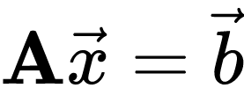
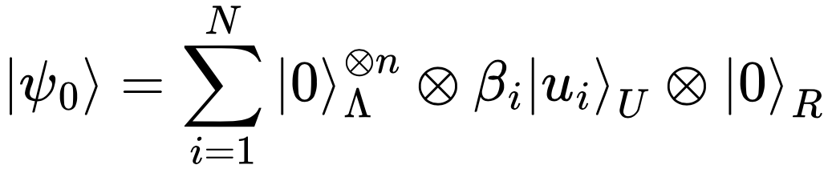
What we need ?

Slide 4
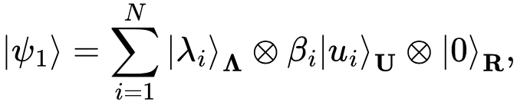
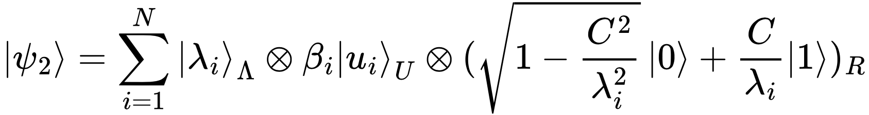
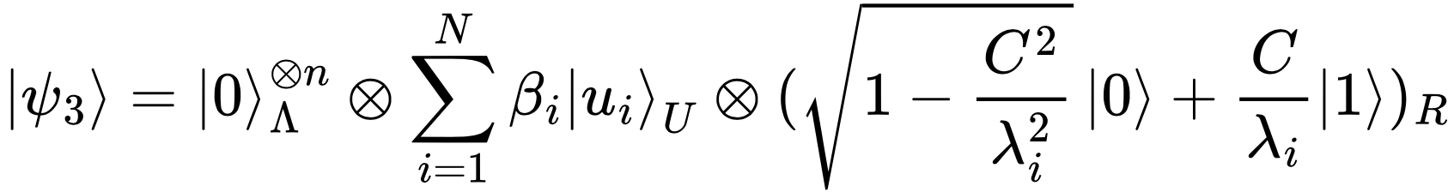
HHL Algorithm

Slide 5
The algorithm

Slide 6





Nonvanishing genuine multipartite entanglement
Theorem -1
For a successful run of the HHL algorithm, genuine multipartite entanglement should be nonvanishing in the second step
We prove that all the single-site local density matrices, , and of the state are mixed i.e.
Since the total state is pure, mixed local density matrices ensure that no biparition is product, thereby proving nonvanishing GME of

Slide 7


Bipartite entanglement between Λ and U is nonvanishing
Theorem -2
Unlike GME, bipartite entanglement between subsystems are always present in different stages of the algorithm

Slide 8
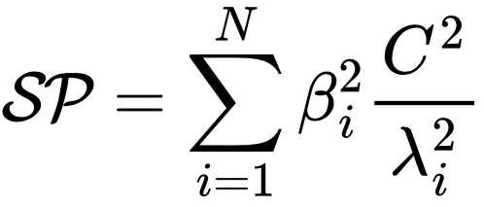
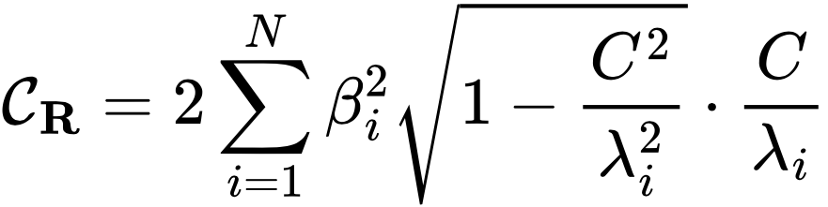
The l1-norm coherences are non-vanishing
Proposition -1
In computational basis C_{R}, C_{U}, and C_{ΛUR} are non vanishing
C_{Λ} is zero as is diagonal in computation basis
Remark : We found that C_{R} is closely related to Success Probability

Slide 9
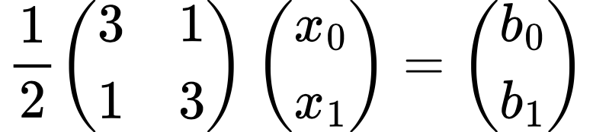



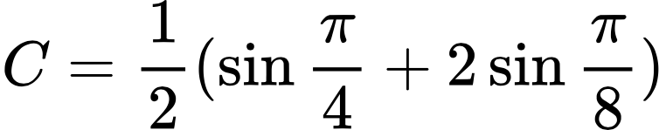
Quantum Advantage

Slide 10
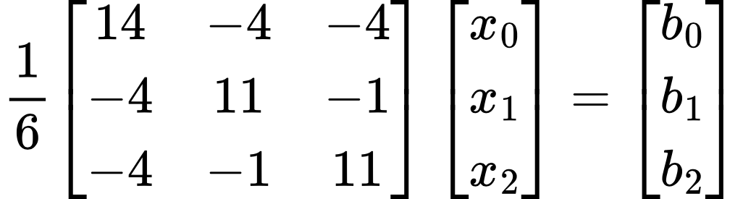
Quantum Advantage in 3D

Slide 11

Success Probability

Slide 12
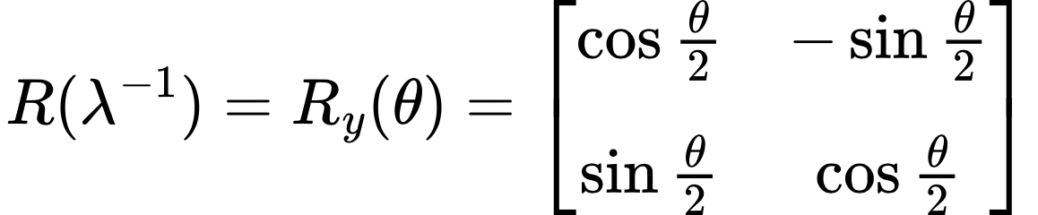
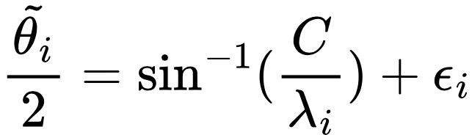
Imperfections

Slide 13
The algorithm

Slide 14
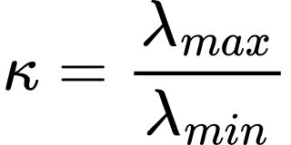
Kappa – κ The condition number

Slide 15
Thank you

