Slide 1
Machine Translation:
Interlingual Methods
Bonnie J. Dorr, Eduard H. Hovy, Lori S. Levin
Thanks to Les Sikos

Slide 2
Overview
What is Machine Translation (MT)?
  Automated system
  Analyzes text from Source Language (SL)
  Produces “equivalent” text in Target Language (TL)
  Ideally without human intervention
Source
Language
Target
Language

Slide 3
Overview
Three main methodologies for Machine Translation
  Direct
  Transfer
  Interlingual

Slide 4
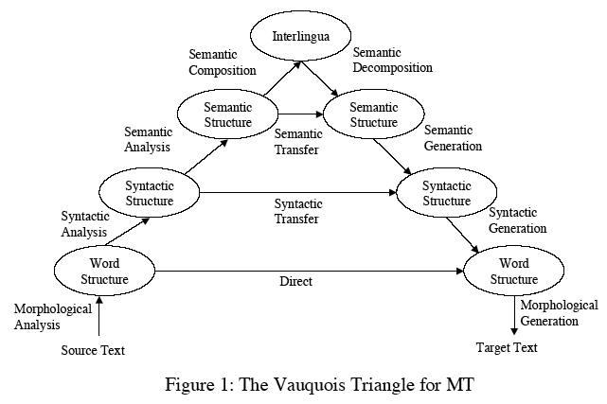
Overview
Three main methodologies for Machine Translation
  Direct
  Transfer
  Interlingual

Slide 5
Overview
Three main methodologies for Machine Translation
  Direct
  Transfer
  Interlingual

Slide 6
Overview
Three main methodologies for Machine Translation
  Direct
  Transfer
  Interlingual

Slide 7
Overview
Interlingua
  Single underlying representation for both SL and TL
  which ideally
    Abstracts away from language-specific characteristics
    Creates a “language-neutral” representation
    Can be used as a “pivot” representation in the translation

Slide 8
Overview
Cost/Benefit analysis of moving up the triangle
  Benefit
    Reduces the amount of work required to traverse
    the gap between languages
  Cost
    Increases amount of analysis
      Convert the source input into a suitable
      pre-transfer representation
    Increases amount of synthesis
      Convert the post-transfer representation
      into the final target surface form

Slide 9
Overview
Two major advantages of Interlingua method
  The more target languages there are, the more valuable an Interlingua becomes
TL₁
TL₂
Source
Language
TL₃
Inter-
Lingua
TL₄
TL₅
TL₆

Slide 10
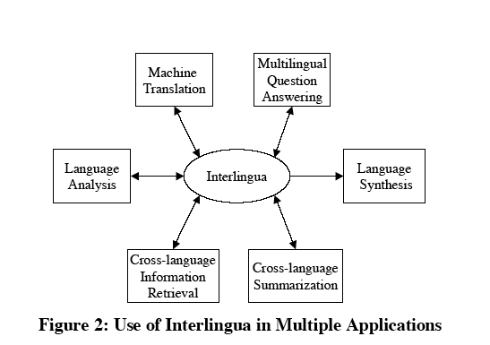
Overview
Two major advantages of Interlingua method
  Interlingual representations can also be used by NLP systems for other multilingual applications

Slide 11
Overview
Sounds great, but…due to many complexities
  Only one interlingual MT system has ever been made operational in a commercial setting
    KANT (Nyberg and Mitamura, 1992, 2000;
    Lonsdale et al., 1995)
  Only a few have been taken beyond research prototype

Slide 12
Current Efforts
KANT system (Nyberg and Mitamura, 1992)
  Only interlingual MT system that has ever been made operational in a commercial setting
    Caterpillar document workflow (mid-90s)
  Knowledge-based system
  Designed for translation of technical documents written in Caterpillar Technical English (CTE) to French, Spanish, and German
  Controlled English – no pronouns, conjunctions,...

Slide 13
Issues
Loss of Stylistic Elements
  Because representation is independent of syntax
    Generated target text reads more like a paraphrase
    Style and emphasis of the original text are lost
  Not so much a failure of Interlingua as incompleteness
    Caused by a lack of understanding of discourse and pragmatic elements required to recognize and appropriately reproduce style and emphasis
    In some cases it may be an advantage to ignore the author’s style
      Outside the field of artistic texts (poetry and fiction) syntactic form of source text is superfluous

Slide 14
Issues
Loss of Stylistic Elements
  Current state of the art
    It is only possible to produce reliable interlinguas between language groups (e.g., Japanese –
    Western European) within specialized domains

Slide 15
Issues
Linguistic Divergences
  Structural differences between languages
    Categorical Divergence
      Translation of words in one language into words that have different parts of speech in another language
        To be jealous
        Tener celos (To have jealousy)

Slide 16
Issues
Linguistic Divergences
    Conflational Divergence
      Translation of two or more words in one language into one word in another language
        To kick
        Dar una patada (Give a kick)

Slide 17
Issues
Linguistic Divergences
    Structural Divergence
      Realization of verb arguments in different
      syntactic configurations in different languages
        To enter the house
        Entrar en la casa (Enter in the house)

Slide 18
Issues
Linguistic Divergences
    Head-Swapping Divergence
      Inversion of a structural-dominance relation between two semantically equivalent words
        To run in
        Entrar corriendo (Enter running)

Slide 19
Issues
Linguistic Divergences
    Thematic Divergence
      Realization of verb arguments that reflect different thematic to syntactic mapping orders
        I like grapes
        Me gustan uvas (To-me please grapes)

Slide 20
Issues
Linguistic Divergences may be the norm rather than
the exception
  Differences in MT architecture (direct, transfer, interlingual) are crucial for resolution of
  cross-language divergences
    Interlingua approach takes advantage of the compositionality of basic units of meaning
    to resolve divergences

Slide 21
Issues
For example:
    To kick – Dar una patada (Give a kick)
  Conflational divergence can be resolved by mapping English kick into two components before translating
  into in Spanish
    Motional component (movement of the leg)
    Manner component (a kicking motion)

Slide 22
Current Efforts
Pangloss project (Frederking et al., 1994)
  Ambitious attempt to build rich interlingual expressions
  Uses humans to augment system analysis
  Representation includes a set of frames for representing semantic components, each of which
    Are headed by a unique identifier
    And have a separate frame with aspectual information (duration, telicity, etc.)
  Some modifiers are treated as scalars and represented by numerical values

Slide 23
Current Efforts
Mikrokosmos (Mahesh and Nirenburg, 1995) / OntoSem (Nirenburg and Raskin, 2004)
  Focus is to produce semantically rich Text-Meaning Representations (TMRs) of text
  TMRs use a language-independent metalanguage also used for static knowledge resources
  TMRs aimed at the most difficult problems of NLP; Disambiguation, reference resolution
  Goal is to populate a fact repository with TMRs as a language-independent search space for question-answering and knowledge-extraction

Slide 24
Current Efforts
PRINCITRAN (Dorr & Voss, 1996)
  Approach assumes an interlingua derived from lexical semantics and predicate decomposition
    Jackendoff 1983, 1990; Levin & Rappaport-Hovav 1995a, 1995b
  Has not complicated, but rather facilitated, the identification and construction of systematic relations at the interface between each level

Slide 25
Current Efforts
Motivation for Non-Uniform Approach
  German: Der Berg liegt im Suden der Stadt
  Ambiguous in English:
    The mountain lies in the south of the city
    The mountain lies to the south of the city
  In other words, the German phrase maps to two
  distinct representations

Slide 26
Current Efforts
Using Default knowledge in the KR
  Mountains are physical entities, typically distinct
  and external to cities
  System chooses second translation
    The mountain lies to the south of the city
Using specific facts in the KR
  A particular mountain is in the city
  System overrides default knowledge and chooses
  first translation
    The mountain lies in the south of the city

Slide 27
Current Efforts
The need to translate such sentences accurately is a clear case of where general as well as specific real-world knowledge should assist in eliminating inappropriate translations
  Knowledge Representational level, not the Interlingual level, provides this capability in this model

Slide 28
Current Efforts
Lexical Conceptual Structure (LCS)
  Used as part of many MT language pairs including ChinMT (Habash et al., 2003a)
    Chinese-English
  Also been used for other natural language applications
    Cross-language information retrieval

Slide 29
Current Efforts
Lexical Conceptual Structure (LCS)
  Approach focuses on linguistic divergences
  For example – Conflational divergence
    Arabic: The reporter caused the email to go to
    Al-Jazeera in a sending manner.
    English: The reporter emailed Al-Jazeera.

Slide 30
Current Efforts
LCS representation
(event cause
(thing[agent] reporter+)
(go loc
(thing[theme] email+)
(path to loc
(thing email+)
(position at loc (thing email+) (thing[goal] aljazeera+)))
(manner send+ingly)))

Slide 31
Current Efforts
LCS representation
(event cause
(thing[agent] reporter+)
(go loc
(thing[theme] email+)
(path to loc
(thing email+)
(position at loc (thing email+) (thing[goal] aljazeera+)))
(manner send+ingly)))
  Primary components of meaning are the top-level conceptual nodes cause and go

Slide 32
Current Efforts
LCS representation
(event cause
(thing[agent] reporter+)
(go loc
(thing[theme] email+)
(path to loc
(thing email+)
(position at loc (thing email+) (thing[goal] aljazeera+)))
(manner send+ingly)))
  Primary components of meaning are the top-level conceptual nodes cause and go
  These are taken together with their arguments
    Each identified by a semantic role
    (agent, theme, goal)
  And a modifier (manner) send+ingly

Slide 33
LCS as an interlingua?
Jackendoff wasn’t trying to capture all of meaning – just the semantics that corresponds to syntactic generalizations
Ch-of-loc, causation, states, ... are very fundamental. If we don’t get anything else, we should get at least these
LCS highlights just these relations – not bad for an interlingua, but what about those stylistic things, etc?

Slide 34
Current Efforts
Approximate Interlingua (Dorr and Habash, 2002)
  Depth of knowledge-based systems is approximated
  Taps into the richness of resources in one language (often English)
  This information is used to map the source-language input to the target-language output

Slide 35
Current Efforts
Approximate Interlingua (Dorr and Habash, 2002)
  Focus on linguistic divergences but with fewer knowledge-intensive components than in LCS
  Key feature
    Coupling of basic argument-structure information with some, but not all, components the LCS representation
    Only the top-level primitives and semantic roles are retained
  This new representation provides the basis for generation of multiple sentences that are statistically pared down – ranked by TL constraints

Slide 36
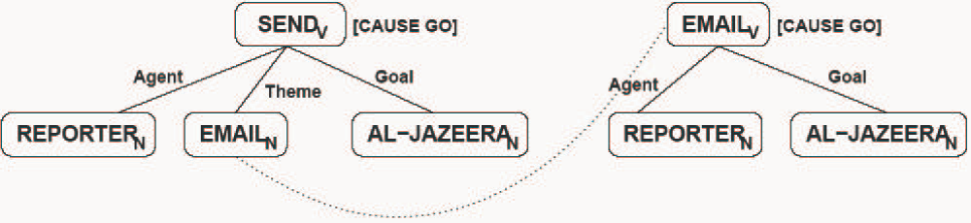
Current Efforts
Approximate Interlingua representation:
  Check top-level conceptual nodes for matches
  Check unmatched thematic roles for ‘conflatability’
    Cases where semantic roles are absorbed into other predicate positions
  Here there is a relation between the conflated argument EMAIL_{N} and EMAIL_{V}

