Slide 1
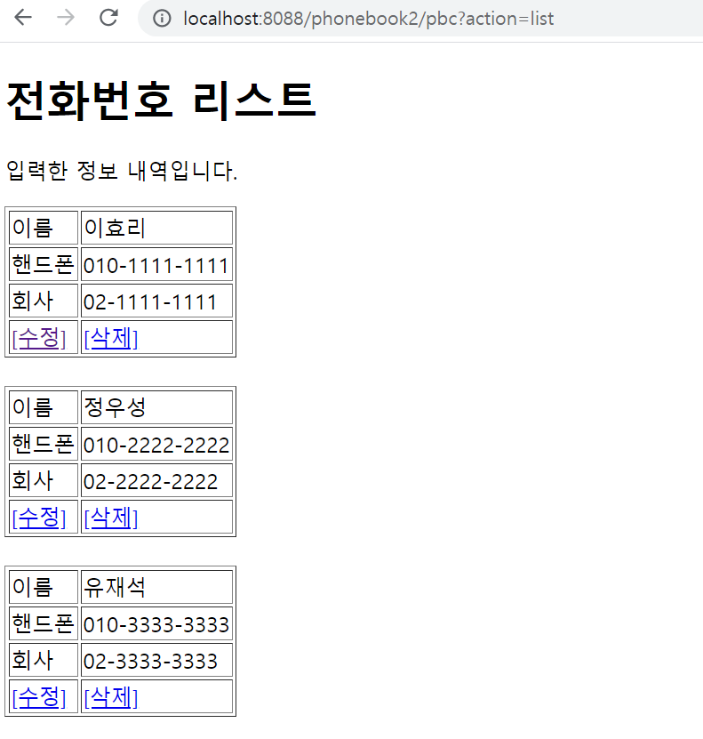
phonebook2 개요 및 분석
01
분석-수정
Rqeust(요청)
Tomcat
phonebook2
action=update
contoller(servlet)객체
phoneDao 객체
http://localhost:8088/phonebook2/pbc?action=list
update..
personUpdate()
rquest
response
Response(응답)
Response header
Response body
리다이렉트
DB

Slide 2
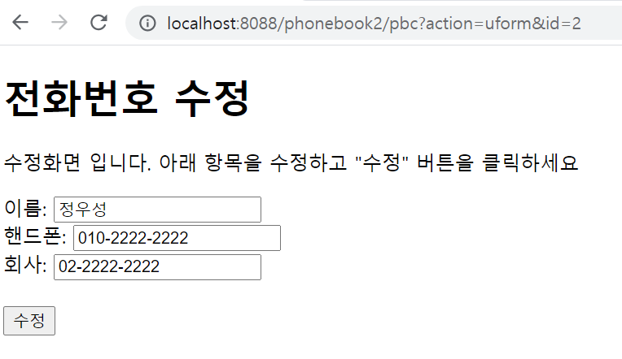

phonebook2 개요 및 분석
01
분석-수정폼
Tomcat
Rqeust(요청)
phonebook2
http://localhost:8088/phonebook2/pbc?action= uform&id=?
action=uForm
contoller(servlet)객체
uForm
..
rquest
response
("/WEB-INF/updateForm.jsp")
Response(응답)
Response header
Response body
html

Slide 3
phonebook2 개요 및 분석
01
분석-삭제
Tomcat
Rqeust(요청)
phonebook2
http://localhost:8088/phonebook2/pbc?action=list
[삭제]
action=delete
contoller(servlet)객체
phoneDao 객체
delete
personDelete()
rquest
response
Response header
Response body
리다이렉트
DB

