Slide 1
CSS3 Transitions
Stettsen Olsen

Slide 2
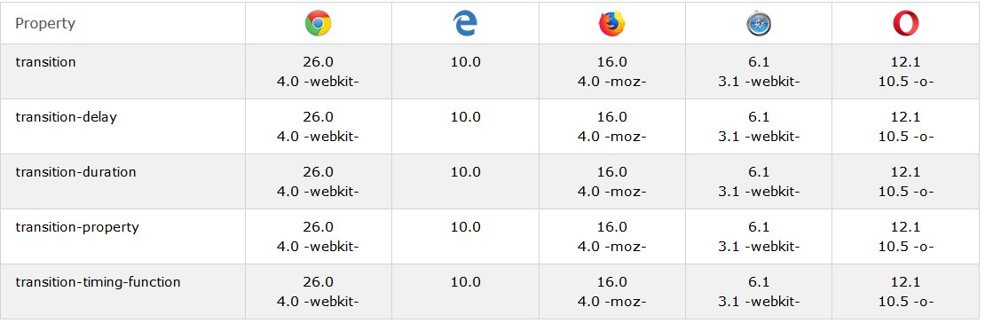
What’s a CSS transition
“CSS transitions allows you to change property values smoothly (from one value to another), over a given duration.” - www.w3schools.com
Mainly supported by all major browsers, but different webkits are needed

Slide 3
How to make it work
“To create a transition effect, you must specify two things:
the CSS property you want to add an effect to
the duration of the effect” - www.w3schools.com

Slide 4
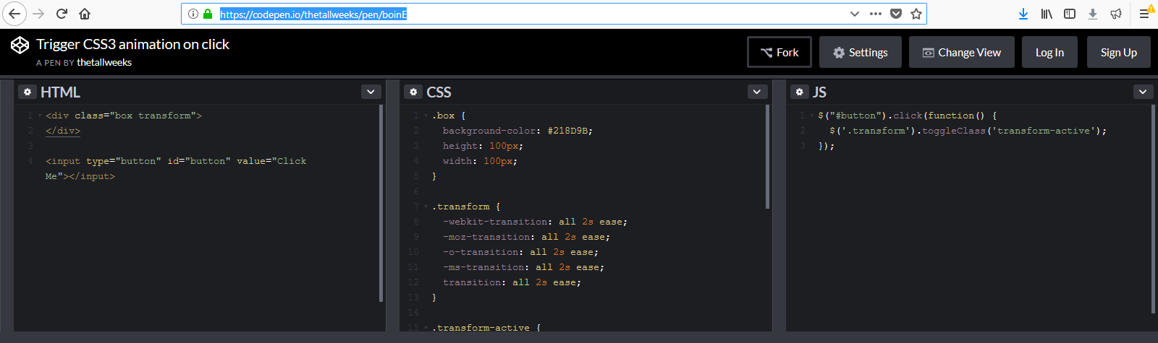
Triggers
Hover
Active
After

Slide 5
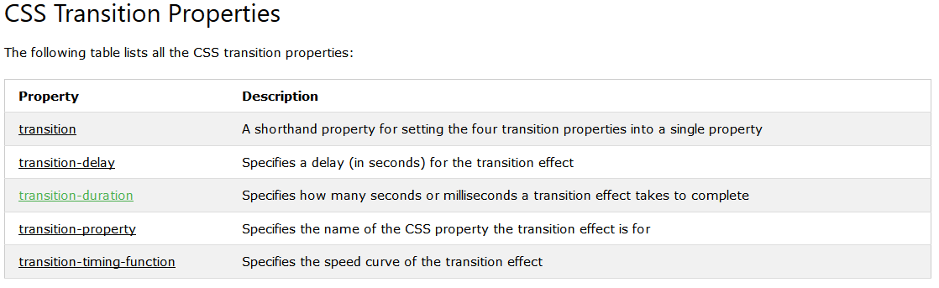
Transition Properties

Slide 6
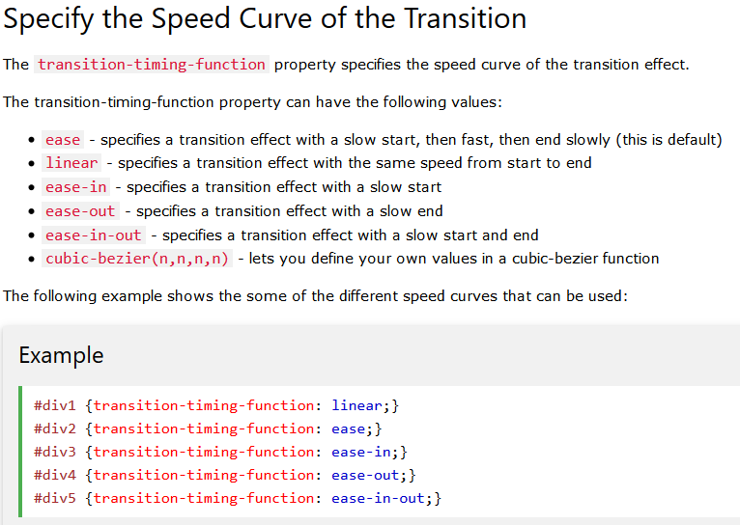
Speed of Transitions

